Slide 1
CEN 4010
Software Engineering I
Modeling with UML
Instructor: Masoud Sadjadi
http://www.cs.fiu.edu/~sadjadi/Teaching/

Slide 2
Acknowledgements
Overview:
Dr. Betty Cheng
Dr. Peter Clarke
Dr. Bernd Bruegge
Dr. Allen Dutoit
Modeling
UML
Use Case Diags.
Class Diagrams
Seq. Diagrams
Statechart Diags.
Activity Diagrams
Summary

Slide 3
Agenda
Overview:
Modeling
UML
Use Case Diagrams
Class Diagrams
Sequence Diagrams
Statechart Diagrams
Activity Diagrams
Summary
Modeling
UML
Use Case Diags.
Class Diagrams
Seq. Diagrams
Statechart Diags.
Activity Diagrams
Summary

Slide 4
What is Modeling?
Overview:
Modeling consists of building an abstraction of a reality.
Abstractions are simplifications because:
  They ignore irrelevant details.
  They only represent the relevant details.
What is relevant or irrelevant depends on the purpose of the model.
Modeling
UML
Use Case Diags.
Class Diagrams
Seq. Diagrams
Statechart Diags.
Activity Diagrams
Summary

Slide 5
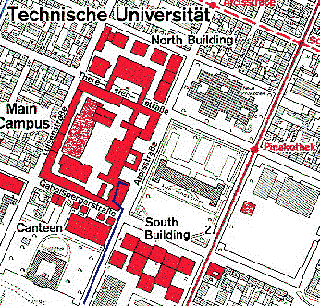
Example of Modeling
Overview:
Street Map
Modeling
UML
Use Case Diags.
Class Diagrams
Seq. Diagrams
Statechart Diags.
Activity Diagrams
Summary

Slide 6
Why Model Software?
Overview:
Software is getting increasingly more complex
  Windows XP > 40 million lines of code.
  A single programmer cannot manage this amount of code in its entirety.
Code is not easily understandable by developers who did not write it.
We need simpler representations for complex systems
  Modeling is a mean for dealing with complexity.
Modeling
UML
Use Case Diags.
Class Diagrams
Seq. Diagrams
Statechart Diags.
Activity Diagrams
Summary

Slide 7
Systems, Models, and Views
Overview:
Model
  An abstraction describing a subset of a system.
View
  Depiction of selected aspects of a model.
Notation
  A set of graphical or textual rules for depicting views.
  Views and models of a single system may overlap each other.
Examples:
  System: Aircraft
  Models: Flight simulator, scale model
  Views: All blueprints, electrical wiring, fuel system
Modeling
UML
Use Case Diags.
Class Diagrams
Seq. Diagrams
Statechart Diags.
Activity Diagrams
Summary

Slide 8
Concepts and Phenomena
Overview:
Phenomenon
  An object in the world of a domain as you perceive it
  Example: The lecture you are attending
  Example: My black watch
Concept
  Describes the properties of phenomena that are common.
  Example: Lectures on software engineering
  Example: Black watches
Concept is a 3-tuple:
  Name (To distinguish it from other concepts)
  Purpose (Properties that determine if a phenomenon is a member of a concept)
  Members (The set of phenomena which are part of the concept)
Modeling
UML
Use Case Diags.
Class Diagrams
Seq. Diagrams
Statechart Diags.
Activity Diagrams
Summary

Slide 9

Concepts and Phenomena
Overview:
Abstraction
  Classification of phenomena into concepts.
Modeling
  Development of abstractions to answer specific questions about a set of phenomena while ignoring irrelevant details.
Modeling
UML
Use Case Diags.
Class Diagrams
Seq. Diagrams
Statechart Diags.
Activity Diagrams
Summary
Name
Purpose
Members
Clock
A device that measures time.

Slide 10
Concepts in Software
Overview:
Type:
  An abstraction in the context of programming languages.
  Name: int, Purpose: integral number, Members: 0, -1, 1, 2, -2, . . .
Instance:
  Member of a specific type.
  The type of a variable represents all possible instances the variable can take.
The following relationships are similar:
  type ↔ instance
  concept ↔ phenomenon
Modeling
UML
Use Case Diags.
Class Diagrams
Seq. Diagrams
Statechart Diags.
Activity Diagrams
Summary

Slide 11
Abstract Data Types and Classes
Overview:
Abstract data type
  Special type whose implementation is hidden from the rest of the system.
Class
  An abstraction in the context of object-oriented languages.
  Like an abstract data type, a class encapsulates both state (variables) and behavior (methods).
  Unlike abstract data types, classes can be defined in terms of other classes using inheritance.
Modeling
UML
Use Case Diags.
Class Diagrams
Seq. Diagrams
Statechart Diags.
Activity Diagrams
Summary

Slide 12
Application and Solution Domain
Overview:
Application Domain
  The environment in which the system is operating
  How to model?
    Requirement Elicitation
    Requirements Analysis
Solution Domain
  The available technologies to build the system
  How to model?
    System Design
    Object Design
Modeling
UML
Use Case Diags.
Class Diagrams
Seq. Diagrams
Statechart Diags.
Activity Diagrams
Summary

Slide 13
Object-Oriented Modeling
Overview:
Application Domain
  The environment in which the system is operating.
Solution Domain
  The available technologies to build the system.
Modeling
UML
Use Case Diags.
Class Diagrams
Seq. Diagrams
Statechart Diags.
Activity Diagrams
Summary
Application Domain
Solution Domain
Application Domain Model
System Model
TrafficControl
SummaryDisplay
MapDisplay
Aircraft
TrafficController
FlightPlanDatabase
FlightPlan
Airport
TrafficControl

Slide 14
What should be done first?
Overview:
Coding or Modeling?
  It all depends….
Forward Engineering:
  Creation of code from a model.
  Greenfield projects.
Reverse Engineering:
  Creation of a model from code.
  Interface or reengineering projects.
Roundtrip Engineering:
  Move constantly between forward and reverse engineering.
  Useful when requirements, technology, and schedule are changing frequently.
Modeling
UML
Use Case Diags.
Class Diagrams
Seq. Diagrams
Statechart Diags.
Activity Diagrams
Summary

Slide 15
Agenda
Overview:
Modeling
UML
Use Case Diagrams
Class Diagrams
Sequence Diagrams
Statechart Diagrams
Activity Diagrams
Summary
Modeling
UML
Use Case Diags.
Class Diagrams
Seq. Diagrams
Statechart Diags.
Activity Diagrams
Summary

Slide 16
Unified Modeling Language (UML)
Overview:
The Unified Modeling Language (UML)
  UML is a standard language for writing software blueprints [Booch99].
  An emerging standard for modeling object-oriented software.
Objectives
  The UML maybe used to visualize, specify, construct, and document the artifacts of a software-intensive system [Booch99].
UML is a notation unifying
  Object Modeling Technique (OMT) [Rumbaugh91]
  Object-Oriented Software Engineering (OOSE) [Jacobson92]
  Booch [Booch94]
Modeling
UML
Use Case Diags.
Class Diagrams
Seq. Diagrams
Statechart Diags.
Activity Diagrams
Summary

Slide 17
Types of Diagrams
Overview:
Structural
  Focus on static aspects of system.
Behavioral
  Focus on dynamic aspects of system (changing parts).
Note:
  You can model 80% of most systems by using about 20 % UML.
  In this course, we focus on those 20%.
Modeling
UML
Use Case Diags.
Class Diagrams
Seq. Diagrams
Statechart Diags.
Activity Diagrams
Summary

Slide 18
Structural Diagrams
Overview:
Class Diagram
  Describe the static structure of the system using objects, attributes, and associations.
  A set of classes and their relationships. An interface is a collection of operations that specify a service of a class.
Object Diagram
  A set of objects and their relationships.
Component Diagram
  A set of components and their relationships.
  Component: Physical realization of a logical grouping of elements (e.g., classes, interfaces).
Deployment Diagram
  A set of nodes and their relationships .
  Exists at run time; Represents computational resources.
  Node typically encloses one or more components.
Modeling
UML
Use Case Diags.
Class Diagrams
Seq. Diagrams
Statechart Diags.
Activity Diagrams
Summary

Slide 19
Behavioral Diagrams
Overview:
Use Case Diagram
  Describe the functional behavior of the system as seen by the user.
  User goals (high-level services of system).
  Perspective from external entities (actors).
Interaction Diagram
  Describe the dynamic behavior between actors and the system and between objects of the system.
    Sequence diagrams focus on time ordering of messages.
    Collaboration diagrams focus on structural organization of objects that send/receive messages.
Statechart Diagram
  Model the changing state of individual objects (essentially a finite state automaton).
Activity Diagram
  Model the workflow (essentially a flowchart) of a system.
  Focus on flow of control from one activity to another.
Modeling
UML
Use Case Diags.
Class Diagrams
Seq. Diagrams
Statechart Diags.
Activity Diagrams
Summary

Slide 20
Development Process
Overview:
High-Level capture of requirements
  Use Case Diagram
Identify major objects and relationships
  Class diagram (object diagram)
Create scenarios of usage
  Interaction Diagrams
    Sequence Diagram
    Collaboration Diagram
Generalize scenarios to describe behavior
  State Diagram
  Activity Diagram
Refine to add implementation details
  Implementation Diagrams
    Component Diagram
    Deployment Diagram
Modeling
UML
Use Case Diags.
Class Diagrams
Seq. Diagrams
Statechart Diags.
Activity Diagrams
Summary

Slide 21
UML Core Conventions
Overview:
Rectangles are classes or instances
Ovals are functions or use cases
Instances are denoted with an underlined names
  myWatch:SimpleWatch
  Joe:Firefighter
Types are denoted with non underlined names
  SimpleWatch
  Firefighter
Diagrams are graphs
  Nodes are entities
  Arcs are relationships between entities
Modeling
UML
Use Case Diags.
Class Diagrams
Seq. Diagrams
Statechart Diags.
Activity Diagrams
Summary

Slide 22
Agenda
Overview:
Modeling
UML
Use Case Diagrams
Class Diagrams
Sequence Diagrams
Statechart Diagrams
Activity Diagrams
Summary
Modeling
UML
Use Case Diags.
Class Diagrams
Seq. Diagrams
Statechart Diags.
Activity Diagrams
Summary

Slide 23
Use Case Diagrams
Overview:
Use cases
  represent a sequence of interaction for a type of functionality used during requirements elicitation to represent external behavior.
  A use case model is the set of all use cases that is a complete description of the functionality of the system and its environment.
Actors
  represent roles, that is, a type of user of the system.
Modeling
UML
Use Case Diags.
Class Diagrams
Seq. Diagrams
Statechart Diags.
Activity Diagrams
Summary
Passenger
PurchaseTicket

Slide 24
Actor
Overview:
An actor models an external entity which communicates with the system.
  A user, an external system, or a physical environment
An actor has a unique name and an optional description.
  Passenger: A person in the train.
  GPS satellite: Provides the system with GPS coordinates.
Modeling
UML
Use Case Diags.
Class Diagrams
Seq. Diagrams
Statechart Diags.
Activity Diagrams
Summary
Passenger

Slide 25
Use Case
Overview:
A use case represents a class of functionality provided by the system as an event flow.
A use case consists of:
  Unique name
  Participating actors
  Entry conditions
  Flow of events
  Exit conditions
  Special requirements
Modeling
UML
Use Case Diags.
Class Diagrams
Seq. Diagrams
Statechart Diags.
Activity Diagrams
Summary
PurchaseTicket

Slide 26
Use Case Diagram: Example
Overview:
Name: Purchase ticket
Participating actor: Passenger
Entry condition:
  Passenger standing in front of ticket distributor.
  Passenger has sufficient money to purchase ticket.
Exit condition:
  Passenger has ticket.
Event flow:
  Passenger selects the number of zones to be traveled.
  Distributor displays the amount due.
  Passenger inserts money, of at least the amount due.
  Distributor returns change.
  Distributor issues ticket.
Modeling
UML
Use Case Diags.
Class Diagrams
Seq. Diagrams
Statechart Diags.
Activity Diagrams
Summary

Slide 27
The <<extends>> Relationship
Overview:
Exceptional or seldom cases
  The exceptional event flows are factored out of the main event flow for clarity.
  It can extend more than one use case.
  The direction is to the extended use case.
Modeling
UML
Use Case Diags.
Class Diagrams
Seq. Diagrams
Statechart Diags.
Activity Diagrams
Summary
Passenger
PurchaseTicket
<<extends>>
<<extends>>
<<extends>>
OutOfOrder
<<extends>>
TimeOut
Cancel
NoChange

Slide 28
The <<includes>> Relationship
Overview:
Behavior that is factored out of the use case
  For reuse, not because it is an exception.
  The direction is to the using use case.
Modeling
UML
Use Case Diags.
Class Diagrams
Seq. Diagrams
Statechart Diags.
Activity Diagrams
Passenger
Summary
PurchaseMultiCard
PurchaseSingleTicket
<<includes>>
<<includes>>
<<extends>>
CollectMoney
<<extends>>
NoChange
Cancel

Slide 29
Summary of Use Case Diagrams
Overview:
Use case diagrams represent external behavior.
Use case diagrams are useful as an index into the use cases.
Use case descriptions provide meat of model, not the use case diagrams.
All use cases need to be described for the model to be useful.
Modeling
UML
Use Case Diags.
Class Diagrams
Seq. Diagrams
Statechart Diags.
Activity Diagrams
Summary

Slide 30
Agenda
Overview:
Modeling
UML
Use Case Diagrams
Class Diagrams
Sequence Diagrams
Statechart Diagrams
Activity Diagrams
Summary
Modeling
UML
Use Case Diags.
Class Diagrams
Seq. Diagrams
Statechart Diags.
Activity Diagrams
Summary

Slide 31
Class Diagrams
Overview:
Class diagrams represent the structure of the system.
Used
  during requirements analysis to model problem domain concepts.
  during system design to model subsystems and interfaces.
  during object design to model classes.
Modeling
UML
Use Case Diags.
Class Diagrams
Seq. Diagrams
Statechart Diags.
Activity Diagrams
Summary

Slide 32
Classes
Overview:
Class
  A class represent a concept.
  A class encapsulates state (attributes) and behavior (operations).
  Each attribute has a type.
  Each operation has a signature.
  The class name is the only mandatory information.
Modeling
UML
Use Case Diags.
Class Diagrams
Seq. Diagrams
Statechart Diags.
Activity Diagrams
Summary
Name
TarifSchedule
zone2price
getZones()
getPrice()
Attributes
Operations

Slide 33
Instances
Overview:
Instance
  An instance represents a phenomenon.
  The name of an instance is underlined and can contain the class of the instance.
  The attributes are represented with their values.
Modeling
UML
Use Case Diags.
Class Diagrams
Seq. Diagrams
Statechart Diags.
Activity Diagrams
Summary
tarif_1974:TarifSchedule
zone2price = {
{‘1’, .20},
{‘2’, .40},
{‘3’, .60}}

Slide 34
Actors, Classes, and Instances
Overview:
What is the difference between an actor, a class, and an instance?
Actor:
  An entity outside the system to be modeled.
  Interacts with the system (“Passenger”).
Class:
  An abstraction modeling an entity in the problem domain, must be modeled inside the system (“User”).
Object:
  A specific instance of a class (“Joe, the passenger who is purchasing a ticket from the ticket distributor”).
Modeling
UML
Use Case Diags.
Class Diagrams
Seq. Diagrams
Statechart Diags.
Activity Diagrams
Summary

Slide 35
Associations
Overview:
Associations denote relationships between classes.
  Associations are uni- or bi-directional (no consensus).
  The multiplicity of an association end denotes how many objects the source object can legitimately reference.
  One-to-one, one-to-many, many-to-one, and many-to-many associations.
Modeling
UML
Use Case Diags.
Class Diagrams
Seq. Diagrams
Statechart Diags.
Activity Diagrams
Summary
TarifSchedule
TripLeg
Enumeration getZones()
Price getPrice(Zone)
*
Price
Zone
*

Slide 36
Aggregation
Overview:
Aggregation
  A special case of association denoting a consists of hierarchy or is-part-of association.
  The aggregate is the parent class.
  The components are the children class.
  A solid diamond denotes composition, a strong form of aggregation where components cannot exist without the aggregate.
Modeling
UML
Use Case Diags.
Class Diagrams
Seq. Diagrams
Statechart Diags.
Activity Diagrams
Summary
Exhaust system
TicketMachine
1
0..2
3
Muffler
Tailpipe
diameter
diameter
ZoneButton

Slide 37
Inheritance
Overview:
Inheritance and Generalization
  The is-a association.
  The children classes inherit the attributes and operations of the parent class.
  Inheritance simplifies the model by eliminating redundancy.
Modeling
UML
Use Case Diags.
Class Diagrams
Seq. Diagrams
Statechart Diags.
Activity Diagrams
Summary
Button
CancelButton
ZoneButton

Slide 38
Packages
Overview:
Package
  A package is a UML mechanism for organizing elements into groups (usually not an application domain concept)
  Packages are the basic grouping construct with which you may organize UML models to increase their readability.
  A complex system can be decomposed into subsystems, where each subsystem is modeled as a package.
Modeling
UML
Use Case Diags.
Class Diagrams
Seq. Diagrams
Statechart Diags.
Activity Diagrams
Summary
DispatcherInterface
Notification
IncidentManagement

Slide 39
Agenda
Overview:
Modeling
UML
Use Case Diagrams
Class Diagrams
Sequence Diagrams
Statechart Diagrams
Activity Diagrams
Summary
Modeling
UML
Use Case Diags.
Class Diagrams
Seq. Diagrams
Statechart Diags.
Activity Diagrams
Summary

Slide 40
Sequence Diagrams
Overview:
Requirements analysis:
  to refine use cases.
  to find additional objects.
System design :
  to refine subsystem interfaces.
Classes are represented by columns.
Messages are represented by arrows.
Activations are represented by narrow rectangles.
Lifelines are represented by dashed lines.
Modeling
UML
Use Case Diags.
Passenger
TicketMachine
Class Diagrams
selectZone()
Seq. Diagrams
Statechart Diags.
Activity Diagrams
Summary
insertCoins()
pickupChange()
pickUpTicket()

Slide 41
Nested messages
Overview:
The source of an arrow indicates the activation which sent the message
An activation is as long as all nested activations
Horizontal dashed arrows indicate data flow
Vertical dashed lines indicate lifelines
Modeling
UML
Use Case Diags.
Class Diagrams
Seq. Diagrams
Statechart Diags.
Activity Diagrams
Summary
Passenger
ZoneButton
TarifSchedule
Display
selectZone()
lookupPrice(selection)
price
Dataflow
displayPrice(price)
…to be continued...

Slide 42
Iteration and Condition
Overview:
Iteration is denoted by a * preceding the message name.
Condition is denoted by boolean expression in [ ] before the message name.
Modeling
UML
Use Case Diags.
Class Diagrams
Seq. Diagrams
Statechart Diags.
Activity Diagrams
…continued from previous slide...
Summary
ChangeProcessor
CoinIdentifier
Display
CoinDrop
Passenger
*
insertChange(coin)
lookupCoin(coin)
Iteration
price
displayPrice(owedAmount)
Condition
[owedAmount<0] returnChange(-owedAmount)
…to be continued...

Slide 43
Creation and Destruction
Overview:
Creation is denoted by a message arrow pointing to the object.
Destruction is denoted by an X mark at the end of the destruction activation.
  In garbage collection environments, destruction can be used to denote the end of the useful life of an object.
Modeling
UML
Use Case Diags.
Class Diagrams
Seq. Diagrams
Statechart Diags.
Activity Diagrams
Summary
…continued from previous slide...
ChangeProcessor
Creation
Passenger
createTicket(selection)
Ticket
print()
free()
Destruction

Slide 44
Summary of Sequence Diagram
Overview:
UML sequence diagram represent behavior in terms of interactions.
Useful to find missing objects.
Time consuming to build but worth the investment.
Complement the class diagrams (which represent structure).
Modeling
UML
Use Case Diags.
Class Diagrams
Seq. Diagrams
Statechart Diags.
Activity Diagrams
Summary

Slide 45
Agenda
Overview:
Modeling
UML
Use Case Diagrams
Class Diagrams
Sequence Diagrams
Statechart Diagrams
Activity Diagrams
Summary
Modeling
UML
Use Case Diags.
Class Diagrams
Seq. Diagrams
Statechart Diags.
Activity Diagrams
Summary

Slide 46
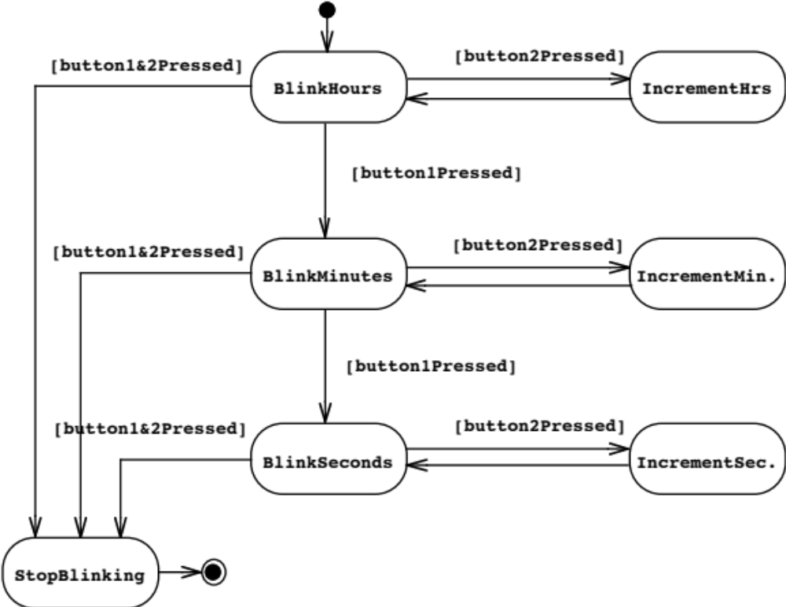
State Chart Diagrams
Overview:
Represent behavior as states and transitions
Modeling
UML
Event
Initial state
State
Use Case Diags.
Class Diagrams
Seq. Diagrams
Statechart Diags.
Activity Diagrams
Transition
Summary
Final state

Slide 47
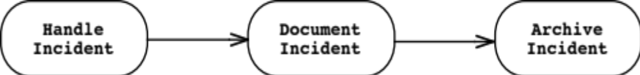
Activity Diagrams
Overview:
An activity diagram shows flow control within a system
  a special case of a state chart diagram in which states are activities (“functions”).
Two types of states:
  Action state:
    Cannot be decomposed any further.
    Happens “instantaneously” with respect to the level of abstraction used in the model.
  Activity state:
    Can be decomposed further.
    The activity is modeled by another activity diagram.
Modeling
UML
Use Case Diags.
Class Diagrams
Seq. Diagrams
Statechart Diags.
Activity Diagrams
Summary

Slide 48
Statechart vs. Activity Diagrams
Overview:
Statechart Diagram
  for Incident similar to Mealy Automaton.
  State: Attribute or Collection of Attributes of object of type Incident.
Activity Diagram
  for Incident similar to Moore Automation
  State: Operation or Collection of Operations.
Modeling
UML
Use Case Diags.
Class Diagrams
Seq. Diagrams
Event causes
State transition
Statechart Diags.
Activity Diagrams
Active
Inactive
Closed
Archived
Summary
Incident-
Handled
Incident-
Documented
Incident-
Archived
Completion of activity
causes state transition
Triggerless
Transition

Slide 49
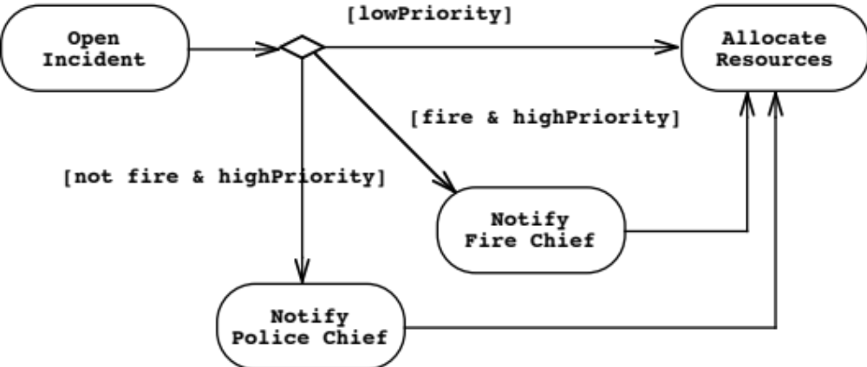
Modeling Decisions
Overview:
Modeling decisions using activity diagrams
Modeling
UML
Use Case Diags.
Class Diagrams
Seq. Diagrams
Statechart Diags.
Activity Diagrams
Summary

Slide 50
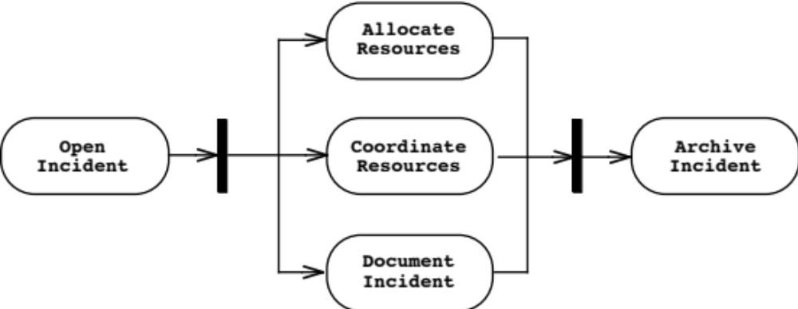
Modeling Concurrency
Overview:
Modeling concurrency using activity diagrams
  Synchronization of multiple activities
  Splitting the flow of control into multiple threads
Modeling
UML
Use Case Diags.
Class Diagrams
Seq. Diagrams
Statechart Diags.
Activity Diagrams
Splitting
Summary
Synchronization

Slide 51
Activity Diagrams: Swimlanes
Overview:
Actions may be grouped into swimlanes to denote the object or subsystem that implements the actions.
Modeling
UML
Use Case Diags.
Class Diagrams
Seq. Diagrams
Statechart Diags.
Dispatcher
Activity Diagrams
Allocate
Resources
Summary
Open
Coordinate
Archive
Incident
Resources
Incident
FieldOfficer
Document
Incident

Slide 52
Agenda
Overview:
Modeling
UML
Use Case Diagrams
Class Diagrams
Sequence Diagrams
Statechart Diagrams
Activity Diagrams
Summary
Modeling
UML
Use Case Diags.
Class Diagrams
Seq. Diagrams
Statechart Diags.
Activity Diagrams
Summary

Slide 53
Summary of UML
Overview:
UML provides a wide variety of notations for representing many aspects of software development.
  A powerful, but complex language.
  It can be misused to generate unreadable models.
  It can be misunderstood when using too many exotic features.
For now we concentrate on a few notations:
  Functional model: Use case diagrams
  Object model: Class diagrams
  Dynamic model: Sequence, statechart and activity diagrams
Modeling
UML
Use Case Diags.
Class Diagrams
Seq. Diagrams
Statechart Diags.
Activity Diagrams
Summary

