Slide 1
CEN 4010
Software Engineering I
Object Design:
Specifying Interfaces
Instructor: Masoud Sadjadi
http://www.cs.fiu.edu/~sadjadi/Teaching/

Slide 2
Acknowledgements
Overview:
Dr. Bernd Bruegge
Dr. Allen Dutoit
Overview
Add Visibility
Add Type Sig.
Add Contracts
iContract
Summary

Slide 3
Agenda
Overview:
Overview
Add visibility information
Add type signature information
Add contracts
iContract
Summary
Overview
Add Visibility
Add Type Sig.
Add Contracts
iContract
Summary

Slide 4
Object Design
Overview:
Object design is the process of adding details to the requirements analysis and making implementation decisions.
Object design serves as the basis of implementation.
Overview
Add Visibility
Add Type Sig.
Add Contracts
iContract
Summary

Slide 5
Req. Analysis vs. Object Design
Overview:
The object designer must choose among different ways to implement the analysis model with the goal to minimize execution time, memory and other measures of cost.
  Requirements Analysis: The functional model and the dynamic model deliver operations for the object model
  Object Design: We decide on where to put these operations in the object model
Overview
Add Visibility
Add Type Sig.
Add Contracts
iContract
Summary

Slide 6
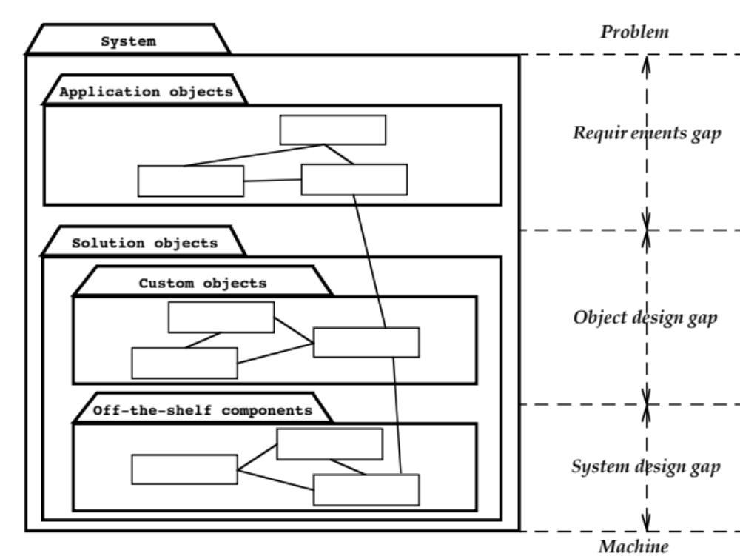
Object Design: Closing the Gap
Overview:
Overview
Add Visibility
Add Type Sig.
Add Contracts
iContract
Summary

Slide 7
Developers and Their Roles
Overview:
Overview
Add Visibility
Add Type Sig.
Add Contracts
iContract
Summary
Class User
Call Class
Developer
Class Implementor
Realize Class
Class Extender
Refine Class

Slide 8
Class user versus Class Extender
Overview:
Developers responsible for
the implementation of Game are
class implementors
Overview
Developers responsible for
the implementation of League are
class users of Game
Add Visibility
Add Type Sig.
Add Contracts
iContract
Summary
League
Game
1
*
Tournament
TicTacToe
Chess
The developer responsible for
the implementation of TicTacToe
is a class extender of Game

Slide 9
Specifying Interfaces
Overview:
Requirements analysis activities
  Identifying attributes and operations without specifying their types or their parameters.
Object design activities
  Add visibility information
  Add type signature information
  Add contracts
Overview
Add Visibility
Add Type Sig.
Add Contracts
iContract
Summary

Slide 10
Agenda
Overview:
Overview
Add visibility information
Add type signature information
Add contracts
iContract
Summary
Overview
Add Visibility
Add Type Sig.
Add Contracts
iContract
Summary

Slide 11
1. Add Visibility Information
Overview:
UML defines three levels of visibility:
Private (Class implementor):
  A private attribute can be accessed only by the class in which it is defined.
  A private operation can be invoked only by the class in which it is defined.
  Private attributes and operations cannot be accessed by subclasses or other classes.
Protected (Class extender):
  A protected attribute or operation can be accessed by the class in which it is defined and on any descendent of the class.
Public (Class user):
  A public attribute or operation can be accessed by any class.
Overview
Add Visibility
Add Type Sig.
Add Contracts
iContract
Summary

Slide 12
UML Visibility in Java
Overview:
Overview
Tournament
Add Visibility
Add Type Sig.
- maxNumPlayers: int
Add Contracts
+ getMaxNumPlayers():int
iContract
+ getPlayers(): List
Summary
+ acceptPlayer(p:Player)
+ removePlayer(p:Player)
+ isPlayerAccepted(p:Player):boolean
public class Tournament {
private int maxNumPlayers;
public Tournament(League l, int maxNumPlayers)
public int getMaxNumPlayers() {…};
public List getPlayers() {…};
public void acceptPlayer(Player p) {…};
public void removePlayer(Player p) {…};
public boolean isPlayerAccepted(Player p) {…};

Slide 13
Information Hiding Heuristics
Overview:
Carefully define the public interface for classes as well as subsystems (façade)
Always apply the “Need to know” principle.
  Only if somebody needs to access the information, make it publicly possible, but then only through well defined channels, so you always know the access.
The fewer an operation knows
  the less likely it will be affected by any changes
  the easier the class can be changed
Trade-off: Information hiding vs. efficiency
  Accessing a private attribute might be too slow (for example in real-time systems or games)
Overview
Add Visibility
Add Type Sig.
Add Contracts
iContract
Summary
Notes:
Information hiding is not a major issue during analysis, however during design it is a problem.
Limit the effect of changes so that changes can be understood clearly and do not cause a major recompilation of the whole system (also called black box design)

Slide 14
Information Hiding Design Principles
Overview:
Only the operations of a class are allowed to manipulate its attributes
  Access attributes only via operations.
Hide external objects at subsystem boundary
  Define abstract class interfaces which mediate between system and external world as well as between subsystems
Do not apply an operation to the result of another operation.
  Write a new operation that combines the two operations.
Overview
Add Visibility
Add Type Sig.
Add Contracts
iContract
Summary

Slide 15
Agenda
Overview:
Overview
Add visibility information
Add type signature information
Add contracts
iContract
Summary
Overview
Add Visibility
Add Type Sig.
Add Contracts
iContract
Summary

Slide 16
2. Add Type Signature Information
Overview:
Overview
Hashtable
Add Visibility
Add Type Sig.
-numElements:int
+put()
Add Contracts
+get()
iContract
+remove()
+containsKey()
Summary
+size()
Attributes and operations
without type information
are acceptable during analysis
Hashtable
-numElements:int
+put(key:Object,entry:Object)
+get(key:Object):Object
+remove(key:Object)
+containsKey(key:Object):boolean
+size():int

Slide 17
Agenda
Overview:
Overview
Add visibility information
Add type signature information
Add contracts
iContract
Summary
Overview
Add Visibility
Add Type Sig.
Add Contracts
iContract
Summary

Slide 18
3. Add Contracts
Overview:
Contracts on a class enable caller and callee to share the same assumptions about the class.
Contracts include three types of constraints:
  Invariant:
    A predicate that is always true for all instances of a class. Invariants are constraints associated with classes or interfaces.
  Precondition:
    Preconditions are predicates associated with a specific operation and must be true before the operation is invoked. Preconditions are used to specify constraints that a caller must meet before calling an operation.
  Postcondition:
    Postconditions are predicates associated with a specific operation and must be true after an operation is invoked. Postconditions are used to specify constraints that the object must ensure after the invocation of the operation.
Overview
Add Visibility
Add Type Sig.
Add Contracts
iContract
Summary

Slide 19
Expressing constraints in UML Models
Overview:
OCL (Object Constraint Language)
OCL allows constraints to be formally specified on single model elements or groups of model elements
A constraint is expressed as an OCL expression returning the value true or false.
OCL is not a procedural language (cannot constrain control flow).
Overview
Add Visibility
Add Type Sig.
Add Contracts
iContract
Summary

Slide 20
Example
Overview:
OCL expressions for Hashtable operation put():
  Invariant:
    context Hashtable inv: numElements >= 0
Overview
Add Visibility
Add Type Sig.
Add Contracts
iContract
Summary
OCL expression
Context is a class
operation put
  Precondition:
    context Hashtable::put(key, entry) pre:!containsKey(key)
  Post-condition:
    context Hashtable::put(key, entry) post: containsKey(key) and get(key) = entry

Slide 21
Expressing Constraints in UML Models
Overview:
A constraint can also be depicted as a note attached to the constrained UML element by a dependency relationship.
Overview
Add Visibility
Add Type Sig.
Add Contracts
iContract
Summary
<<invariant>>
numElements >= 0
<<precondition>>
HashTable
!containsKey(key)
numElements:int
<<postcondition>>
put(key,entry:Object)
get(key) == entry
<<precondition>>
get(key):Object
containsKey(key)
remove(key:Object)
<<precondition>>
containsKey(key:Object):boolean
containsKey(key)
size():int
<<postcondition>>
!containsKey(key)

Slide 22
Example
Overview:
Contract for acceptPlayer in Tournament
Overview
Add Visibility
context Tournament::acceptPlayer(p) pre:
not isPlayerAccepted(p)
context Tournament::acceptPlayer(p) pre:
getNumPlayers() < getMaxNumPlayers()
context Tournament::acceptPlayer(p) post:
isPlayerAccepted(p)
context Tournament::acceptPlayer(p) post:
getNumPlayers() = @pre.getNumPlayers() + 1
Add Type Sig.
Add Contracts
iContract
Summary

Slide 23
Example
Overview:
Contract for removePlayer in Tournament
Overview
Add Visibility
Add Type Sig.
context Tournament::removePlayer(p) pre:
isPlayerAccepted(p)
context Tournament::removePlayer(p) post:
not isPlayerAccepted(p)
context Tournament::removePlayer(p) post:
getNumPlayers() = @pre.getNumPlayers() - 1
Add Contracts
iContract
Summary

Slide 24
Annotation of Tournament class
Overview:
public class Tournament {
/** The maximum number of players
* is positive at all times.
* @invariant maxNumPlayers > 0
*/
private int maxNumPlayers;
/** The players List contains
* references to Players who are
* are registered with the
* Tournament. */
private List players;
/** Returns the current number of
* players in the tournament. */
public int getNumPlayers() {…}
/** Returns the maximum number of
* players in the tournament. */
public int getMaxNumPlayers() {…}
/** The acceptPlayer() operation
* assumes that the specified
* player has not been accepted
* in the Tournament yet.
* @pre !isPlayerAccepted(p)
* @pre getNumPlayers()<maxNumPlayers
* @post isPlayerAccepted(p)
* @post getNumPlayers() =
* @pre.getNumPlayers() + 1
*/
public void acceptPlayer (Player p) {…}
/** The removePlayer() operation
* assumes that the specified player
* is currently in the Tournament.
* @pre isPlayerAccepted(p)
* @post !isPlayerAccepted(p)
* @post getNumPlayers() =
@pre.getNumPlayers() - 1
*/
public void removePlayer(Player p) {…}
}
Overview
Add Visibility
Add Type Sig.
Add Contracts
iContract
Summary

Slide 25
Agenda
Overview:
Overview
Add visibility information
Add type signature information
Add contracts
iContract
Summary
Overview
Add Visibility
Add Type Sig.
Add Contracts
iContract
Summary

Slide 26
iContract
Overview:
iContract: Design by Contract in Java, By Oliver Enseling
Source: http://www.javaworld.com/javaworld/jw-02-2001/jw-0216-cooltools_p.html
Alternative link:
http://www.cs.fiu.edu/~sadjadi/Classes/CEN-5011/Lectures/iContract.html
Overview
Add Visibility
Add Type Sig.
Add Contracts
iContract
Summary

Slide 27
Agenda
Overview:
Overview
Add visibility information
Add type signature information
Add contracts
iContract
Summary
Overview
Add Visibility
Add Type Sig.
Add Contracts
iContract
Summary

Slide 28
Summary
Overview:
Developer roles during object design
  Class user, class implementor, and class extender
During object design we specify visibility rules
Constraints are boolean expressions on model elements.
Contracts are constraints on a class enable class users, implementors, and extenders to share the same assumption about the class (“Design by contract”)
OCL is a language that allows us to express constraints on UML models
iContract allows you to explicitly specify your class contracts in Java
Overview
Add Visibility
Add Type Sig.
Add Contracts
iContract
Summary

