Slide 1
Advance Software Engineering (CEN-5011)
Testing
Fall 2005
Instructor: Masoud Sadjadi
http://www.cs.fiu.edu/~sadjadi/Teaching/

Slide 2
Acknowledgements
Overview:
Dr. Bernd Bruegge
Dr. Allen Dutoit
Motivation
Overview
Testing Activities
Unit Testing
Integration Test.
System Testing
Management
Summary

Slide 3
Agenda
Overview:
Motivation
Overview
Testing Activities
Unit Testing
Integration Testing
System Testing
Management
Summary
Motivation
Overview
Testing Activities
Unit Testing
Integration Test.
System Testing
Management
Summary

Slide 4
Motivation
Overview:
Quality of today’s software….
The average software product released on the market is not error free.
Motivation
Overview
Testing Activities
Unit Testing
Integration Test.
System Testing
Management
Summary

Slide 5
Some Observations
Overview:
It is impossible to completely test any nontrivial module or any system
  Theoretical limitations: Halting problem
    Testing is not decidable.
  Practial limitations: Prohibitive in time and cost
    Testing must be performed under time and budget constraints.
Testing can only show the presence of bugs, not their absence (Dijkstra)
It is not a job for beginners.
Motivation
Overview
Testing Activities
Unit Testing
Integration Test.
System Testing
Management
Summary

Slide 6
Testing takes creativity
Testing often viewed as dirty work.
To develop an effective test, one must have:
    Detailed understanding of the system
    Knowledge of the testing techniques
    Skill to apply these techniques in an effective and efficient manner
Testing is done best by independent testers
  We often develop a certain mental attitude that the program should in a certain way when in fact it does not.
Programmer often stick to the data set that makes the program work
  "Don’t mess up my code!"
A program often does not work when tried by somebody else.
  “Don't let this be the end-user.”
Overview:
Motivation
Overview
Testing Activities
Unit Testing
Integration Test.
System Testing
Management
Summary

Slide 7
Agenda
Overview:
Motivation
Overview
Testing Activities
Unit Testing
Integration Testing
System Testing
Management
Summary
Motivation
Overview
Testing Activities
Unit Testing
Integration Test.
System Testing
Management
Summary

Slide 8
Testing
Overview:
Testing is the process of analyzing a system or system component to detect the differences between the expected/required behavior of the system specified by system models and the observed/existing behavior of the implemented system.
Testing is the systematic attempt to show that the implementation of the system is inconsistent with the system model in a planned way.
  Testing is aimed at breaking the system.
  A successful test is one that finds faults in the system.
Motivation
Overview
Testing Activities
Unit Testing
Integration Test.
System Testing
Management
Summary

Slide 9
Reliability
Overview:
Reliability
  The measure of success with which the observed behavior of a system conforms to some specification of its behavior.
Software Reliability
  The probability that a software system will not cause system failure for a specified time under specified conditions.
Motivation
Overview
Testing Activities
Unit Testing
Integration Test.
System Testing
Management
Summary

Slide 10
Testing Concepts
Overview:
Component
  A part of the system that can be isolated for testing.
Fault (Bug or defect)
  A design or coding mistake that may cause abnormal component behavior
Erroneous State
  A manifestation of a fault during the execution.
  The system is in a state such that further processing by the system will lead to a failure.
Failure
  A deviation between the specified and the actual behavior.
Motivation
Overview
Testing Activities
Unit Testing
Integration Test.
System Testing
Management
Summary

Slide 11
Test Case, Stub, and Driver
Overview:
Test Case
  A set of inputs and expected results that exercises a component with the purpose of causing failure and detecting faults.
Test Stub
  A partial implementation of components on which the tested component depends.
Test Driver
  A partial implementation of a component that depends on the tested component.
  Test stub and drivers enable components to be isolated from the rest of the system for testing.
Motivation
Overview
Testing Activities
Unit Testing
Integration Test.
System Testing
Management
Summary

Slide 12
Model Elements Used During Testing
Overview:
Motivation
Overview
Testing Activities
Test suite
Unit Testing
exercises
is revised by
Integration Test.
*
*
1…n
System Testing
Test case
Component
Correction
Management
*
*
Summary
*
Test stub
finds
repairs
*
Test driver
*
*
Failure
*
*
Error
*
*
Fault
is caused by
is caused by

Slide 13
Examples of Faults and Errors
Overview:
Faults in the Interface specification
  Mismatch between what the client needs and what the server offers
  Mismatch between requirements and implementation
Algorithmic Faults
  Missing initialization
  Branching errors (too soon, too late)
  Missing test for nil
Mechanical Faults (very hard to find)
  Documentation does not match actual conditions or operating procedures
Errors
  Stress or overload errors
  Capacity or boundary errors
  Timing errors
  Throughput or performance errors
Motivation
Overview
Testing Activities
Unit Testing
Integration Test.
System Testing
Management
Summary

Slide 14
Fault Handling Techniques
Overview:
Motivation
Fault Handling
Overview
Testing Activities
Unit Testing
Fault Avoidance
Fault Detection
Fault Tolerance
Integration Test.
System Testing
Management
Design
Methodology
Reviews
Atomic
Transactions
Modular
Redundancy
Summary
Verification
Configuration
Management
Testing
Debugging
Testing
Unit
Testing
Integration
Testing
System
Testing
Correctness
Debugging
Performance
Debugging
Unit
Testing
Integration
Testing
System
Testing

Slide 15
Quality Assurance encompasses Testing
Overview:
Motivation
Quality Assurance
Overview
Usability Testing
Testing Activities
Unit Testing
Scenario
Testing
Prototype
Testing
Product
Testing
Integration Test.
System Testing
Fault Avoidance
Fault Tolerance
Management
Summary
Atomic
Transactions
Modular
Redundancy
Verification
Configuration
Management
Fault Detection
Reviews
Debugging
Walkthrough
Inspection
Testing
Testing
Correctness
Debugging
Performance
Debugging
Integration
Testing
Integration
Testing
System
Testing
Unit
Testing
System
Testing
Unit
Testing

Slide 16
Techniques for Increasing Reliability
Overview:
Fault Avoidance
  Detecting faults statically, that is, without relying on the execution of any of the system models, in particular the code model.
  Development methodologies, configuration management, and verification.
Fault Detection
  Controlled/uncontrolled techniques used during the development process to identify erroneous states and find the underlying faults before releasing the system.
  Debugging (uncontrolled) and testing (controlled).
Fault Tolerance
  Releasing a system with the assumption that there may be some faults in the system.
  System failure can be recovered at runtime.
  Modular redundant systems.
Motivation
Overview
Testing Activities
Unit Testing
Integration Test.
System Testing
Management
Summary

Slide 17
Fault Avoidance/Detection Techniques
Overview:
Review (Fault Avoidance)
  The manual inspection of the system without actually executing the system.
  Up to 85% of all identified faults were found in reviews.
  Walkthrough (informal)
  Inspection (formal)
Debugging (Fault Detection)
  Assumes that faults can be found by starting from an unplanned failure.
  The developer moves the system through a succession of states, ultimately arriving at and identifying the erroneous state.
  Correctness debugging
  Performance debugging
Testing (Fault Detection)
  A successful test is the one that identifies faults.
Motivation
Overview
Testing Activities
Unit Testing
Integration Test.
System Testing
Management
Summary

Slide 18
Increasing Reliability, Another View
Overview:
Error prevention (before the system is released)
  Use good programming methodology to reduce complexity.
  Use version control to prevent inconsistent system.
  Apply verification to prevent algorithmic bugs.
Error detection (while system is running)
  Testing: Create failures in a planned way.
  Debugging: Start with an unplanned failures.
  Monitoring: Deliver information about state. Find performance bugs.
Error recovery (recover from failure once the system is released)
  Data base systems (atomic transactions)
  Modular redundancy
  Recovery blocks
Motivation
Overview
Testing Activities
Unit Testing
Integration Test.
System Testing
Management
Summary

Slide 19
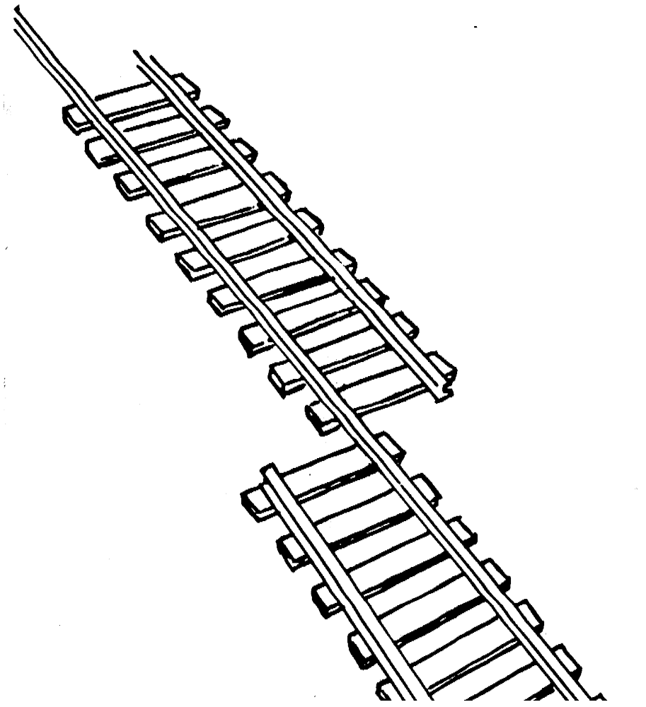
What is this?
Overview:
A failure?
An error?
A fault?
Need to specify
the desired behavior
first.
Motivation
Overview
Testing Activities
Unit Testing
Integration Test.
System Testing
Management
Summary

Slide 20

Erroneous State (“Error”)
Overview:
Motivation
Overview
Testing Activities
Unit Testing
Integration Test.
System Testing
Management
Summary

Slide 21

Algorithmic Fault
Overview:
Motivation
Overview
Testing Activities
Unit Testing
Integration Test.
System Testing
Management
Summary

Slide 22

Mechanical Fault
Overview:
Motivation
Overview
Testing Activities
Unit Testing
Integration Test.
System Testing
Management
Summary

Slide 23
How do we deal with Errors and Faults?
Overview:
Verification:
  Assumes hypothetical environment that does not match real environment
  Proof might be buggy (omits important constraints; simply wrong)
Modular redundancy:
  Expensive
Declaring a bug to be a “feature”
  Bad practice
Patching
  Slows down performance
Testing (this lecture)
  Testing is never good enough
Motivation
Overview
Testing Activities
Unit Testing
Integration Test.
System Testing
Management
Summary

Slide 24
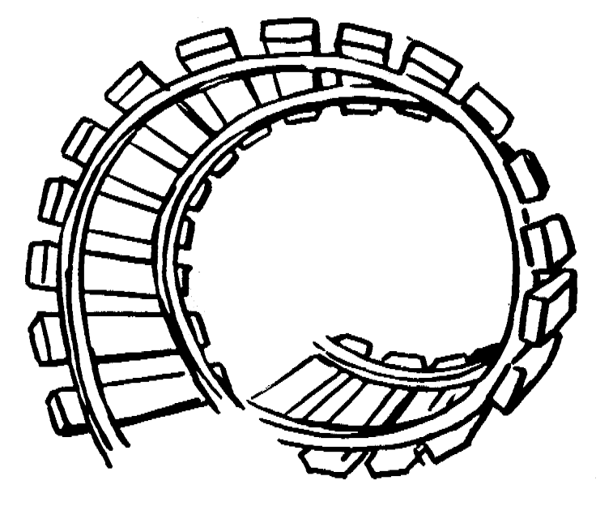
Verification?
Overview:
Motivation
Overview
Testing Activities
Unit Testing
Integration Test.
System Testing
Management
Summary

Slide 25
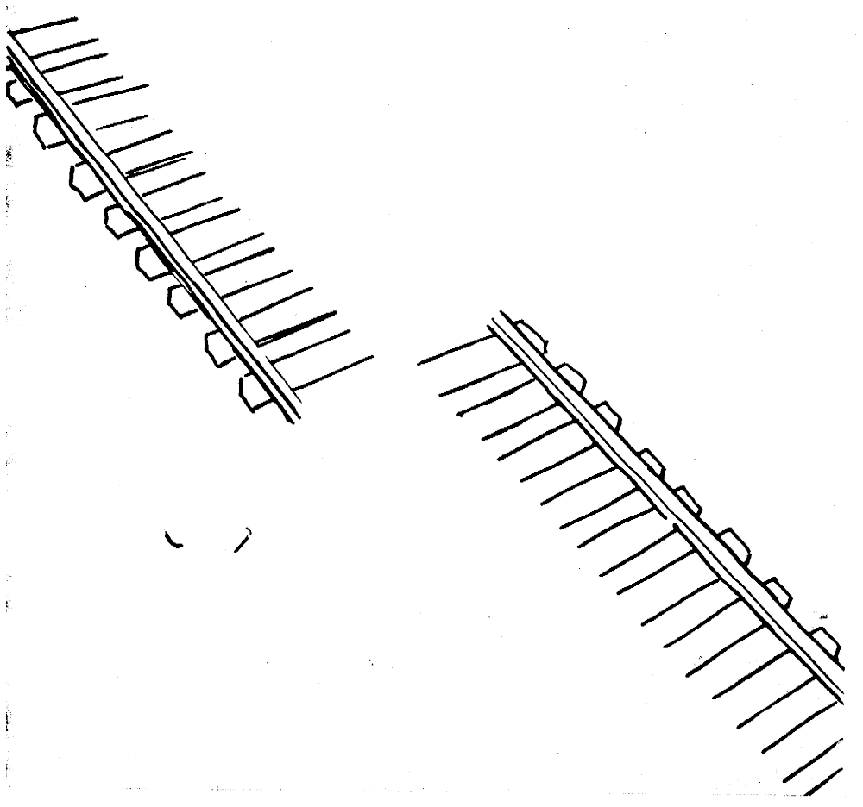
Modular Redundancy?
Overview:
Motivation
Overview
Testing Activities
Unit Testing
Integration Test.
System Testing
Management
Summary

Slide 26
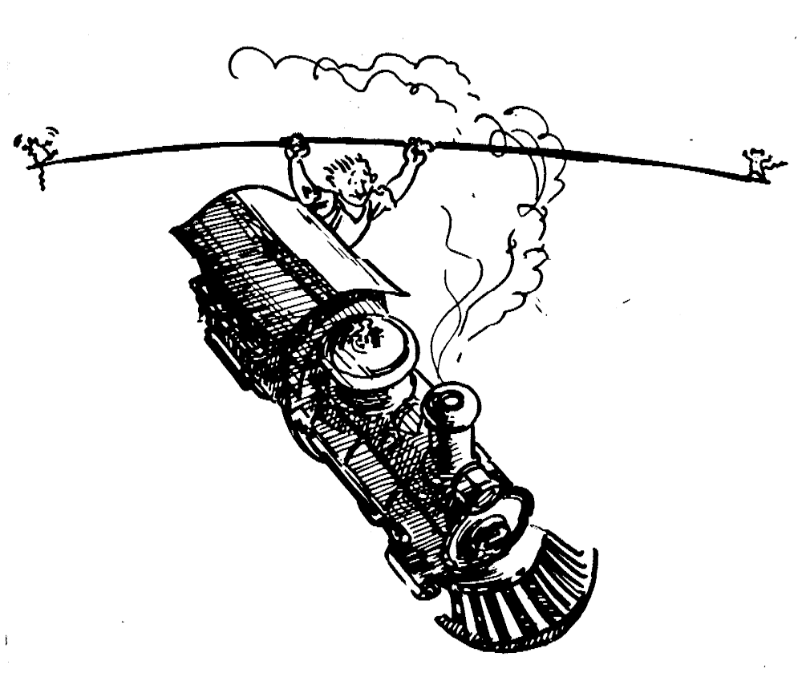
Declaring the Bug as a Feature?
Overview:
Motivation
Overview
Testing Activities
Unit Testing
Integration Test.
System Testing
Management
Summary

Slide 27

Patching?
Overview:
Motivation
Overview
Testing Activities
Unit Testing
Integration Test.
System Testing
Management
Summary

Slide 28
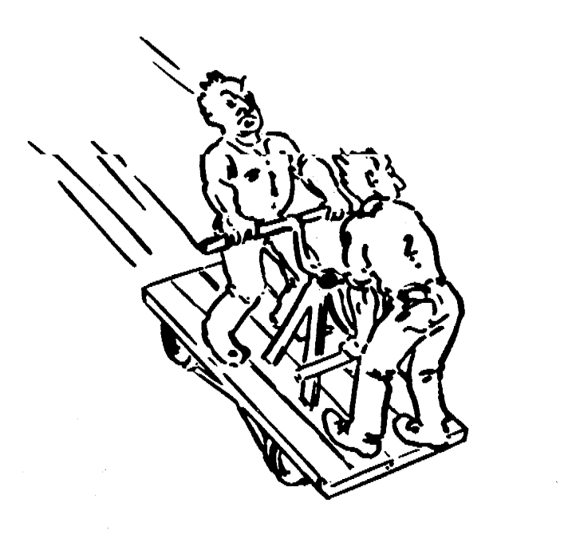
Testing?
Overview:
Motivation
Overview
Testing Activities
Unit Testing
Integration Test.
System Testing
Management
Summary

Slide 29
Agenda
Overview:
Motivation
Overview
Testing Activities
Unit Testing
Integration Testing
System Testing
Management
Summary
Motivation
Overview
Testing Activities
Unit Testing
Integration Test.
System Testing
Management
Summary

Slide 30
Testing activities (1)
Overview:
Motivation
Developer
Client
User
Overview
Management
plan
Test planning
Testing Activities
User interface
design
Usability test
Unit Testing
From RAD
Integration Test.
Object design
Unit test
System Testing
From ODD
Management
Integration
strategy
Integration test
Summary
From TP
System
Structure test
decomposition
From SDD
Functional
Functional test
requirements
From RAD
Continued
on next slide
Continued
on next slide

Slide 31
Testing Activities (2)
Overview:
Developer
Client
User
Motivation
Functional
requirements
Overview
Functional test
User manual
Testing Activities
From RAD
Unit Testing
Integration Test.
System Testing
Nonfunctional
requirements
Performance test
Field test
Management
From RAD
Summary
Acceptance test
Project
agreement
Installation test
Daily operation

Slide 32
Testing Activities (3)
Overview:
Test Planning
  Allocates resources and schedules the testing.
Usability Testing
  Tries to find faults in the user interface design of the system.
Unit Testing
  Tries to find faults in participating objects and/or sybsytems with respect to the use cases from the use case model.
Integration Testing
  The activity of finding faults when testing the individually tested componetns together.
Structural Testing
  Finds differences between the system design model and a subset of integrated subsystems.
Motivation
Overview
Testing Activities
Unit Testing
Integration Test.
System Testing
Management
Summary

Slide 33
Testing Activities (4)
Overview:
System Testing
  Tests all the components together, seen as a single system to identify faults with respect to the problem statement and the requirements and design goals identified in the analysis and system design, respectively:
  Functional Testing
    Finds differences between the use case model and the system.
  Performance Testing
    Finds differences between nonfunctional requirements and actual system performance.
  Acceptance and Installation Testing
    Check the system against the project aggreement and is done by the client.
Motivation
Overview
Testing Activities
Unit Testing
Integration Test.
System Testing
Management
Summary

Slide 34
Testing Activities (5)
Overview:
Motivation
Overview
Subsystem
Code
Requirements
Analysis
Document
Testing Activities
Unit
System
Design
Document
Requirements
Analysis
Document
T
Unit Testing
est
Integration Test.
Tested
Subsystem
User
Manual
System Testing
Subsystem
Code
Unit
T
Management
est
Summary
Tested
Subsystem
Integration
Functional
Test
Test
Functioning
System
Integrated
Subsystems
Tested Subsystem
Subsystem
Code
Unit
T
est
All tests by developer

Slide 35
Testing Activities (6)
Overview:
Motivation
Overview
Client’s
Understanding
of Requirements
Global
Requirements
User
Environment
Testing Activities
Unit Testing
Integration Test.
System Testing
Validated
System
Accepted
System
Functioning
System
Management
Performance
Acceptance
Installation
Summary
Test
Test
Test
Usable
System
Tests by client
Tests by developer
User’s understanding
System in
Use
Tests (?) by user

Slide 36
Agenda
Overview:
Motivation
Overview
Testing Activities
Unit Testing
Integration Testing
System Testing
Management
Summary
Motivation
Overview
Testing Activities
Unit Testing
Integration Test.
System Testing
Management
Summary

Slide 37
Unit Testing
Unit testing focuses on the building blocks of the software system (objects and subsystems).
  Informal: Incremental coding.
Static Analysis:
  Hand execution: Reading the source code
  Walk-Through (informal presentation to others)
  Code Inspection (formal presentation to others)
  Automated Tools checking for
    syntactic and semantic errors
    departure from coding standards
Dynamic Analysis:
  Black-box testing (Test the input/output behavior)
  White-box testing (Test the internal logic of the subsystem or object)
  Data-structure based testing (Data types determine test cases)
Overview:
Motivation
Overview
Testing Activities
Unit Testing
Integration Test.
System Testing
Management
Summary

Slide 38
Black-box Testing
Overview:
Focus: I/O behavior. If for any given input, we can predict the output, then the module passes the test.
  Almost always impossible to generate all possible inputs ("test cases")
Goal: Reduce number of test cases by equivalence partitioning:
  Divide input conditions into equivalence classes
  Choose test cases for each equivalence class. (Example: If an object is supposed to accept a negative number, testing one negative number is enough)
Motivation
Overview
Testing Activities
Unit Testing
Integration Test.
System Testing
Management
Summary

Slide 39
Black-box Testing (Continued)
Overview:
Selection of equivalence classes (No rules, only guidelines):
  Input is valid across range of values. Select test cases from 3 equivalence classes:
    Below the range
    Within the range
    Above the range
  Input is valid if it is from a discrete set. Select test cases from 2 equivalence classes:
    Valid discrete value
    Invalid discrete value
Another solution to select only a limited amount of test cases:
  Get knowledge about the inner workings of the unit being tested => white-box testing
Motivation
Overview
Testing Activities
Unit Testing
Integration Test.
System Testing
Management
Summary

Slide 40
White-box Testing
Overview:
Focus: Thoroughness (Coverage). Every statement in the component is executed at least once.
Four types of white-box testing
  Statement Testing
  Loop Testing
  Path Testing
  Branch Testing
Motivation
Overview
Testing Activities
Unit Testing
Integration Test.
System Testing
Management
Summary

Slide 41
White-box Testing (Continued)
Statement Testing (Algebraic Testing):
  Test single statements (Choice of operators in polynomials, etc)
Loop Testing:
  Cause execution of the loop to be skipped completely. (Exception: Repeat loops)
  Loop to be executed exactly once
  Loop to be executed more than once
Path testing:
  Make sure all paths in the program are executed
Branch Testing (Conditional Testing):
  Make sure that each possible outcome from a condition is tested at least once
Overview:
Motivation
Overview
Testing Activities
Unit Testing
Integration Test.
System Testing
Management
Summary
if ( i =
TRUE) printf("YES\n");
else
printf("NO\n");
Test cases: 1) i = TRUE; 2) i = FALSE

Slide 42
White-box Testing Example
Overview:
Motivation
FindMean(float Mean, FILE ScoreFile)
Overview
{ SumOfScores = 0.0; NumberOfScores = 0; Mean = 0;
Testing Activities
Read(Scor
eFile, Score);
/*Read in and sum the scores*/
Unit Testing
while (! EOF(ScoreFile) {
Integration Test.
if ( Score > 0.0 ) {
System Testing
SumOfScores = SumOfScores + Score;
Management
NumberOfScores++;
Summary
}
Read(ScoreFile, Score);
}
/* Compute the mean and print the result */
if (NumberOfScores > 0 ) {
Mean = SumOfScores/NumberOfScores;
printf("The mean score is %f \n", Mean);
} else
printf("No scores found in file\n");
}

Slide 43
White-box Testing Example
Overview:
FindMean (FILE ScoreFile)
{ float SumOfScores = 0.0;
  int NumberOfScores = 0;
  float Mean=0.0; float Score;
  Read(ScoreFile, Score);
  while (! EOF(ScoreFile) {
    if (Score > 0.0 ) {
        SumOfScores = SumOfScores + Score;
        NumberOfScores++;
        }
    Read(ScoreFile, Score);
  }
  /* Compute the mean and print the result */
  if (NumberOfScores > 0) {
      Mean = SumOfScores / NumberOfScores;
      printf(“ The mean score is %f\n”, Mean);
  } else
      printf (“No scores found in file\n”);
}
Motivation
Overview
1
Testing Activities
Unit Testing
2
Integration Test.
3
System Testing
Management
4
Summary
5
6
7
8
9

Slide 44
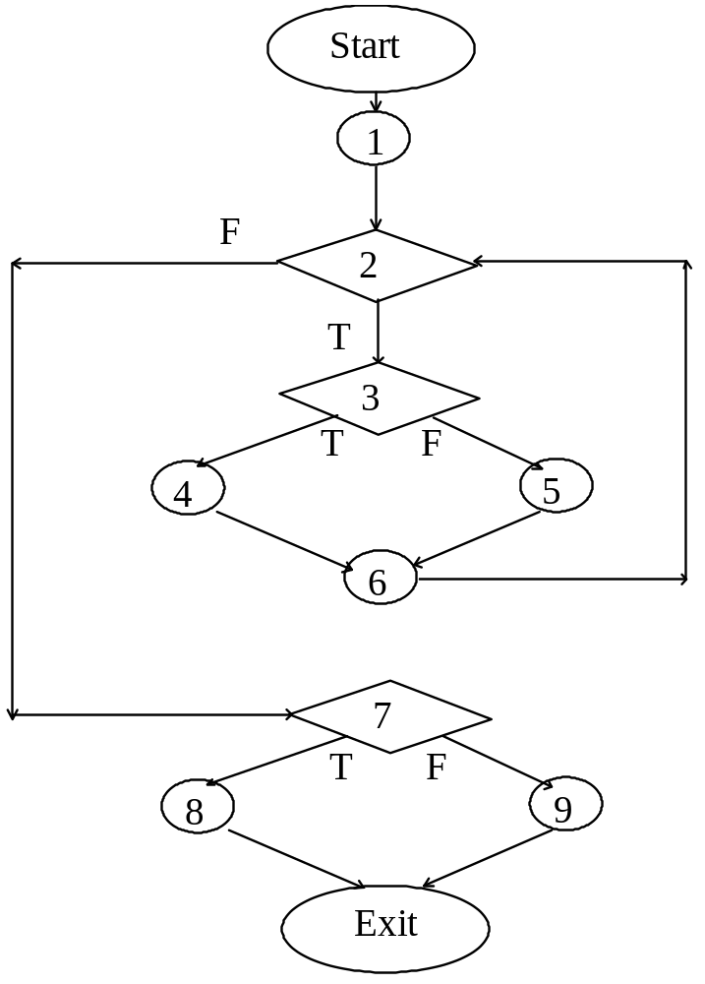
Constructing the Logic Flow Diagram
Overview:
Motivation
Overview
Testing Activities
Unit Testing
Integration Test.
System Testing
Management
Summary

Slide 45
Finding the Test Cases
Overview:
Start
Motivation
Overview
1
Testing Activities
a (Covered by any data)
Unit Testing
2
Integration Test.
b
(Data set must contain at least
one value)
System Testing
(Positive score)
d
3
e
(Negative score)
Management
c
Summary
4
5
(Data set must
h
(Reached if either f or
be empty)
f
g
6
e is reached)
7
j
(Total score < 0.0)
i
(Total score > 0.0)
8
9
k
l
Exit

Slide 46
Test Cases
Overview:
Test case 1 : ? (To execute loop exactly once)
Test case 2 : ? (To skip loop body)
Test case 3: ?,? (to execute loop more than once)
These 3 test cases cover all control flow paths
Motivation
Overview
Testing Activities
Unit Testing
Integration Test.
System Testing
Management
Summary

Slide 47
White-box vs. Black-box Testing (1)
Overview:
White-box Testing:
  Potentially infinite number of paths have to be tested.
  White-box testing often tests what is done, instead of what should be done.
  Cannot detect missing use cases.
Black-box Testing:
  Potential combinatorial explosion of test cases (valid & invalid data).
  Often not clear whether the selected test cases uncover a particular error.
  Does not discover extraneous use cases ("features").
Motivation
Overview
Testing Activities
Unit Testing
Integration Test.
System Testing
Management
Summary

Slide 48
White-box vs. Black-box Testing (2)
Overview:
Both types of testing are needed.
White-box testing and black box testing are the extreme ends of a testing continuum.
Any choice of test case lies in between and depends on the following:
  Number of possible logical paths.
  Nature of input data.
  Amount of computation.
  Complexity of algorithms and data structures.
Motivation
Overview
Testing Activities
Unit Testing
Integration Test.
System Testing
Management
Summary

Slide 49
The 4 Testing Steps
Overview:
1. Select what has to be measured:
  Analysis: Completeness of requirements.
  Design: tested for cohesion.
  Implementation: Code tests.
2. Decide how the testing is done:
  Code inspection.
  Proofs (Design by Contract).
  Black-box or white box.
  Select integration testing strategy (big bang, bottom up, top down, sandwich)
3. Develop test cases:
  A test case is a set of test data or situations that will be used to exercise the unit (code, module, system) being tested or about the attribute being measured.
4. Create the test oracle:
  An oracle contains of the predicted results for a set of test cases.
  The test oracle has to be written down before the actual testing takes place.
Motivation
Overview
Testing Activities
Unit Testing
Integration Test.
System Testing
Management
Summary

Slide 50
Guidance for Test Case Selection
Overview:
Use analysis knowledge about functional requirements (black-box testing):
  Use cases
  Expected input data
  Invalid input data
Use design knowledge about system structure, algorithms, data structures (white-box testing):
  Control structures
    Test branches, loops, ...
  Data structures
    Test records fields, arrays, ...
Use implementation knowledge about algorithms:
  Examples:
    Force division by zero.
    Use sequence of test cases for interrupt handler.
Motivation
Overview
Testing Activities
Unit Testing
Integration Test.
System Testing
Management
Summary

Slide 51
Unit-testing Heuristics
Overview:
1. Create unit tests as soon as object design is completed:
  Black-box test: Test the use cases & functional model.
  White-box test: Test the dynamic model.
  Data-structure test: Test the object model.
2. Develop the test cases :
  Goal: Find the minimal number of test cases to cover as many paths as possible.
3. Cross-check the test cases to eliminate duplicates:
  Don't waste your time!
4. Desk check your source code:
  Reduces testing time.
5. Create a test harness:
  Test drivers and test stubs are needed for integration testing.
6. Describe the test oracle
  Often the result of the first successfully executed test.
7. Execute the test cases:
  Don’t forget regression testing.
  Re-execute test cases every time a change is made.
8. Compare the results of the test with the test oracle:
  Automate as much as possible.
Motivation
Overview
Testing Activities
Unit Testing
Integration Test.
System Testing
Management
Summary

Slide 52
Agenda
Overview:
Motivation
Overview
Testing Activities
Unit Testing
Integration Testing
System Testing
Management
Summary
Motivation
Overview
Testing Activities
Unit Testing
Integration Test.
System Testing
Management
Summary

Slide 53
Integration Testing Strategy
Overview:
Integration testing detects faults that have not been detected during unit testing.
The entire system is viewed as a collection of subsystems (sets of classes) determined during the system and object design.
The order in which the subsystems are selected for testing and integration determines the testing strategy.
For the selection use the system decomposition from the SDD.
Motivation
Overview
Testing Activities
Unit Testing
Integration Test.
System Testing
Management
Summary

Slide 54
Bridge Pattern and Integration Testing
Overview:
Use the bridge pattern to provide multiple implementations under the same interface.
Interface to a component that is incomplete, not yet known or unavailable during testing
Motivation
Overview
Testing Activities
Unit Testing
Integration Test.
System Testing
Management
Summary
VIP
Seat Interface
(in Vehicle Subsystem)
Seat Implementation
Stub Code
Simulated
Seat (SA/RT)
Real Seat

Slide 55
Example: Three Layer Call Hierarchy
Overview:
Motivation
Overview
A
Testing Activities
Layer I
Unit Testing
Integration Test.
System Testing
B
C
D
Management
Layer II
Summary
E
F
G
Layer III

Slide 56
Integration Testing Strategies
Overview:
Big bang integration (Nonincremental)
  Assumes that all components are first tested individually and then tested together as a single system. (no additional test stubs and drivers.)
Bottom up integration
  First tests each component of the bottom layer individually, and then integrates them with components of the next layer up. (no test stubs.)
Top down integration
  First tests the components of the top layer and then integrates the next layer down. (no test drivers.)
Sandwich testing
  Combines the best of top down and bottom up. (no test driver for the bottom and no test stubs for the top.)
Modified sandwich testing
  Test the three layers individually, before combining them. (need for test stubs and drivers.)
Motivation
Overview
Testing Activities
Unit Testing
Integration Test.
System Testing
Management
Summary

Slide 57
Integration Testing: Big-Bang Approach
Overview:
Motivation
Unit Test
A
Overview
Don’t try this!
Testing Activities
Unit Testing
Unit Test
B
Integration Test.
System Testing
Unit Test
C
System Test
Management
Summary
Unit Test
D
Unit Test
E
Unit Test
F

Slide 58
Bottom-up Testing Strategy
Overview:
The subsystem in the lowest layer of the call hierarchy are tested individually.
Then the next subsystems are tested that call the previously tested subsystems.
This is done repeatedly until all subsystems are included in the testing.
Special program needed to do the testing, Test Driver:
  A routine that calls a subsystem and passes a test case to it
Motivation
Overview
Testing Activities
Unit Testing
Integration Test.
System Testing
Management
Summary
SeatDriver
(simulates VIP)
Seat Interface
(in Vehicle Subsystem)
Seat Implementation
Stub Code
Simulated
Seat (SA/RT)
Real Seat

Slide 59
Bottom-up Integration
Overview:
A
Layer I
Motivation
Overview
B
C
D
Layer II
Testing Activities
Unit Testing
E
F
G
Integration Test.
Test E
Layer III
System Testing
Management
Test B, E, F
Summary
Test F
Test
A, B, C, D,
E, F, G
Test C
Test D,G
Test G

Slide 60
Bottom-Up Integration Testing
Overview:
Cons
  Bad for functionally decomposed systems
  Tests the most important subsystem (UI) last
Pros
  Useful for integrating the following systems
    Object-oriented systems
    real-time systems
    systems with strict performance requirements
Motivation
Overview
Testing Activities
Unit Testing
Integration Test.
System Testing
Management
Summary

Slide 61
Top-Down Testing Strategy
Overview:
Test the top layer or the controlling subsystem first
Then combine all the subsystems that are called by the tested subsystems and test the resulting collection of subsystems
Do this until all subsystems are incorporated into the test
Special program is needed to do the testing, Test stub :
  A program or a method that simulates the activity of a missing subsystem by answering to the calling sequence of the calling subsystem and returning back fake data.
Motivation
Overview
Testing Activities
Unit Testing
Integration Test.
System Testing
Management
Summary

Slide 62
Top-Down Integration Testing
Overview:
A
Layer I
Motivation
Overview
B
C
D
Layer II
Testing Activities
Unit Testing
E
F
G
Layer III
Integration Test.
System Testing
Management
Test
A, B, C, D,
E, F, G
Summary
Test A, B, C, D
Test A
Layer I
Layer I + II
All Layers

Slide 63
Top-Down Integration Testing
Overview:
Pros
  Test cases can be defined in terms of the functionality of the system (functional requirements)
Cons
  Writing stubs can be difficult: Stubs must allow all possible conditions to be tested.
  Possibly a very large number of stubs may be required, especially if the lowest level of the system contains many methods.
  One solution to avoid too many stubs: Modified top-down testing strategy
    Test each layer of the system decomposition individually before merging the layers
    Disadvantage of modified top-down testing: Both, stubs and drivers are needed
Motivation
Overview
Testing Activities
Unit Testing
Integration Test.
System Testing
Management
Summary

Slide 64
Sandwich Testing Strategy
Overview:
Combines top-down strategy with bottom-up strategy
The system is view as having three layers
  A target layer in the middle
  A layer above the target
  A layer below the target
  Testing converges at the target layer
How do you select the target layer if there are more than 3 layers?
  Heuristic: Try to minimize the number of stubs and drivers
Motivation
Overview
Testing Activities
Unit Testing
Integration Test.
System Testing
Management
Summary

Slide 65
Sandwich Testing Strategy
Overview:
A
Layer I
Motivation
B
C
D
Layer II
Overview
Testing Activities
Test E
E
F
G
Layer III
Unit Testing
Integration Test.
System Testing
Test B, E, F
Bottom
Layer
Tests
Management
Test F
Summary
Test
A, B, C, D,
E, F, G
Test D,G
Test G
Test A,B,C, D
Top
Layer
Tests
Test A

Slide 66
Pros and Cons of Sandwich Testing
Overview:
Top and Bottom Layer Tests can be done in parallel
Does not test the individual subsystems thoroughly before integration
Solution: Modified sandwich testing strategy
Motivation
Overview
Testing Activities
Unit Testing
Integration Test.
System Testing
Management
Summary

Slide 67
Modified Sandwich Testing Strategy
Overview:
Test in parallel:
  Middle layer with drivers and stubs
  Top layer with stubs
  Bottom layer with drivers
Test in parallel:
  Top layer accessing middle layer (top layer replaces drivers)
  Bottom accessed by middle layer (bottom layer replaces stubs)
Motivation
Overview
Testing Activities
Unit Testing
Integration Test.
System Testing
Management
Summary

Slide 68
Modified Sandwich Testing Strategy
Overview:
Test B
A
Motivation
Layer I
Overview
B
C
D
Layer II
Testing Activities
Test E
Unit Testing
E
F
G
Layer III
Integration Test.
Test B, E, F
System Testing
Management
Test F
Summary
Test
A, B, C, D,
E, F, G
Test D
Test D,G
Test G
Test A,C
Test A
Test C

Slide 69
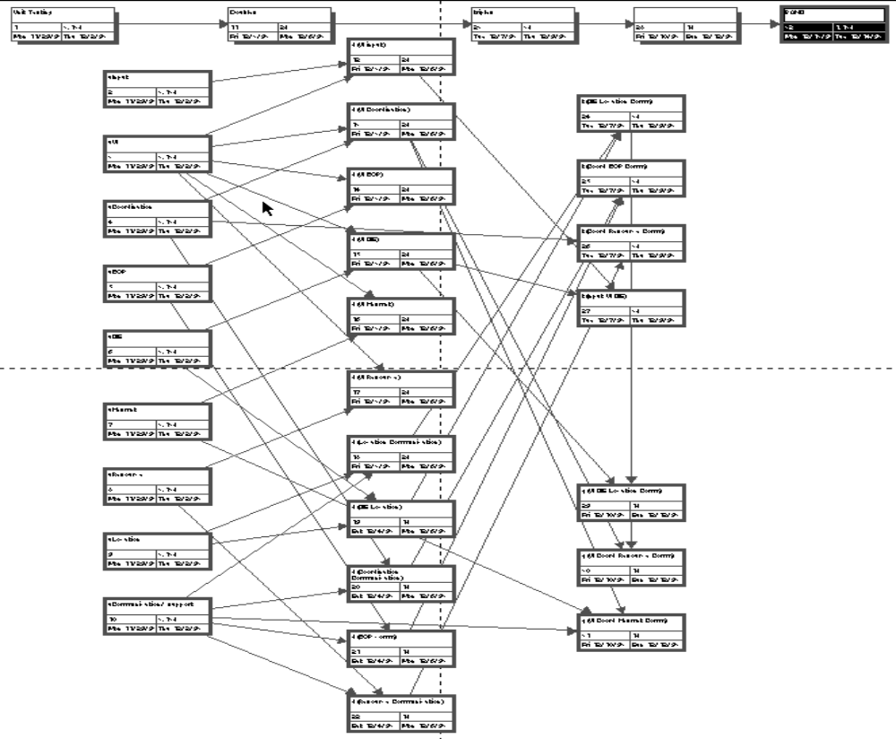
Scheduling Sandwich Tests
Example of a Dependency Chart
Overview:
Motivation
Overview
Testing Activities
Unit Testing
Integration Test.
System Testing
Management
Summary
Unit Tests
Double Tests
Triple Tests
SystemTests

Slide 70
Steps in Integration-Testing
Overview:
1. Based on the integration strategy, select a component to be tested. Unit test all the classes in the component.
2. Put selected component together; do any preliminary fix-up necessary to make the integration test operational (drivers, stubs)
3. Do functional testing: Define test cases that exercise all uses cases with the selected component
4. Do structural testing: Define test cases that exercise the selected component
5. Execute performance tests
6. Keep records of the test cases and testing activities.
7. Repeat steps 1 to 7 until the full system is tested.
The primary goal of integration testing is to identify errors in the (current) component configuration.
Motivation
Overview
Testing Activities
Unit Testing
.
Integration Test.
System Testing
Management
Summary

Slide 71
Which Integration Strategy?
Overview:
Factors to consider
  Amount of test harness (stubs & drivers).
  Location of critical parts in the system.
  Availability of hardware.
  Availability of components.
  Scheduling concerns.
Bottom up approach
  good for object oriented design methodologies.
  Test driver interfaces must match component interfaces.
  ...
  ...Top-level components are usually important and cannot be neglected up to the end of testing
  Detection of design errors postponed until end of testing
Top down approach
  Test cases can be defined in terms of functions examined
  Need to maintain correctness of test stubs
  Writing stubs can be difficult
Motivation
Overview
Testing Activities
Unit Testing
Integration Test.
System Testing
Management
Summary

Slide 72
Agenda
Overview:
Motivation
Overview
Testing Activities
Unit Testing
Integration Testing
System Testing
Management
Summary
Motivation
Overview
Testing Activities
Unit Testing
Integration Test.
System Testing
Management
Summary

Slide 73
System Testing
Overview:
Functional Testing
  Test of functional requirements (form RAD).
Performance Testing
  Test of nonfunctional requirements (from SDD).
Pilot Testing
  Test of common functionality among a selected group of end users in the target environment.
Acceptance Testing
  Usability, functional, and performance tests perfomed by the customer in the development environment against acceptance criteria (from Project Aggreement).
Installation Testing
  Usability, functional, and performance tests perfomed by the customer in the target environment.
  If only a small selected set of customers, then beta test.
Motivation
Overview
Testing Activities
Unit Testing
Integration Test.
System Testing
Management
Summary

Slide 74
Impact of Requirements on Testing
Overview:
The more explicit the requirements, the easier they are to test.
Quality of use cases determines the ease of functional testing.
Quality of subsystem decomposition determines the ease of structure testing.
Quality of nonfunctional requirements and constraints determines the ease of performance tests.
Motivation
Overview
Testing Activities
Unit Testing
Integration Test.
System Testing
Management
Summary

Slide 75
Structure Testing
Overview:
Essentially the same as white box testing.
Goal: Cover all paths in the system design
Exercise all input and output parameters of each component.
Exercise all components and all calls (each component is called at least once and every component is called by all possible callers.)
Use conditional and iteration testing as in unit testing.
Motivation
Overview
Testing Activities
Unit Testing
Integration Test.
System Testing
Management
Summary

Slide 76
Functional Testing
Overview:
Essentially the same as black box testing
Goal: Test functionality of system
Test cases are designed from the requirements analysis document (better: user manual) and centered around requirements and key functions (use cases).
The system is treated as black box.
Unit test cases can be reused, but in end user oriented new test cases have to be developed as well.
Motivation
Overview
Testing Activities
Unit Testing
Integration Test.
System Testing
Management
Summary
.

Slide 77
Performance Testing
Overview:
Stress Testing
  Stress limits of system (maximum # of users, peak demands, extended operation)
Volume testing
  Test what happens if large amounts of data are handled
Configuration testing
  Test the various software and hardware configurations
Compatibility test
  Test backward compatibility with existing systems
Security testing
  Try to violate security requirements
Timing testing
  Evaluate response times and time to perform a function
Environmental test
  Test tolerances for heat, humidity, motion, portability
Quality testing
  Test reliability, maintain- ability & availability of the system
Recovery testing
  Tests system’s response to presence of errors or loss of data.
Human factors testing
  Tests user interface with user
Motivation
Overview
Testing Activities
Unit Testing
Integration Test.
System Testing
Management
Summary

Slide 78
Test Cases for Performance Testing
Overview:
Push the (integrated) system to its limits.
Goal: Try to break the subsystem
Test how the system behaves when overloaded.
  Can bottlenecks be identified? (First candidates for redesign in the next iteration
Try unusual orders of execution
  Call a receive() before send()
Check the system’s response to large volumes of data
  If the system is supposed to handle 1000 items, try it with 1001 items.
What is the amount of time spent in different use cases?
  Are typical cases executed in a timely fashion?
Motivation
Overview
Testing Activities
Unit Testing
Integration Test.
System Testing
Management
Summary

Slide 79
Acceptance Testing
Overview:
Goal: Demonstrate system is ready for operational use
  Choice of tests is made by client/sponsor
  Many tests can be taken from integration testing
  Acceptance test is performed by the client, not by the developer.
Majority of all bugs in software is typically found by the client after the system is in use, not by the developers or testers. Therefore two kinds of additional tests:
Alpha test:
  Sponsor uses the software at the developer’s site.
  Software used in a controlled setting, with the developer always ready to fix bugs.
Beta test:
  Conducted at sponsor’s site (developer is not present)
  Software gets a realistic workout in target environ- ment
  Potential customer might get discouraged
Motivation
Overview
Testing Activities
Unit Testing
Integration Test.
System Testing
Management
Summary

Slide 80
Agenda
Overview:
Motivation
Overview
Testing Activities
Unit Testing
Integration Testing
System Testing
Management
Summary
Motivation
Overview
Testing Activities
Unit Testing
Integration Test.
System Testing
Management
Summary

Slide 81
Test Plan Document
Overview:
Introduction
Relationship to other documents
System overview
Features to be tested/not to be tested
Pass/Fail criteria
Approach
Suspension and resumption
Testing materials (hardware/software req.)
Test cases
Testing schedule
Motivation
Overview
Testing Activities
Unit Testing
Integration Test.
System Testing
Management
Summary

Slide 82
Test Case Specification
Overview:
Test case specification identifier
Test items
Input specifications
Output specifications
Environmental needs
Special procedural requirements
Intercase dependencies
Motivation
Overview
Testing Activities
Unit Testing
Integration Test.
System Testing
Management
Summary

Slide 83
Testing has its own Life Cycle
Overview:
Motivation
Overview
Establish the test objectives
Testing Activities
Unit Testing
Design the test cases
Integration Test.
System Testing
Write the test cases
Management
Test the test cases
Summary
Execute the tests
Evaluate the test results
Change the system
Do regression testing

Slide 84
Test Team
Overview:
Professional
Tester
too familiar
with code
Motivation
Overview
Programmer
Testing Activities
Analyst
Unit Testing
Integration Test.
System Testing
Management
System
Designer
Summary
User
Test
Team
Configuration
Management
Specialist

Slide 85
Agenda
Overview:
Motivation
Overview
Testing Activities
Unit Testing
Integration Testing
System Testing
Management
Summary
Motivation
Overview
Testing Activities
Unit Testing
Integration Test.
System Testing
Management
Summary

Slide 86
Summary
Overview:
Testing is still a black art, but many rules and heuristics are available.
Testing consists of component-testing (unit testing, integration testing) and system testing.
Design Patterns can be used for integration testing.
Testing has its own lifecycle.
Motivation
Overview
Testing Activities
Unit Testing
Integration Test.
System Testing
Management
Summary

