Slide 1
Opendemo
Portfolio Overview

Slide 2
Outline of topics
Objectives
Portfolio trends
1
Objectives
2
Objective trends per capability

Slide 3
Progress towards objectives between February 2026 and March 2026
PROGRESS_STATUS_CHART
Objectives - Progress
Percentage of portfolio
⬤ Complete ⬤ Increased ⬤ Decreased ⬤ Incomplete

Slide 4
Progress towards objectives over time
PROGRESS_TIME_CHART
Objectives - Progress
Percentage of portfolio (%)
⬤ Objectives completed

Slide 5
Progress towards objectives per capability between February 2026 and March 2026
PROGRESS_CAPABILITY_CHART
Objectives - Progress
Percentage of portfolio
⬤ Complete ⬤ Increased ⬤ Decreased ⬤ Incomplete

Slide 6
Progress towards objectives: Maintainability
PROGRESS_MAINTAINABILITY_TIME_CHART
Objectives – Maintainability
Percentage of portfolio (%)
⬤ Objectives completed

Slide 7
Progress towards objectives: Architecture
PROGRESS_ARCHITECTURE_TIME_CHART
Objectives – Architecture
Percentage of portfolio (%)
⬤ Objectives completed

Slide 8
Progress towards objectives: Open Source Health
PROGRESS_OSH_TIME_CHART
Objectives – Open Source Health
Percentage of portfolio (%)
⬤ Objectives completed

Slide 9
Progress towards objectives: Security
PROGRESS_SECURITY_TIME_CHART
Objectives – Security
Percentage of portfolio (%)
⬤ Objectives completed

Slide 10
Progress towards objectives between February 2026 and March 2026
OBJECTIVES_STATUS_CHART
Objectives – Status
Percentage of portfolio
⬤ Objective met ⬤ Improved ⬤ Unchanged ⬤ Worsened ⬤ Unknown

Slide 11
Progress towards objectives per team between February 2026 and March 2026
OBJECTIVES_TEAM_CHART
Objectives – Team
Percentage of team’s systems
⬤ Objective met ⬤ Improved ⬤ Unchanged ⬤ Worsened ⬤ Unknown

Slide 12
Progress towards objectives per capability between February 2026 and March 2026
OBJECTIVES_CAPABILITY_CHART
Objectives – Capability
Percentage of portfolio
⬤ Objective met ⬤ Improved ⬤ Unchanged ⬤ Worsened ⬤ Unknown

Slide 13
Progress towards objectives over time
OBJECTIVES_OVERALL_CHART
Objectives – Overall
Percentage of portfolio
⬤ Objective met ⬤ Improved ⬤ Unchanged ⬤ Worsened ⬤ Unknown

Slide 14
Progress towards objectives: Security
OBJECTIVES_SECURITY_CHART
Objectives – Security
Percentage of portfolio
⬤ Objective met ⬤ Improved ⬤ Unchanged ⬤ Worsened ⬤ Unknown

Slide 15
Progress towards objectives: Open Source Health
OBJECTIVES_OSH_CHART
Objectives – Open-Source Health
Percentage of portfolio
⬤ Objective met ⬤ Improved ⬤ Unchanged ⬤ Worsened ⬤ Unknown

Slide 16
Progress towards objectives: Maintainability
OBJECTIVES_MAINTAINABILITY_CHART
Objectives – Maintainability
Percentage of portfolio
⬤ Objective met ⬤ Improved ⬤ Unchanged ⬤ Worsened ⬤ Unknown

Slide 17
Progress towards objectives: Architecture
OBJECTIVES_ARCHITECTURE_CHART
Objectives – Architecture
Percentage of portfolio
⬤ Objective met ⬤ Improved ⬤ Unchanged ⬤ Worsened ⬤ Unknown

Slide 18
Index
Objectives
Portfolio trends
1
Maintainability
2
Open Source Health
3
Security

Slide 19
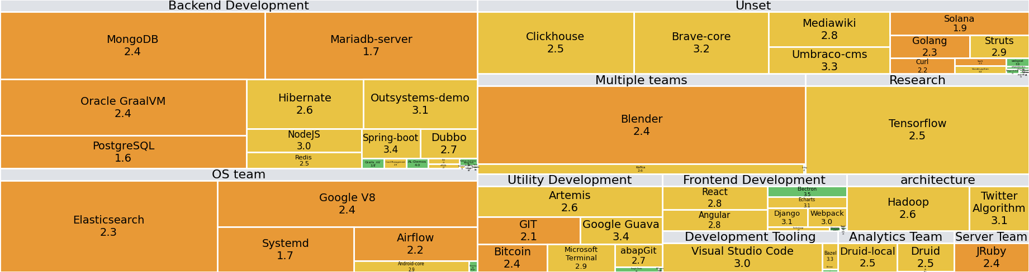

About 45 (48%) systems score market average on maintainability
Portfolio trends – Maintainability
The average maintainability rating for the portfolio is 2.5 ★.
32% of systems score above market average (≥3.5★).
48% of systems score market average (3★).
19% of systems score below market average (≤2.5★).
1 star
2 stars
3 stars
4 stars
5 stars
Systems grouped by Team

Slide 20
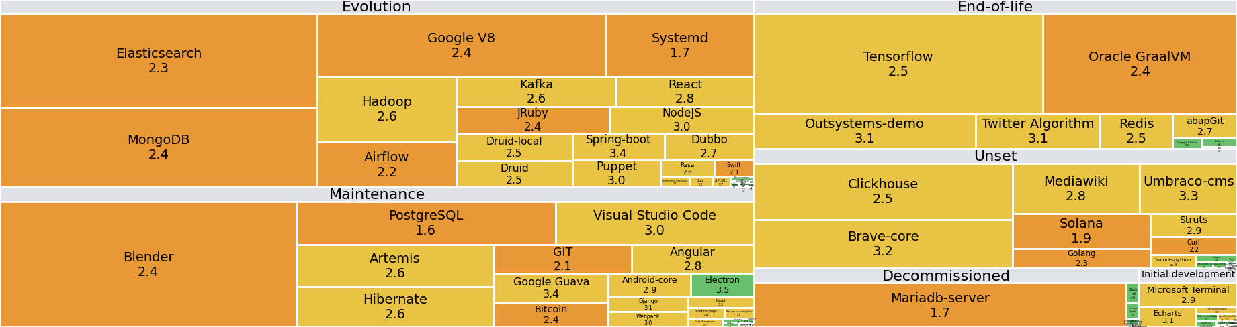
Maintainability Grouped by Lifecycle
Portfolio trends – Maintainability
@@
1 star
2 stars
3 stars
4 stars
5 stars
Systems grouped by Lifecycle

Slide 21
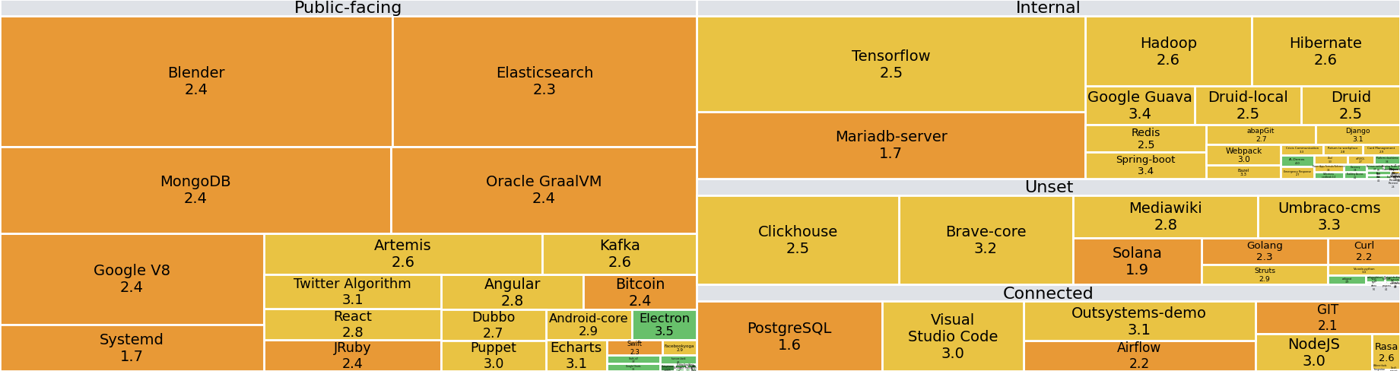
Maintainability Grouped by Deployment Type
Portfolio trends – Maintainability
@@
1 star
2 stars
3 stars
4 stars
5 stars
Systems grouped by Deployment Type

Slide 22
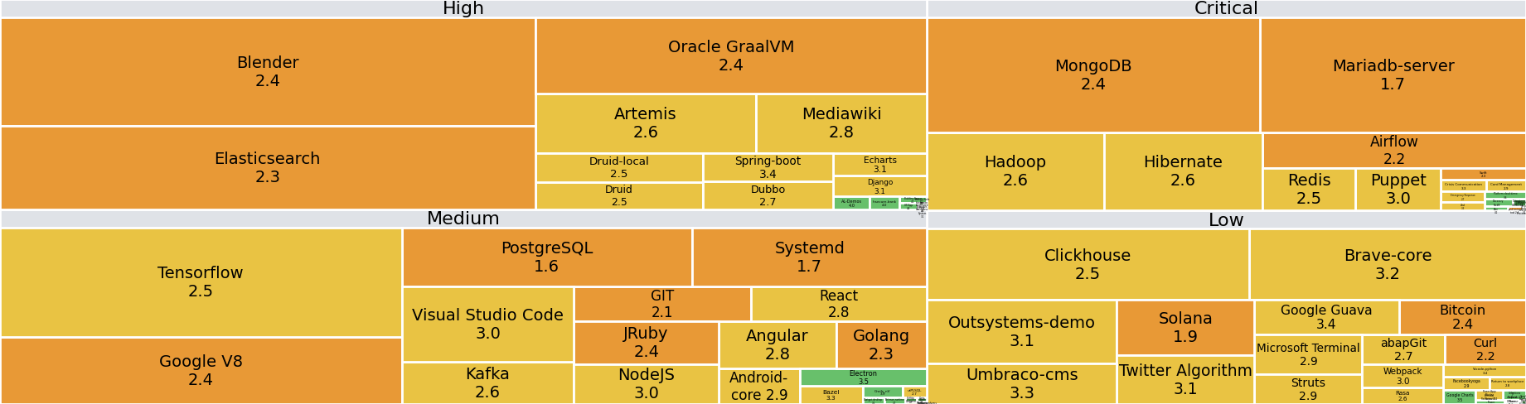
Maintainability Grouped by Business Criticality
Portfolio trends – Maintainability
@@
1 star
2 stars
3 stars
4 stars
5 stars
Systems grouped by Business Criticality

Slide 23
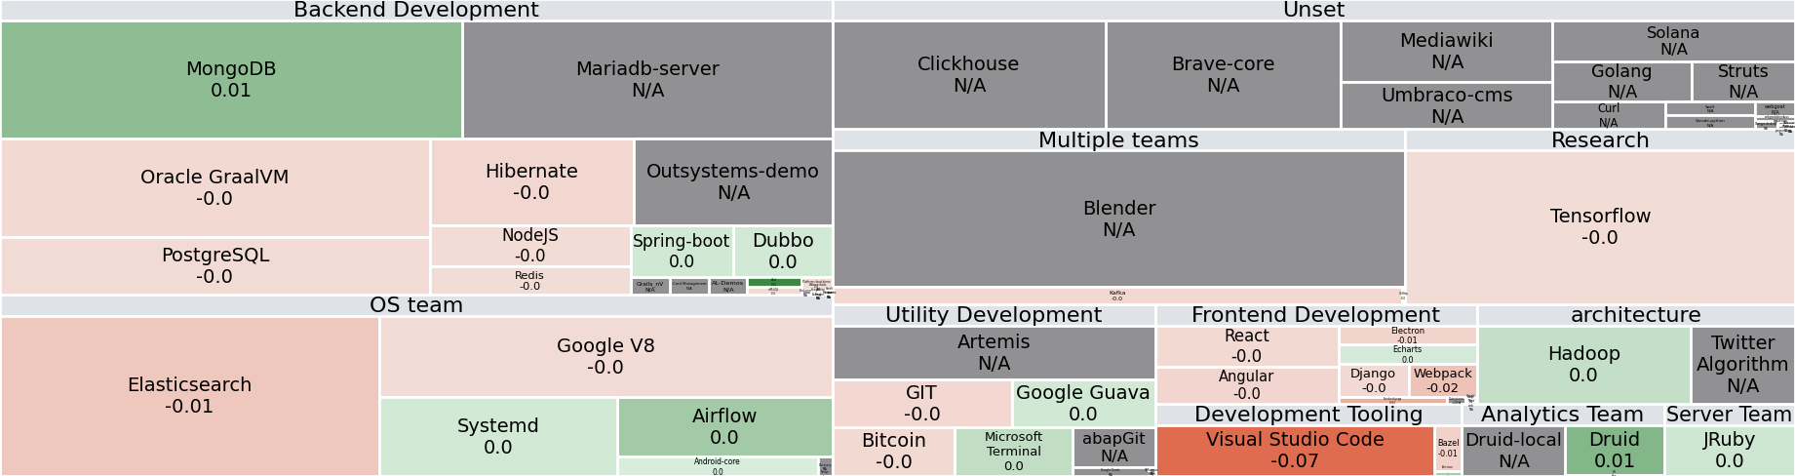
The portfolio remained stable (2.5) during the measured period
Portfolio trends – Maintainability – Change
17% of systems has seen an increase in maintainability. 59% of systems has remained stable. 24% of systems has seen a decrease in maintainability.
The largest increase in maintainability rating was experienced by zuul (0.0 stars). The largest decrease in maintainability rating was experienced by vscode (0.0 stars).
-★
+★
Systems grouped by Team

Slide 24
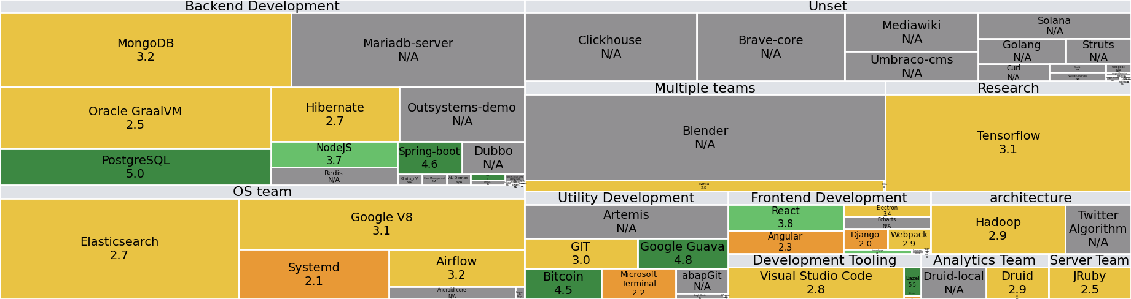
Maintainability ratings of newly written code between 2026-02-12 and 2026-03-12
Portfolio trends – Maintainability – Delta Quality
The highest maintainability rating for new code was achieved by zuul (5.5 stars). The lowest maintainability rating for new code was in postman-runtime (1.9 stars).
1 star
2 stars
3 stars
4 stars
5 stars
Systems grouped by Team

Slide 25
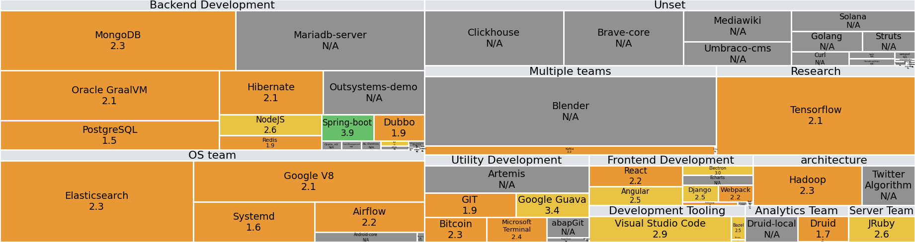
Maintainability ratings of changed code between 2026-02-12 and 2026-03-12
Portfolio trends – Maintainability – Delta Quality
@@
1 star
2 stars
3 stars
4 stars
5 stars
Systems grouped by Team

Slide 26
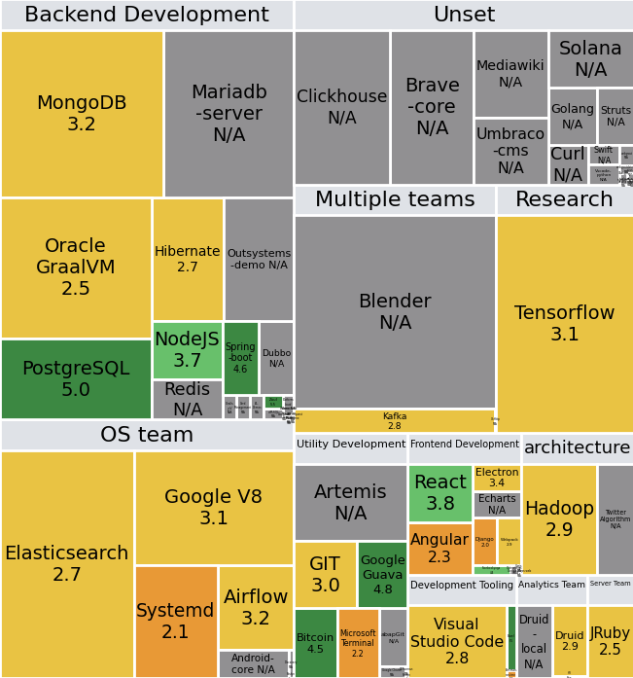
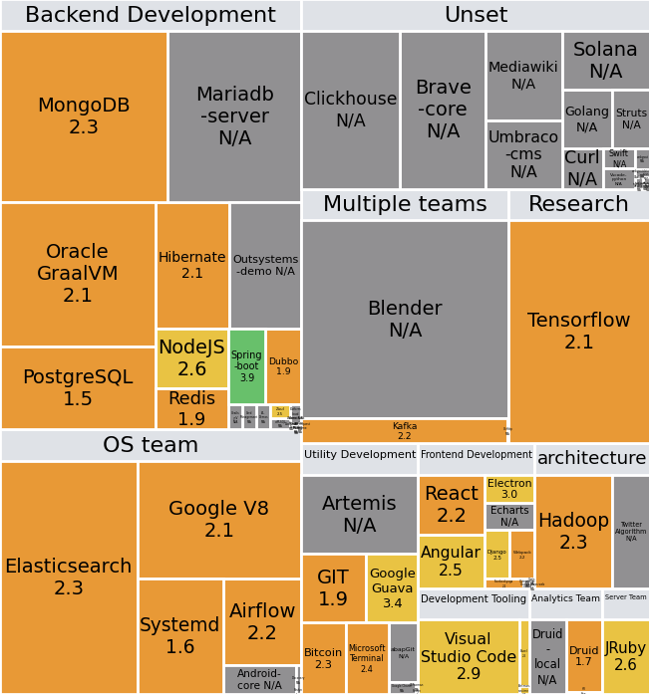

Maintainability delta quality ratings of the portfolio between 2026-02-12 and 2026-03-12
Portfolio trends – Maintainability – Delta Quality
New code
Changed code
New and changed code
1 star
2 stars
3 stars
4 stars
5 stars
Systems grouped by Team

Slide 27
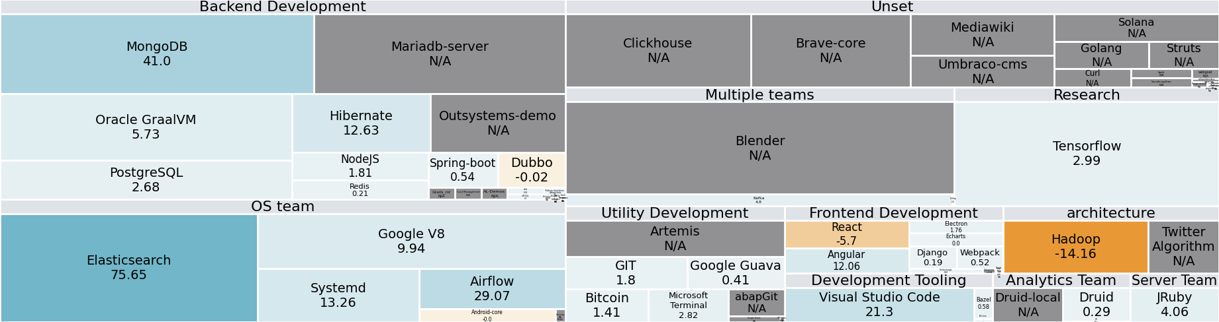
Change in volume (effort) of the portfolio between 2026-02-12 and 2026-03-12
Portfolio trends – Volume Change
The portfolio has seen an overall increase in volume of 19.1 person years.
The system elasticsearch has seen the biggest change with an increase of 6.3 person years.
-PY
+PY
Systems grouped by Team

Slide 28
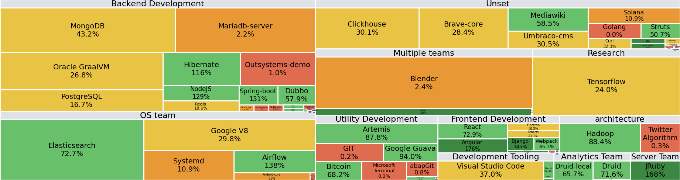
Test-to-production code ratios of the portfolio between 2026-02-12 and 2026-03-12
Portfolio trends – Test-to-production code ratio
65% systems have a test code ratio of < 50%.
17% of systems have a test code ratio between 50% and 100%.
17% of systems have a test code ratio ≥ 100%
≤ 1%
1% - 15%
15% - 50%
50% - 150%
> 150%
Systems grouped by Team

Slide 29
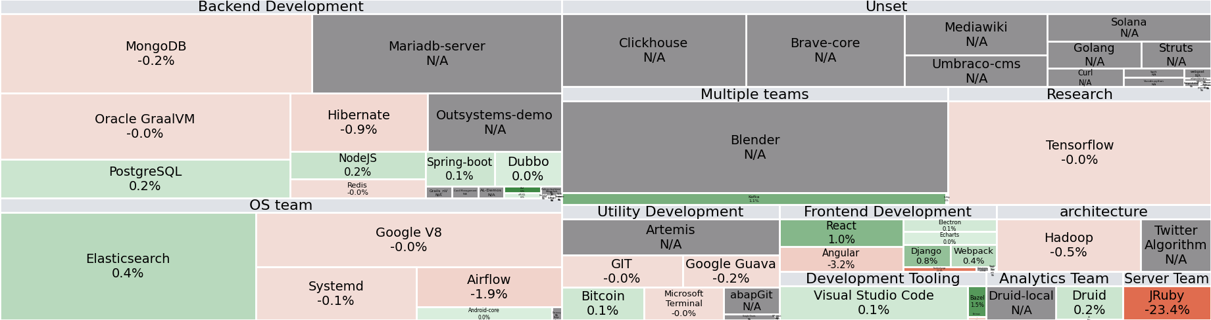
Change in test-to-production code ratios of the portfolio between 2026-02-12 and 2026-03-12
Portfolio trends – Test-to-production code ratio – Change
Overall, there has been a decrease in test code ratio for the portfolio (-0.9%).
8% of systems have seen an increase in test code ratio while 12% of systems have seen a decrease.
The largest increase in test code ratio was experienced by zuul (+1.8%). The largest decrease in test code ratio was experienced by jruby (-23.4%).
-%
+%
Systems grouped by Team

Slide 30
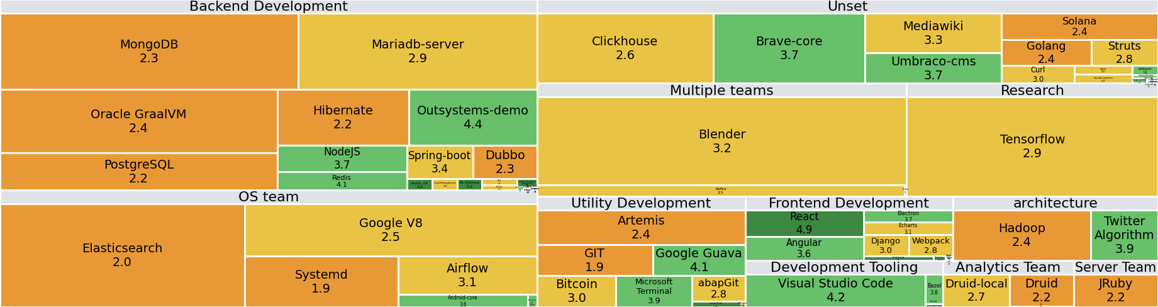
Architecture ratings of the portfolio between 2026-02-12 and 2026-03-12
Portfolio trends – Architecture
The average Architecture Quality rating for the portfolio is 2.9 ★.
55% of systems score above market average for Architecture Quality (≥3.5★).
26% of systems score market average for Architecture Quality (3★).
19% of systems score below market average for Architecture Quality (≤2.5★).
1 star
2 stars
3 stars
4 stars
5 stars
Systems grouped by Team

Slide 31
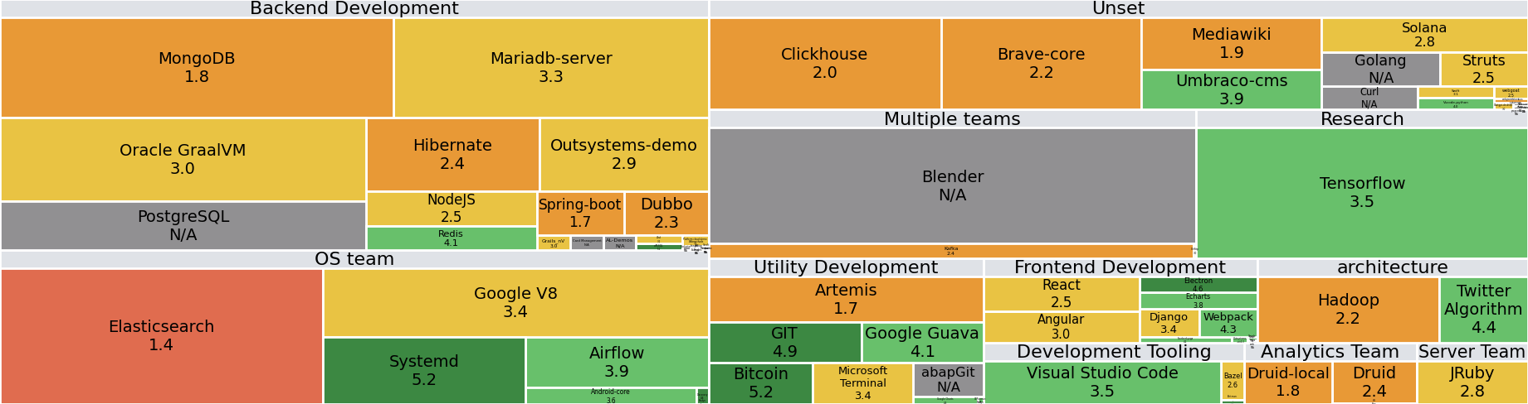
Open-source health ratings of the portfolio between 2026-02-12 and 2026-03-12
Portfolio trends – Open-Source Health
The average Open Source Health rating for the portfolio is 2.8 ★.
40% of systems score above market average for Open Source Health (≥3.5★).
35% of systems score market average for Open Source Health (3★).
25% of systems score below market average for Open Source Health (≤2.5★).
1 star
2 stars
3 stars
4 stars
5 stars
Systems grouped by Team

Slide 32
Overall Open Source Health Library Risks Overview
Key findings – Open Source and IP
7% of dependencies (489 in total) used in the system contain one or more known vulnerabilities.
1% of dependencies (41 in total) uses a potentially restrictive open-source license (e.g. GPL/AGPL).
35% of dependencies (2508 in total) used in the system have not been updated for over 2 years.
10% of dependencies (736 in total) does not use a package manager but is placed in the codebase directly.
7083
1449
645
1692
735
1918

Slide 33
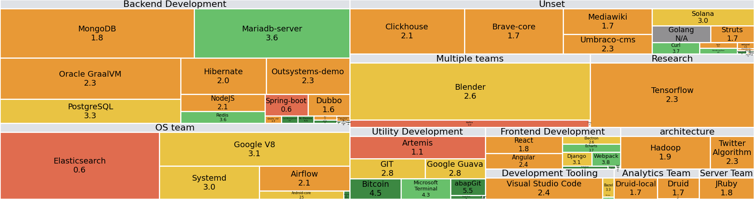
Security ratings of the portfolio between 2026-02-12 and 2026-03-12
Portfolio trends – Security
The average Security rating for the portfolio is 2.3 ★.
46% of systems score above market average for Security (≥3.5★).
15% of systems score market average for Security (3★).
40% of systems score below market average for Security(≤2.5★).
1 star
2 stars
3 stars
4 stars
5 stars
Systems grouped by Team

Slide 34
Critical findings trends of the last 12 months (ending at 2025-12-31)
PORTFOLIO_SECURITY_FINDINGS_CRITICAL
Portfolio trends – Security – Findings trend
Since 2025-01-01, 675 critical security findings have been resolved while 731 new critical findings were discovered. Overall, there has been an increase in critical security findings of 56.
Of the resolved critical findings, most were resolved in at least 30 days (518 findings). 37 findings were resolved within the recommended 7 days while 518 were resolved after 30 days or more.
Critical

Slide 35
Security resolution times of the portfolio of the last 12 months (ending at 2026-03-12)
PORTFOLIO_SECURITY_FINDINGS_HIGHMED
Portfolio trends – Security – Resolution times
Since 2025-04-01, 979 high security findings have been resolved while 1530 new high findings were discovered. Overall, there has been an increase in high security findings of 551.
Of the resolved high findings, most were resolved in at least 180 days (944 findings). 6 findings were resolved within the recommended 14 days while 944 were resolved after 180 days or more.
370 medium security findings have been resolved while 1571 new medium findings were discovered. Overall, there has been an increase in medium security findings of 1201.
Of the resolved medium findings, most were resolved in at least 270 days (189 findings). 110 findings were resolved within the recommended 30 days while 189 were resolved after 270 days or more.
High
Medium

Slide 36
Security findings of the portfolio of the last 12 months (ending at 2026-03-12)
Portfolio trends – Security – Findings trend
Security findings
Critical
High
Medium

Slide 37
Security findings of the portfolio of the last 12 months (ending at 2026-03-12)
Portfolio trends – Security – Findings trend
Security findings
Critical
High
Medium

