Slide 1

Welcome to
Algorithm Presentation
Presenting Algorithm Research Paper

Slide 2



Meet The Team
SIUM BIN NOOR
191-15-12516
Theoretical Introducer
Abruna Afrin
191-15-12303
Algorithm Analyzer

Slide 3
Paper Discussion Topics
Introduction
Dijkstra Algorithm
Greedy Algorithm
Graphical Difference
Analyzing Algorithm
Conclusion

Slide 4
Introduction
A process or set of rules to be followed in calculations or other problem-solving operations, especially by a computer.
Dijkstra
Greedy
&

Slide 5
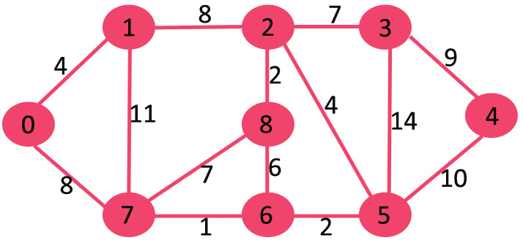
Dijkstra Algorithm
Dijkstra Algorithm is an algorithm which is used to find the shortest distance between two nodes in a graph.
Graph

Slide 6
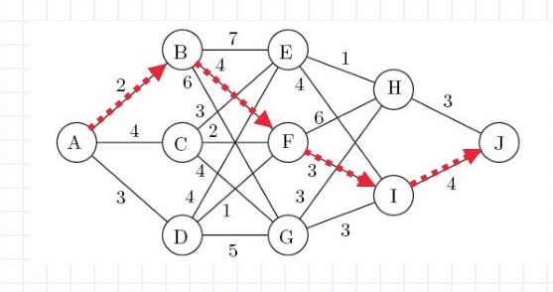
Greedy Algorithm
Greedy is an algorithmic paradigm that builds up a solution piece by piece, always choosing the next piece that offers the most obvious and immediate benefit.
Graph

Slide 7
Analyzing Algorithm (Dijkstra)
function Dijkstra (Graph, source):
dist[source] = 0
for each vertex v in Graph
if v ≠ source
dist[v] = infinity
previous[v] = undefined
end if
add v to Q
end for
while Q is not empty:
u = vertex in Q with min dist[u]
remove u from Q
for each neighbor v of u:
alt = dist[u] + length (u, v)
if alt < dist[v]:
dist[v] = alt
previous[v] = u
end if
end for
end while
return dist [], previous []
end function

Slide 8
Analyzing Algorithm (Greedy)
current_distance = 0
current_stop = 0
stops = []
while current! = Dhaka:
next_stop = 0
while distance(next_stop) - current_distance <= m
next_stop = next_stop + 1
next_stop = next_stop - 1
current_stop = next_stop
current_distance = distance(current_stop)
add next_stop to stops
return stops

Slide 9
Complexity
Dijkstra Algorithm has complexity O(n^2).
Greedy Algorithm has complexity O(n).

Slide 10
Conclusion
Based on the time complexity and Analyzing we stand on a decision that the Greedy Algorithm is better than the Dijkstra Algorithm.

Slide 11
Thank y u

