Slide 1
uantum
We are
K
omputer’s
Welcome to our presentation

Slide 2
Who we are:
Elias
Tom
Robert
Thomas
William

Slide 3
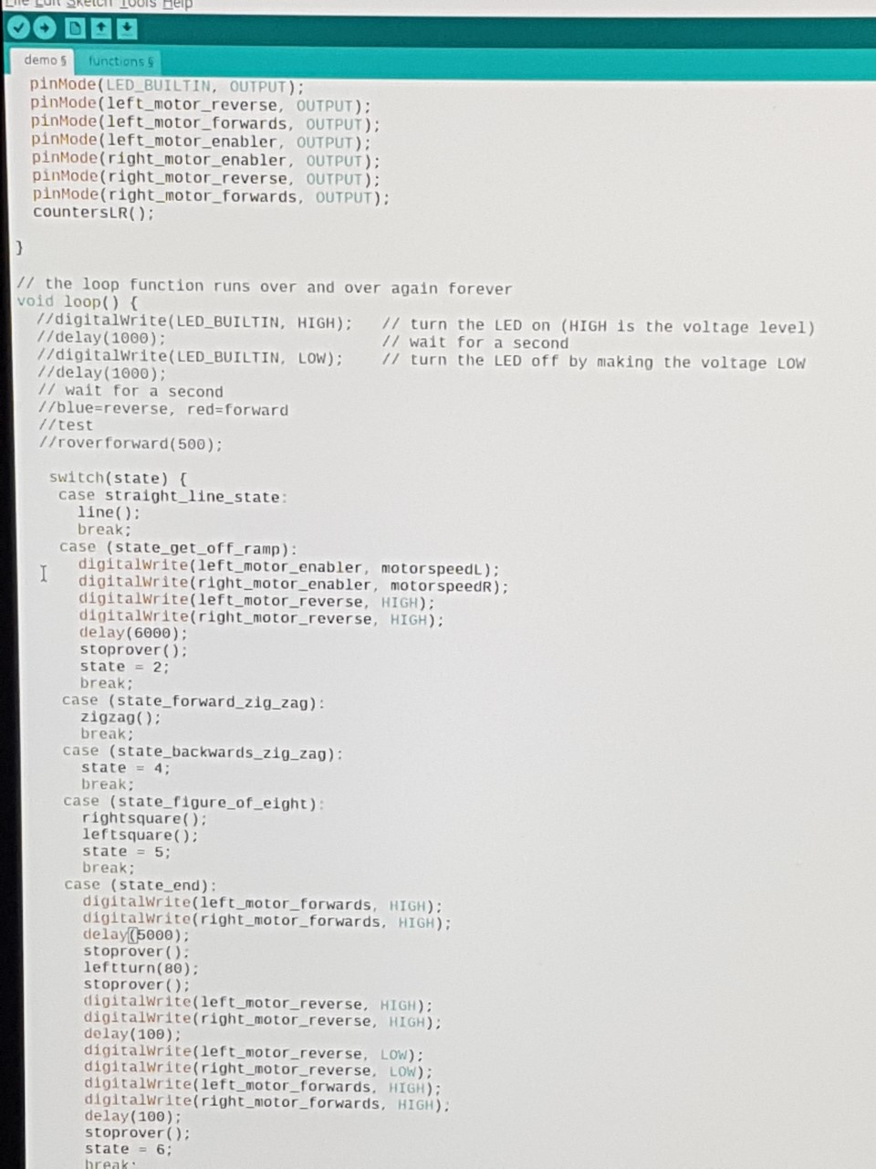
Our Week
We have spent the past week coding our rover.
Coding is easy, right?
We used C++ to code this rover, which is one of the most challenging languages to learn.
This is all program based, in case you thought we had some magic remote control.
This whole week has been really enjoyable for all of us ad it’s been great learing new computer skills.

Slide 4
What We Hope Will Happen
We wired up this bread board earlier in the week,on which we tested most of our code.
This required a lot of practical skill and patience by everyone who wired it.
We want it to pull some funky dance moves and steal the night away. Including a zig-zag and a quick footed ‘figure of eight’.
Then we’re gonna explain some of the code and the process of our project.

Slide 5
Demonstration

Slide 6
Retrospective
What worked out this week:
we’ve made a lot more progress then we thought we would and have built a good team. We also comunicated very effectively and worked well throughout.
What worked against us:
We over-complicated a lot of the code a lot of the time and spent a lot of that time fine-tuning details that might not have been that important.

Slide 7
Feel free to ask questions now.

