Slide 1

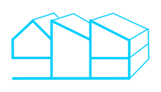
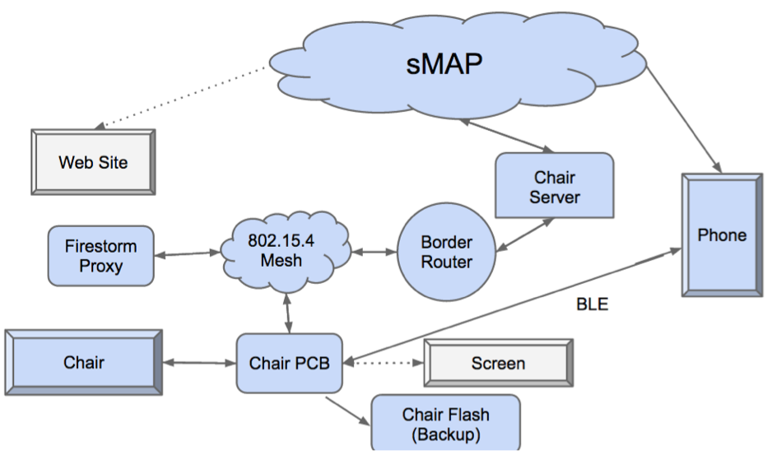
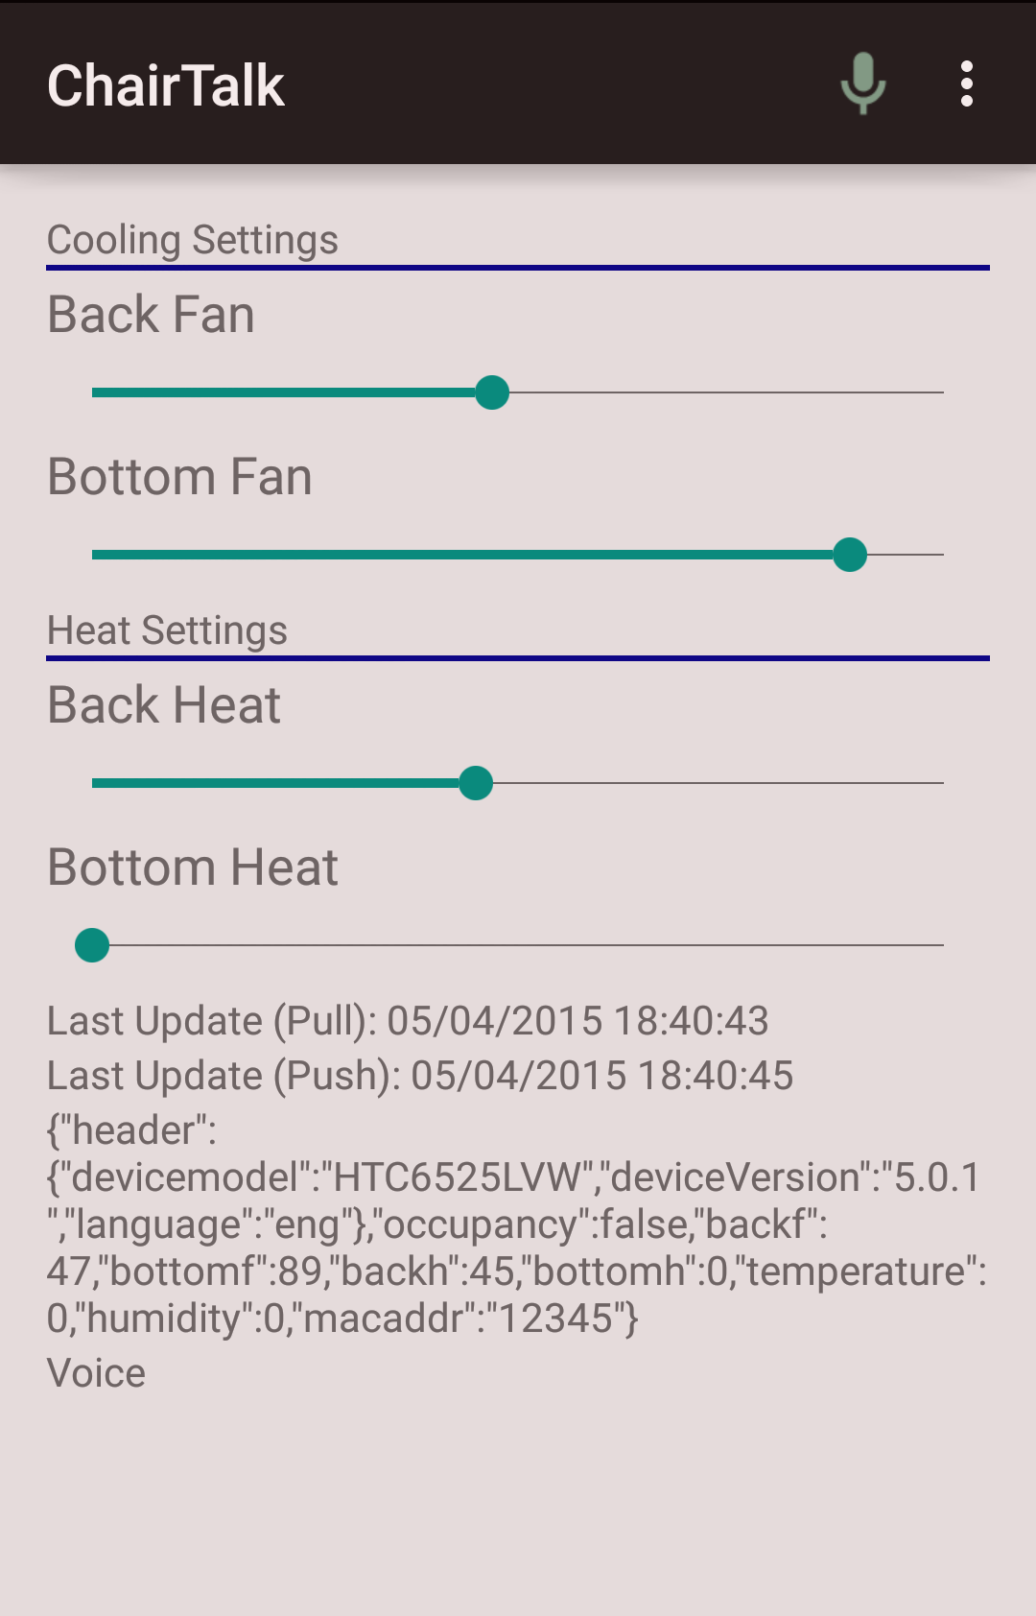
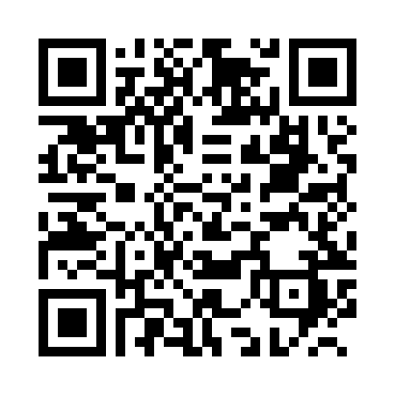

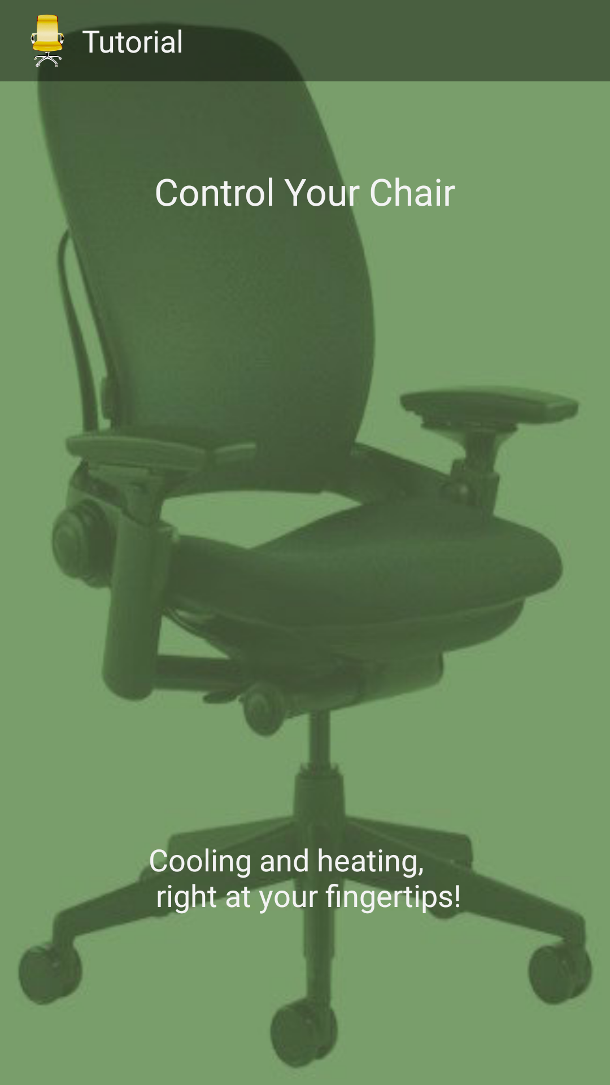
A Smarter Chair
Customizable Personal Environments
Michael Chen, Sam Kumar, Leonard Truong
Goals
Architecture
Learn about user behavior with respect to thermal environments
Log this information on server-side
Adjust building/personal environments to maximize energy savings
Provide adjustable personal environments
Users can turn on fans and heaters on the chair from their own smartphones
Chair automatically shuts off heaters and fans when users are not in the chair
Chair remembers users’ last settings and restores them upon return
Reliable Delivery, Communication and Logging
User Interaction
Data Flow
Users control the chair via a phone app, which connects to the chair via both Bluetooth and Wifi
Both Android and iOS implementations
Chair periodically logs current state (occupancy, fan state, heater state, temperature)
Chair stores this in flash (persistent storage) for recovery in case of failure
State in flash is flushed to remote servers
Chair sends logged data to sMAP over 15.4 via a Firestorm Proxy implementing a reliable network queue
Phone app also relays data should a link in the Wifi connection fail
Phone app relays current time to chair for chair maintain timestamps for logging in flash storage
Intuitive, slider elements for controlling chair
User can control fans and heaters on the back and bottom of the chair independently
(Some) voice command functionality (Android only)
Application warns user of sitting in chair for an extended period of time
Initialization/Setup
Future Work
User scans QR code or taps NFC tag (NFC on Android only)
User reaches appropriate location for app download
In app, user scans QR code again or taps NFC tag
App automatically configures chair communication over Bluetooth and communication with the server
Learn user preferences and adapt personal environments accordingly
Algorithmically minimize energy usage through adjusting microclimates as well as building HVACs

