Slide 1
Biomass Cookstove Optimization Tool
Liam Cassidy

Slide 2
Overview
Project Motivation
Background
Research Gap
Theory
Software Details
Preliminary Results
Conclusions
Future Work
Questions

Slide 3
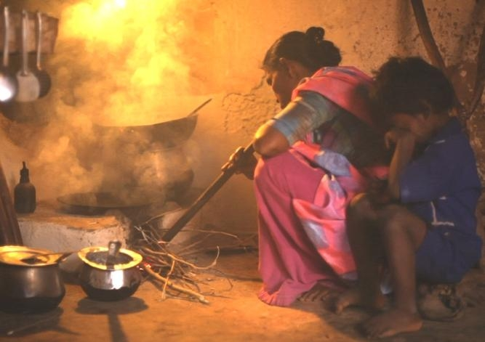
Project Motivation—Global Significance
Population Significance: In 2010, over 2.4 billion rely on biomass to fuel household cooking and heating¹.
Health Significance: Nearly 4 million premature deaths annually¹.
Environmental Significance: Black Carbon, CH₄, CO and CO₂ emissions contribute to climate change².
Indoor Air Pollution²
[1] MacCarty, N., Bryden, K., Modeling of household Biomass cookstoves: A review. June 2015
[2] Clean Cooking Alliance, Climate and Environment, 2018.

Slide 4
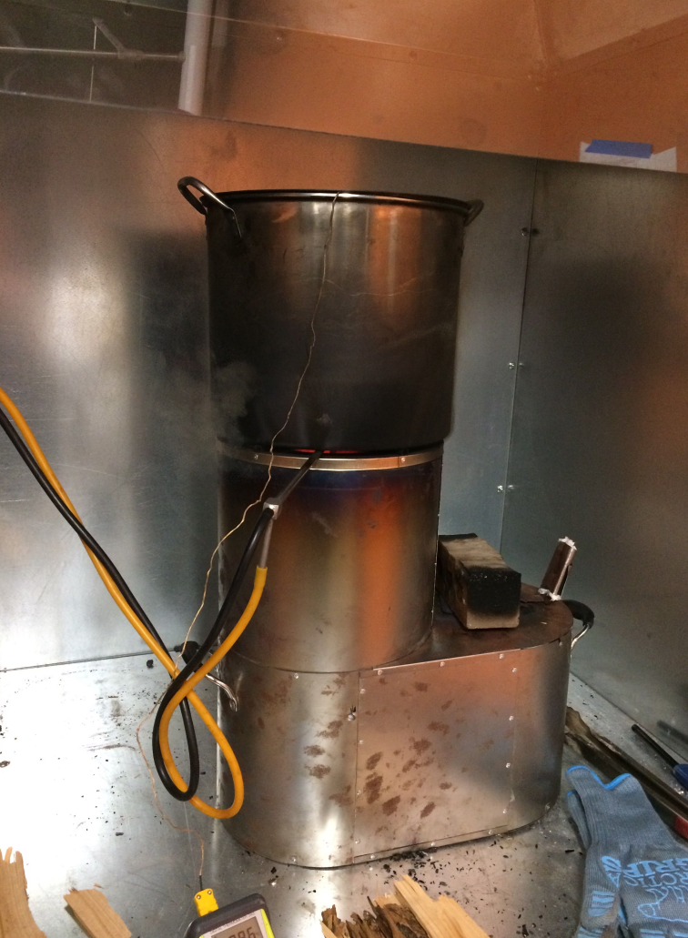
Project Motivation—Cookstove Industry
Current Goals: Design affordable cleaner burning cookstoves
Current Methods: Mostly experimental
Problems: time consuming, expensive, limited impact.
Solution: Computational modelling
Instrumented Cookstove³
[3] Erin Pfieffer, Oregon State University, 2018

Slide 5
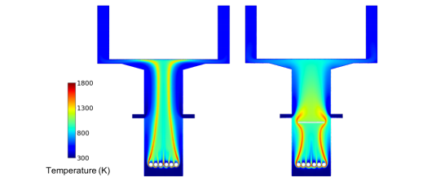
Background
Existing CFD modelling:
Posner et al. Steady State, 2D, forced draft CFD model of single cookstove geometry⁴.
Miller-Loinberg fine resolution transient, 3D, natural draft CFD model of single cookstove geometry⁵.
Out of Context Contour Plots⁴
[4] Posner, Jonathon D., Multidisciplinary Design of an Innovative Natural Draft, Forced Diffusion Cookstove for Woody and Herbaceous Biomass Fuels in East Africa., University of Washington, September 2018.
[5] Miller-Loinberg, D., A Fine Resolution CFD Simulation Approach for Biomass Cook Dtove Development., Colorado State University, Spring 2011.

Slide 6

Research Gap
No existing user-friendly modelling software for cookstove designers.
Current investigations are limited to single cookstove geometries.
Proposed Solution: Develop user-friendly software for cookstove CFD simulation with optimization functionality. Allow users to analyze any geometry based on a variety of input parameters.
Software Development

Slide 7
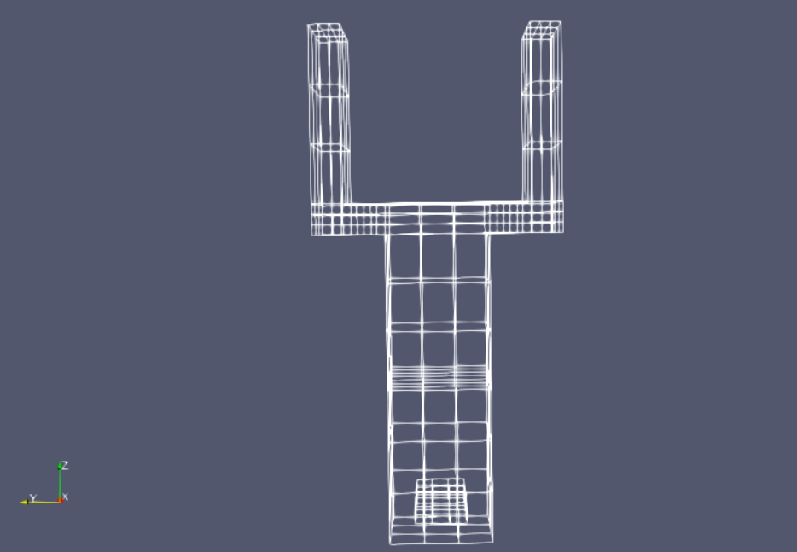
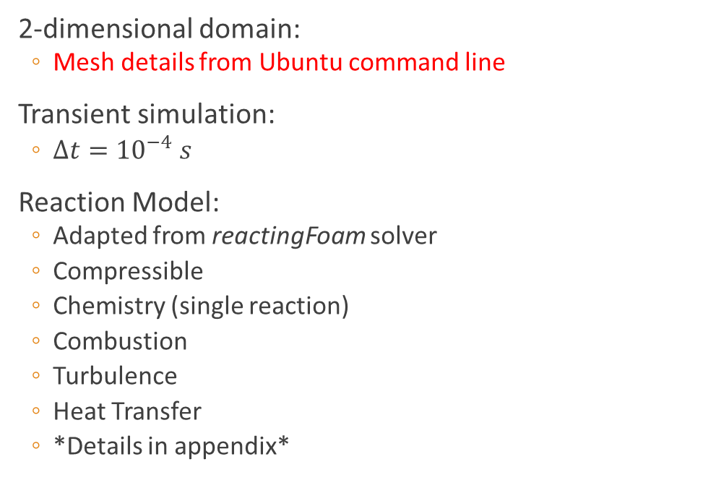
Theory—CFD Models
2-dimensional domain:
Mesh details from Ubuntu command line
Transient simulation:
$∆t={10}^{−4} s$
Reaction Model:
Adapted from reactingFoam solver
Compressible
Chemistry (single reaction)
Combustion
Turbulence
Heat Transfer
*Details in appendix*

Slide 8
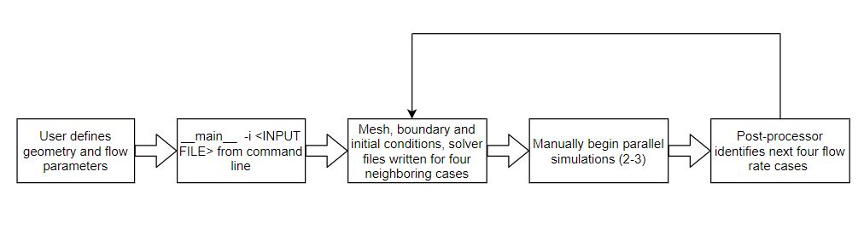
Software—Overview
Windows OS, programmed in Python using Spyder IDE.
Dependencies:
Python (V 2.7 or greater), OpenFOAM (V6), Linux subsystem
General Flow:

Slide 9
Software—User Inputs
Geometric Parameters:
Combustion chamber diameter (d_{c})
Combustion chamber height (h_{c})
Height of secondary inlet (h_{FD})
Diameter of secondary inlet (d_{FD})
Channel width (w_{ch})
Channel height (h_{ch})
Cone Deck height(h_{cd})
Cone deck length (L_{cd})
Pot spacing (p_{sp})
Flow Parameters:
Secondary inlet flow rate (Q_{FD})
LC make a figure with the variables

Slide 10
Software—Modules
review this to make sure it flows well and makes some sense
Import_geometry:
Imports geometry from user definition, converts to strings compatible with OpenFOAM convention
create_blockmeshfile:
Writes the geometry and mesh assignment to blockMeshDict file
setup_surrounding_cases:
Creates four new cases (varying flow rate) around the user defined flow rate (25-150% user defined flow rate). Writes initial conditions, solver, and control files for each
runner:
Automate meshing and simulations in parallel.
Still in development
post_processor:
Reads data from OpenFOAM outfiles
Computes maximum average pot temperature as metric for optimization
Creates four new cases surrounding the optimal case from the previous five simulations

Slide 11
Software—Optimization Details
Single variable optimization.
Design variable: Secondary air flow rate
Objective function: Average cookpot temperature
Direct method: only using objective function values to guide search
Closest algorithm called “exhaustive search method”

Slide 12
Software—Optimization Example
--LC make a little excel sheet to compute values of a function with known amplitude/frequency relationship
---maybe just use a random Gaussian bell curve for a simple example

Slide 13
Preliminary Results
Flow Input:

Slide 14
Conclusions

Slide 15
Future Work
Reduce Runtime:
Convert CFD to Axisymmetric
Auto-runner
Improve Optimization Algorithm:
Multi-variable
Gradient based methods
Alternative methods: Genetic Algorithm
Improve User Friendliness:
Improve Physical Relevance:

Slide 16
Questions

Slide 17
References
Department of Mechanical Engineering, Indian Institute of Technology Madras., Optimization Algorithms. URL: https://mech.iitm.ac.in/meiitm/

Slide 18
Appendix

Slide 19
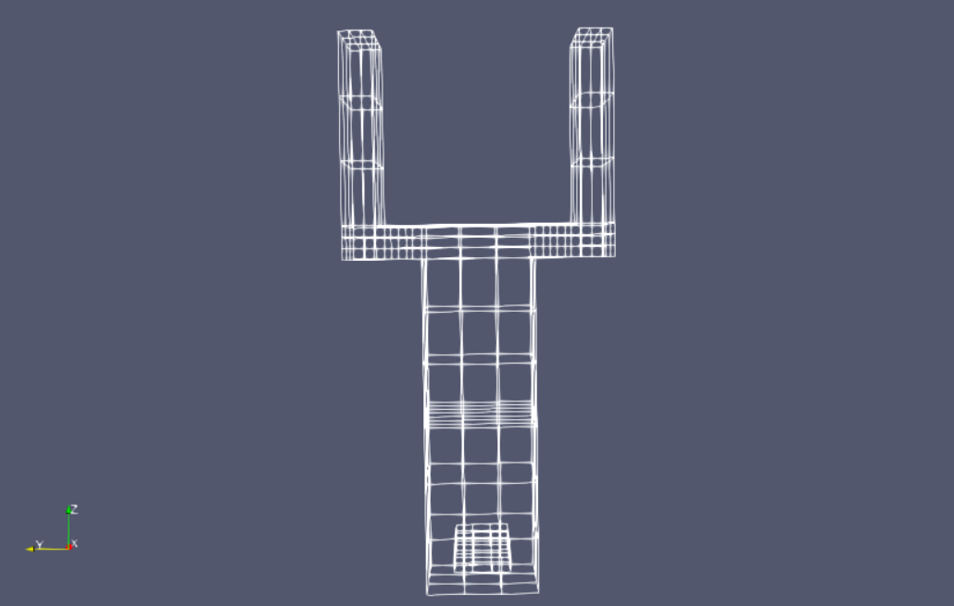
Appendix

