Slide 1
Quantum Capacitance Effects
In Carbon Nanotube
Field-Effect Devices
L. Latessa, A. Pecchia, A. Di Carlo
University of Rome ‘Tor Vergata’
P. Lugli
Lehrstuhl fur Nanoelectronic, Munchen

Slide 2
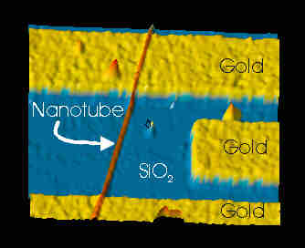
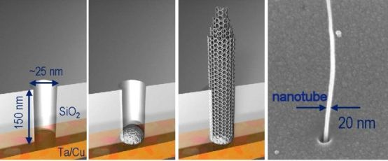
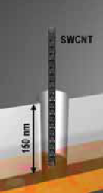
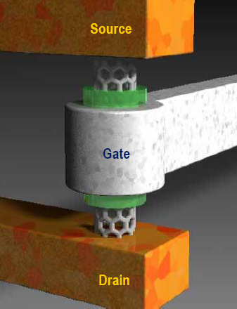
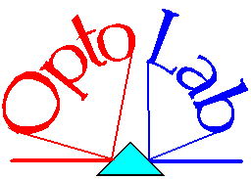
Devices based on field effect (CNTFET)
Planar
geometry top/bottom gate
(IBM)
ULSI Devices
Quasi-1D coherent transport over
long distances
Si integrable technology
Vertical
Geometry
coaxial
gate
(Infineon)

Slide 3
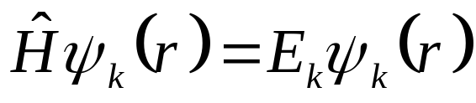
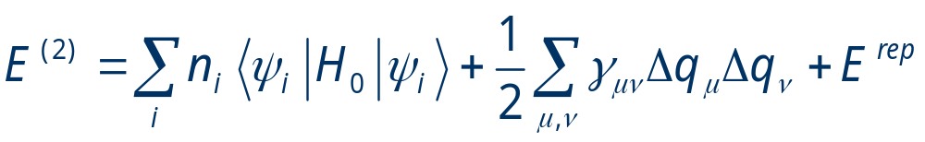
gDFTB
Green’s functions Density Functional Tight-Binding
(A.Pecchia, L.Latessa, A.Di Carlo)
Atomistic simulations:
Quantum treatment
Approximated DFT:

Slide 4
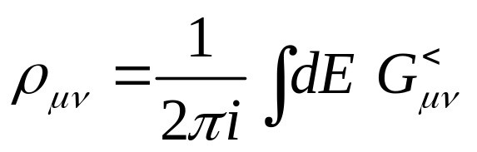
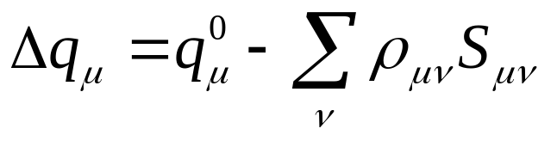
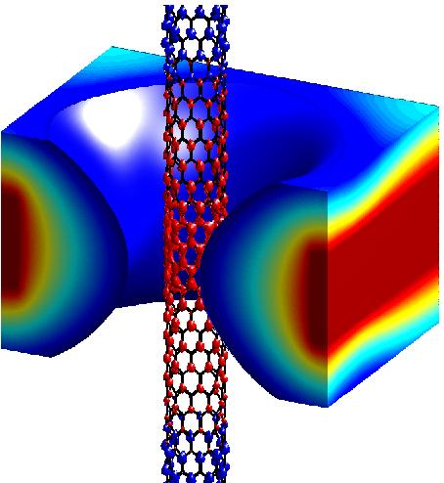
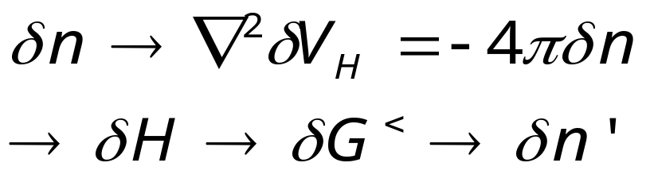
NEGF Extention
μ_{L}
μ_{R}
Density Matrix
Mullikan
Charges
SCC
loop
A. Pecchia, A. Di Carlo, Rep Prog Phys 67, 1-65 (2004)

Slide 5
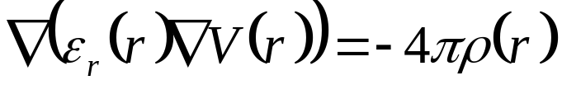





3D Poisson Multigrid
The cylindrical gate is added as an
appropiate Dirichlet boundary condition
Metal Gate
Insulating dielectric
and CNT

Slide 6
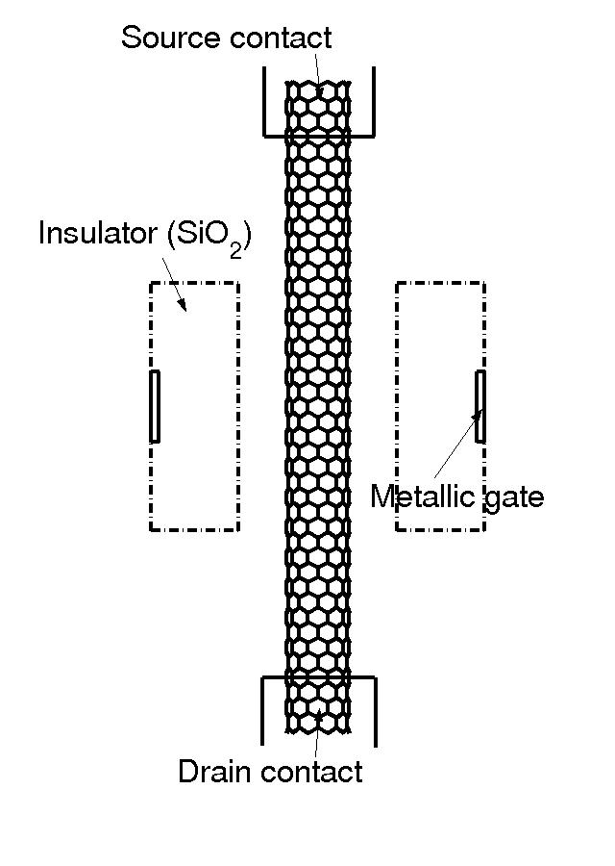
Coaxially gated CNTFET
Working mechanisms:
Schottky barrier modulation
at the contacts
local modulation of
channel conductance
Model:
semiconducting CNT(10,0)
neglect Schottky barrier
Charge injection from p-doped
CNT contacts

Slide 7
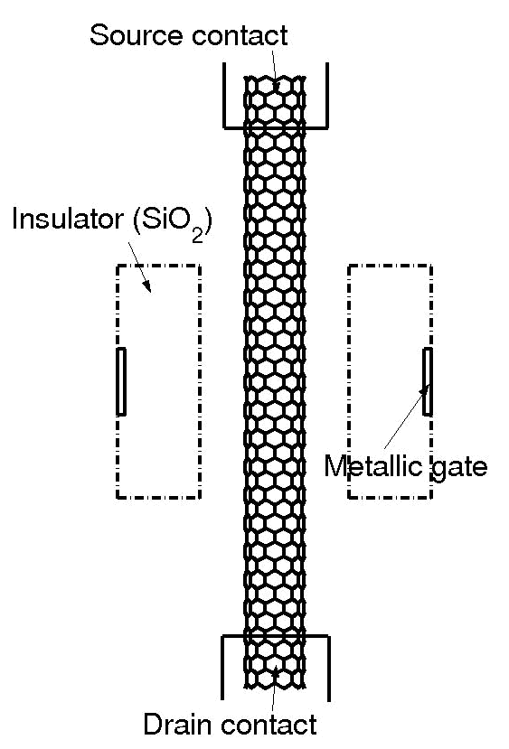
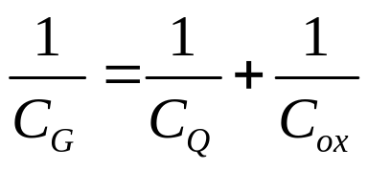
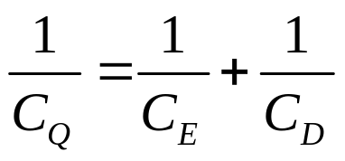
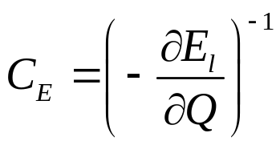

CNTFET control capacities
V_{g}
C_{S}
C_{ox}
V_{CNT}
C_{Q}
C_{G}
C_{G}
C_{D}
(S.Luryi, Appl.Phys.Lett. 52, 501 (1988), sistemi 2DES)

Slide 8
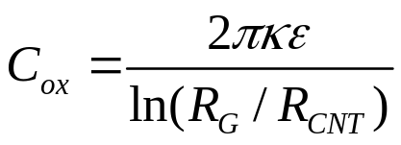
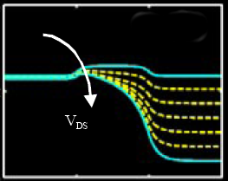
Gate capacitance
Gate is a Macroscopic metal
Oxide
CNT
In a classic MOS C_{Q} >> C_{ox} => modulation depends on C_{ox}
In a well-tempered MOS C_{G} >> C_{S},C_{D}
In 1D systems C_{Q} is small
V_{ds} can influence the channel charge and barrier

Slide 9
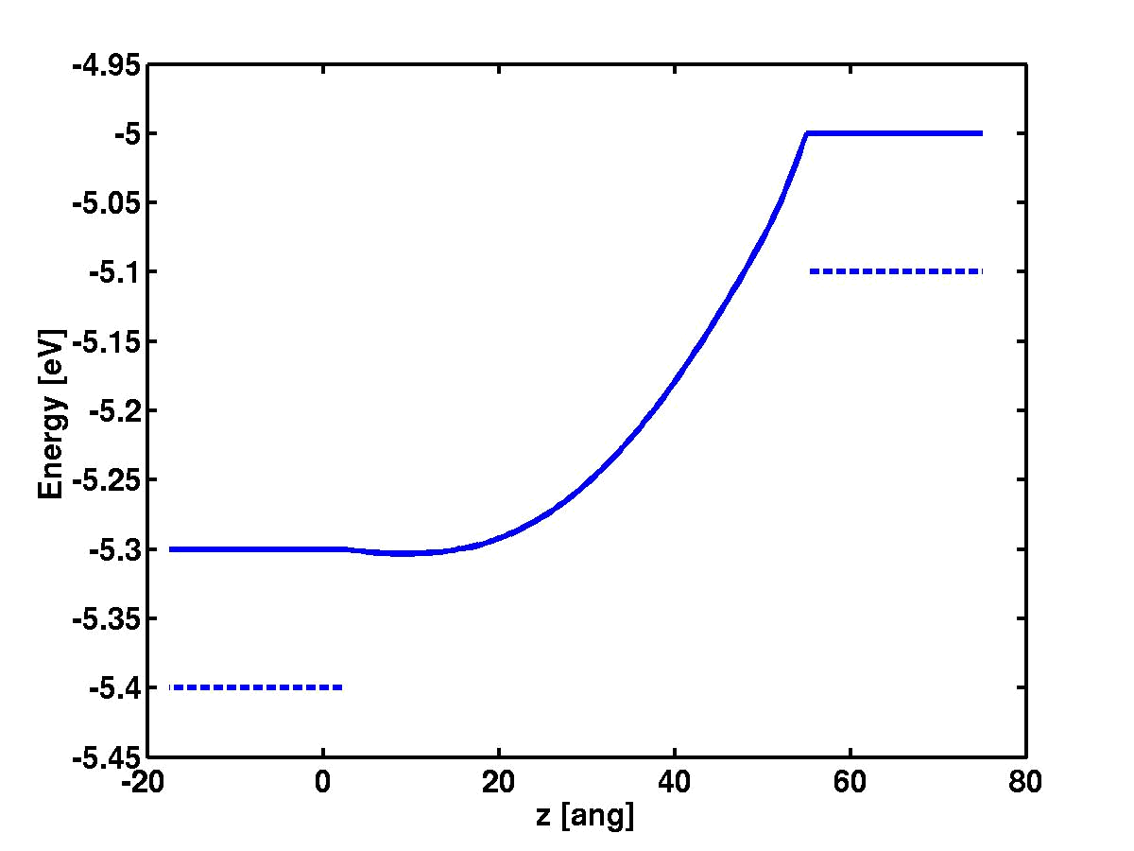
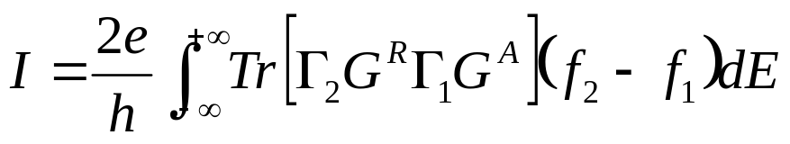
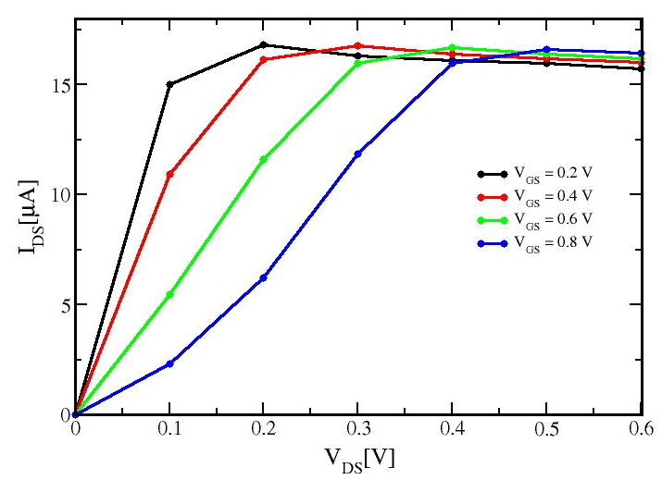
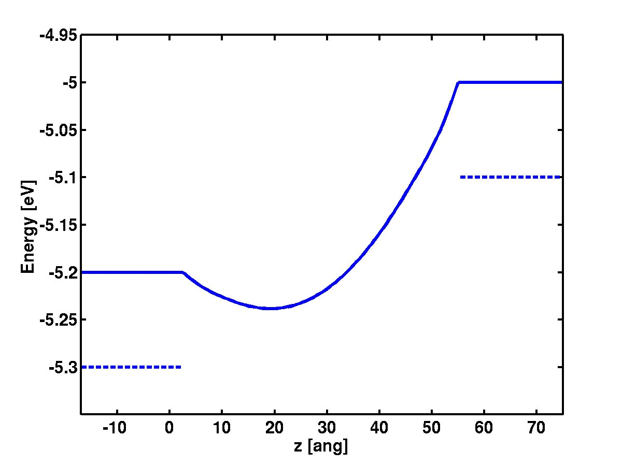
Caratteristiche di uscita I_{DS}/V_{DS}
Drain
Source
Drain
Source

Slide 10
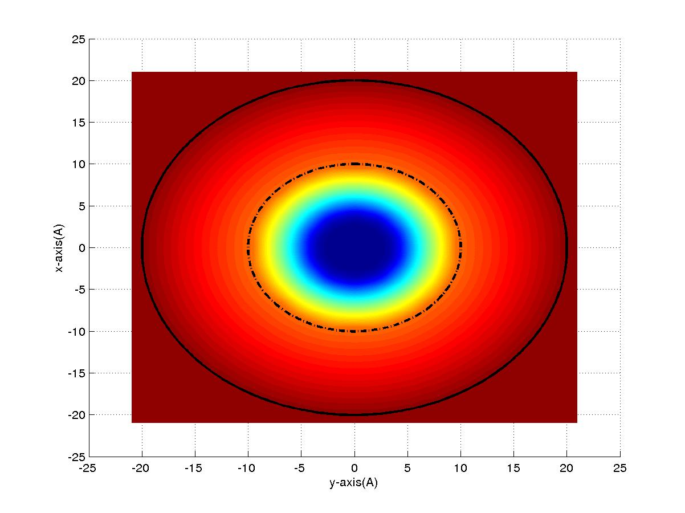
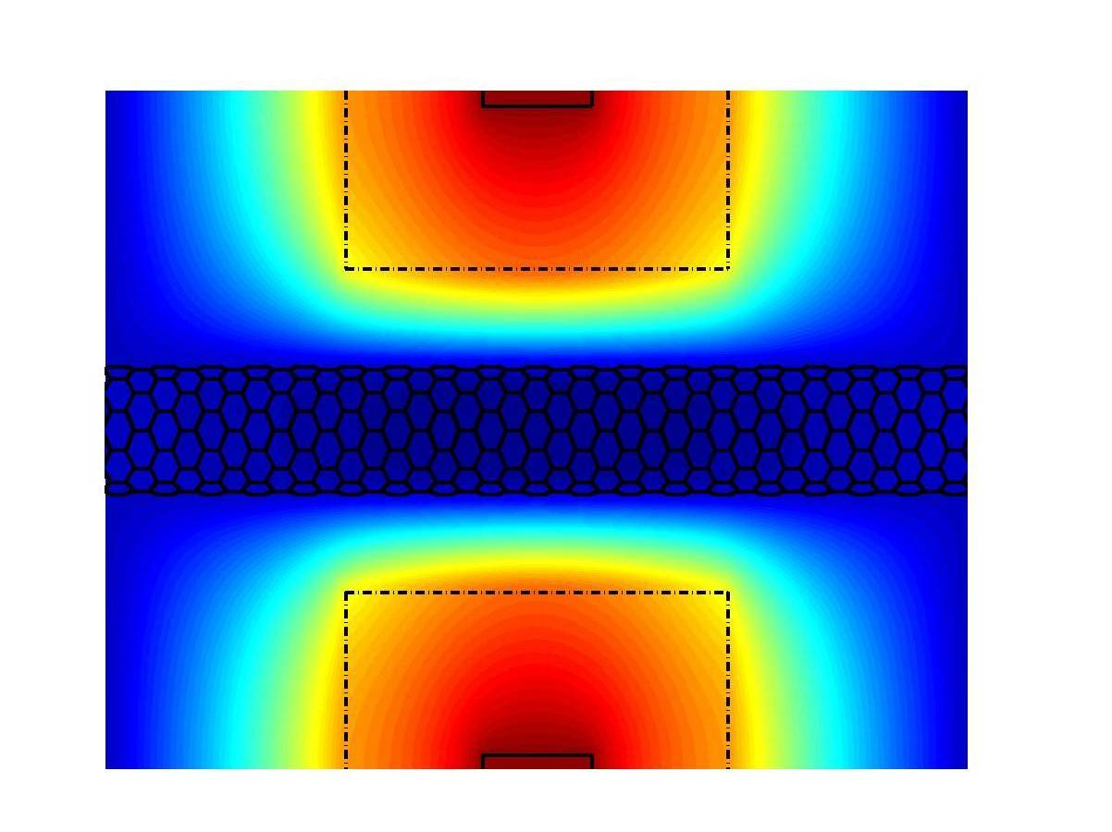
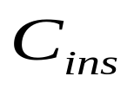
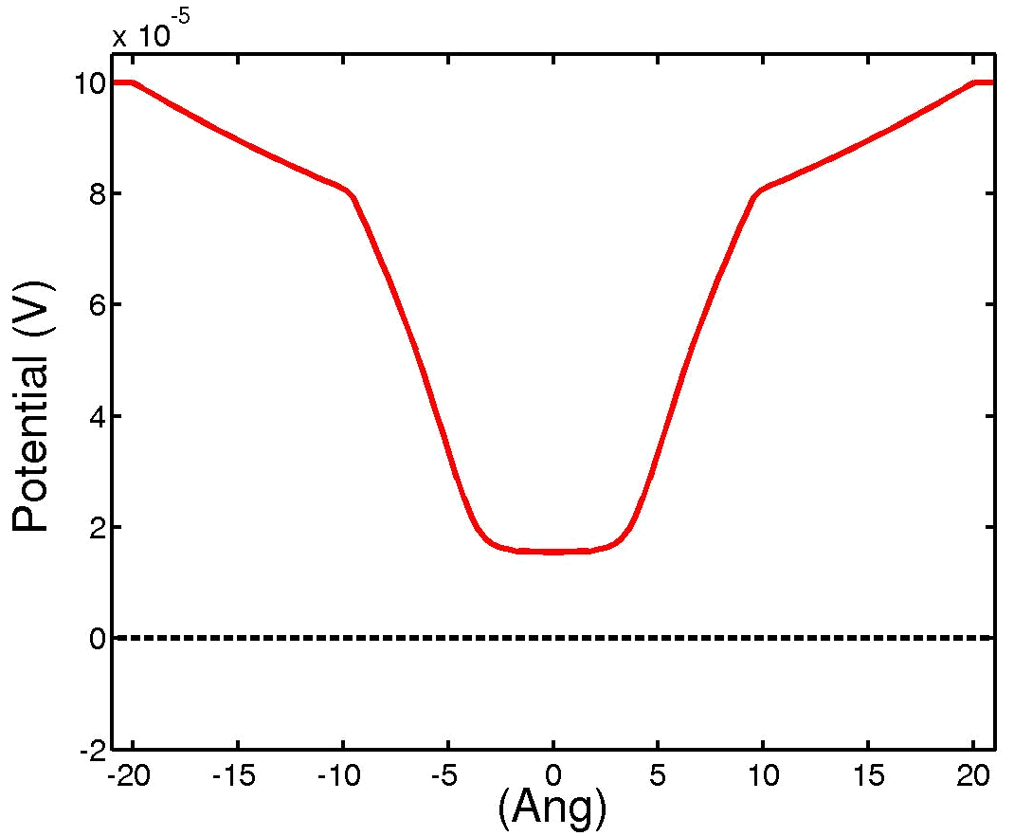
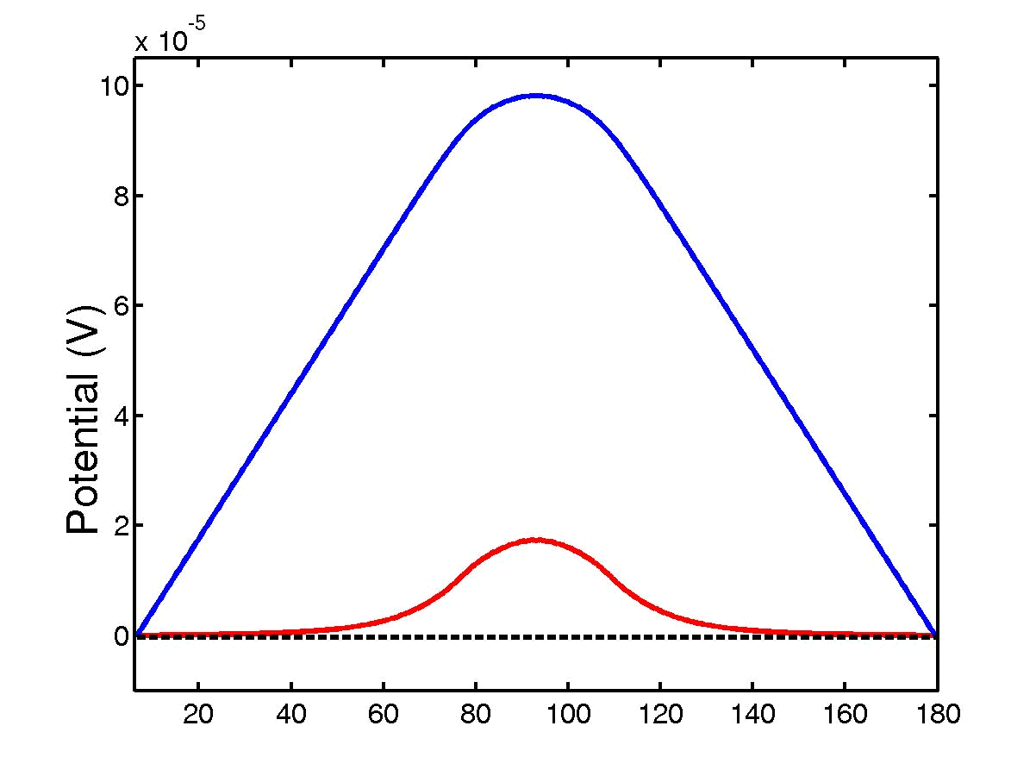



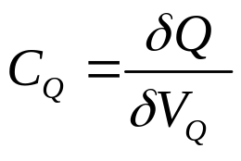
Calculation of C_{Q}
Bare Potential
Partial Screening

Slide 11
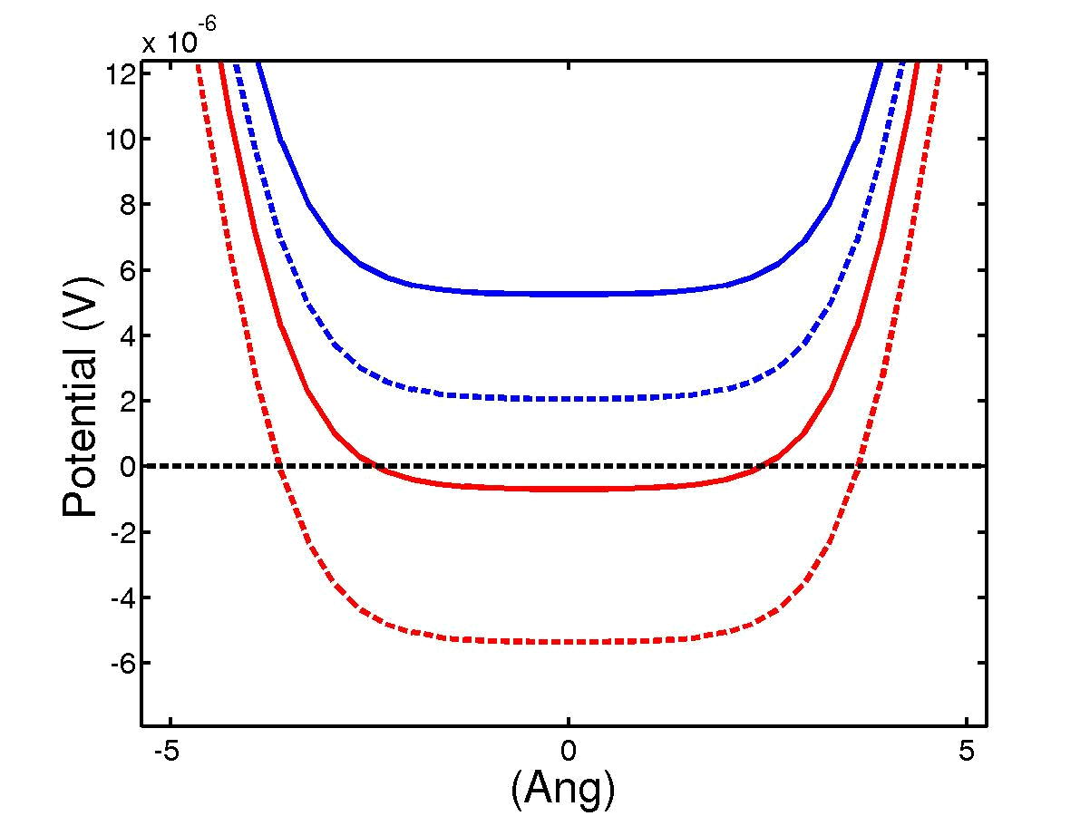
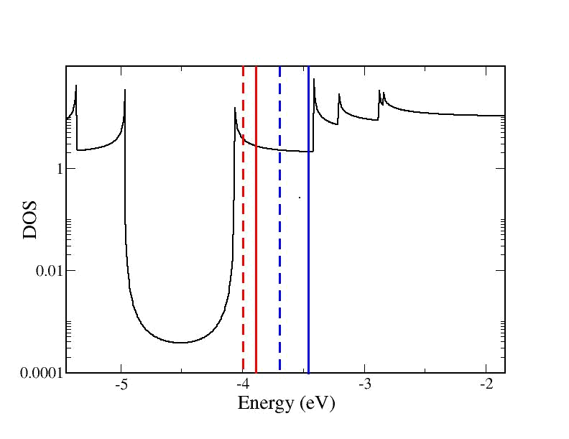
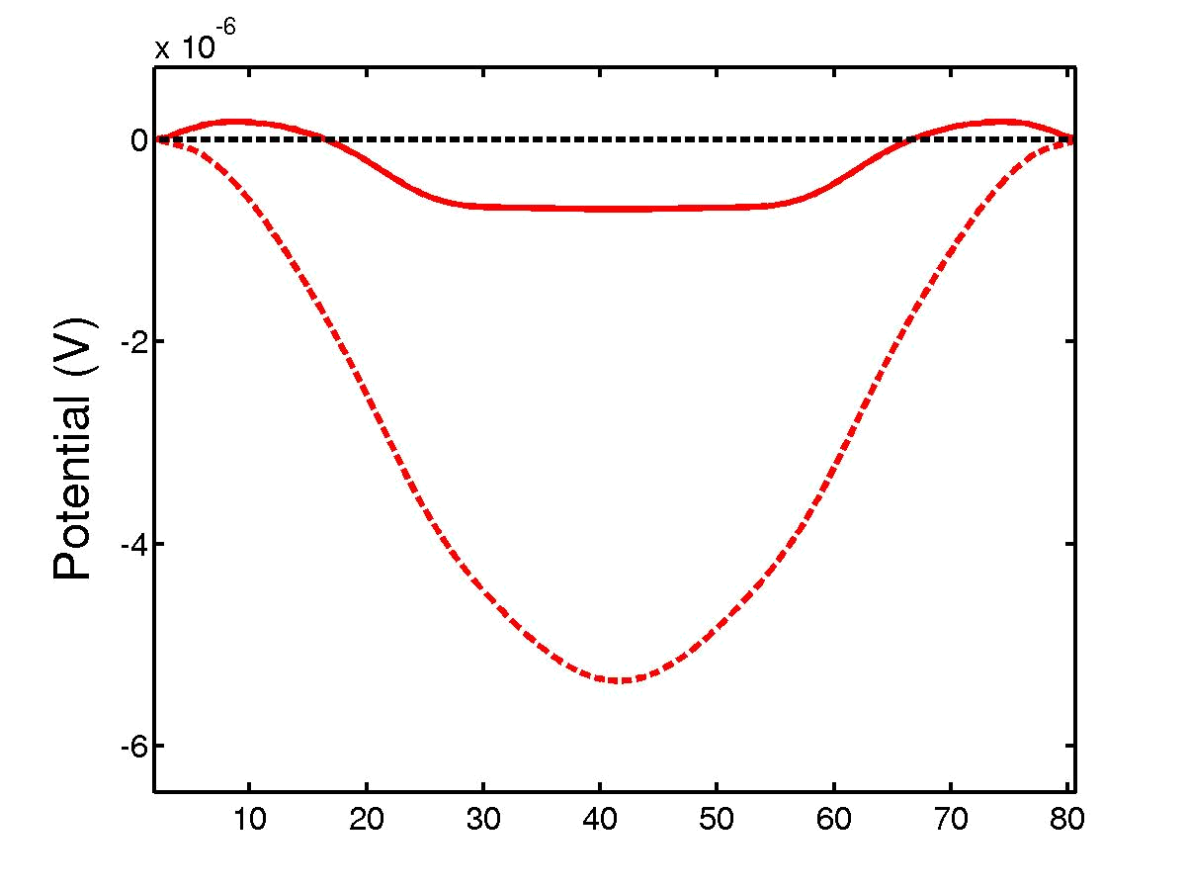
Over-screening in CNT
r_{s}=5.03
r_{s}=6.71
r_{s}=10.06
r_{s}=20.12
r_{s}=6.71
r_{s}=5.03
Negative C_{Q} C_{tot} > C_{ins}
The can CNT better than a metal!

Slide 12
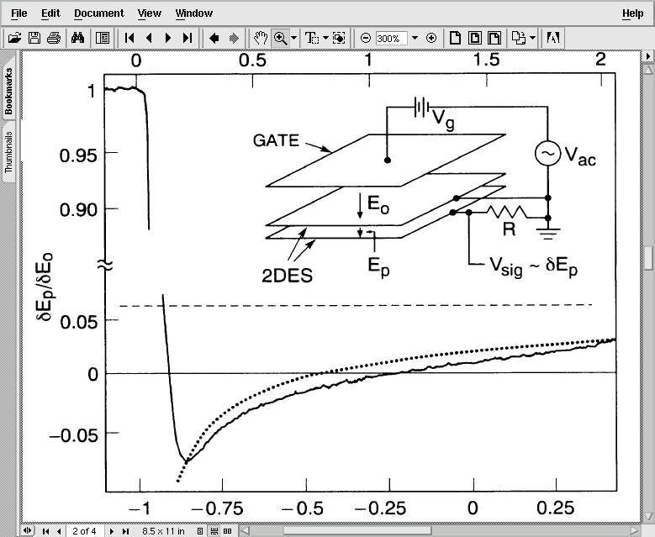
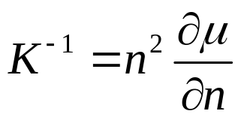
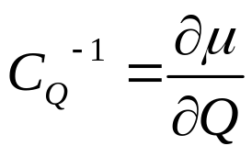
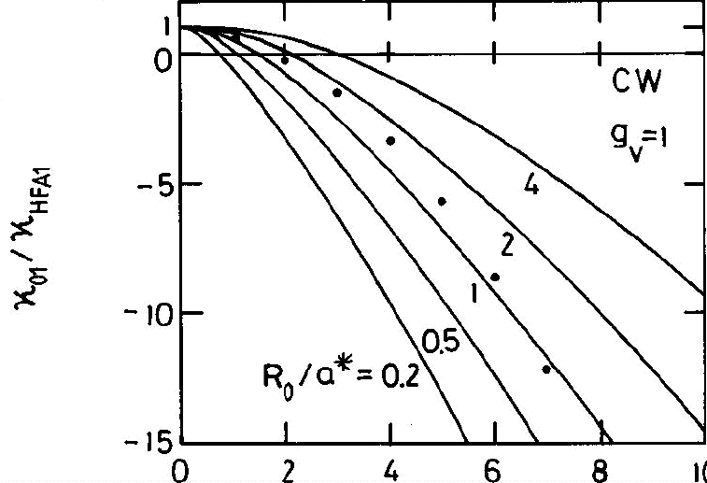
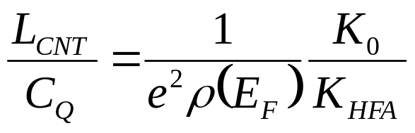
Negative compressibility
Experimental measurements in
GaAs quantum wells
J.P.Eisenstein et al., Phys.Rev.Lett. 68, 647 (1992)
⇐⇒
Analytic results for quasi-1D electron systems
L.Calmels, A.Gold, Phys. Rev.B. 53, 10846 (1996)
K₀ : free electrons compressibility
K_{HFA}: Hartree-Fock exchange compress.

Slide 13
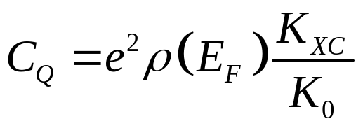
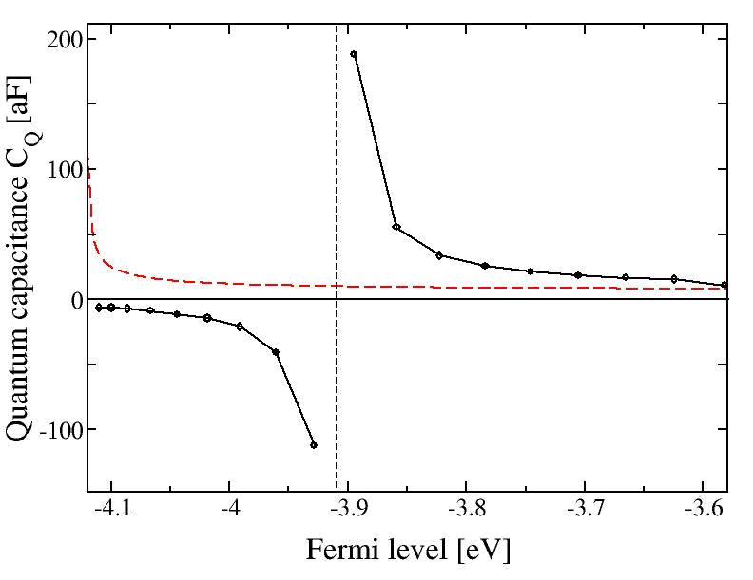
Many-body exchange effect
Calcolo DFT
Charge carrier density n_{C}: TOTAL SCREENING
CNT ~ macroscopico
C_{Q}= e²ρ(E_{F})
High density:
PARTIAL SCREENING
Dominated by DOS
Low density: OVER-SCREENING
Exchange interaction preveal

Slide 14
XC in gDFTB
In DFTB the XC term is treated with a Hubbard on-site energy
Substituting U_{H} with U_{ee} accounts only for Hartree
r_{s}=5.03
r_{s}=6.71
r_{s}=10.06
r_{s}=20.12
The capacity becomes positive again

Slide 15
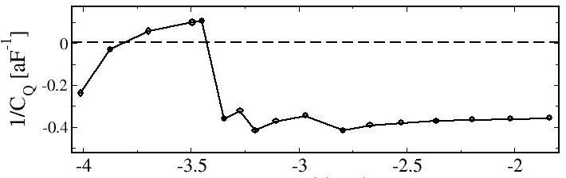
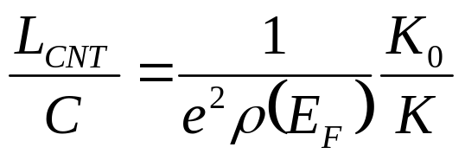
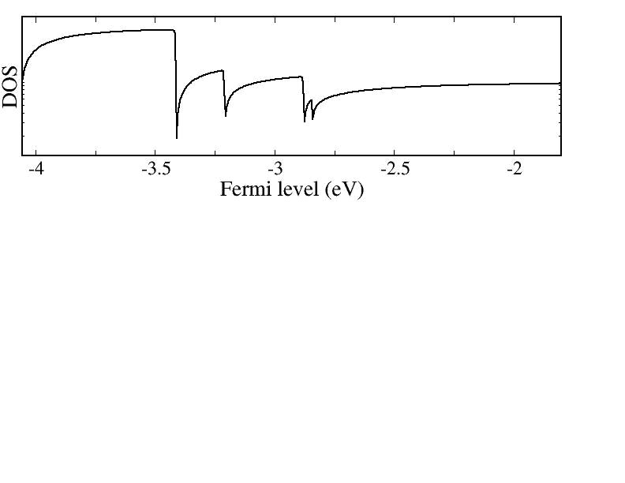
Quantum Capacitance vs DOS
1/DOS

Slide 16
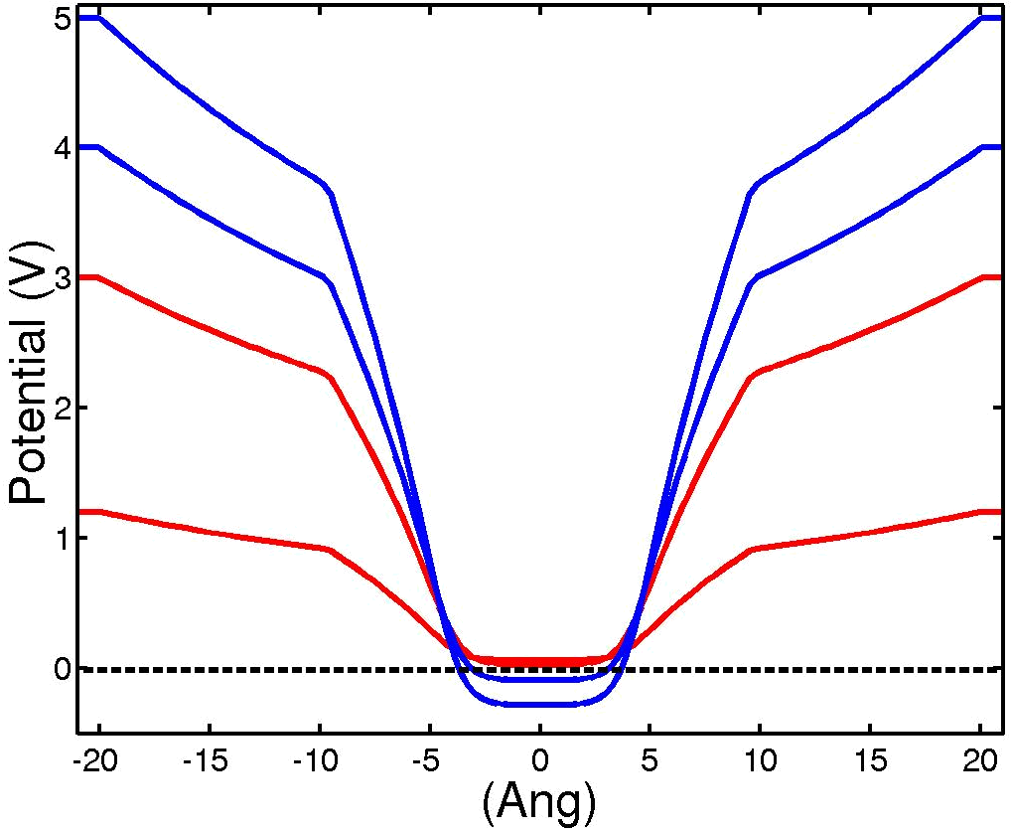
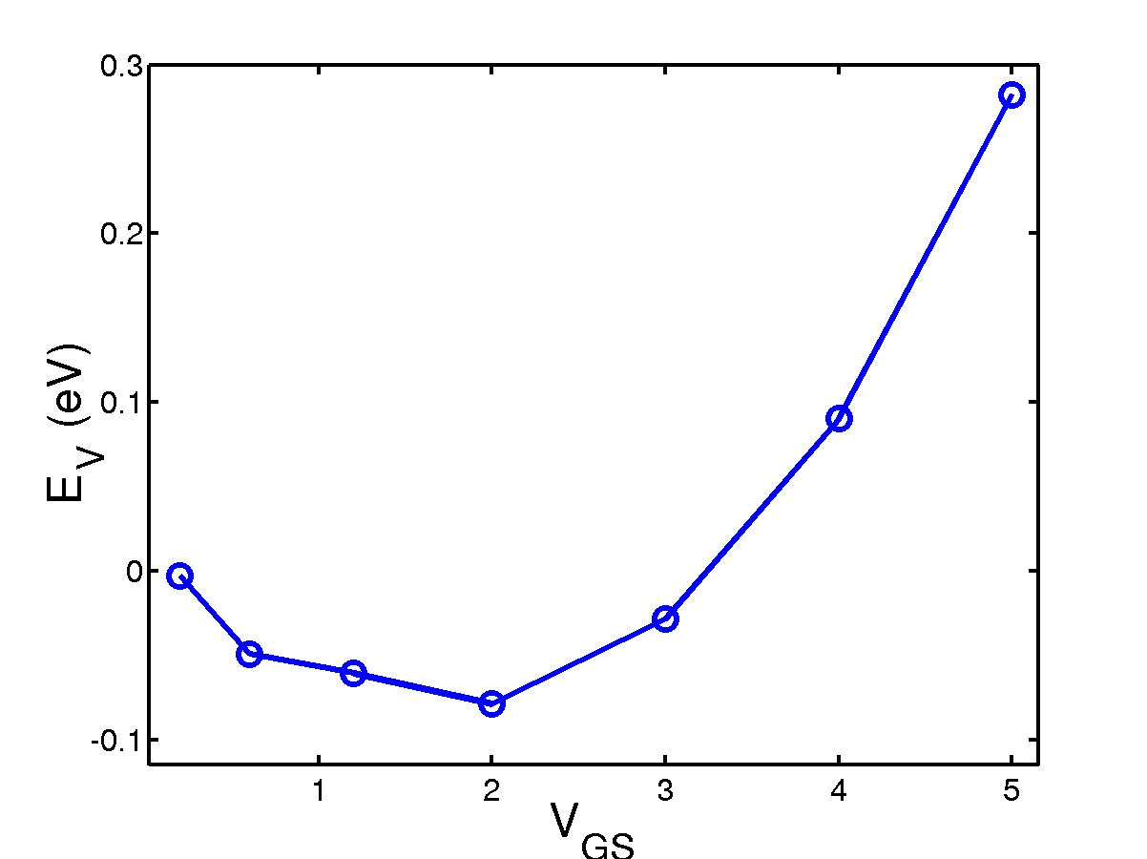
Over-screening and modulation
V_{GS}
Unconventional Trans-characteristics
Possible applications ?
V_{GS}

Slide 17
Conclusions
Comprehensive calculation of Quantum Capacity in a CNT(10,0) using NEGF
XC effects can give deviations from “classical” C_{Q}
Negative C_{Q} below a crytical carrier density which compares well with analytic results in quasi 1D systems
More complicated behaviour when more subbands are occupied

