Slide 1


WEB PAGE DATA FLOW
DATABASE
PHP
PYTHON

Slide 2
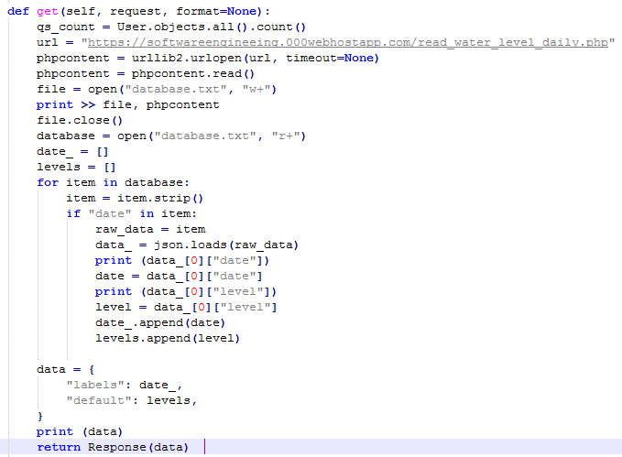
Important Python Code
views.py (extract data from php file)
Package needed: Code:
import json
import urllib2

Slide 3
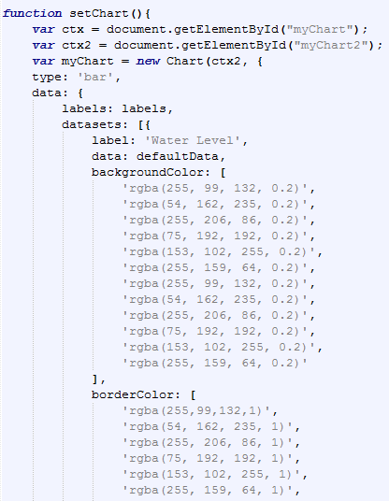
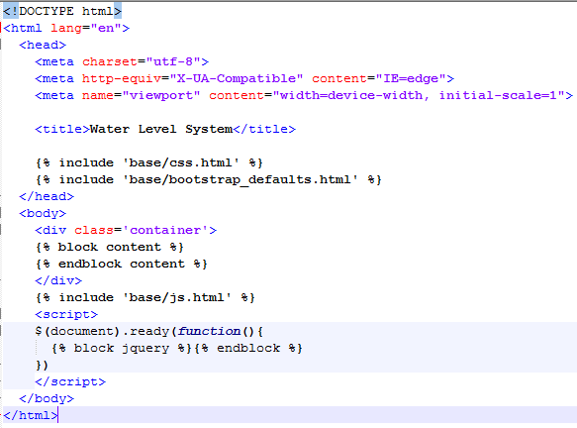
html file for graph specification
chart.html: base.html:

Slide 4
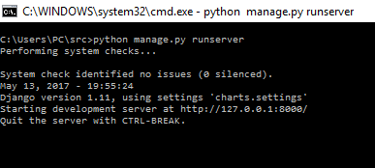
Steps to produce web page
Run the manage.py:
Goto: http://127.0.0.1:8000

