Slide 1
Element in Web Server

Slide 2
Data Flow

Slide 3
Backup

Slide 4
Web server
https://softwareengineeing.000webhostapp.com

Slide 5
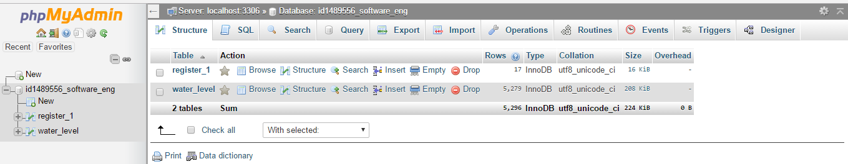
Database

Slide 6
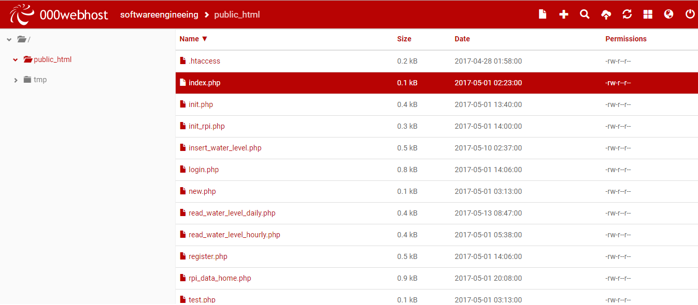
php files

