Slide 1

Car Pool
Ride Share Website

Slide 2
Agenda
Team Introduction
Our Project
Development Process Model
Project Activities Timeline
Tools and technologies
Use case diagram
System Architecture
Domain Model
Class Diagram
Database Schema
Project Demo

Slide 3
Team Introduction
Zuha Agha (Leader)
Aisha Mushtaq
Ali Raza
Mohsin Ali
Documentation, Interface designing
Documentation, Implementation
Interface Designing, Testing
Implementation, Testing

Slide 4
Carpool
Provides a car-sharing service to students commuting to and from LUMS
Help save resources by sharing
People with transport can optimize on cost of travel
Reduce the vehicle fleet on-campus

Slide 5
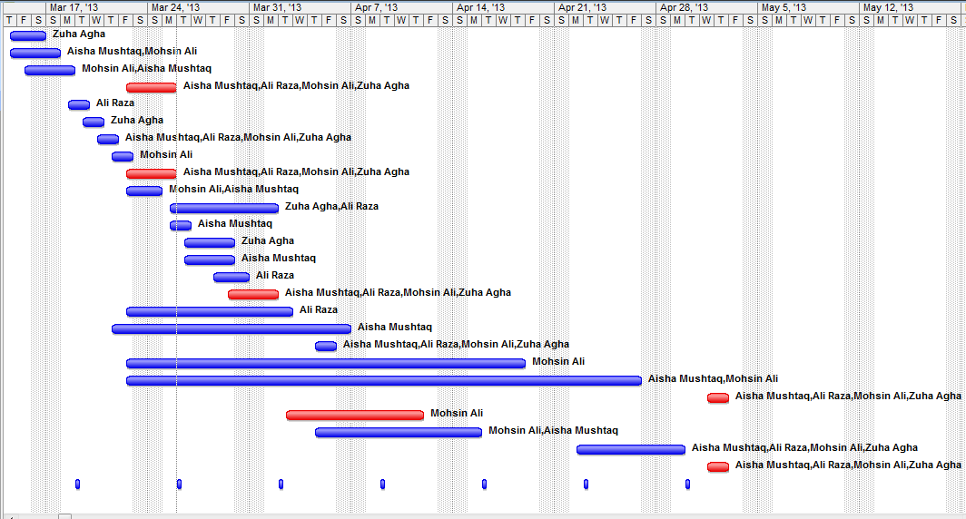
Project Timeline

Slide 6
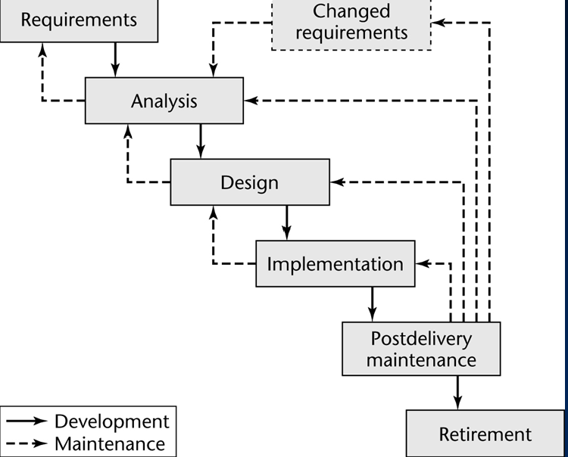
Developmental Process
Waterfall Life -Cycle Model

Slide 7
Tools and Technologies
MySQL (Wamp)
HTML and PHP
Photoshop
Axure
Microsoft Visio

Slide 8
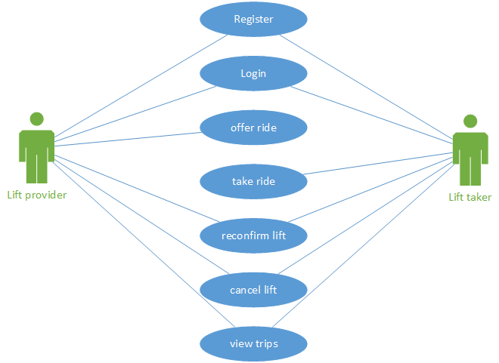
Use Case Diagram

Slide 9
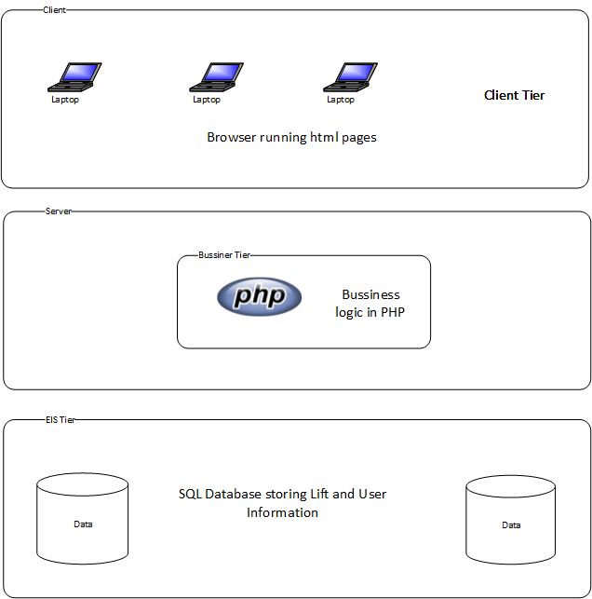
System Architecture

Slide 10
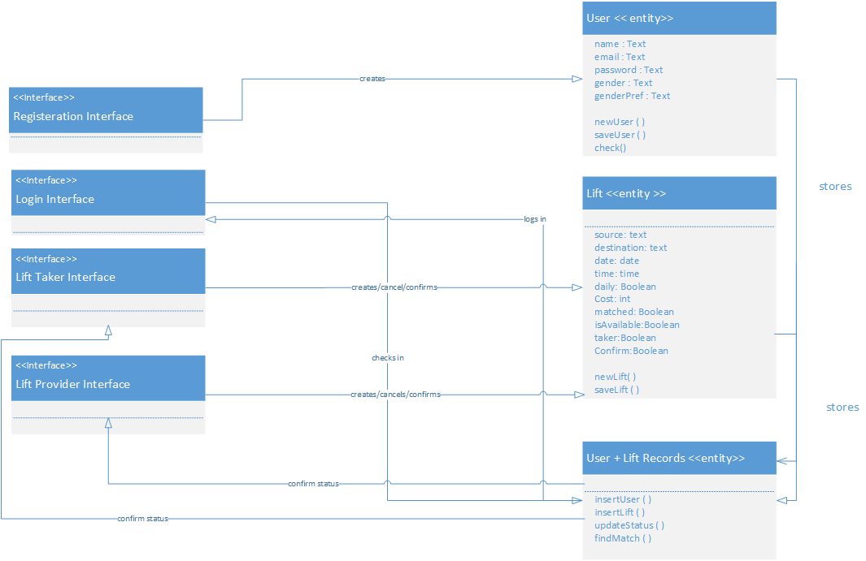
Class Diagram

Slide 11
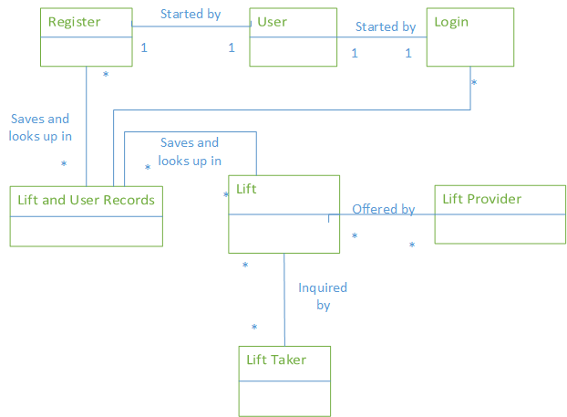
Domain Model

Slide 12
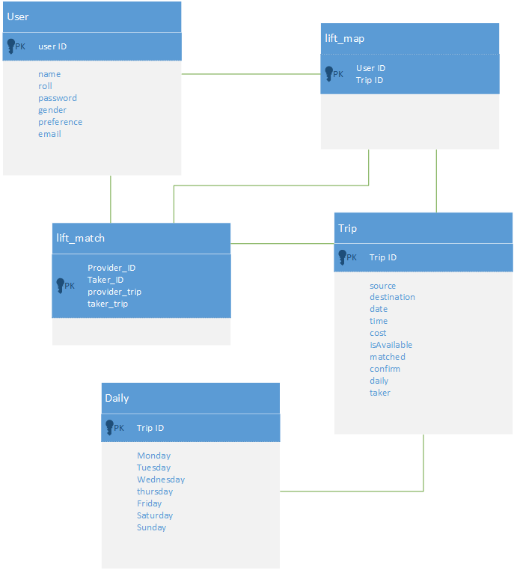
Database Schema

Slide 13
Demo

