Slide 1
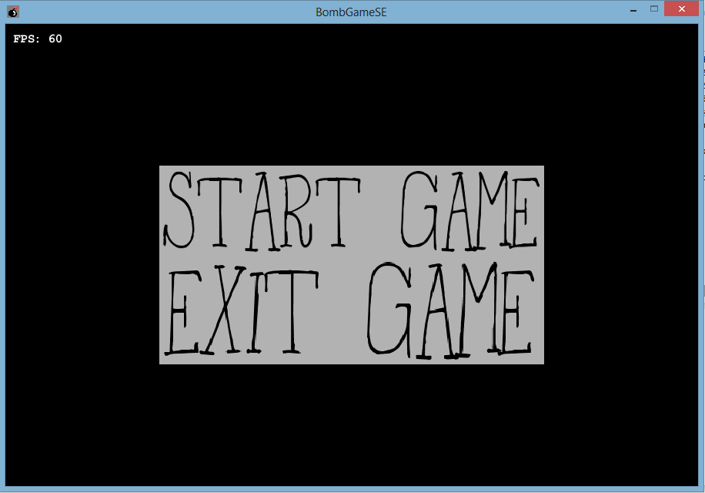
BombGameSE

Slide 2
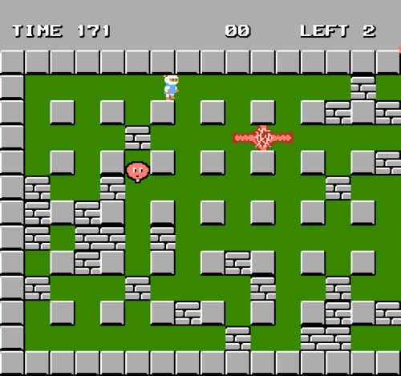
Create a bomberman clone featuring:
Standard bomberman game functions
AI
Random maze generation
Scalable
TUI/GUI

Slide 3
Architecture goals
MVC-structure
Code coverage 100% (except GUI/TUI)
Run GUI/TUI simultaneously
provide 0% code duplication
provide 0% tangle index
use interfaces and components

Slide 4
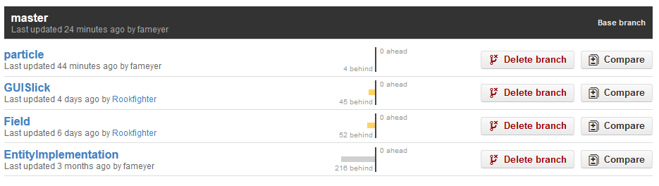
Project environment
Hosted on Github (documentation in markdown)
Jenkins for CI
Sonar for quality management
Code coverage: EclEmma

Slide 5
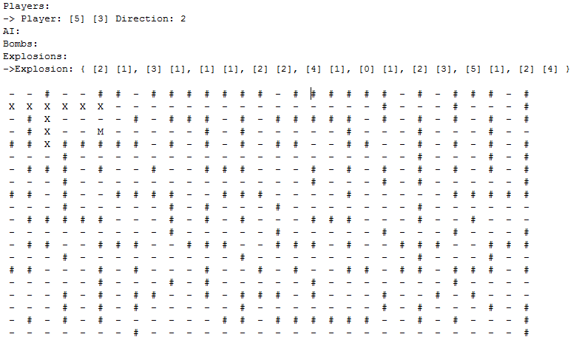
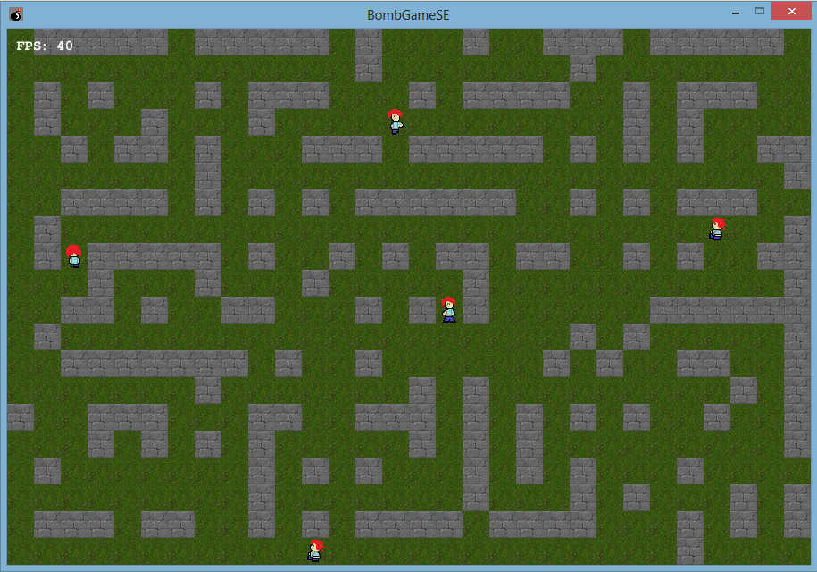
TUI/GUI

Slide 6
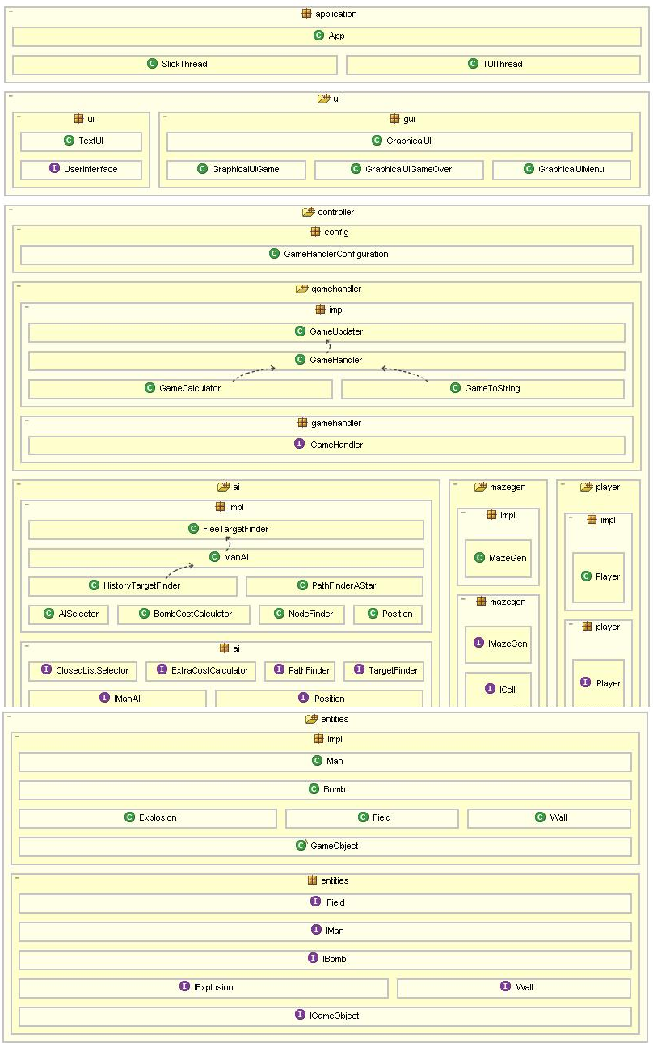
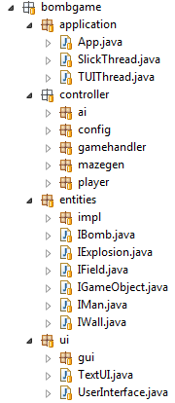
MVC Structure

Slide 7
GameField[][] (2D Array)
Wall
Explosion
Man
X
Bomb
Y
Player
Holds status

Slide 8
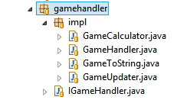
GameHandler
Central logics component
> Moves objects
> Correct object spawn
> Calculates explosion
> Update Field

Slide 9

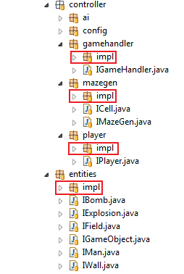
Interfaces
Only interfaces are used
Concrete creation -> Factory:
GameHandlerConfiguration
Holds the game config
Nr. of Ais, width, height, …

Slide 10

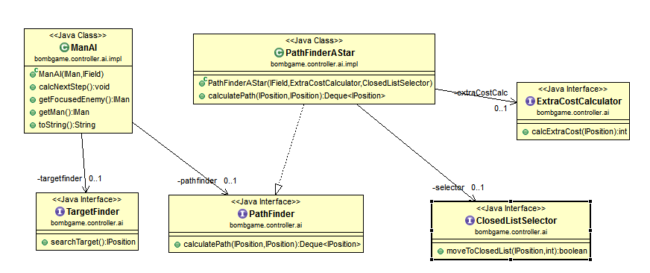
Patterns
Strategies in AI

Slide 11
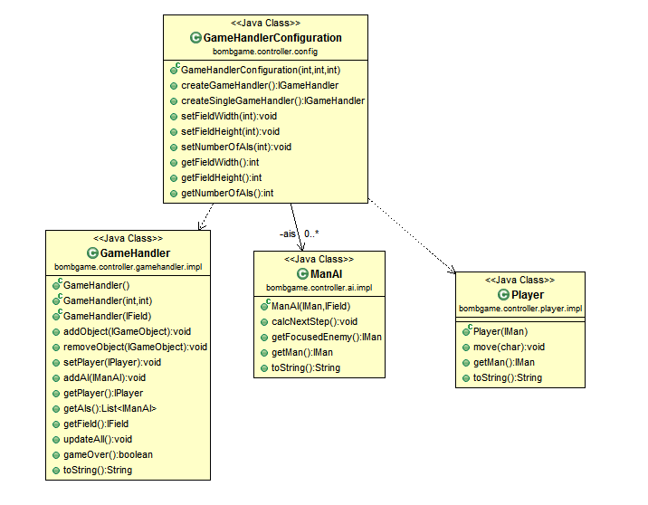
Patterns
Factory GameHandlerConfiguration

Slide 12
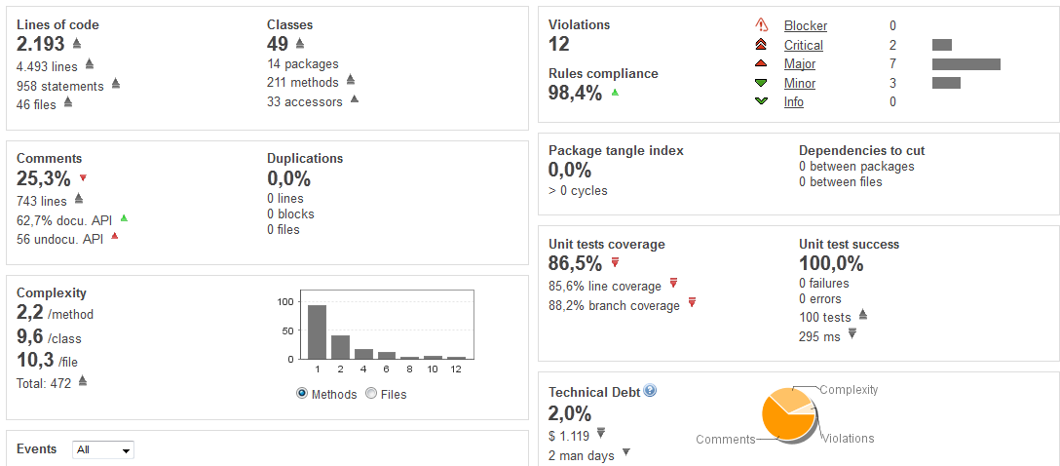
Sonar Metrics

Slide 13
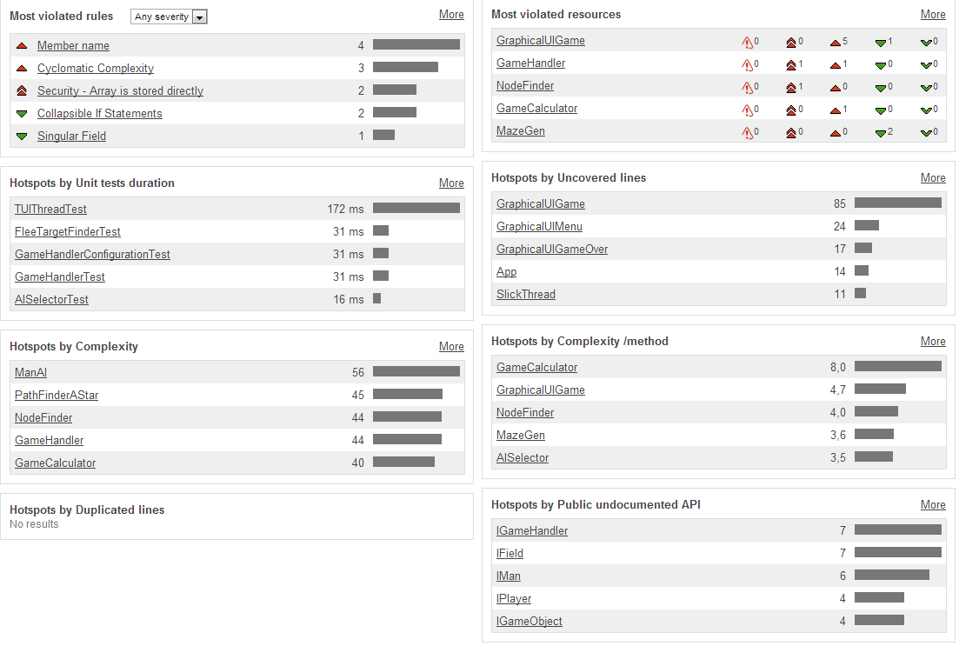
Hotspots

