Slide 1
Term Project Prototype Software Demo
Software Squad
Mariah, Todd, James, Quinn
18 October 2017

Slide 2
Star List
Star List is a website that allows users to buy and sell items online. Each user has a profile which contains their name, email address, and a rating.
Star List is built on Ruby on Rails with a MySQL database. We use RubyMine as our main development IDE, Github for version control, and Trello for project Management.

Slide 3
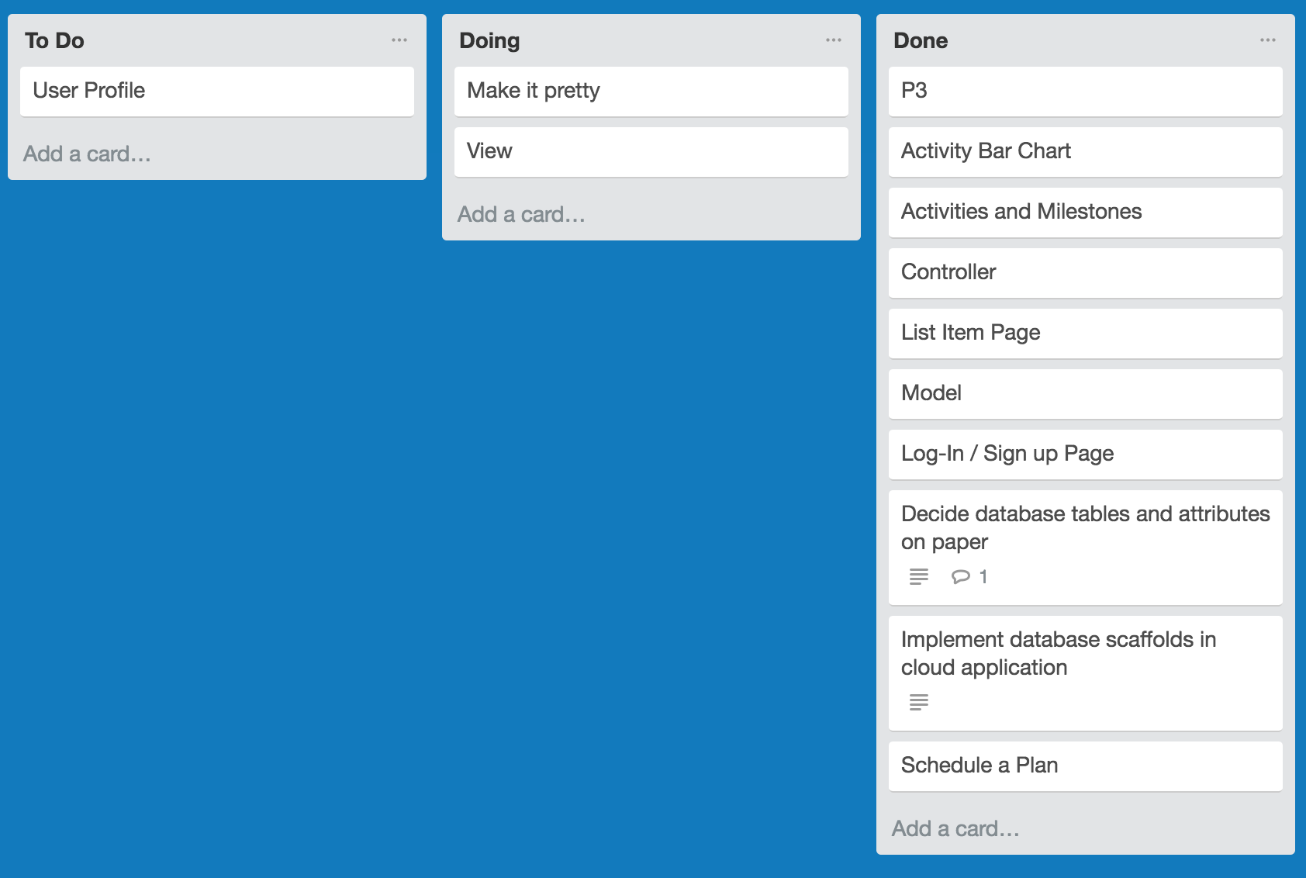
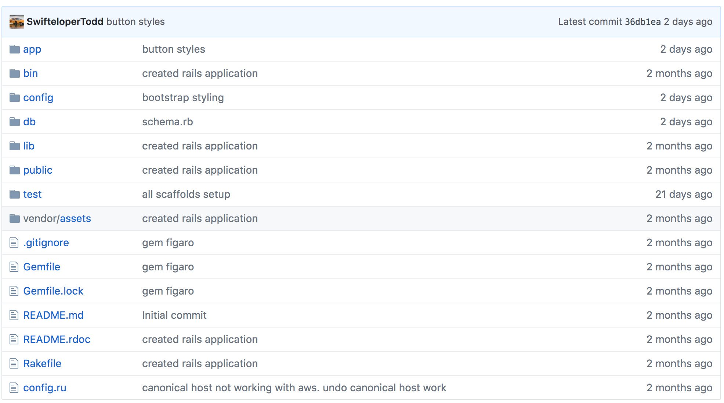
Demo
Demonstrate
http://software-squad.com
Management
Trello
Github

Slide 4
Goodbye

