Slide 1
line 25
line 29
breakpoint hit
3
2
1
lastChange
lastChange
trace

Slide 2


bar id at the reproduction point : 1010

Slide 3

foo scope id at the reproduction point : 55

Slide 4
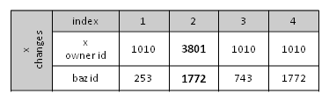

bar id at the reproduction point : 3801

