Slide 1

Real-Time Flight Stabilization System for Fixed
Wing RC Aircraft Using ESP32 and MPU6050 with
WiFi based Wireless Ground Control Station
Firmware · WiFi Ground Control Station · GCS Helper
Arjun Veeramony(7219119)
M.Sc. Embedded Systems Engineering
Project Thesis
FH Dortmund - University of Applied Sciences and Arts
Supervisor: Prof. Dr. Björn Schäfer

Slide 2
How a Plane Actually Flies
Wings generate lift as air flows over them. The aircraft is steered by deflecting three control surfaces, each rotating the plane around one of its three axes:
PITCH
ROLL
YAW
Elevator (tail)
Ailerons (wings)
Rudder (tail fin)
Nose up / down - rotation around the lateral axis. Controls climb and descent.
Wing tilt left / right — rotation around the longitudinal axis. Banks the aircraft into turns.
Nose left / right — rotation around the vertical axis. Coordinates turns.
Stable flight = continuously holding the desired pitch and roll attitude against every disturbance.

Slide 3
The Need for a Flight Stabilization System
Inherent instability
A fixed-wing aircraft never stays put - every gust, thermal and turbulence pocket constantly pushes it off attitude.
Weather is unpredictable
Crosswinds and gusts arrive faster than a human can react. Corrections must happen many times per second, continuously.
Pilot workload
Hobby pilots must manage throttle, attitude and navigation simultaneously - a single lapse in attention may end in crash.
Small aircraft suffer most
Light foam RC planes have low inertia: disturbances that an airliner ignores will flip a model aircraft instantly.

Slide 4
Flight Stabilization System
A stabilizer is an electronic co-pilot: it senses the aircraft's attitude and automatically commands the control surfaces to hold it level — faster and more consistently than any human.
SENSE
COMPUTE
ACT
IMU measures pitch, roll & yaw rates 50× per second
→
Control law compares attitude to the desired reference
→
Servos deflect elevator & ailerons to cancel the error
…and the loop repeats every 20 ms (50 Hz), for the entire flight.
Rejects gusts and turbulence the moment they occur - before the pilot even notices
Lets the pilot focus on navigation while the system keeps the aircraft level
Acts as a safety net: release the sticks and the aircraft returns to stable flight

Slide 5
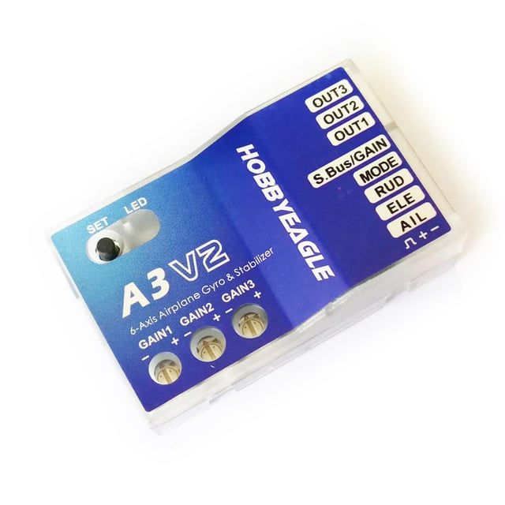
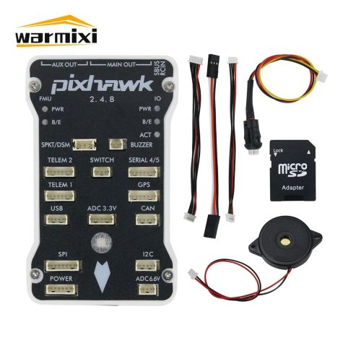
Existing Solutions: Gyro vs. Flight Controller
Hobby Gyro
Flight Controller
e.g. HobbyEagle A3 V2 · ~40–50 €
e.g. Pixhawk 2.4.8 · 100 €+ incl. GPS etc.
Simple rate damping — easy to set up
Gains tuned with a tiny physical screw/pot on the case
No wireless access, no telemetry, no live feedback
Re-tuning means landing, walking over, and turning a screwdriver
Full autopilot: GPS waypoints, missions, RTL, telemetry, Auto takeoff/landings…
Wireless tuning via ground stations (Mission Planner)
Steep learning curve, complex setup & calibration
Costly and overkill if you only want stable, level flight

Slide 6
My System: The Middle Ground
HOBBY GYRO
THIS PROJECT
FLIGHT CONTROLLER
cheap, but blind:
screwdriver tuning only
ESP32 stabilizer with
wireless live tuning
powerful, but costly
and overkill
← capability & cost →
Wireless gain tuning from a laptop — change PID & filter values mid-session over WiFi, no screwdriver, no reflashing
Live telemetry: real-time attitude HUD, RC stick monitor and diagnostics streamed over TCP
A fraction of the cost — built on a ~5 € ESP32 and a ~3 € MPU6050 IMU
Deliberately focused: attitude stabilization done well, without the complexity of a full autopilot stack

Slide 7
System Overview - Basic Structure
RC Receiver
Flight Controller
Actuators
4 PWM channels
sticks + autopilot switch
→
ESP32 + MPU6050 IMU
fusion · PID · 50 Hz loop
→
Pitch & roll servos
elevator + ailerons
pilot commands
PWM 45°–135°
Two modes: MANUAL - sticks drive the servos directly. STABILIZE - a switch on CH4 engages the stabilizer: the ESP32 holds the reference attitude via PID, while stick input still overrides per axis.

Slide 8
System Overview - Three Components
FIRMWARE
C++ on ESP32 (main.cpp)
sensor fusion · PID · RC input ·
TCP server · EEPROM config
WiFi · TCP port 12345
USB · serial 115200
FLIGHT GCS
GCS HELPER
Python · Tkinter + pygame
Live tuning of filters & PID · attitude HUD ·
RC monitor · diagnostics — all over WiFi
Python · USB toolbox
Serial monitor for boot logs & WiFi setup ·
.bin firmware flashing via esptool
In flight: wireless tuning & telemetry On the bench: flashing & configuration

Slide 9
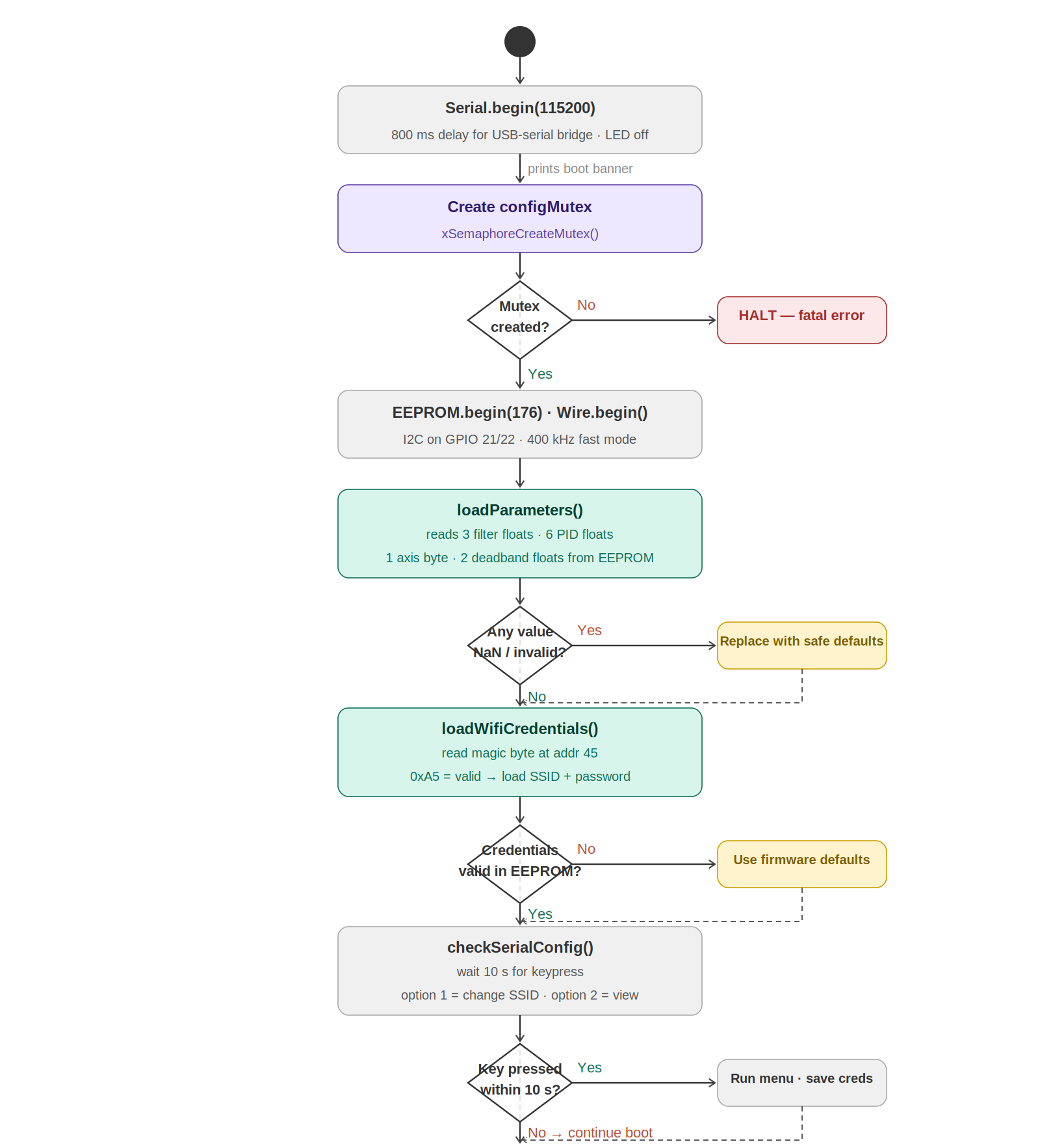
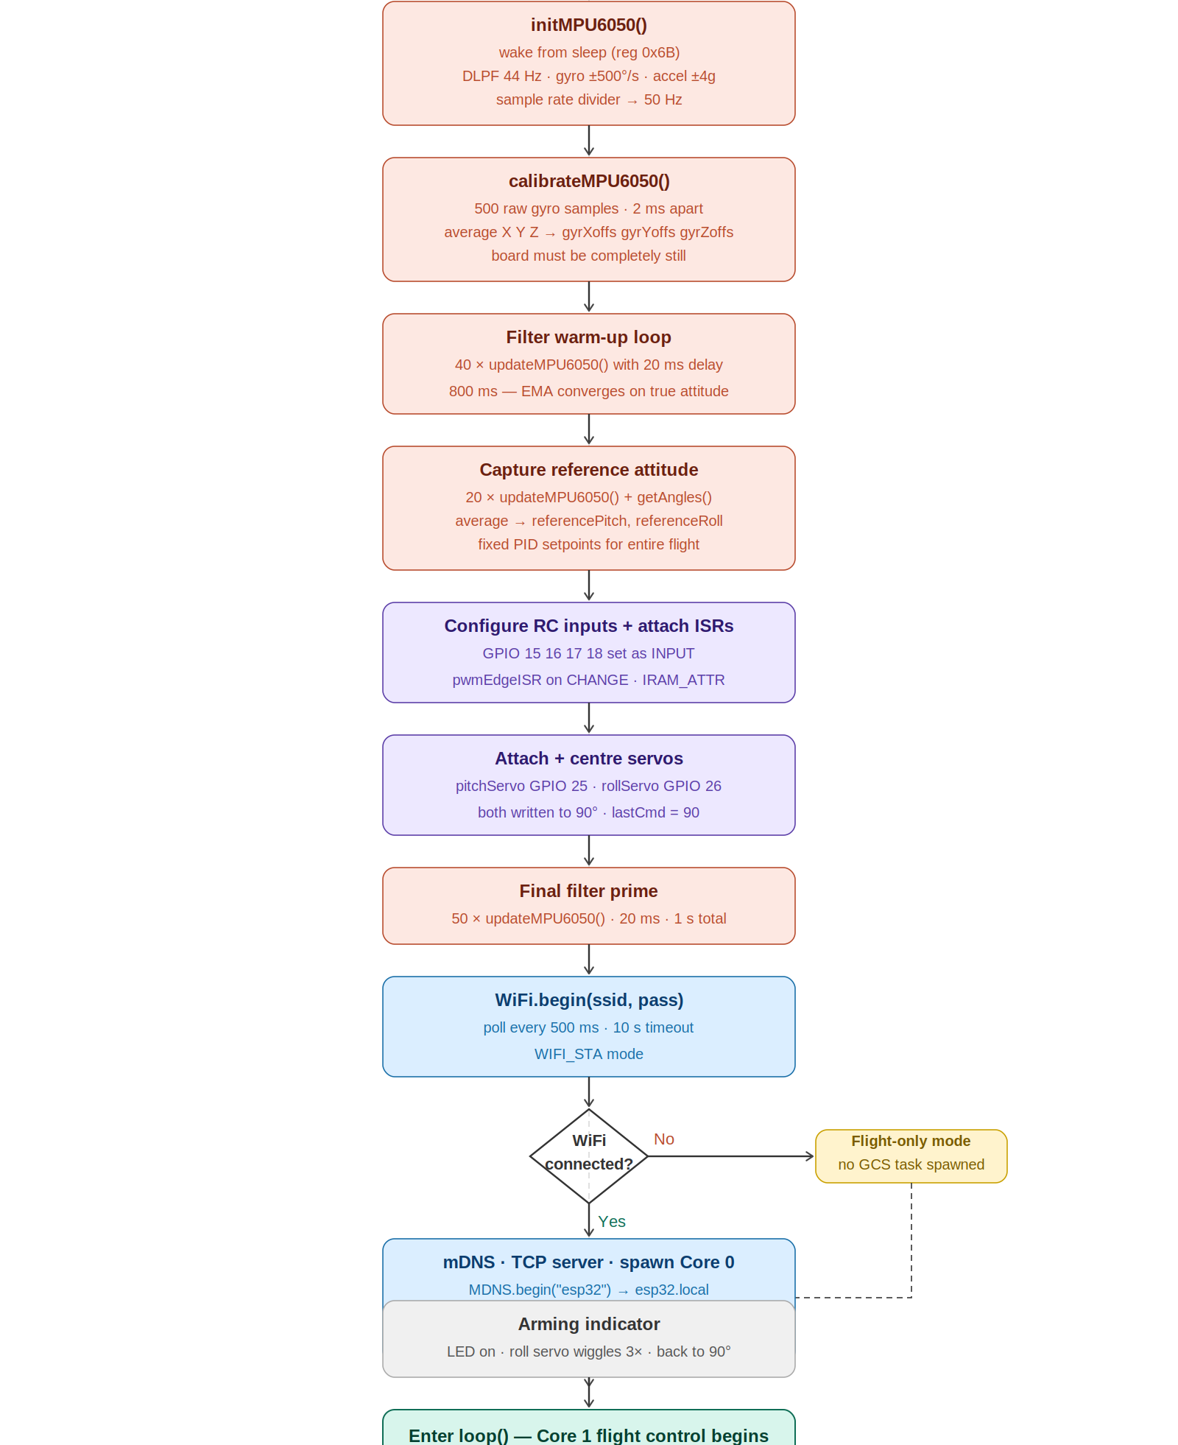
Firmware: Pre-Flight Setup (Boot Sequence)
Starts Serial Connection, creates mutex, initializes EEPROM and I2C
Load WiFi cred and other tunable param from EEPROM
10s wait lets Wifi cred be changed via serial comm without reflashing.
Initialize and calibrate MPU6050.
Sensor warmup.
Capture and lock in the reference attitude
Configure RC inputs and attach ISRs to i/p pins
Attach Servos and center it.
Connect to WiFi connected ? spawn CommTask : skip
Wiggle R-servos to notify setup is complete
Start flight control loop

Slide 10
From Raw Sensor to Servo Command - The Data Pipeline
1 · Raw sensor read (I2C)
MPU6050 burst-read → AcX,AcY,AcZ, GyX,GyY,GyZ (raw)
2 · Convert to physical units
fgy = (Gy − bias)/65.5 → °/s · accelPitch via atan2 → °
4 · np refined — complementary blend
np = np × 0.98 + accelPitch × 0.02
3 · np born — gyro integration
np = sensorPitch(old) + fgy × dt
5 · Saved to global — np dies
sensorPitch = np → persists to next 20 ms tick
6 · PID error vs. fixed setpoint
error = referencePitch − sensorPitch
8 · Servo command
commandAngle = 90° + pidOutput → clamp 45°–135° → writeMicroseconds()
7 · PID computes correction
pidOutput = Kp·error + Ki·∫error·dt + Kd·Δmeasurement
Key insight: np is a local, temporary variable — born from sensorPitch, refined each tick, then written back as sensorPitch. Only sensorPitch persists across the 20 ms cycle; np is recreated from scratch every time.
Notes:
sensorPitch convergence (200 iterations)
Setup
COMP_FILTER (α) = 0.02
True board tilt = 5.0°
fgy ≈ 0 (board not rotating)
accelPitch ≈ 5.0° (constant — board not moving)
dt = 0.02s (constant — 50Hz loop) => 1/50 => 0.02
sensorPitch(0) = 0.0° (C++ global default)
The recurrence
sensorPitch(n) = sensorPitch(n-1) or just np × 0.98 + 5.0 × 0.02
This is a standard exponential decay toward a target, with closed form:
sensorPitch(n) = 5.0 × (1 - 0.98^n)
65.5 is the MPU6050's hardware conversion factor for the ±500°/s range — "65.5 raw units = 1°/s." Dividing by it turns the sensor's meaningless integer output into a real angular velocity in degrees per second, which is the unit fgy needs to be in before it can be multiplied by dt to get an angle change.

Slide 11
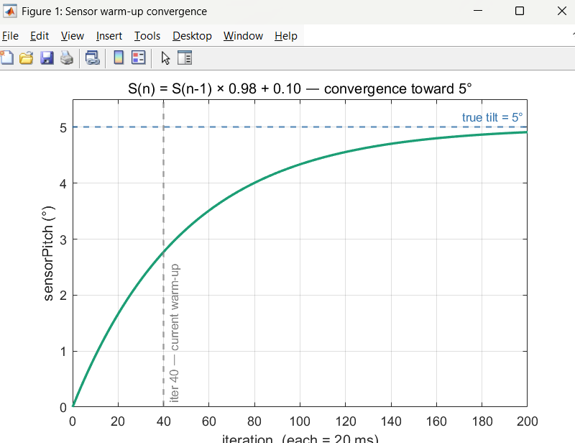
Why the Filter Must Warm Up Before Flight
The complementary filter blends 98% gyro integration + 2% accelerometer angle each tick. Its angle estimate starts at 0° and converges toward the true attitude gradually.
Without warm-up, the reference attitude would be captured while the estimate is still near zero - wrong PID setpoint for the entire flight
Fig: filter estimate converging from 0° to the true tilt(5 °) over ~200 iteration
Notes:
Convergence table — milestones
Iterations (n) Time elapsed 0.98ⁿ sensorPitch error from 5° %converged
0 0 s 1.0000 0.0000° 5.0000° 0%
10 0.2s 0.8171 0.9146° 4.0854° 18.3%
100 2s 0.1326 4.3372° 0.6628° 86.7%
200 4s 0.0176 4.9118° 0.0882° 98.2%

Slide 12
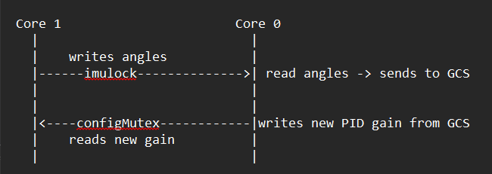
Two Cores, Two Loops
Core 1(flight loop): sensor → PID → servos, every 20 ms, always running from boot. Needs no WiFi, no GCS.
Core 0(communication task): spawned only if WiFi connects; accepts the GCS client, parses commands, streams telemetry.
Shared data crosses cores only through two guards: imuLock (spinlock, angle reads) and configMutex (parameter writes).
Result: a slow WiFi retransmit or TCP timeout can never delay a servo command — control and communication are fully isolated.

Slide 13
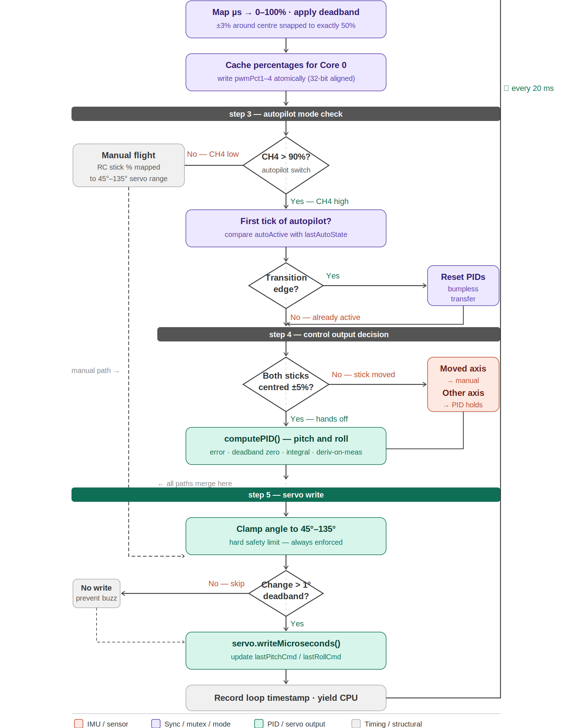
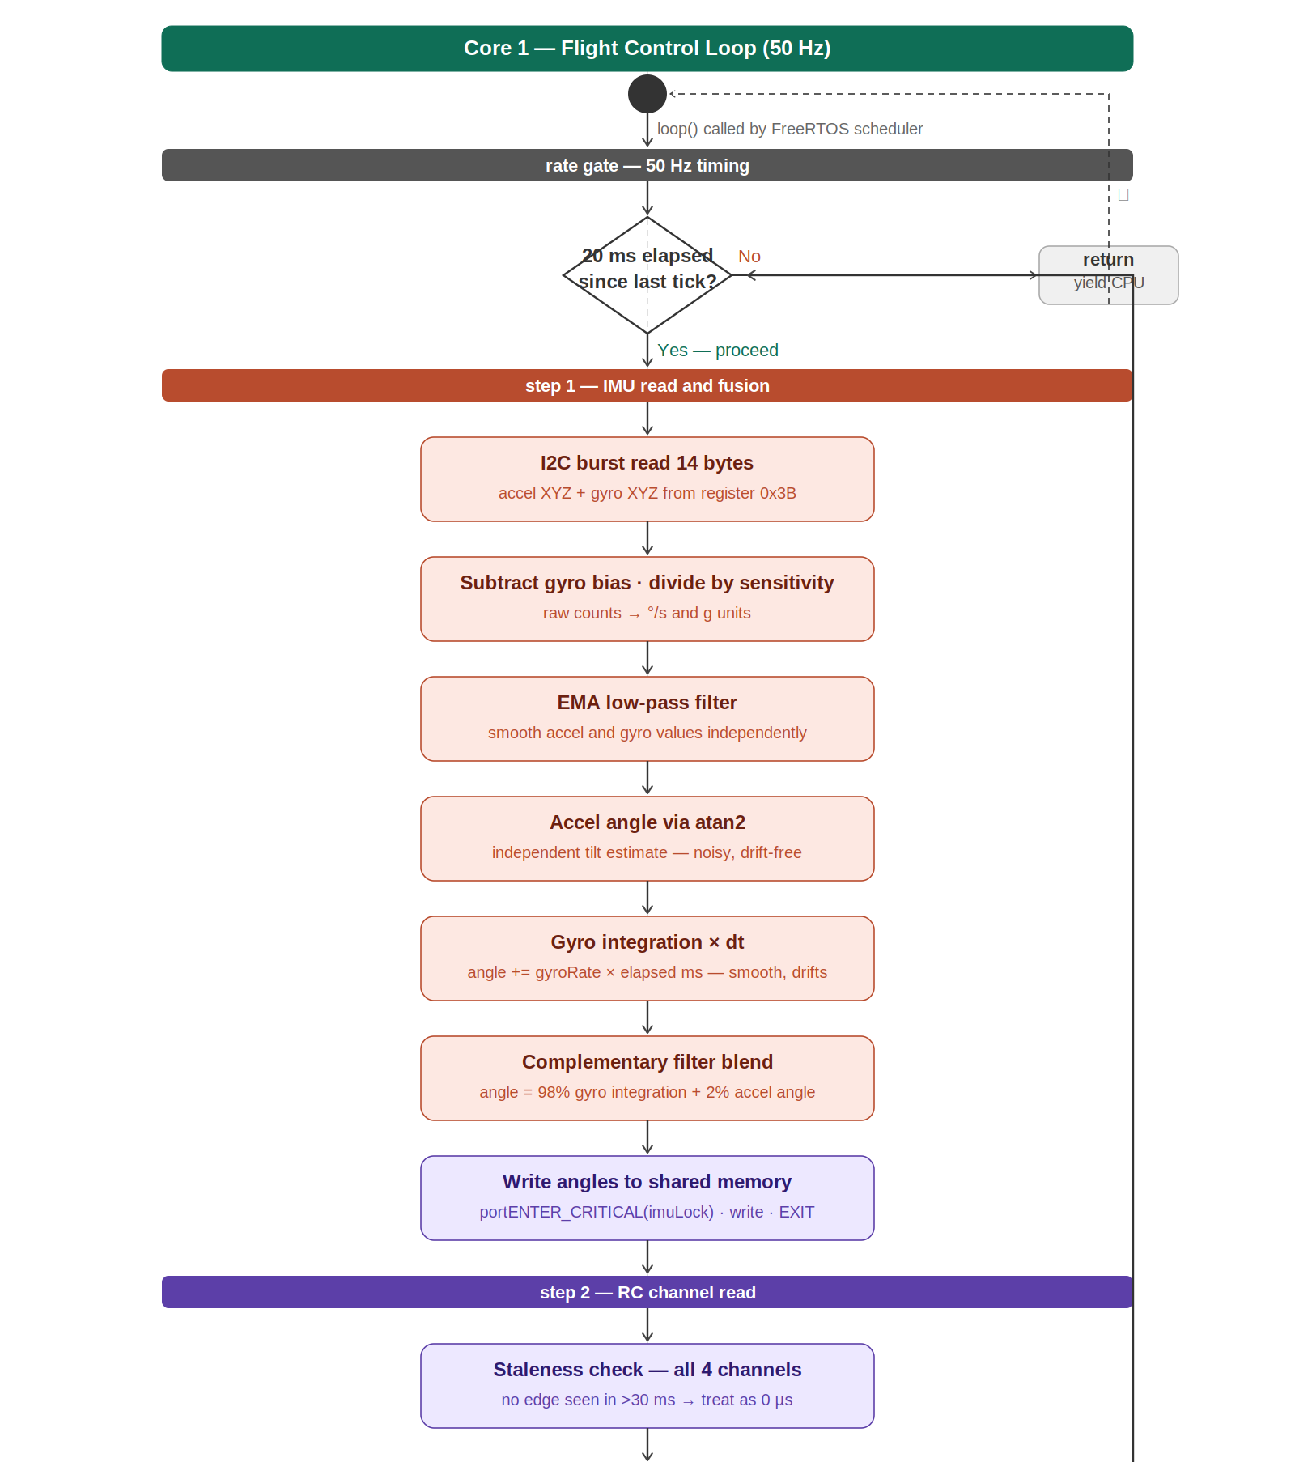
Flight Control Loop
1. Rate gate - checks if 20ms have passed since the last tick; if not, returns immediately and tries again next cycle
2. I2C read 14 bytes from MPU6050 in one transaction - gives raw accel XYZ + gyro XYZ
3. Subtract gyro bias offsets, convert raw counts to °/s and g-units for both sensors
4. Apply low-pass filter to smooth accel and gyro values independently, reducing noise
5. Complementary filter blends 98% gyro integration + 2% accel angle → writes sensorPitch/Roll/Yaw to shared memory under imuLock
6. Read all 4 RC channels - check for signal staleness (>30ms = 0), map pulse width to 0–100%, snap ±3% deadband to 50%, cache for Core 0
7. Check CH4 to determine autopilot mode; on transition into autopilot, reset both PIDs using bumpless transfer (no servo jump)
8. If both sticks centered (+/-5%) → run full PID on pitch and roll; if one stick moved → that axis goes manual, other axis stays on PID
9. computePID() — error, deadband zero, integral clamp, derivative-on-measurement → produces correction output
10. Clamp final angle to 45°–135°, write servo only if change exceeds 1° deadband (prevents buzzing)
11. Record loop timestamp, yield CPU, repeat every 20ms

Slide 14
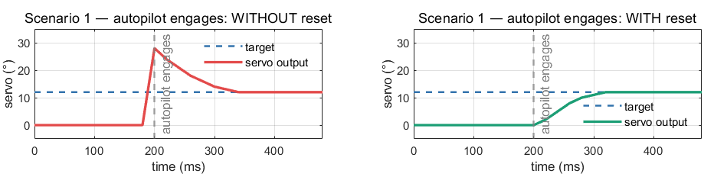
Smooth Mode Transitions - PID Reset
Engaging autopilot with stale PID state causes a violent servo “kick”: the integral holds old history and the derivative sees a fake spike. resetPID() clears the integral, syncs the previous measurement to the current angle, and resets dt - so the servo starts smoothly from where it is.
1 · Autopilot engages
reset both axes → no jolt
2 · Pilot moves stick
reset that axis only → pilot has full control
Without reset: ~30° servo spike on engage. With reset: smooth handover.
3 · Pilot releases stick
reset again → PID resumes from current attitude
Notes:
PID formulae:
error = reference - current_angle
integral = integral + error × dt
derivative = (angle - prevMeasurement) / dt
output = Kp×error + Ki×integral - Kd×derivative
=========================================
The without-reset case — why the spike happens
During the manual phase (before autopilot engages), the pilot is flying at angle = 0° but the reference is 12°. Even though PID is not controlling the servo, I'm still accumulating the integral in the simulation as if PID was watching:
error = 12 - 0 = 12° every tick
integral += 12 × 0.02 = 0.24 each tick
after 10 ticks: integral ≈ 2.4
=========================================
void resetPID(PID& pid, float initMeas) {
pid.integral = 0.0f; // wipes accumulated error
pid.prevMeasurement = initMeas; // sets reference point to current angle
pid.lastTime = millis(); // resets dt
pid.justReset = true; // skips bumpless transfer on first tick
}
=========================================
So at the moment autopilot engages:
integral = 0 ← no history, clean start
prevMeasurement = 8° ← current actual angle
First PID output:
error = 12 - 8 = 4° (small, real error)
integral = 0 + 4 × 0.02 = 0.08 (tiny, just started)
derivative = (8 - 8) / 0.02 = 0 (no change since last tick)
output = 1.2×4 + 0.3×0.08 - 0
= 4.8 + 0.024
= 4.824 ← small, proportional to actual error only

Slide 15
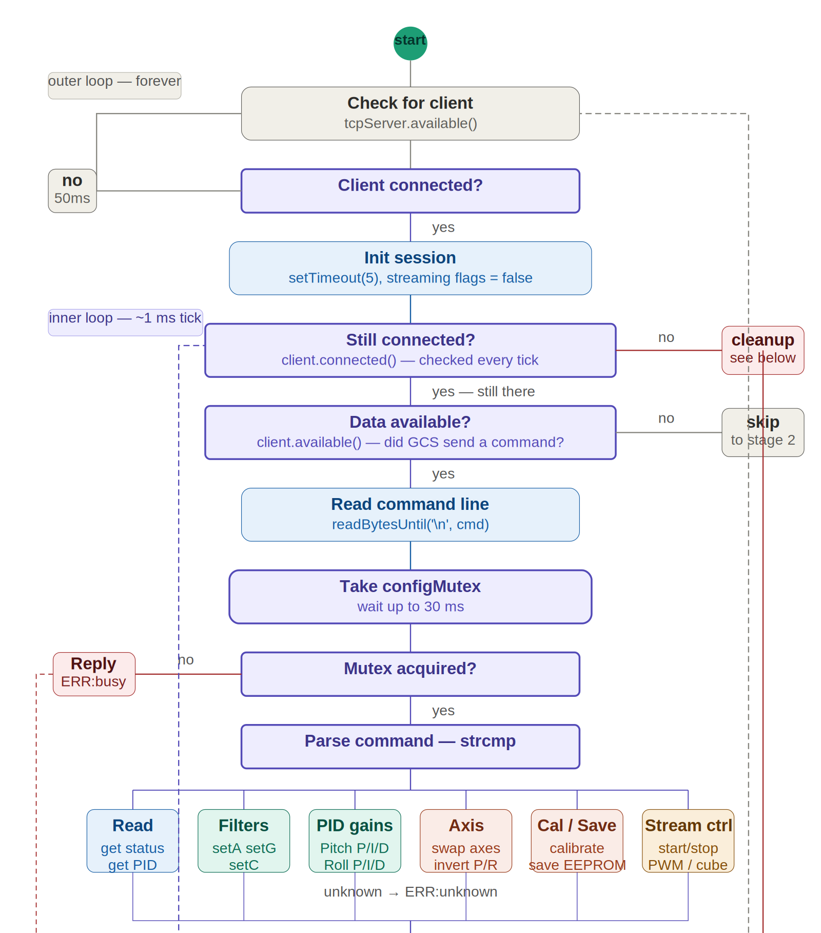
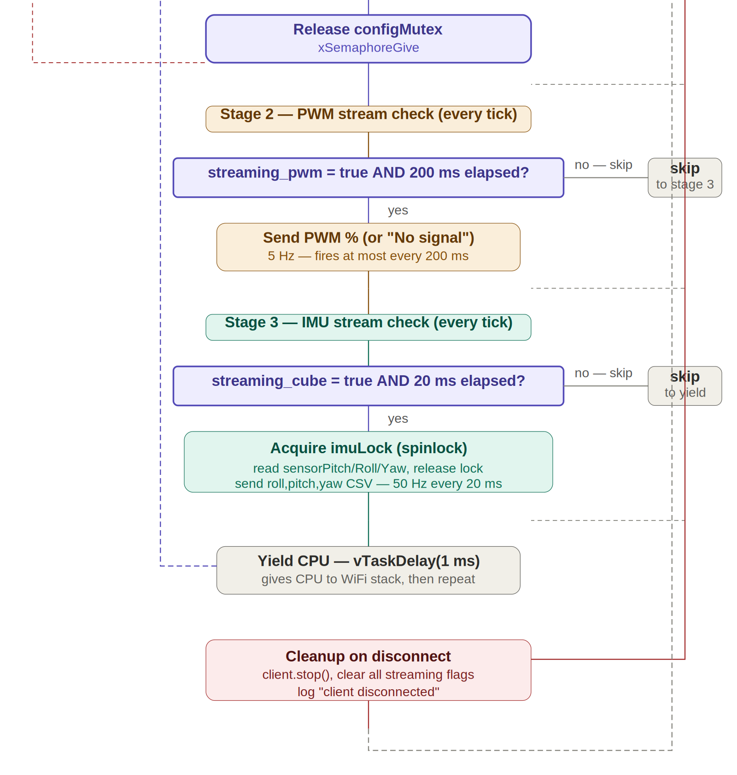
Communication Task
Wait for client to connect
Init session
Still client connected?
Data available?
Take mutex, read cmd.
Parse cmd, Release mutex
PWM stream flag? stream PWM : skip
Cube stream flag? stream IMU : skip
Repeat

Slide 16
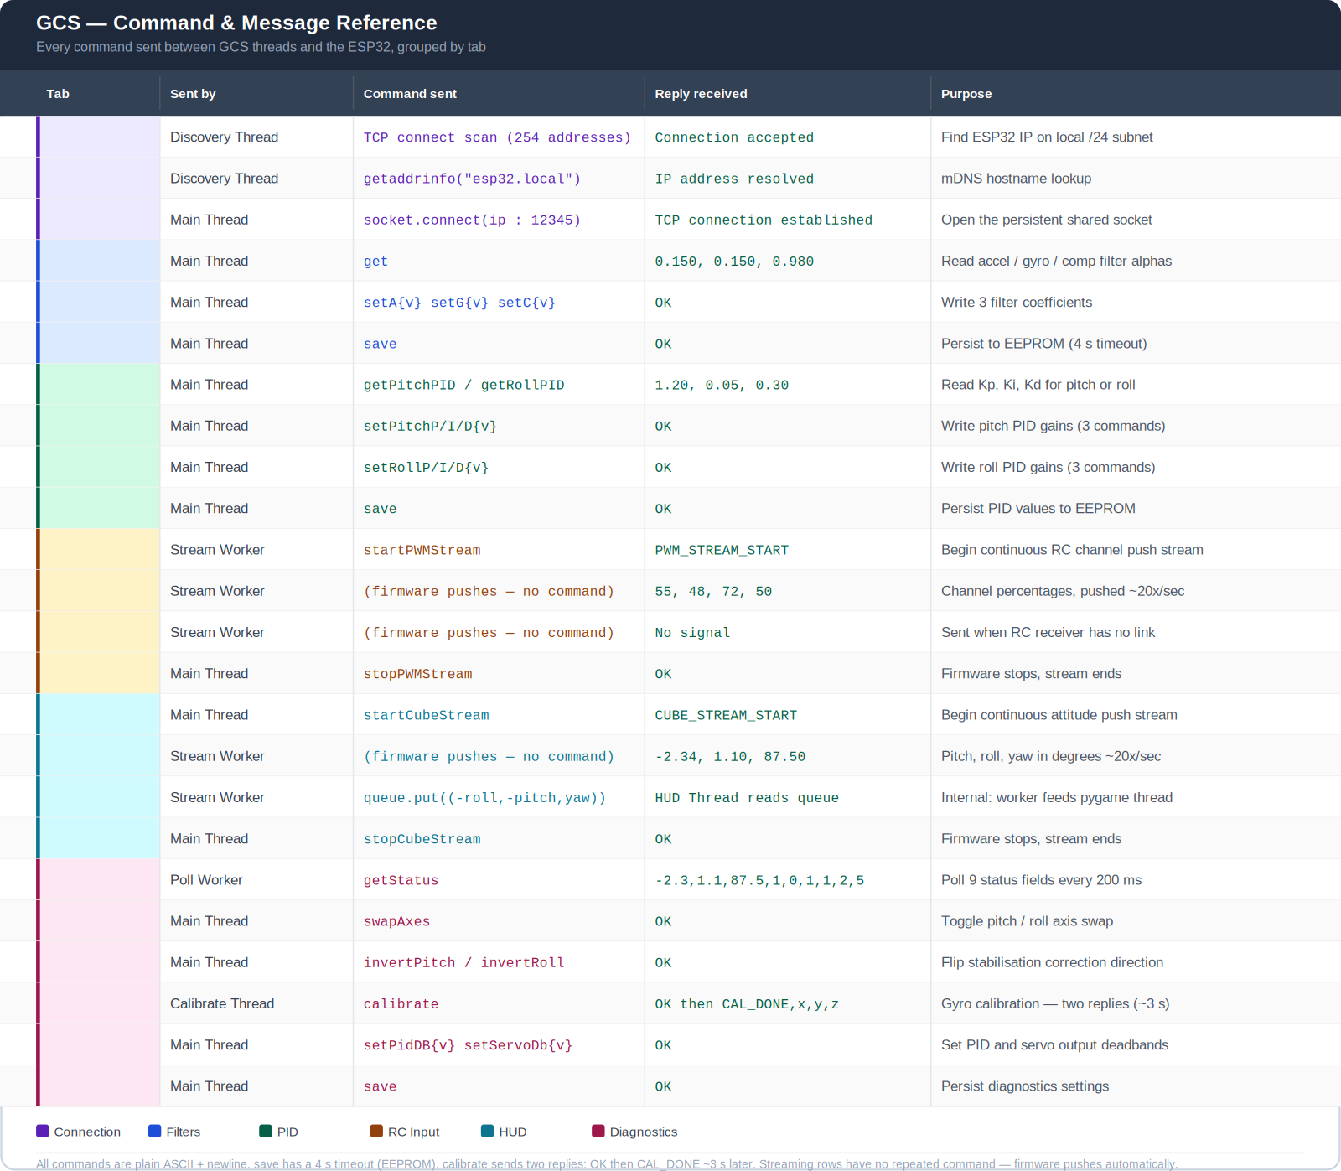
GCS ↔ ESP32 Command Protocol
Plain ASCII + newline: human-readable and trivially debuggable
Three interaction patterns: request/response (filters, PID), push streaming (RC, HUD), and timed polling (diagnostics)
save persists to EEPROM (4 s timeout); calibrate replies twice (OK, then CAL_DONE)

Slide 17
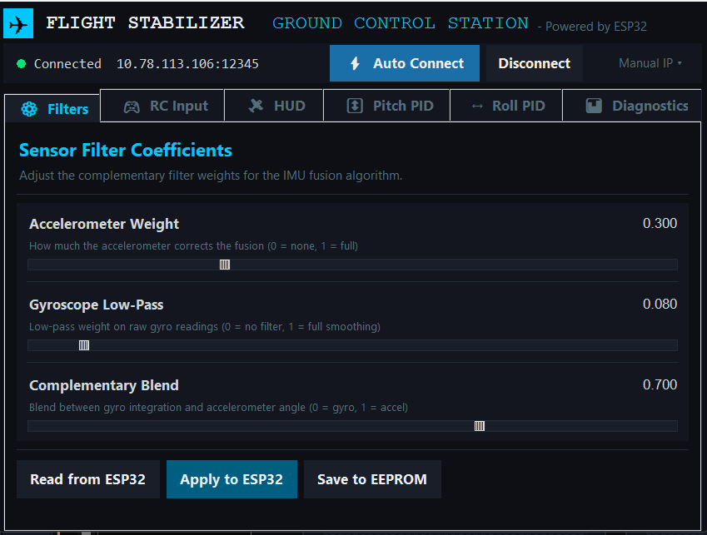
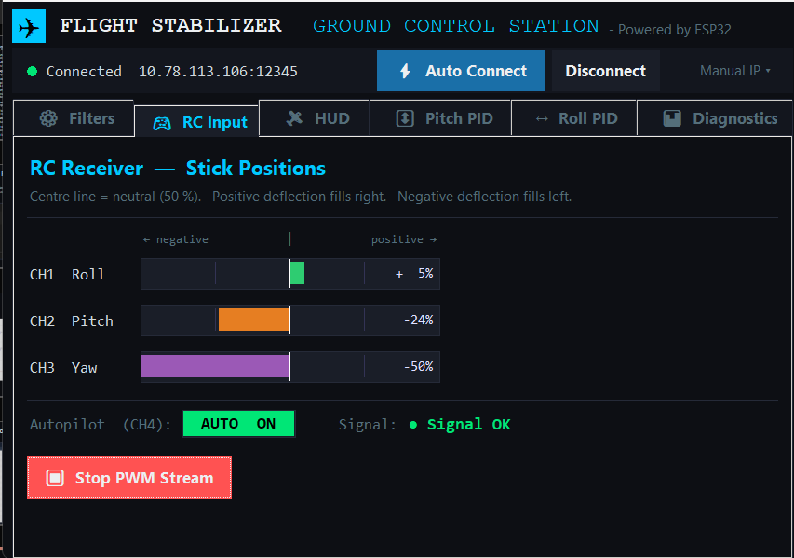
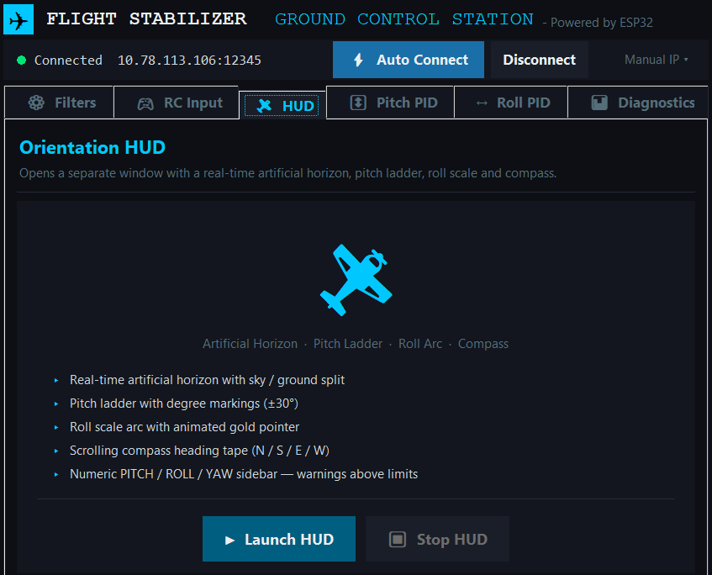
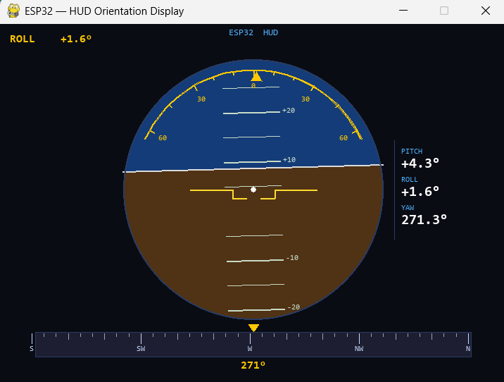
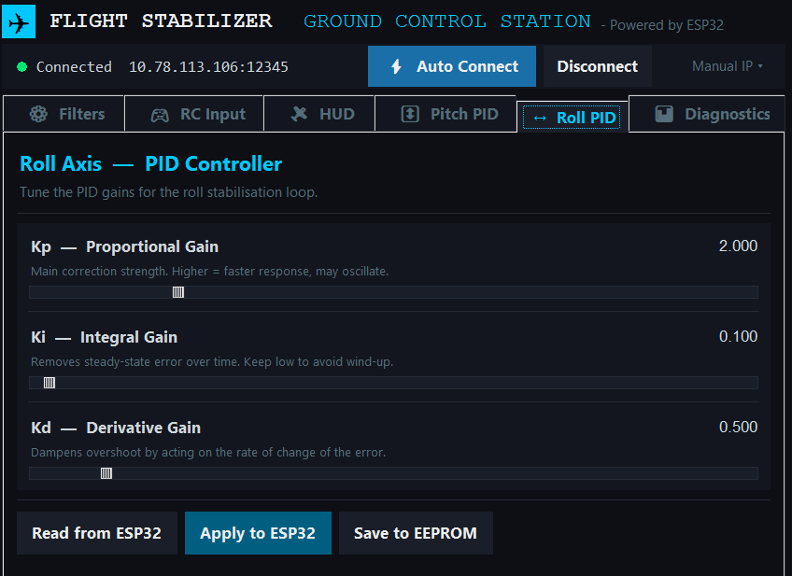
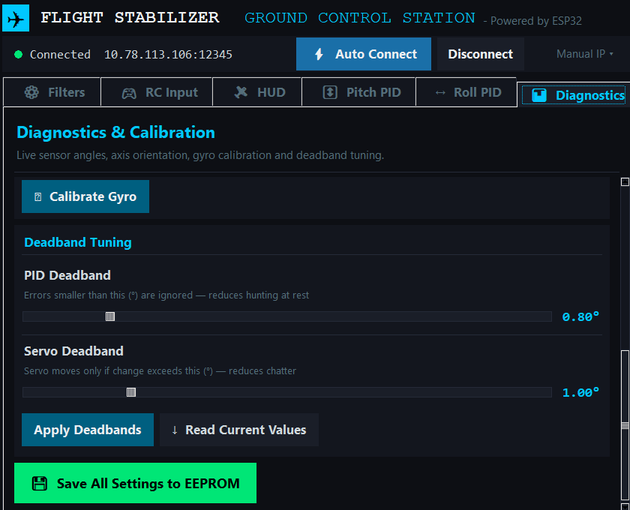
FlightGCS - User Interface
⚙ Filters
🎮 RC Input
🛩 HUD Tab
🛩 HUD Screen
↔ Roll PID
📊 Diagnostics

Slide 18
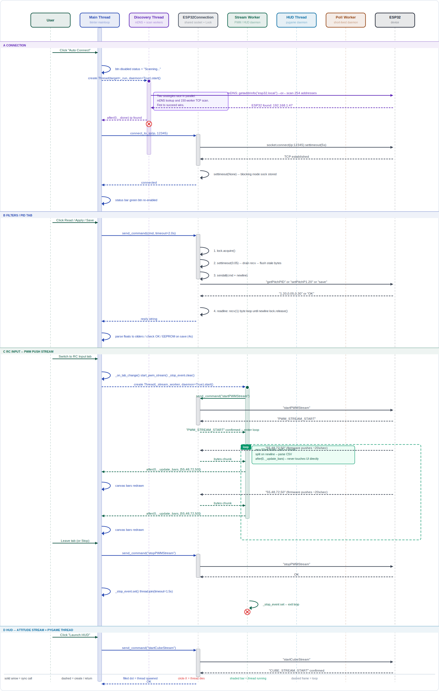
FlightGCS — Connection & Threading Model
Main Thread — runs the UI, handles button clicks, and sends/receives one-off commands (read/apply/save settings)
Discovery Thread — finds the ESP32 on the network (mDNS + subnet scan) when "Auto Connect" is clicked
Stream Worker (PWM) — continuously reads RC channel data while the RC Input tab is open, updates the bar graphs
HUD Thread — continuously reads IMU orientation data while the HUD is open, updates the attitude display
Poll Worker — periodically checks device status/diagnostics in the background
The main thread stays responsive for UI clicks, while each stream/poll runs on its own thread so nothing blocks the interface - and all of them talk to the same ESP32 over one shared socket connection.

Slide 19
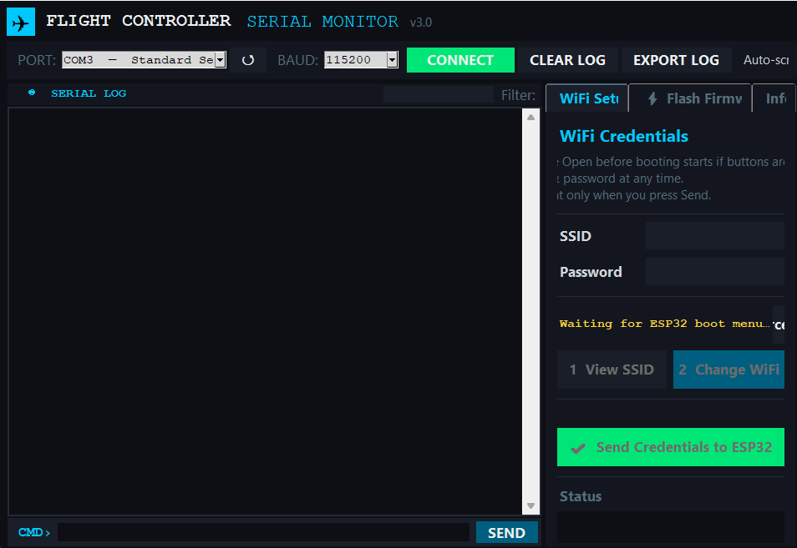
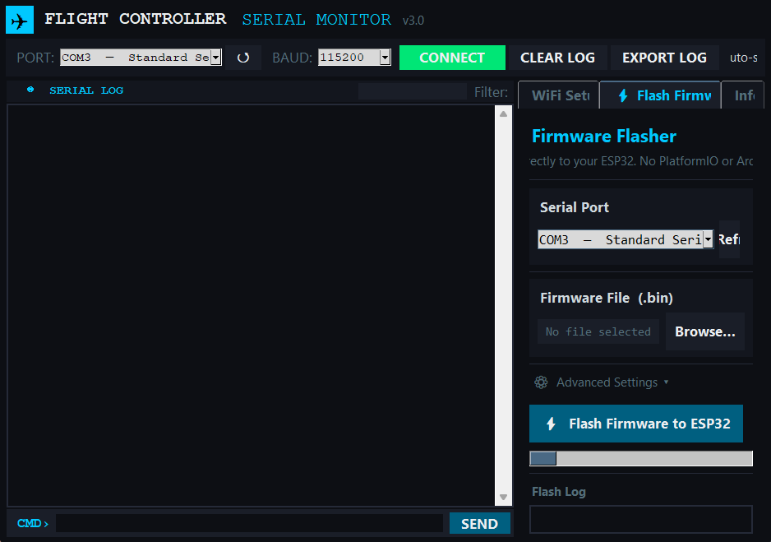
GCSHelper — Bench Companion Tool
Standalone Python desktop app for the wired side of the workflow — everything that happens before the aircraft leaves the bench
Serial Monitor: live boot logs at 115200 baud, plus access to the 10 s boot menu for storing WiFi credentials in EEPROM
Flash tab: upload new .bin firmware images to the ESP32 via esptool — no PlatformIO install needed by the end user
Status: functional, still under active development — UI polish and guided flashing flow in progress
Serial Monitor
Flash Firmware

Slide 20
Thank You

