Slide 1

Information and Computation via Quantum Lens Coding and Distance Metrics
Ph.D. Dissertation Summary (Part I),
Level: Ph.D.
Supervisor:
Dr. T. A. Gulliver
Supervisory Committee Members:
Drs. T. A. Gulliver, Tao Lu, and
Marcelo Laca
Feb 10, 2020 (last update: Aug 2022)
University of Victoria,
Dept. of Electrical and Computer Engineering, Canada
By:
Philip B. Alipour

Slide 2
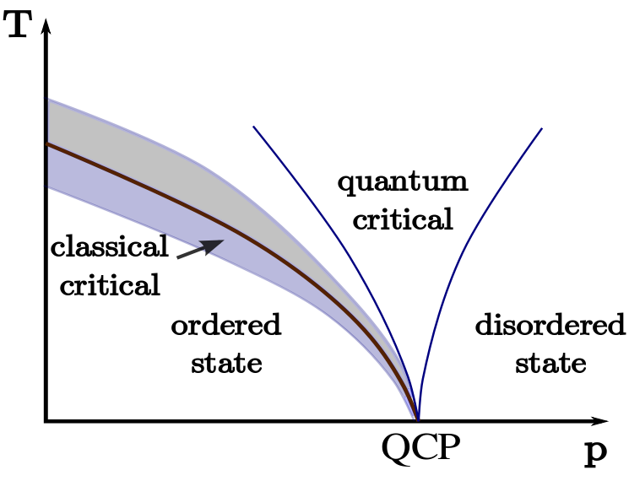
Introduction
In this research work:
A Thermodynamic System: energy states, transition (event), microstates contributing to a macrostate within a given Thermodynamic limit: Volume, Mass and Density relationship
Determine Quantum Phase Transition (QPT) vs. Classical Phase Transition (CPT) in the system: via Correlation length switch and photonic probes
Two key papers representing a Universal System Model:
Physical elements (particles, controllers, switches, sensors, probes, etc.)
Measurable parameters (particle motion, spin position, frequency, etc.) through distance metrics
Information representation on the parameters: bits vs. qubits in a lens coding algorithm
Characterizing and predicting states in the system
Magnetic field or pressure

Slide 3
Research objectives
The two key papers aim to achieve the following:
A distance metric to determine an energy state output for a given number of input states (the 1st paper focus):
Determine an output state for a given input state contributing to a CPT or QPT.
Prediction and probability calculation of an event during a PT.
Choose and reroute energy paths as input states and output states in the system to achieve a PT, a desirable energy outcome or gain better efficiencies (the 2nd paper focus).
Quantum and classical code representation and computation
States transitioning over a communication channel in order to calculate entropy between systems where states are exchanged, distributed and/or contributed to a PT.
Information model representation for efficient ways of computation and determination of states.
Notes:
The paper entitled “A Quantum Scalar Double-field Game Theory Model” (referred to as “the 1st paper focus”) covers the first two research objectives.

Slide 4

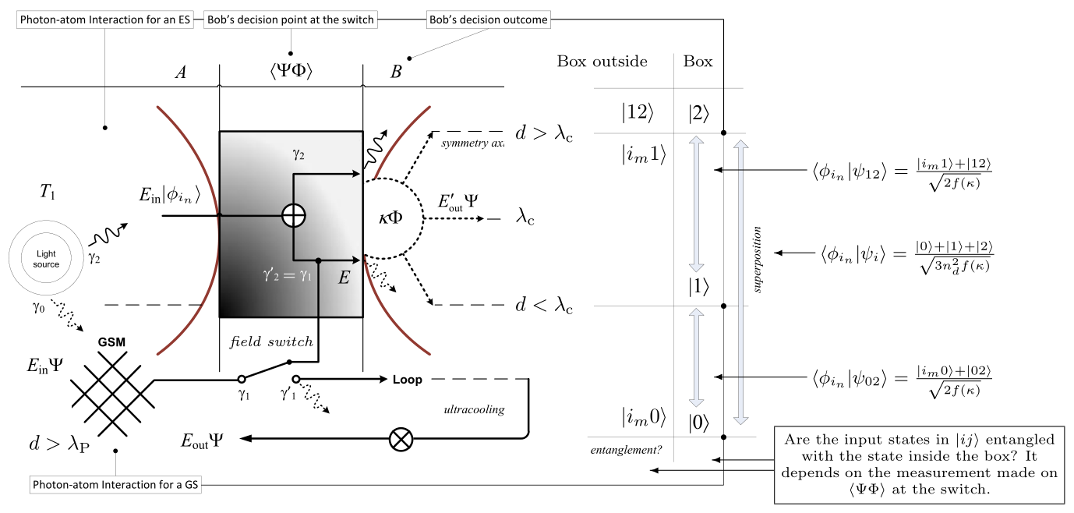


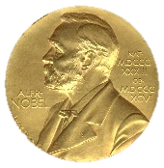

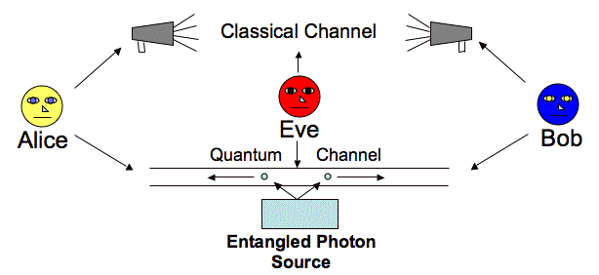
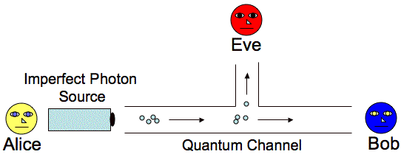


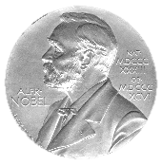
Paper I: The Quantum Game (DFGTAnim)
Four or more participants interact on a quantum level and make a guest participant to decide (a QPT) to win a prize.
Observes the prize state & QKD
Choose & Decide
Share
Choose
Entangle?
Superposition
Teleportation
Entangled QKD model (teleportation)
Notes:
Click once and let the animation steps execute in a flow corresponding to the game steps stated in the paper.
Once stopped, click again and continue in order to view the rest of the animation.

Slide 5
Paper I: A κ Scalar, ΨΦ Field Switch and Correlation Model (DFGTAnim)
The κ scalar is generated when the switch is ON/OFF:
External field creation of photonic probes
The scalar is generated when both fields interact as ΨΦ and produce an effect.
Is interaction length dependent.
Interaction length (over the possible longest distance d) determines how weak or strong an interaction is between particles
This scalar is determined from the product of position r and momentum (wavevector) k of the particles given their correlation length.
Interaction distance is the absolute difference of the last two.

Slide 6
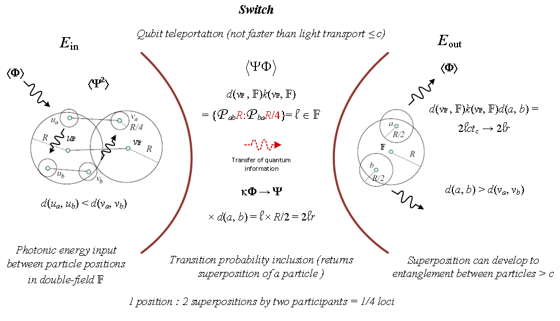




Paper I: A Scalar Double Field and Correlation Model (DFGTAnim)
The four measurement variables (fmv) and the quantum double-field
A PT is characterized and predicted using correlation function ⟨ΨΦ⟩ and probability measure for the states under the double-field transformation from a transition matrix.
The value produced in this matrix denotes a thermal state, symmetry (breaking), or entanglement on a magnitude of |κ²|$ρ$ ≤ 2.
κ, 2|r|→ |r|, d, λc
Proof
2 2 2
Notes:
When the screen goes blank, use one of the number keys (not from the numpad) to execute the animation step on the metric space model. Stop the progress of the animation step using the number key again. To resume use the "C" key on your keyboard. Mouse left click will skip the slide. So take the former approach to study the model as it unveils from the left side to the right side of the screen.

Slide 7
Future Work and Conclusions
The κ-based metric is applicable to any information model such as measuring symmetry, symmetry breaking and entanglement.
All thermodynamic phenomena can be determined by the proposed double-field metric once associated with relevant condensed matter materials and information.
Next work is based on this paper, since the κ-scalar and the transition matrix can be a basis of a new quantum computational and thermodynamic technique for experimental models (see the Popular Summary of the current paper)
This enables the observer to determine states by classifying them based on their probability value in any system.
The probability value results in a strong prediction of the next energy state of the system through a trainable quantum circuit.

