Slide 1
INTERNAL WORKSHOP
QI
Lab
Hardware-in-the-Loop Quantum Network Test Platform
Milen Kolev
30-03-2026 · Delft
Internal use only

Slide 2
01
QI Lab Overview
General description
Internal use only

Slide 3
What is QI Lab?
A hybrid hardware-in-the-loop platform for small local quantum networks
GENERAL DESCRIPTION
NETWORK ARCHITECTURE
Hybrid Hardware-in-the-Loop Platform
CNPU-QNPU
Node 1
QI
Lab
CNPU-QNPU
Node 2
Nodes combine real classical hardware (CNPU + QNPU) running QNodeOS
Quantum device (QDevice) replaced by a simulator — no physical qubit hardware needed
Designed for small co-located quantum networks
Built for fast iteration, easy testing, and low cost of quantum network applications
QNodeOS
QNodeOS
SPI
The QI Lab domain hosts a Hardware SPI Manager and Simulation Platform, bridging all nodes via a single high-speed connection.
Scalability
Short-term goal: maximum 4 nodes
Mid/Long-term goal: support 8 nodes in the same location
Internal use only
01 / 32

Slide 4
General Use Cases
What can QI Lab be used to design, evaluate, and validate?
USE CASE 01
USE CASE 02
Control Plane Algorithms
Network OS Concepts
Scheduling, routing, and SDN architecture elements evaluated on real-world implementations on QiLab.
Network operating system concepts and implementations, such as local scheduling algorithms running on live hardware.
USE CASE 03
USE CASE 04
Programming & Compilers
Tooling & Benchmarks
Design, evaluation, and validation of quantum network programming models and compiler concepts.
Evaluation of tools such as the quantum network benchmark suite in a realistic multi-node setting.
Internal use only
03 / 32

Slide 5
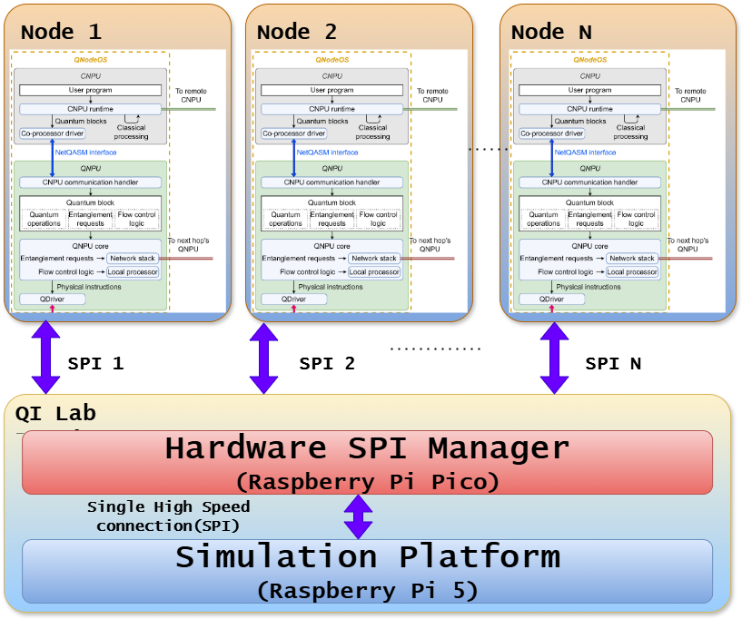
Hardware Platform
Raspberry Pi 5 with Linux RT + Raspberry Pi Pico
HARDWARE — CHEAP & READILY AVAILABLE SOLUTION
SYSTEM ARCHITECTURE
Raspberry Pi 5 + Pico
Debian with PREEMPT_RT real-time kernel
SPI @ 20 MHz between Pi 5 and Pico co-processor
Programmable Input-Output (PIO) engine on the Pico enables support for more nodes (up to 4 per Pico)
Bare-bone application running on Pico
Faster development and less maintenance overhead
Low cost and widely available hardware
Internal use only
02/ 32

Slide 6
02
Motivation
Why do we need QI Lab?
Internal use only

Slide 7
Why QI Lab?
The limitations that motivated a hybrid hardware-in-the-loop approach
CHALLENGE 01
CHALLENGE 02
Simulation Is Not Enough
Hardware Is Restricted
Pure simulation cannot fully explore, test, and validate quantum network research ideas in realistic conditions.
Real quantum network hardware in the lab is highly restricted and not freely accessible for experimentation. Qubit number is restricted
CHALLENGE 03
CHALLENGE 04
Multi-Node Research
Real-Time Scenarios
Many research questions require multiple interconnected nodes operating simultaneously.
Classical communication in real-time scenarios demands a live, responsive test environment.
Internal use only
04/ 32

Slide 8
Positioning: Simulation vs QI Lab vs Real Hardware
Where does QI Lab sit in the research toolchain?
Criterion | Pure Simulation | QI Lab | Real Quantum HW
Accessibility | ✔ High | ✔ High | ✘ Very Limited
Real-time classical comms | ✘ No | ✔ Yes | ✔ Yes
Multi-node support | ✔ Yes | ✔ Yes | ~ Yes, but Restricted
Real classical HW stack | ✘ No | ✔ Yes | ✔ Yes
Cost | Low | Low | Very High
Internal use only
05 / 32

Slide 9
03
Technical Architecture
Hardware platform, software design, and positioning
Internal use only

Slide 10
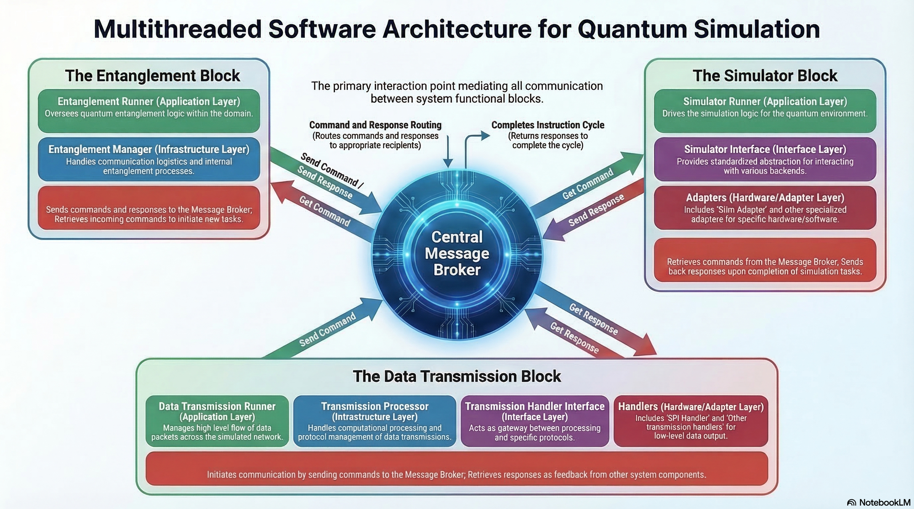
Hardware Platform & Software Architecture
Raspberry Pi 5 + Pico with a modular, threaded software design
SOFTWARE —MULTITHREADED REAL-TIME
RUNTIME
SOFTWARE ARCHITECTURE SIMULATION PLATFORM
Raspberry Pi 5 + Pico
Multithreaded architecture and physical core isolation
Lock-free messaging++7
Configurable transmission mechanism – supports different mechanism and number of nodes
Configurable simulation block – supports different simulations engines and simulation instructions sets (NV center, generic)
Entanglement block that manages and pairs up requests
Internal use only
06 / 32

Slide 11
Stim & Stabilizer Tableau
Quantum circuit simulator · Internal state representation
SIMULATOR
INTERNAL REPRESENTATION
Stim
Stabilizer tableau
High-performance Clifford circuit simulator
Compact binary matrix encoding the quantum state
What it is
What it is
A C++ library (with Python bindings) that simulates Clifford circuits at massive scale (thousands of qubits, millions of gates (Gidney, 2021)).
Used as the quantum device back-end in QI Lab — replacing real QDevice hardware.
uses
Instead of a 2ⁿ state vector, Stim tracks the n Pauli operators that stabilize the state.
Each row = one stabilizer generator. Clifford gates = row operations on this matrix.
Key properties
Structure (3-qubit example)
Clifford gates only: CNOT, H, S, CZ, SWAP
Pauli measurements: X, Y, Z
Scales to millions of qubits (O(n²) memory)
T-gate (non-Clifford) not supported
sign | X₁ X₂ X₃ | Z₁ Z₂ Z₃
+1 | 1 0 0 | 0 0 0
+1 | 0 1 0 | 0 0 0
+1 | 0 0 1 | 0 0 0
QI Lab: replaces QDevice hardware
Gate applied → row ops (XOR, swap) · Measure → Gaussian elimination
Scales as O(n²) not O(2ⁿ)
Gidney, C. (2021). Stim: A fast stabilizer circuit simulator. Quantum, 5, 497. https://doi.org/10.22331/q-2021-07-06-497
07 / 32

Slide 12
04
Workshop
Hands-on: build, configure, and run QiLab from scratch
Internal use only

Slide 13
HW BOM — Hardware Bill of Materials
All components needed to build a QiLab setup
QNodeOS Hardware
HW-QN-001 MicroZed 7020 Industrial SOM
Zynq-7000 XC7Z020 · 1GB DDR3 · GbE · USB 2.0 · Qty: 2
HW-QN-002 JTAG-HS2 Programming Cable
High-speed JTAG/SPI cable · Digilent 410-249 · Qty: 1
QiLab Hardware
HW-QL-001 Raspberry Pi 5 8GB
ARM Cortex-A76 · 2.4GHz · 8GB RAM · Qty: 1
HW-QL-002 Raspberry Pi Power Supply (USB-C 5.1V/5A)
Model SC1407 · Qty: 1
HW-QL-003 Raspberry Pi 5 Cooling Fan
Model SC1148 · Qty: 1
HW-QL-004 Standoffs
Standoff for mounting on the raspberry · Qty: 10
HW-QL-005 QiLab Expansion HAT
Custom in-house HAT · supports up to 4 nodes · Qty: 1
In-house manufacturing — see hardware spec in Pico repo
HW-QL-006 Raspberry Pi Pico Debug Probe (opt.)
Raspberry Pi Debug Probe· Qty: 1
Only needed if freshy manufactured HAT is used
Miscellaneous / Accessories
HW-MISC-001 USB Hub (USB 3.0, ≥3 ports)
Qty: 1 — for connecting MicroZed boards to host PC
HW-MISC-002 Micro SD Card (≥32GB, 64GB+ recommended)
Qty: 1 — SanDisk Extreme Pro A2 recommended
HW-MISC-003 Network Switch (5-port)
Qty: 1 — minimum 5 ports
HW-MISC-004 USB to Ethernet Adapter (opt.)
Qty: 1 — Optional item if computers does not have ethernet port
HW-MISC-005 Micro USB cables (0.5m)
Qty: 2 — power + serial logs from MicroZed
HW-MISC-006 Patch cables (0.5m)
Qty: 4 — connection from MicroZed, QiLab and PC
HW-MISC-007 Ribbon cables (2x6, 2.54mm)
Qty: 2 — connection from MicroZed to extender HAT
Internal use only
09 / 32

Slide 14
HW Assembly — How to Put It Together
Step-by-step: from parts to a running setup
Assembly Steps
→ Attach cooling fan and standoffs (M2.5, 11×17mm)
→ Mount QiLab Expansion HAT on Raspberry Pi 5
  - The HAT should point outwards from the PI and should be NOT above the cooling fan
→ Connect ribbon cables (HAT → MicroZed boards)
  - Pin 1 is indicated on the ribbon cable as well as on the HAT and MicroZed (see Appendix 2)
→ Check MicroZed configuration jumpers. They should be in the same line. From the factory one is shifted up. Move it in the same line as the other two (see Appendix 1)
→ Connect Micro USB cables from USB Hub → MicroZed and connect the hub to your PC
→ Connect all nodes via network switch (patch cables)
→ Connect Raspberry Pi 5 and your PC to the switch
→ Connect JTAG-HS2 cable for firmware flashing
→ Insert Micro SD card (flashed with QiLab image see next slide for where to find the image and slide 21 on how to flash the sd card)
NOTE Flash SD card and HAT before first use
Power-On Sequence
Power on network switch
Power on MicroZed boards via Micro USB
  Check that on both nodes red and green LED is on
3. Power on Raspberry Pi 5 (if SD card flashed, QiLab boots, default address: 192.168.0.100:8000)
HAT firmware
Flash HAT with Pico SDK before first use (see Pico repo).
Pre-flashed if obtained from Wehner group.
Internal use only
12/ 32

Slide 15
SW BOM — QiLab Components
Image, firmware and supporting tools
QiLab Software
SW-QL-001 QiLab Raspberry Pi Image v0.1.8
Pre-built Linux PREEMPT_RT Debian Bookworm. Includes QiLab, web server (control/config), SSH. Default IP: 192.168.0.100.
Note: Minimum 32GB SD card. Use Raspberry Pi Imager to flash.
SW-QL-002 QiLab Extender HAT Firmware (opt.) v0.1
Firmware for the Pico co-processor on the expansion HAT. Only needed for freshly manufactured boards.
Note: No CI/CD release yet — compile with Pico SDK. See repo documentation.
Toolchain
SW-QL-003 Raspberry Pi Imager v2.0.6
Used to write the QiLab image to the SD card.
Internal use only
11/ 32

Slide 16
Setup PC Environment
Install toolchain and packages before hardware setup
General
  1. Set static IP address on PC. Use one between 192.168.0.10 – 192.168.0.99
QiLab
6. Install Raspberry Pi Imager
7. (opt.) Install VS Code with Pico extension – only if you get fresh HAT without firmware
Internal use only
14 / 32

Slide 17
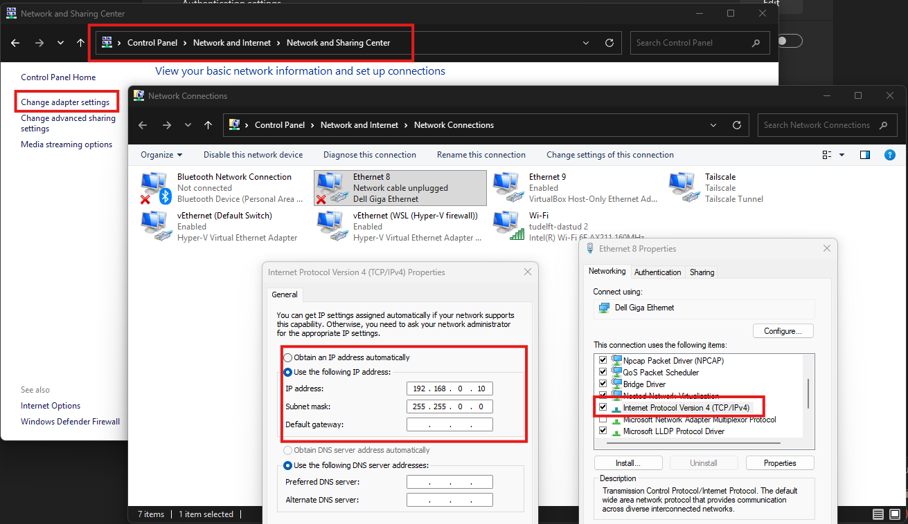
Setup PC Environment
Install toolchain and packages before hardware setup
1
Set static IP address
Set static IP address on PC. Use one between 192.168.0.10 – 192.168.0.99
On Linux depending on the distribution, can be done from UI, or command line(UI preferred way)
Internal use only
15 / 32

Slide 18
Setup and Run QiLab
Flash the image and access the platform
Steps
Flash the SD Card
Check web control for status and verify that everything is running fine
Internal use only
20 / 32

Slide 19
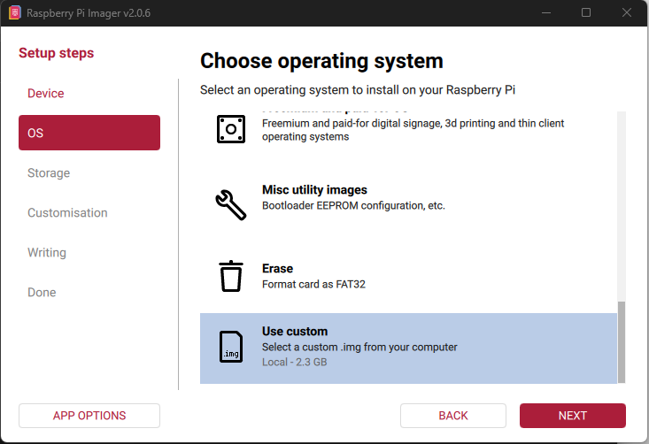
Setup and Run QiLab
Flash the image and access the platform
1
Flash the SD card
Choose Use Custom and select the QiLab image
Internal use only
21 / 32

Slide 20
Thank You
Questions & Discussion
Milen Kolev
M.R.Kolev@tudelft.nl
Internal use only

Slide 21
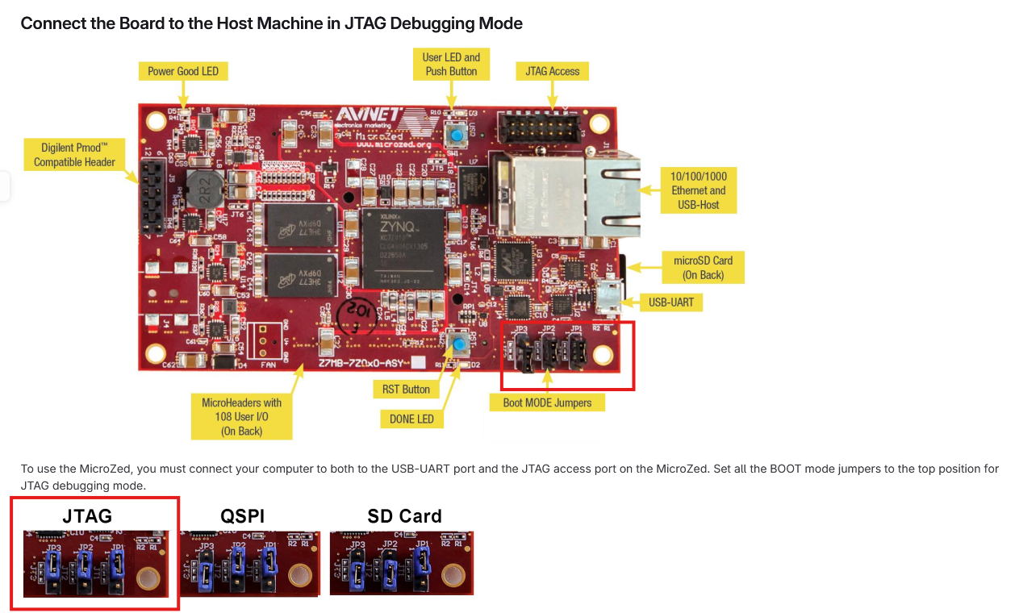
Appendix 1
Microzed Board Boot Mode Jumpers
Internal use only
32 / 32

Slide 22
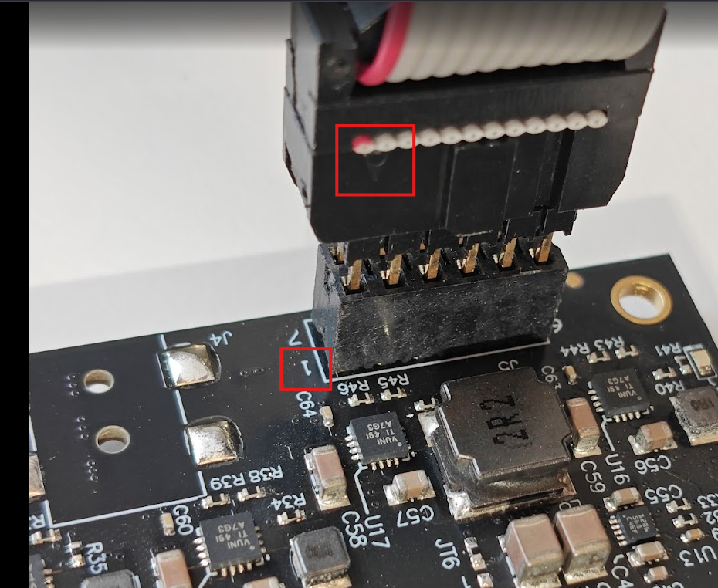
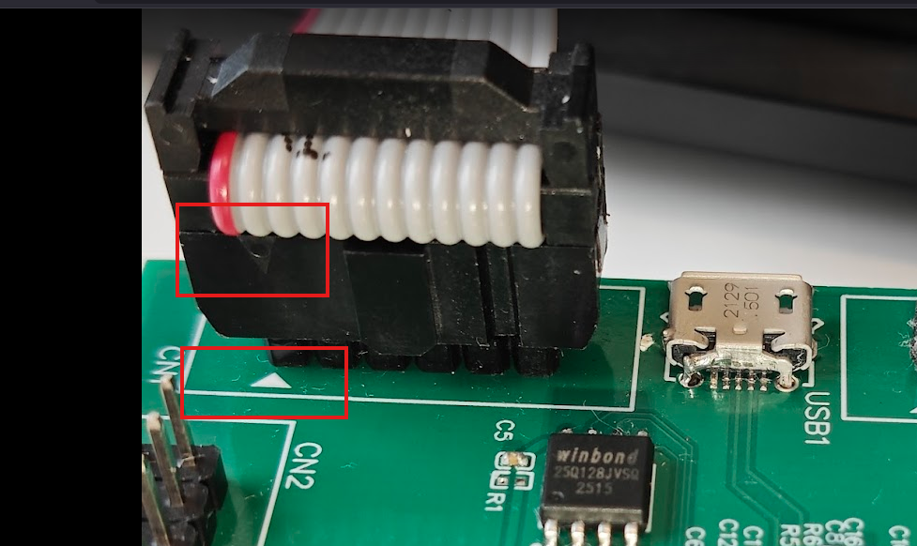
Appendix 2
QiLab ribbon cable connection
Internal use only
32 / 32

Slide 23
Appendix 3
Pico Basic Software Architecture
Internal use only
32 / 32

