Slide 1
Food Delivery system

Slide 2
Description
Customers:
Sign up and log in
Browse menus from various restaurants
Customize orders based on preferences
Add items to cart
Securely pay using different options
Track orders in real-time
View past orders
Rate and review restaurants and delivery
Restaurants:
Update profiles with new menus, prices, and availability
Receive and process customer orders
Track order status
Read customer feedback to improve service
Use data to understand customer preferences

Slide 3
Description
Delivery Personnel:
Log in to see delivery requests
Get pick-up and drop-off locations
Update order statuses to keep customers informed
Communicate directly with customers or restaurants
Admins:
Manage user accounts
Handle complaints
Generate reports to monitor system performance
Ensure smooth operation for all users

Slide 4
Diagrams

Slide 5
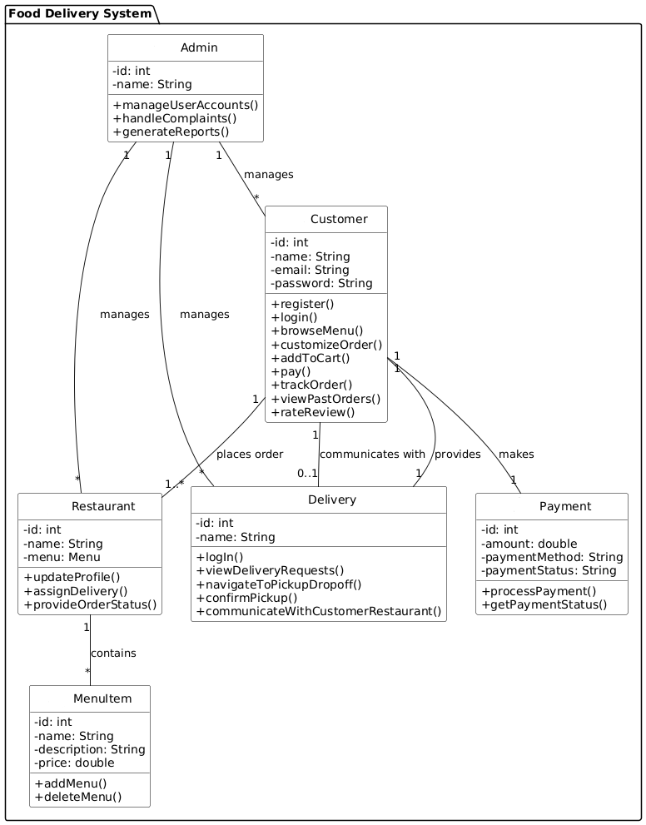
Class Diagram:

Slide 6
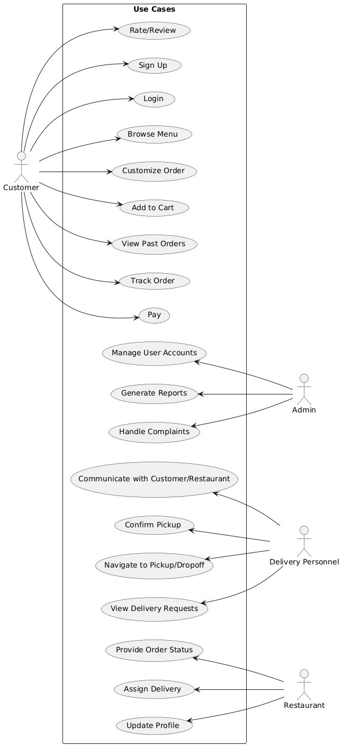
Use-case Diagram

Slide 7
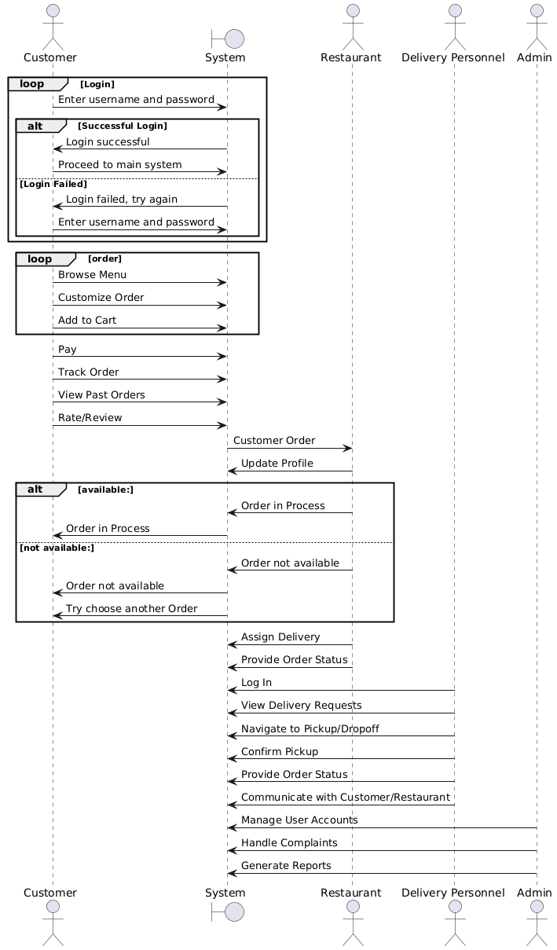
Sequence Diagram:

Slide 8
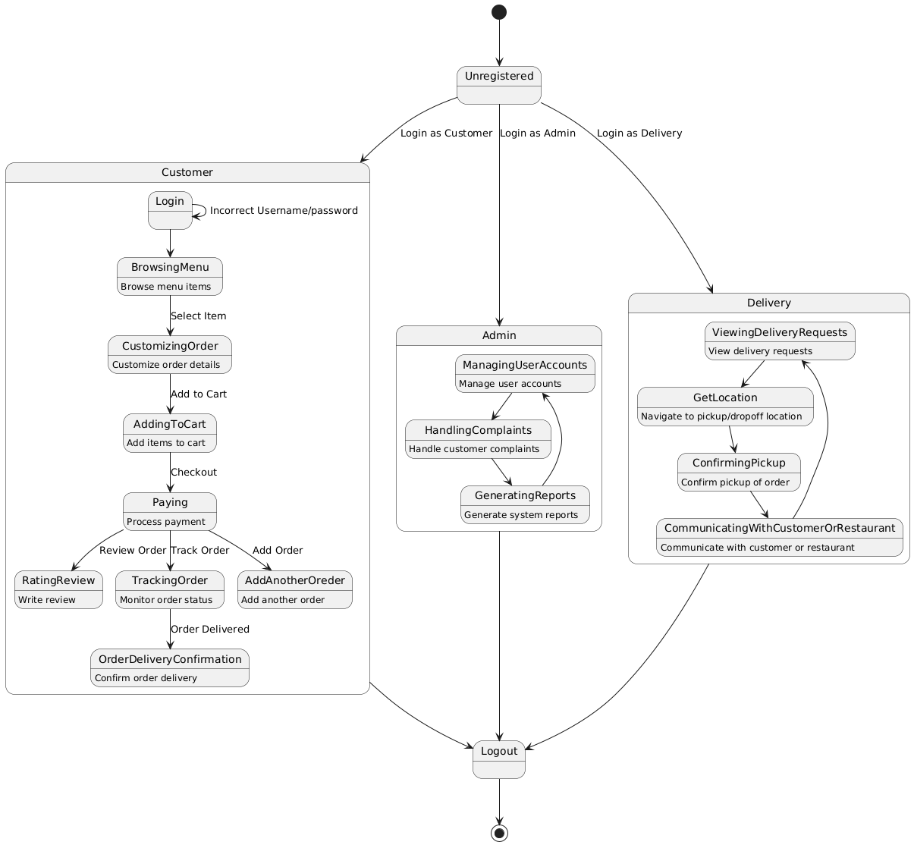
State Machine Diagram

Slide 9
THANK YOU

