Slide 1

The Power of AI in Business

Slide 2
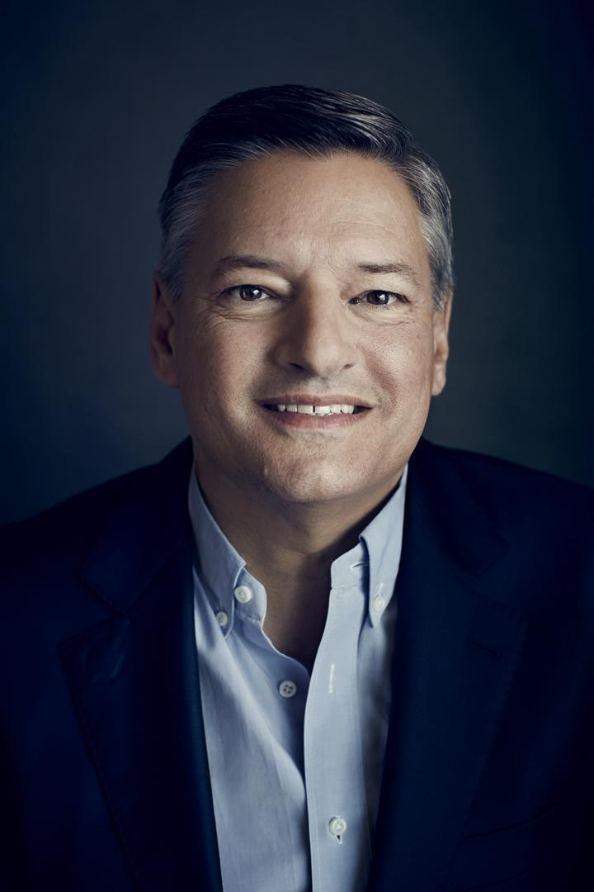
Introduction
“AI will not replace jobs;
it will replace people
who don't know how to use AI.”
Ted Sarandos Netflix CEO

Slide 3

Introduction
The Businesses Use AI
The steps to Start a Business Using AI
The future role of AI in Companies
This order provides a clear and logical flow, moving from understanding current uses to steps and future role.

Slide 4



The Businesses Use AI
Graphic designers
Online store
Content creator

Slide 5
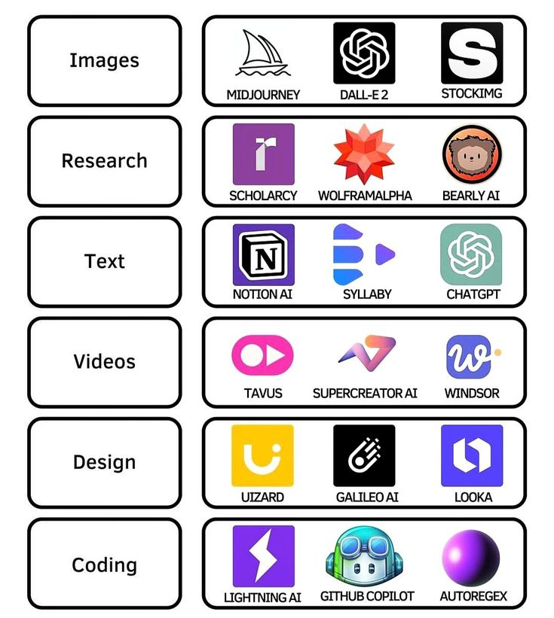
The steps to Start a Business Using AI
Develop Your Business Idea
Create a Unique Brand
Design Your Logo
Write a Business Plan
Build a Website
Implement AI Tools

Slide 6
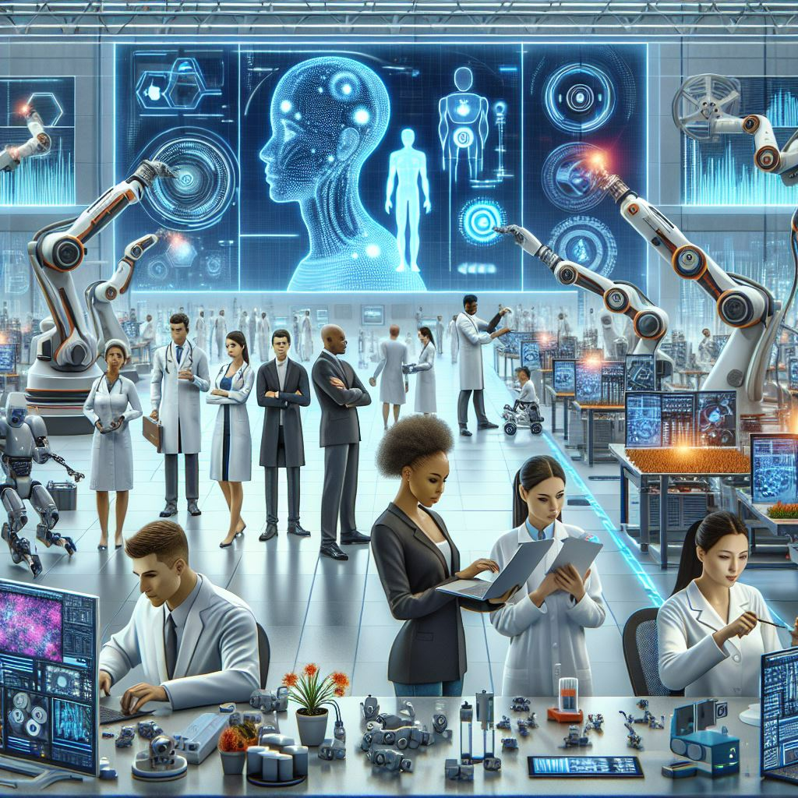
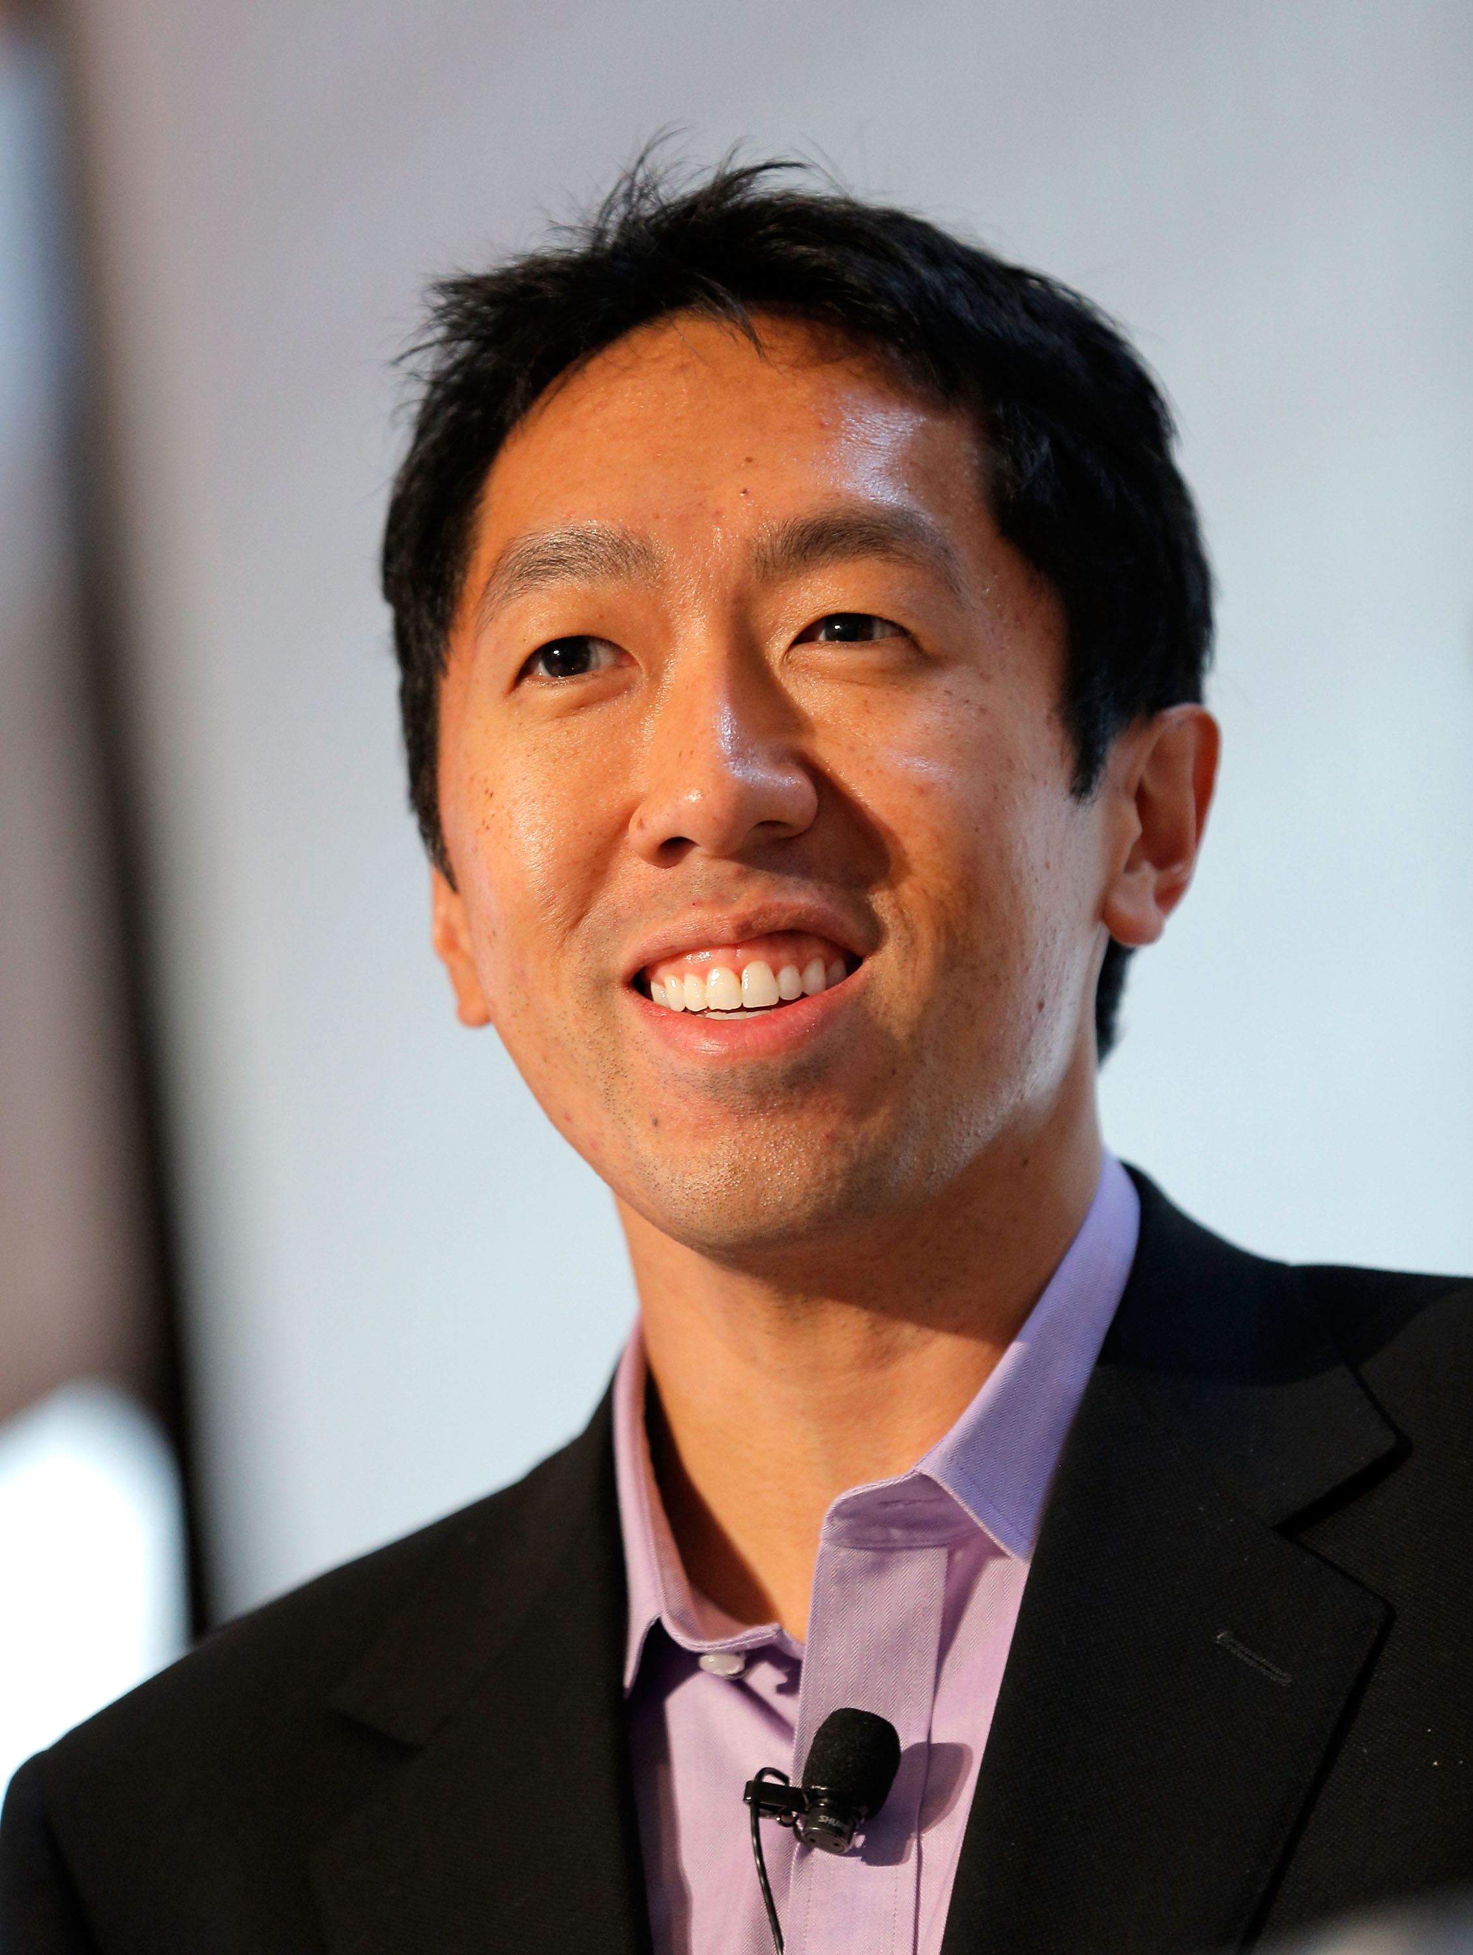
The future role of AI in Companies
As Andrew Ng said, "First solve AI, then use it to solve your problem."

Slide 7

Conclusion
Using AI is not just about keeping up. It is about getting ahead. AI will make you successful.

Slide 8
References
Ted Sarandos Netflix CEO, 2023, CTV News, CTV News Article
Gartner, 2021, Gartner report on AI adoption trends.
Antoine de Saint-Exupéry, 1943,” Wind, Sand and Stars," a book by Antoine de Saint-Exupéry.
Andrew Ng, March 23, 2021, MIT Technology Review, during an interview at EmTech Digital.

