Slide 1
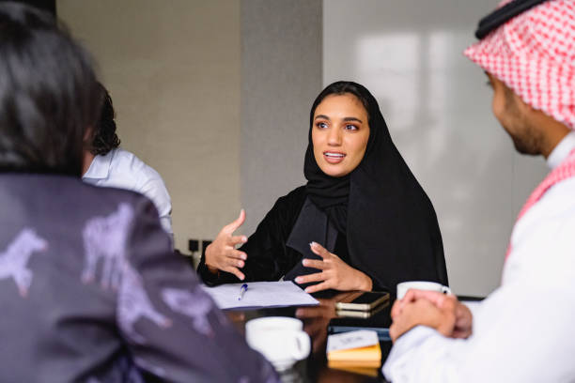




Women should be employed

Slide 2
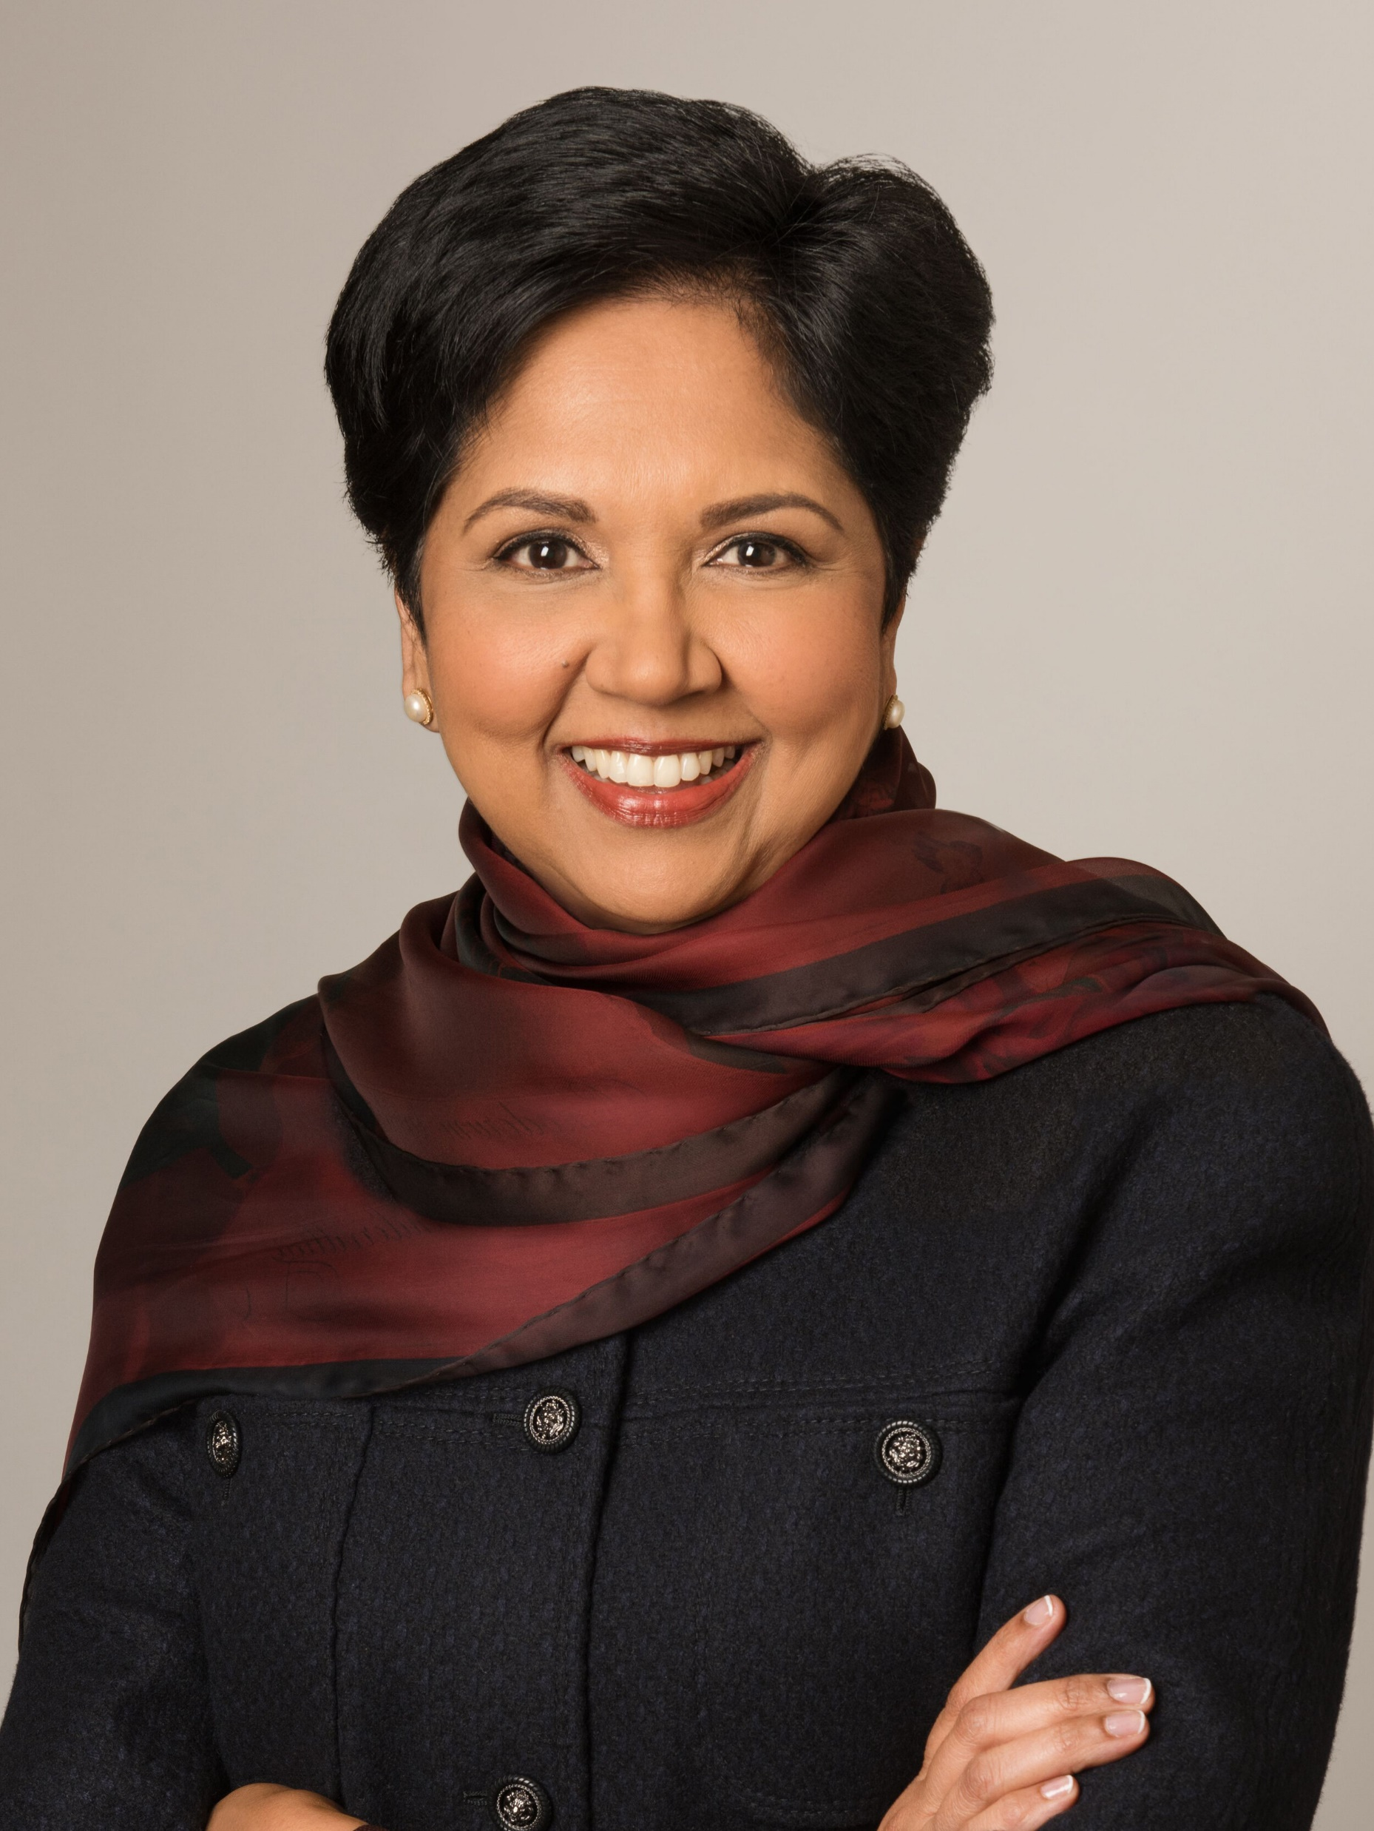
Introduction
"Women should be able to thrive in any field they choose."
Indra Nooyi

Slide 3
Introduction
Diversity and Creativity
The Impact of Women in the Workplace
Multitasking Abilities

Slide 4
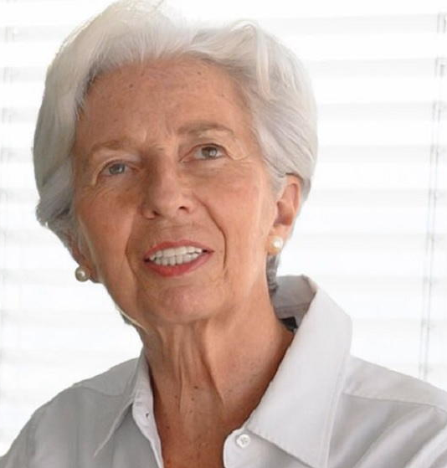
Diversity Boosts Creativity
"Diversity is not a weakness; it is a strength."
Christine Lagarde

Slide 5
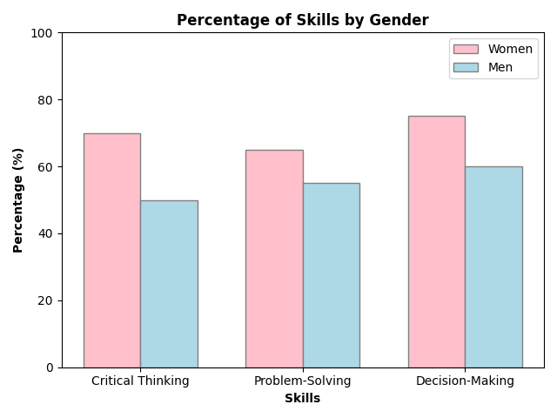
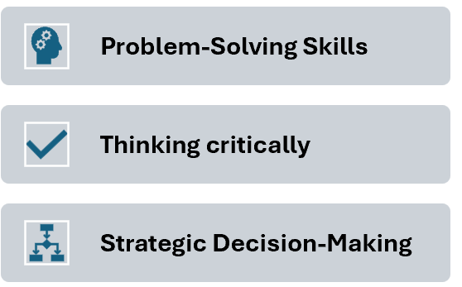
The Impact of Women in the Workplace

Slide 6
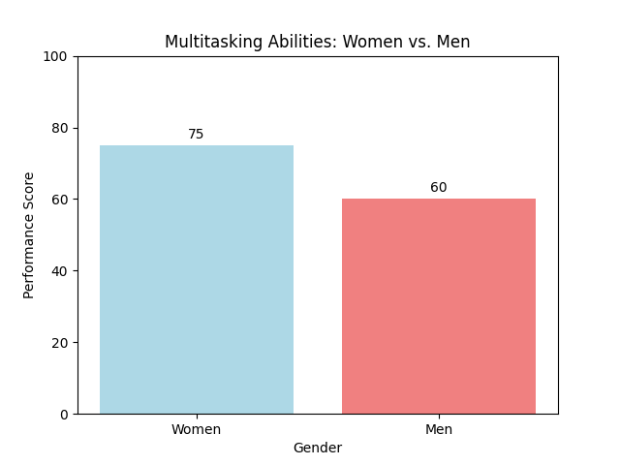
Multitasking Abilities of Women in the Workplace
Importance of Multitasking
Work-Life Balance

Slide 7
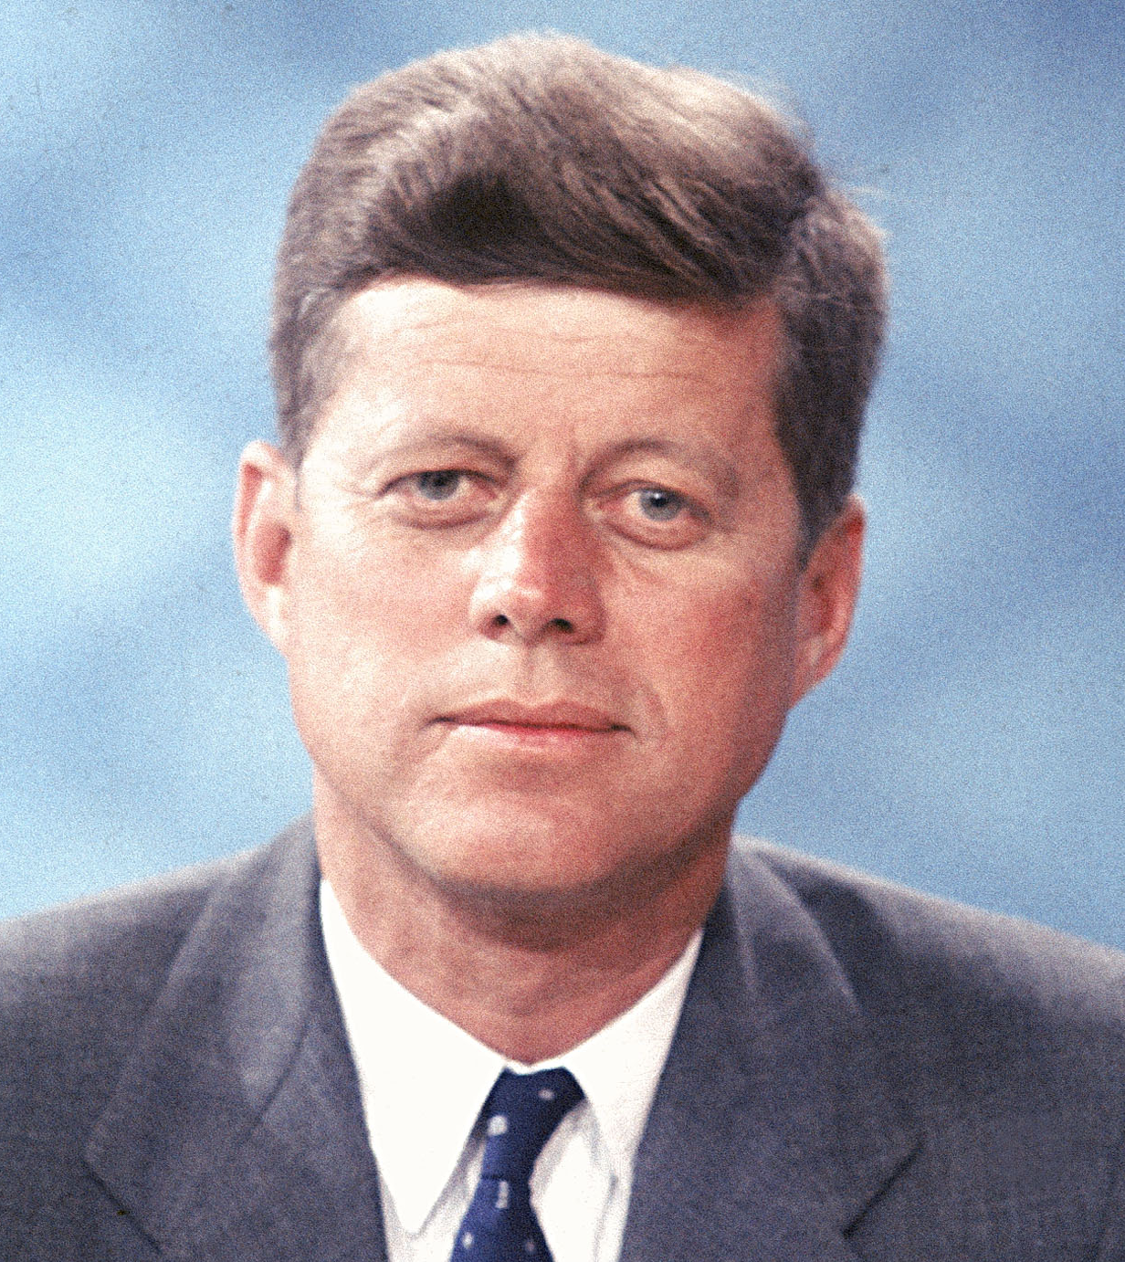
Conclusion
"If not me
and you,
who?
If not now,
when?"
John F. Kennedy

Slide 8
Let’s make
it happen!

Slide 9
References
Merkel, A., 2015, speech at the United Nations, "Gender Equality and Women’s Empowerment."
Gilbert, E., 2015, Big Magic: Creative Living Beyond Fear.
Lagarde, C., 2013, speech at the World Economic Forum, "The Importance of Diversity in Leadership."
Eagly, A. H., & Carli, L. L., 2003, "The Female Leadership Advantage: An Evaluation of the Evidence," The Leadership Quarterly.
BMC Psychology. (2013). Are women better than men at multi-tasking?

