Slide 1
3D Printing
For beginners
Markus V rnbwdsh@github

Slide 2
What to make? Models
What from? Materials
With what? Printers/features
Refinement: Tools
Problems & Hacks
1
2
3
4
5

Slide 3
Models
Ready to print
Thangs
Thingyverse
Fiver
1

Slide 4
Games, Toys, figures
Printer improvements
Functional / spare parts
Decorative
Tool holders
Spool holders
Scraper
Feet
Collapsable sword
Fidget toy
LEGO
RPG figures
Phone case
Raspi case
Extra key
Broken parts of chairs, fridges, tents, games
Vases
Cups
Lamp shade

Slide 5
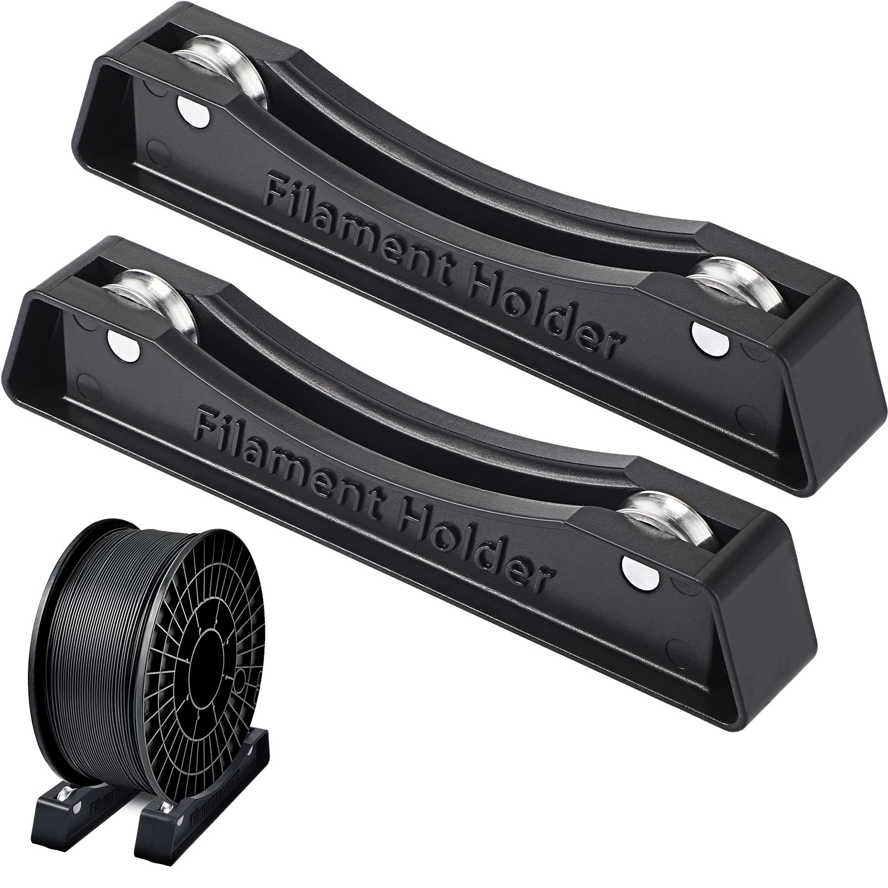
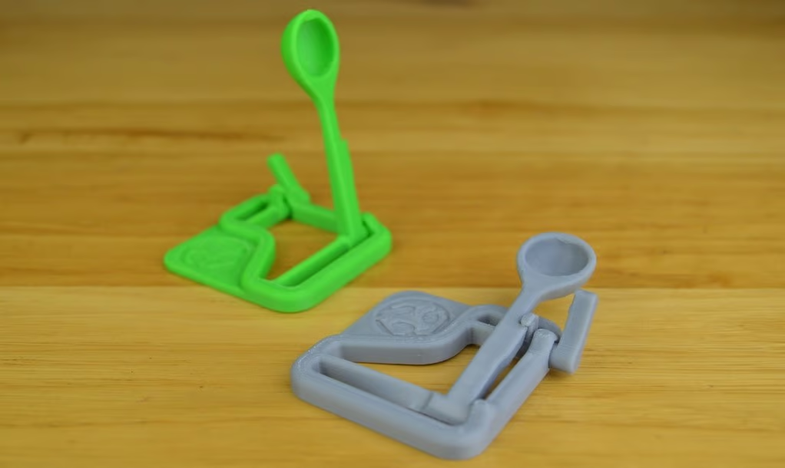
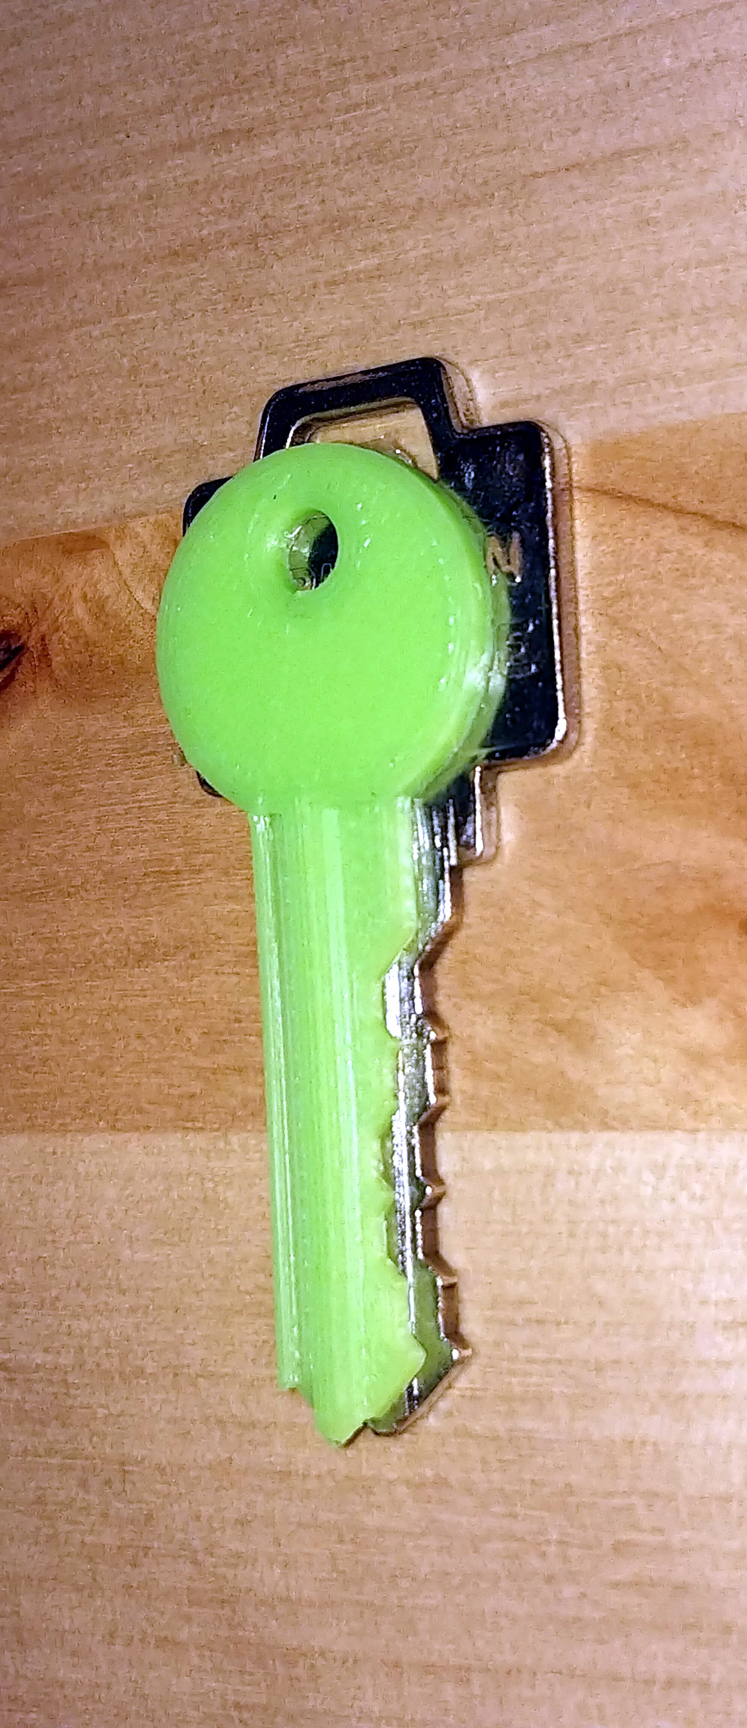
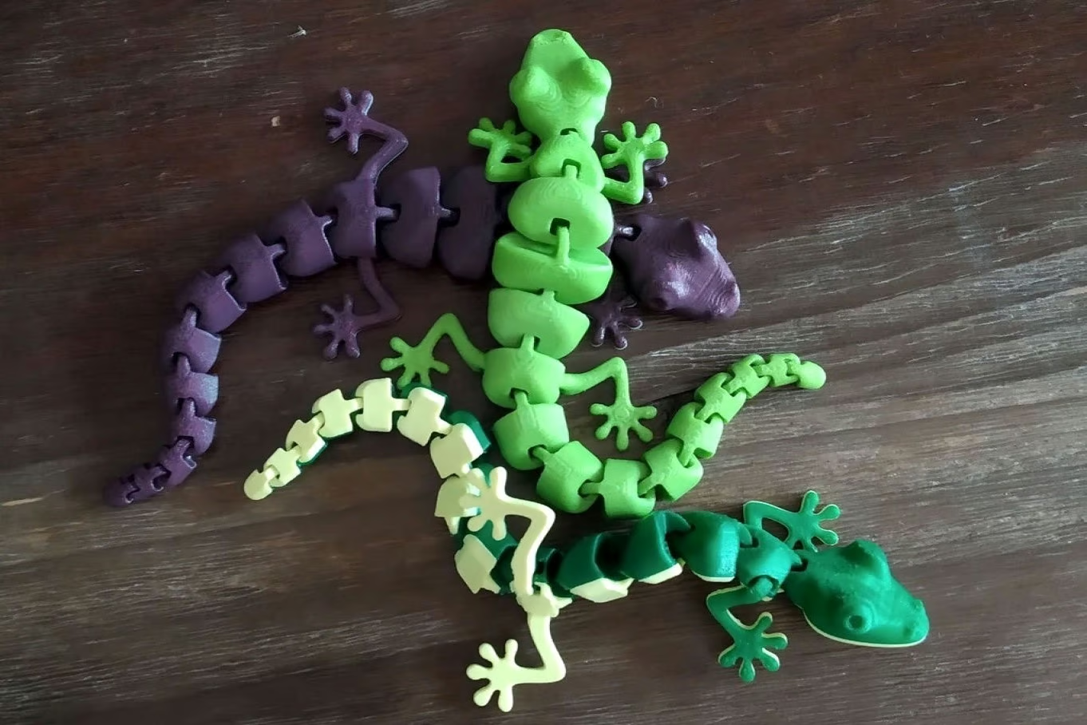
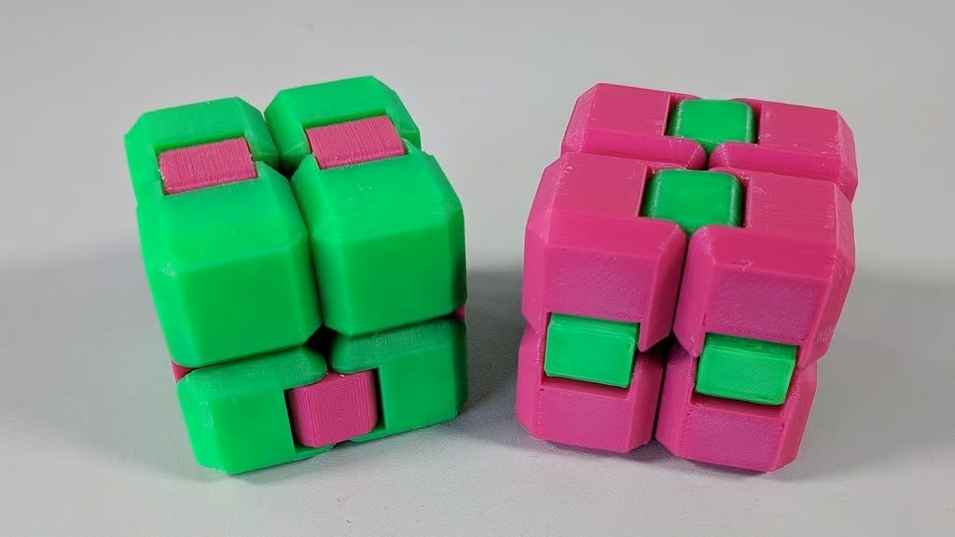
v

Slide 6
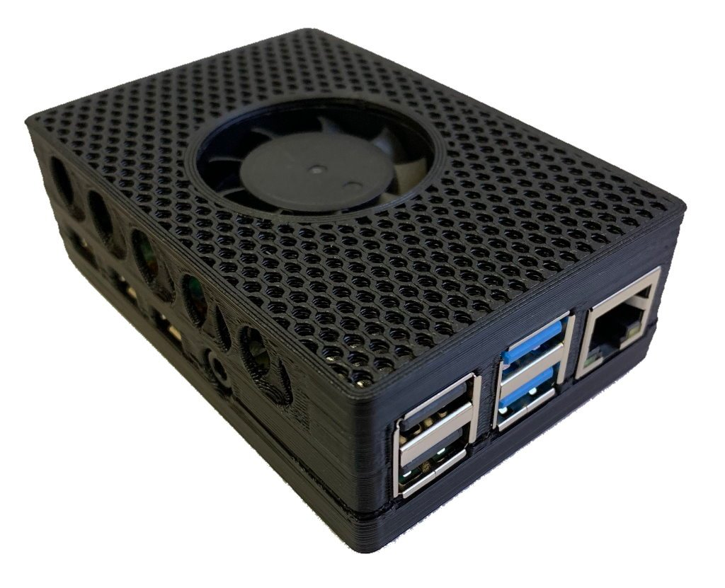
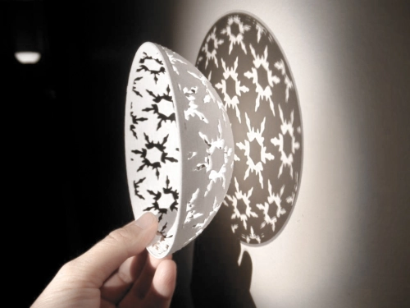
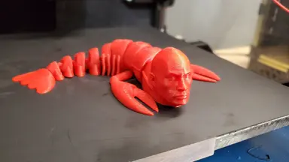
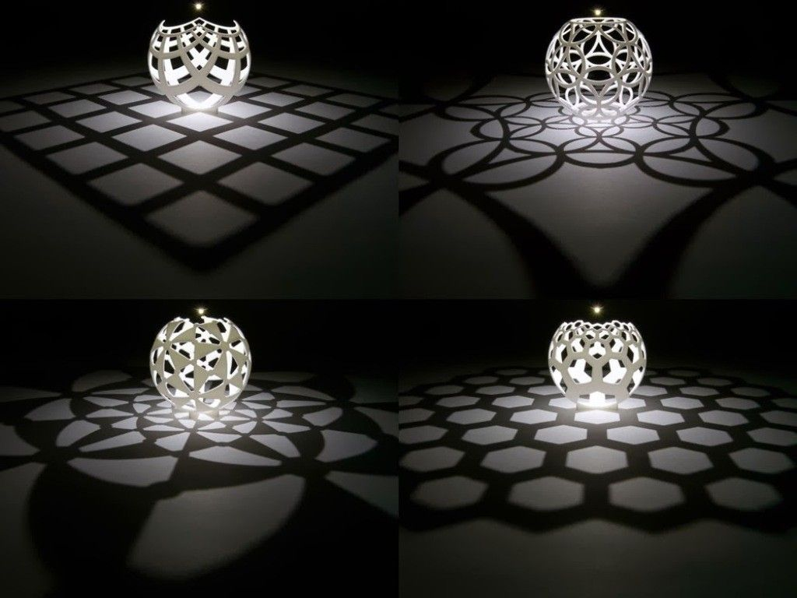
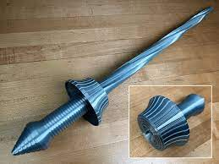

Slide 7
Materials
What to make your prints from?
2

Slide 8
Acrylnitril-Butadien-Styrol
Legacy. LEGO. Toxic fumes, shrinkage
Impact strength, stiff, light, cheap
180°
Polylactic acid
Bio: Made from starch/sugar
200°, most popular plastic, easy to use, fast annealable → heat resistance
PET glycol
Glycol makes PET amorphous → 240°
Elastic, stable, adhesion, transparency instead of 260° → PTFE limit 250°
Thermoplastic Urethane
Rubber, elastic, phone cases, tires, adult toys. Print slow, direct drive
ABS
PLA
PETG
TPU

Slide 9
Printers/features
Kinds of printers, standard features
3

Slide 10
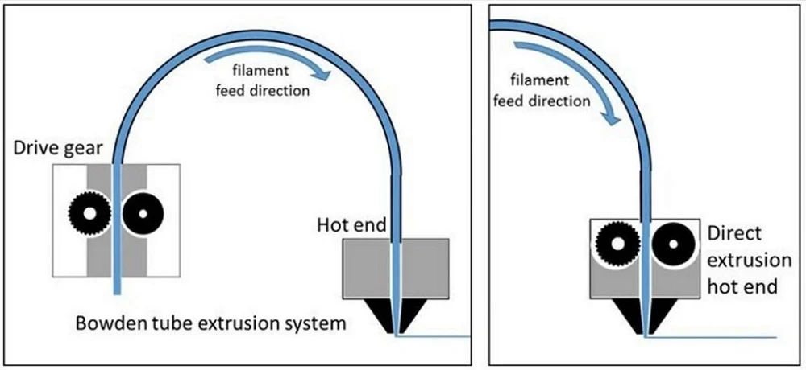
Printer features
Bodwden tube vs direct drive
  Speed of head

Slide 11
Printer features
Bodwden tube vs direct drive
  Speed of head

Slide 12
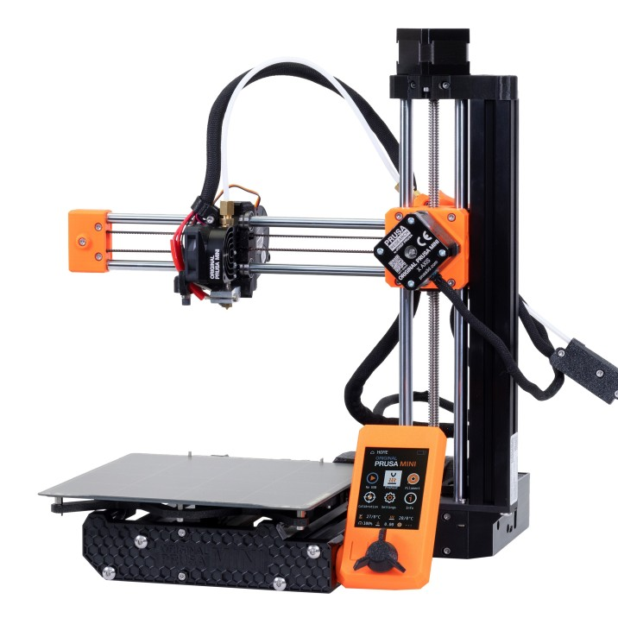
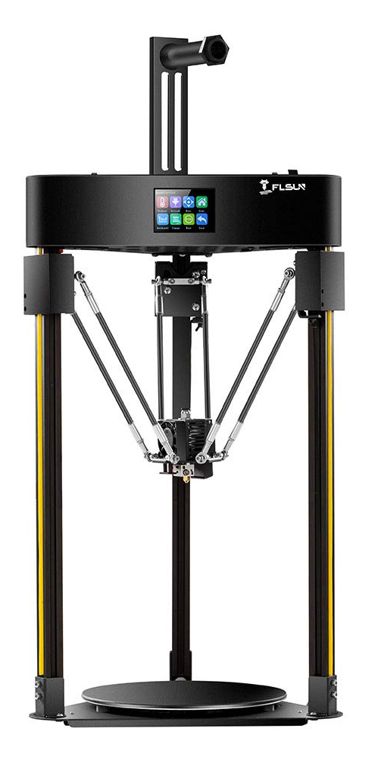
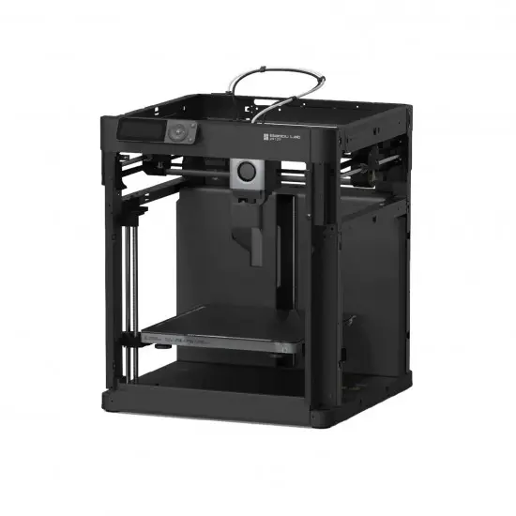
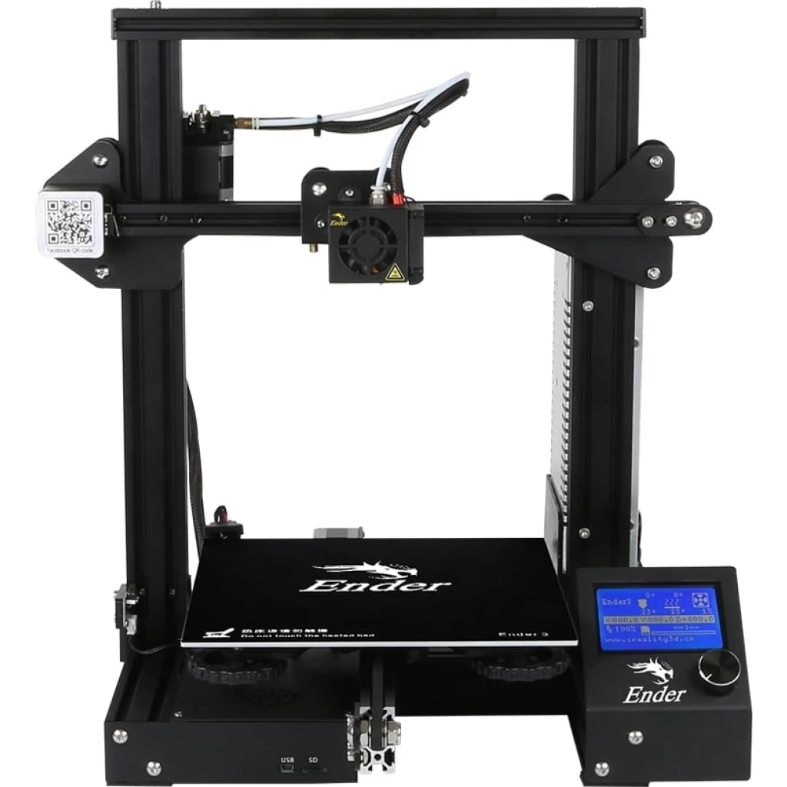
Carthesian / CoreXY / Delta

Slide 13
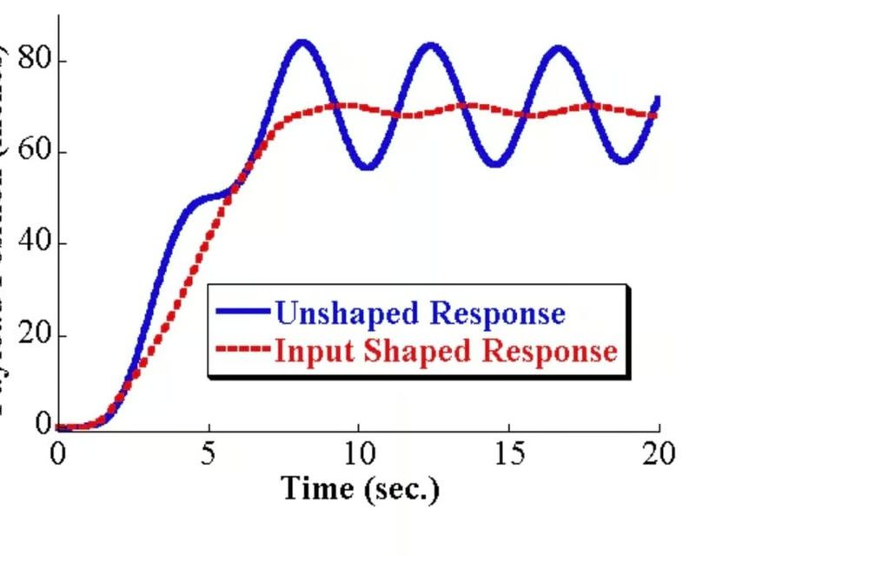
Ender 3 – 250€
Prusa i3 - 1000€
Auto-Leveling:
Guaranteed bed adhesion
700€ + BMS
Auto filament switching: Multicolor
Heated beds:
Important for ABS
400€ Sovol
700€ Bambu Lab
1000€ Voron
Laser-auto-Z
Klipper Input-shaping:
Stupid fast printing

Slide 14
Software Tools
Kinds of printers, standard features
4

Slide 15

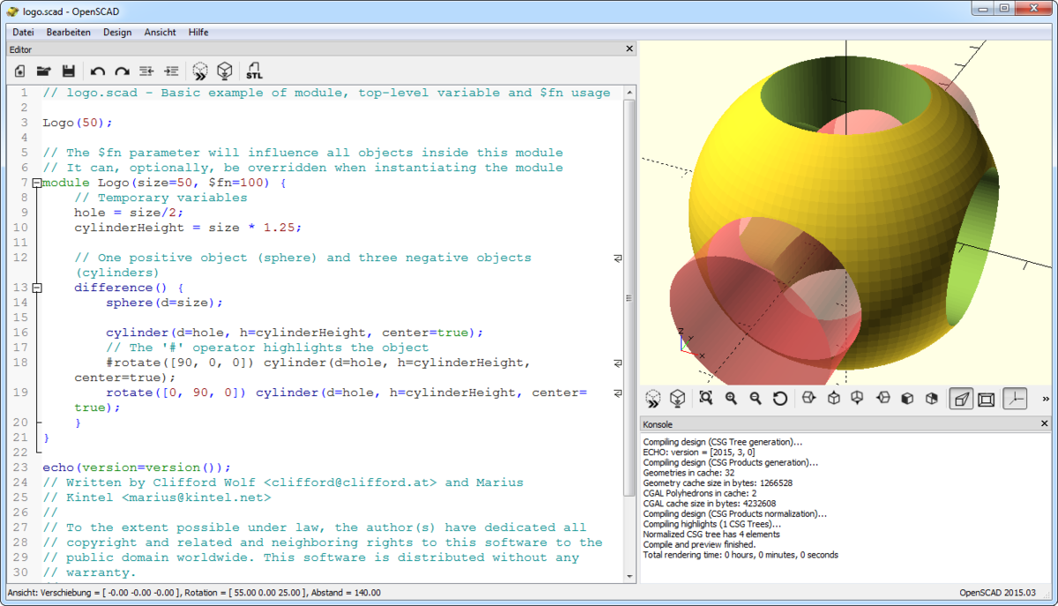
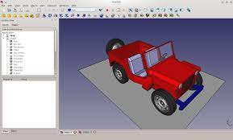
3D Design
OpenSCAD – Model as code
Blender – For game devs – 3D plugin
FreeCAD, TinkerCAD
Work by: Muhammad Aria

Slide 16
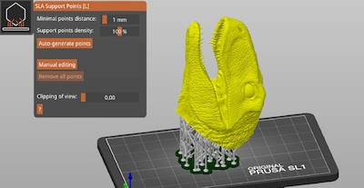

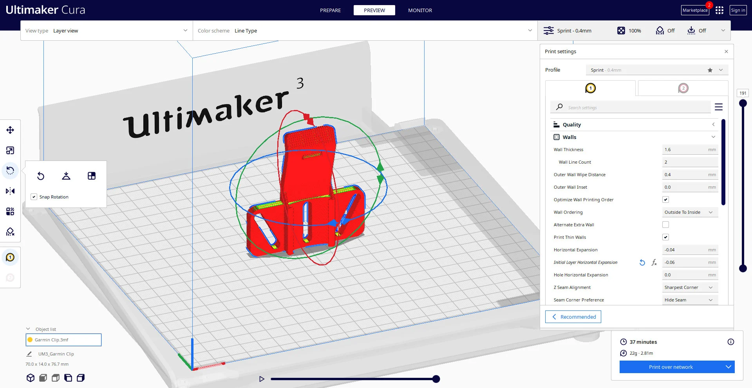
Slicer → 3D model to STL
PrusaSlicer
Cura (Ultimaker)
Orcaslicer (Bambu)
Work by: Falia Vicky

Slide 17
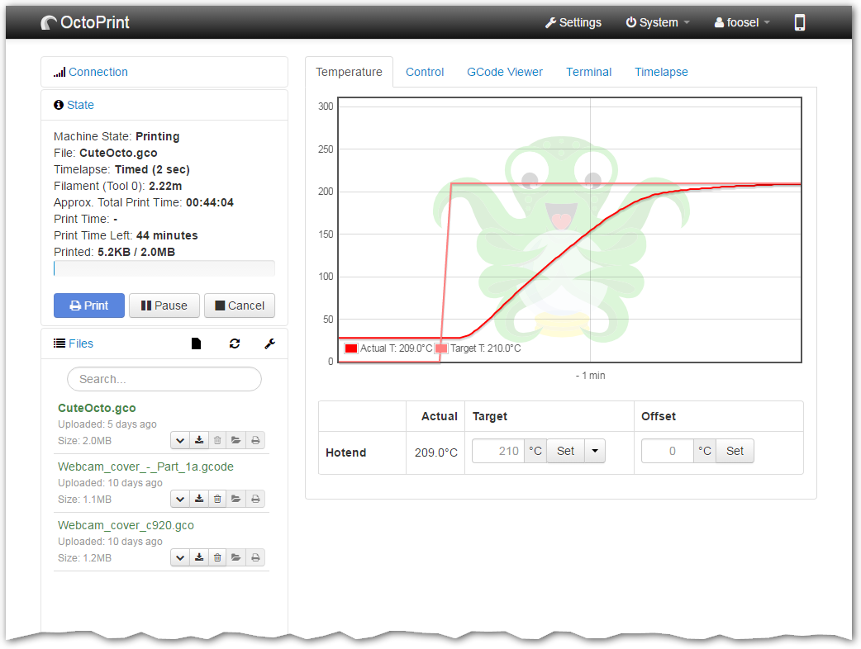
OctoPrint || SDCard
Transfer .3mf commands to printer
Work by: Falia Vicky

Slide 18
Hardware Tools
Kinds of printers, standard features
4

Slide 19
Extra tools
Sticky spray | Tape | Glue Stick
Deburring tool (Entgraten) / lighter / torch
Merge: Soldering iron | solvent | 3Doodler
Screws + Nuts
Paint, Primer, PU Lack, Sanding paper

Slide 20
Problems
& hacks
Kinds of printers, standard features
5

Slide 21
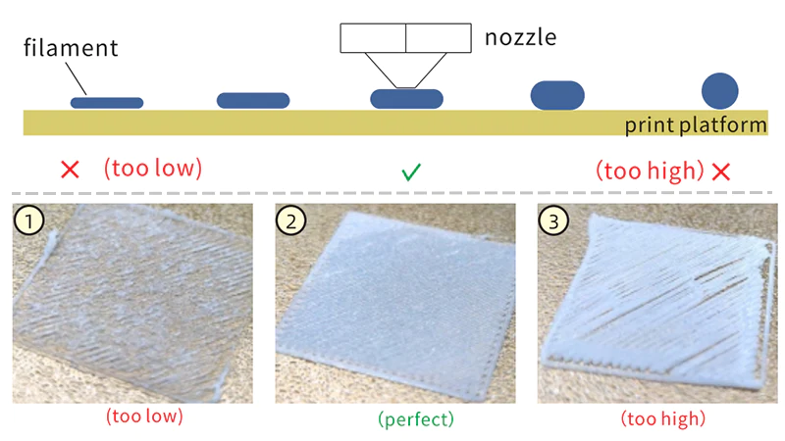
Standard problems: Adhesion
Too little: Adjust Z distance
Watch your 0th layer
Too much:
  Spray / Tape / Glue
  Freezer

Slide 22
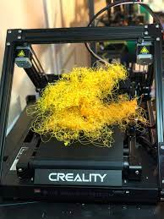
Standard problems: Spaghetti
His palms are sweaty
Knees weak
Arms are heavy
Vomit on my sweater already
Moms spaghetti

Slide 23
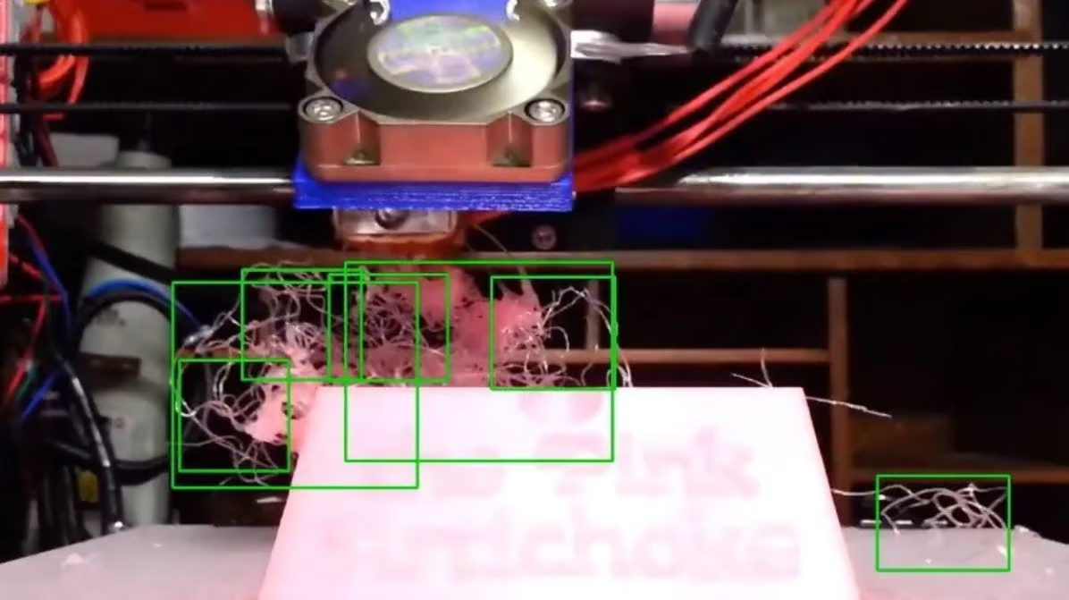
Standard problems: Spaghetti
Spaghetti detective:
  Free OctoPrint AI plugin
    Made for raspi
Watch your print
  Don’t touch
Slower & Hotter

Slide 24
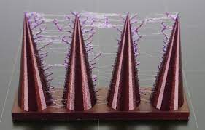
Stringing
Filament too wet:
  Food dehumidifier, pro dryer, geddo: box + heated bed
Slicer setting:
  Avoid crossing
  perimeter
  Slower
  More retraction
Direct drive

Slide 25
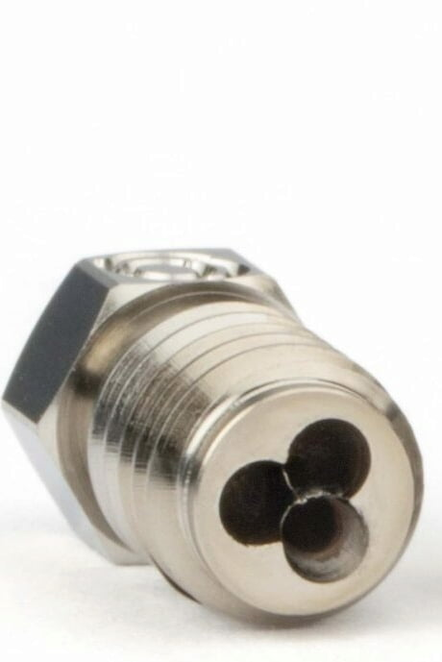
“Problem”: Printer is too slow
Bigger Nozzle:
  0.4 → 0.6 is 225% more area
  Higher layer height → 150% * 225% = 300%
Overextruding via software
  Potentially harder on extruder
Speed filament, CHT nozzle

Slide 26
THANK YOU

