Slide 1
Marc Matthews
Solutions engineering manager (Candidate)
SE Interview Exercise – Build a small Tailnet environment and explain it
NOT a Role Play ☺
Notes:
Lee reached out to me on LinkedIn to ask if I was interested in hearing about this job.
He seemed ”real” so I replied and told him I knew of Tailscale because I use in my homelab.
We had a good chat where he explained the exciting growth going on.
I started using Tailscale a couple of years ago in my home for what I am guessing is a typical residential/consumer use case: to access videos. My daughter just graduated from high school and I have 18 years of video which total several terabytes of files. Sure I can use public clouds for data files or photos, but video literally eats storage and of course cloud providers charge for storing and in some cases the transit to/from those files in the cloud.
I can also VPN from any device back to my home and then access the Internet from my home internet provider, which means I won’t have to tell my video provider than I am traveling AND I can access all restricted US content when traveling out of the country.
Another use case is for anyone in my TailNet to be able to print to my printers in my home. Great for having a hardcopy ready when I get home.
My final use case is to connect two geographicly separated NASes together to sync or really just backup my primary NAS. I don’t do ALL files, just the important irreparable ones like videos of my daughter since birth.
After my HR screening with Kelly, she sent me the Exercise.
Lee original had suggested that I just show my own Tailnet, but after review of the exercise requirements, I pivoted away from explaining my own personal use and into what I see is a pretty common enterprise use-case: how to allow secure access to a developer.

Slide 2



Reaching private resources shouldn't mean
opening a door to the internet.
The customer problem: a developer needs access to private cloud dashboard and database.
The legacy solutions all add risk and friction.
Exposed ports
Bastion + SSH keys
Classic VPN concentrator
Opening 5432/443 to 0.0.0.0/0 invites scans and brute-force; one misconfig is a breach.
A jump host to patch, keys to rotate, and a fat target for lateral movement.
A central choke point: hair-pin latency, coarse network-wide access, single point of failure.
Notes:
Port Forwarding is bad
One problem with port forwarding is that it doesn’t scale. What if you get a new server or app, then you’ve got to go configure that on your firewall. What if you’re constantly spinning up apps or more disasterly is what happens when that device goes away and you still have a hole in your firewall.

Slide 3

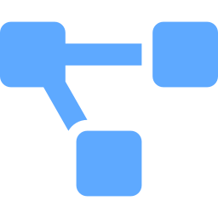



The Tailscale way: identity is the key
Every node joins one Tailnet and gets a stable identity.
A direct, end-to-end-encrypted WireGuard tunnel carries the data — peer-to-peer, never through Tailscale's servers.
How a packet flows
1. MagicDNS resolves the name
client looks up backend.<tailnet>.ts.net
ONE TAILNET · default-deny ACL
2. Direct WireGuard tunnel
backend namespace
encrypted peer-to-peer; user data never transits Tailscale
ts-client
allow
tag:client · dev
ts-backend
nginx :80 + serve
3. ACL evaluated per-connection
tag:client → backend on 80,443,5432; all else denied
nginx dashboard
ts-dev
4. Reaches the private service
postgres :5432
HTTP on the tailnet; optional HTTPS
tag:dev · attacker

Slide 4

Access is identity-based — and provable
One readable policy replaces brittle IP firewall rules. The whole security claim is demonstrable: the authorized developer gets in, any unauthorized node is denied by default.
Validation evidence — make validate
policy.hujson
"acls": [
{ // the developer — least privilege
"action": "accept",
"src": ["tag:client"],
"dst": ["tag:backend:80,443,5432"]
}
// no rule for tag:dev
// → denied by default
],
developer → dashboard
HTTP 200
developer → postgres :5432
accepting
attacker → dashboard
BLOCKED
attacker → postgres
BLOCKED
public host ports
none exposed
client↔backend tunnel
direct WireGuard

Slide 5


TECHNICAL REFERENCE
Secure Remote Developer over a Tailnet
Architecture, traffic flow, access control, and the engineering decisions behind the demo.
Architecture
Traffic flow
Access control
Debugging story
3 nodes, 1 tailnet, isolated networks
userspace · serve · SOCKS5 · DERP
tags + default-deny ACL
3 real failures, found & fixed

Slide 6
ARCHITECTURE
Three nodes, one tailnet, fully isolated
Each node sits on its own Docker network and runs Tailscale with a tag, so the only route between any two nodes is the tailnet itself.
ONE TAILNET · default-deny
ts-client
tag:client
backend server
NODE
TAG
ROLE
allow
ts-backend
ts-backend
tag:backend
Web dashboard + Database server
serve :80,:5432
ts-client
tag:client
Authorized developer
ts-dev
nginx :80
tag:dev
ts-dev
tag:dev
Unauthorized (attacker)
postgres :5432
isolated Docker networks → tailnet is the only path

Slide 7



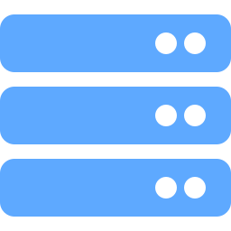
TRAFFIC FLOW
How a request actually travels (userspace mode)
On Docker compose there's no TUN device, so Tailscale runs in userspace mode. Application traffic can't route transparently — so the backend uses tailscale serve for ingress and clients use the built-in SOCKS5 proxy for egress. The ACL is evaluated on every connection.
1 · App → SOCKS5
The authorized developer's process connects to tailscaled local SOCKS5 proxy (127.0.0.1:1055).
2 · Identity attached
tailscaled originates the tailnet connection as tag:client.
3 · WireGuard
Encrypted peer-to-peer link to the backend (direct, or via a DERP relay).
4 · ACL check
Backend evaluates: tag:client→tag:backend on 80/443/5432 = allow.
5 · serve → localhost
tailscale serve proxies the accepted connection to nginx :80 or postgres :5432 on localhost.
Key point for customers: data traffic is peer-to-peer and end-to-end encrypted — it does not flow through Tailscale's servers. The coordination plane only exchanges keys and routes.
Notes:
DERP (Designated Encrypted Relay for Packets) servers manage device connections and NAT traversal. They serve two primary purposes:
Negotiating and establishing connections between tailnet devices (direct or relayed).
Serving as a fallback option when a direct connection isn't possible and a peer relay server isn't available.
Most connections between tailnet devices only use DERP servers to establish a direct connection to another tailnet device. But as a last resort, when other connection types aren't possible due to hard NAT, firewalls, or another reason, devices can communicate using a DERP server as a relay.

Slide 8
ACCESS CONTROL
Identity-based ACLs — the policy explained
policy.hujson
tagOwners
Declares the tags exist and that the admin may assign them. Without this, nodes can't advertise their tag — registration fails.
"tagOwners": {
// who may ADVERTISE each tag
"tag:backend": ["autogroup:admin"],
"tag:client": ["autogroup:admin"],
"tag:dev": ["autogroup:admin"],
},
"acls": [
{ // the ONLY allow rule
"action": "accept",
"src": ["tag:client"],
"dst": ["tag:backend:80,443,5432"]
}
// no tag:dev rule → denied
],
Default-deny
Once any acls rule exists, anything not explicitly allowed is denied. The starter '*→*' rule must be removed.
The deny is structural
tag:dev has no rule, so it's denied by absence.
Why this beats IP rules
Identity survives IP changes, scales by tag not by host, and is readable in one screen — far less human error.
Tailscale SSH is also gated here: admin-only, identity-based, no keys to manage, every session logged.
Notes:
Why this beats IP rules -

Slide 9
VALIDATION
How the solution is proven — six checks
`./scripts/doctor.sh` runs diagnostics, then six checks, and exits non-zero if any failure occurs.
1 · developer → dashboard
3 · developer → postgres :5432
HTTP 200 via serve, through SOCKS5
TCP reachable over the tailnet
2 · attacker → dashboard
4 · attacker → postgres
blocked — no ACL rule
blocked — no ACL rule
5 · public host ports
6 · client↔backend link
none exposed
encrypted WireGuard (direct/DERP)
Result on a healthy run: Passed: 6 Failed: 0

Slide 10

DEBUGGING STORY
1 · ACL not enforcing
2 · Wrong wire
3 · Key expiration
Both developer AND attacker got in. Cause: the new tailnet's default '*→*' allow-all rule was still present alongside the policy.
Attacker still got in after the ACL fix. The nodes shared a Docker bridge; the test hit the service by Docker hostname, bypassing the tailnet entirely.
The project’s original auth-key expired mid-development.
Fix: replace the entire ACL — one tag:client→tag:backend rule, no wildcard.
Fix: isolate each node on its own network; test against the backend's Tailscale IP.
Fix: Generate new key and add to .env
And a “few” more issues – both nothing related to Tailscale

Slide 11
COMPARISON
Why Tailscale vs traditional approaches
Approach
Cost / risk
This solution
Public IP/port allowlist
Internet-facing surface; brittle, leaky IP lists
No public port at all
Bastion / jump host
A box to patch; key sprawl; lateral-movement risk
No bastion; identity is the perimeter
Classic VPN concentrator
Hub-and-spoke choke point; hair-pin latency; coarse access
Direct WireGuard mesh; per-service ACLs
ssh -L port-forwarding
Manual, unaudited, easy to leave open
Tailscale SSH: keyless, ACL-gated, logged
Notes:
One line: the service stops having a public door — identity decides who gets in, the path is encrypted by default, and the denial is provable.

Slide 12


THE VALUE
Stronger security, faster access, cost savings.
Security posture
Developer velocity
Less to operate
No public attack surface. Identity + tag rules instead of error-prone IP lists.
Access in minutes.
No load-balancers. No VPN concentrator. No bastion. No patches. No key rotation.
“The service stops having a public door. Identity decides who gets in — and you can prove the attacker is locked out.”

Slide 13




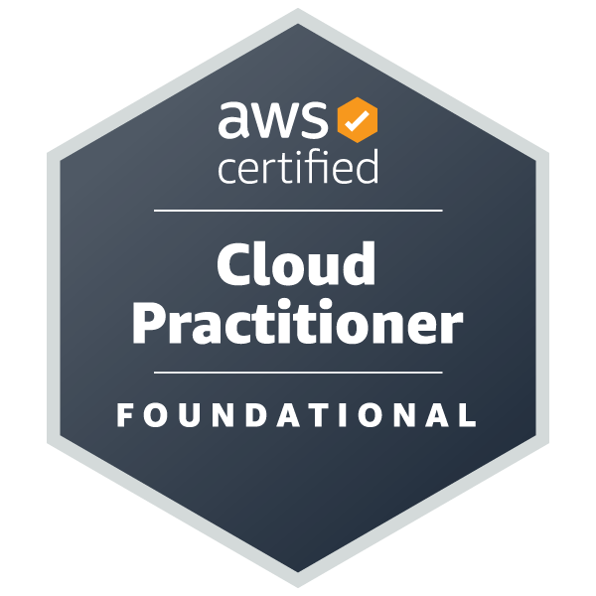
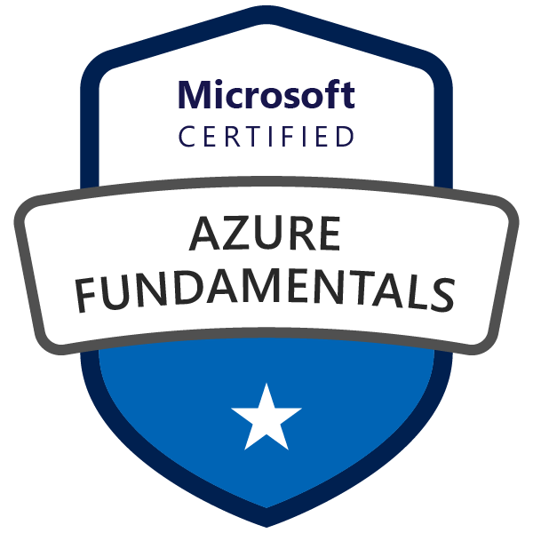

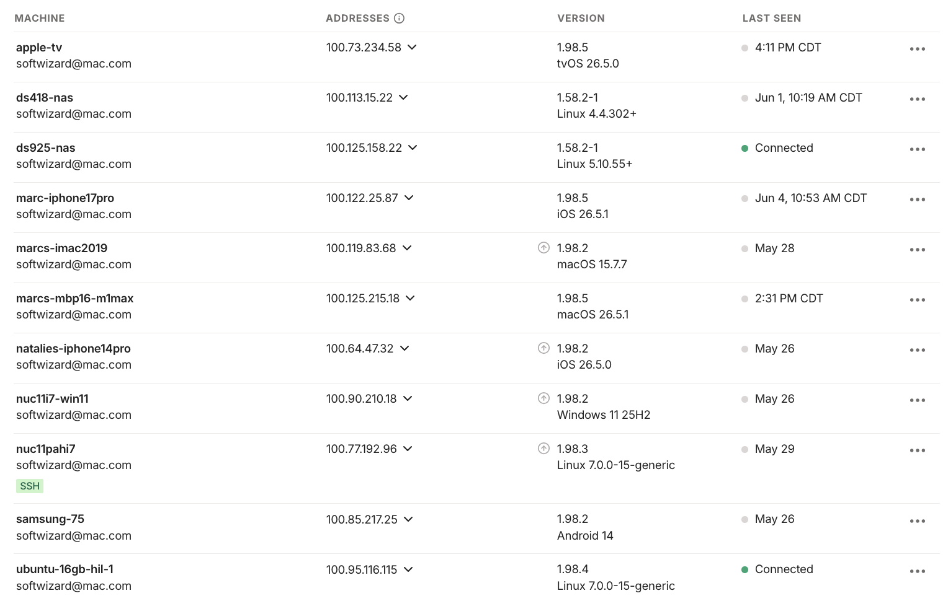
Why Marc is a great choice to work at Tailscale
Multiple successful stints at start-ups leading the SE org
Deep networking knowledge and a constant, proven ability to learn new technologies
I have been a believer in Tailscale as a product before even beginning this interview process

