Slide 1
2000–2025
7 / 26 years
Drought comes back about one year in four
Red squares show drought years.
2000–2008
2000
2001
2002
2003
2004
2005
2006
2007
2008
2009–2016
2009
2010
2011
2012
2013
2014
2015
2016
2017–2025
2017
2018
2019
2020
2021
2022
2023
2024
2025
Drought hit Mykolaiv region in 7 of the last 26 years.
What is a drought year? A year when April to September was much drier than normal and crops were much less green, across more than 1/5 of the region's farmland.
Based on rain, heat and satellite images of crops, 2000–2025.

Slide 2
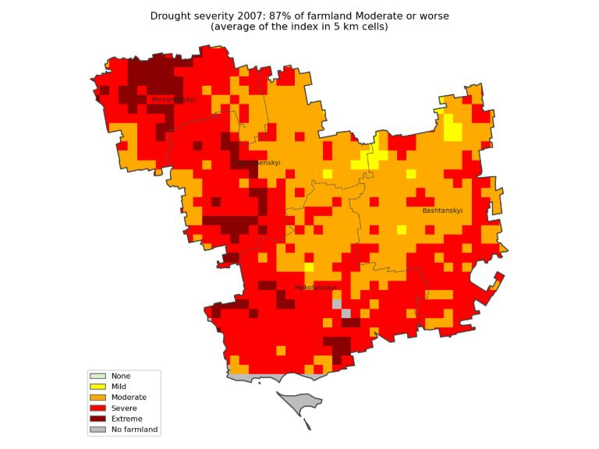
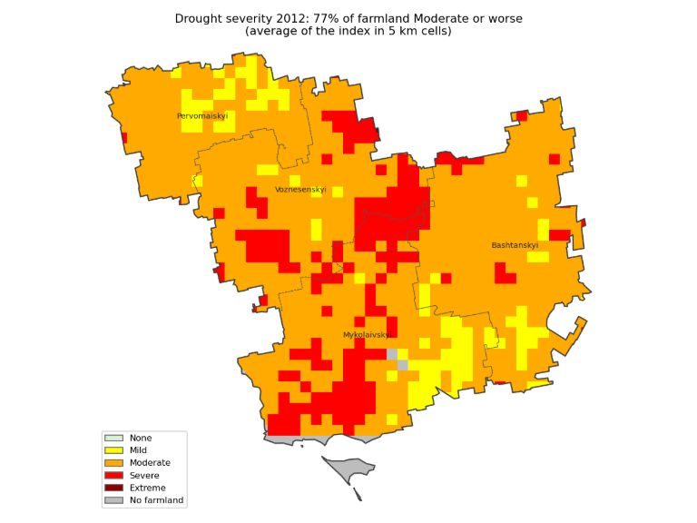
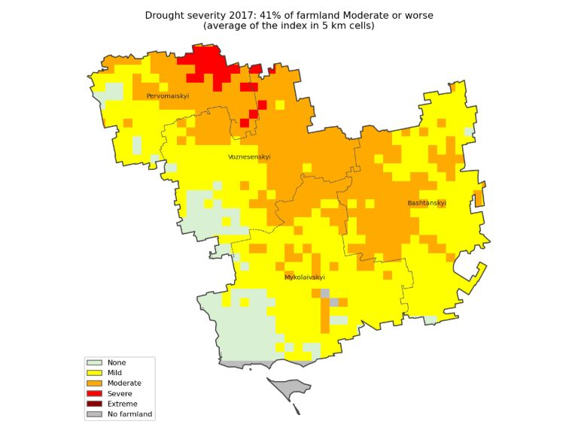
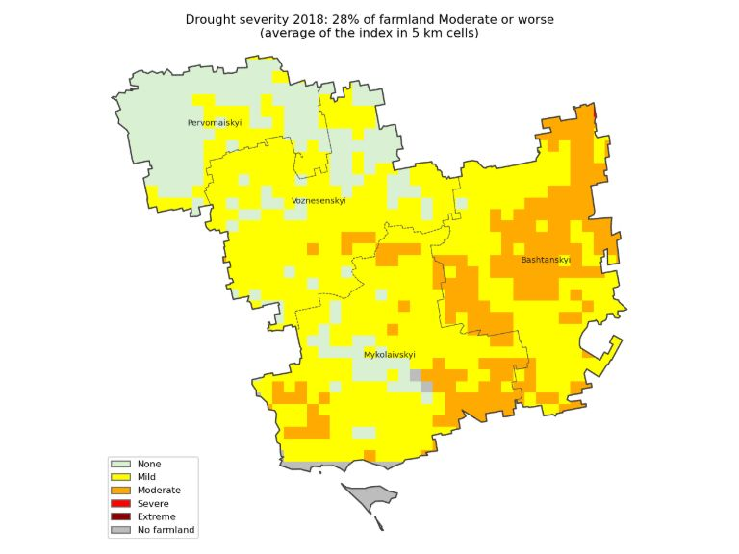
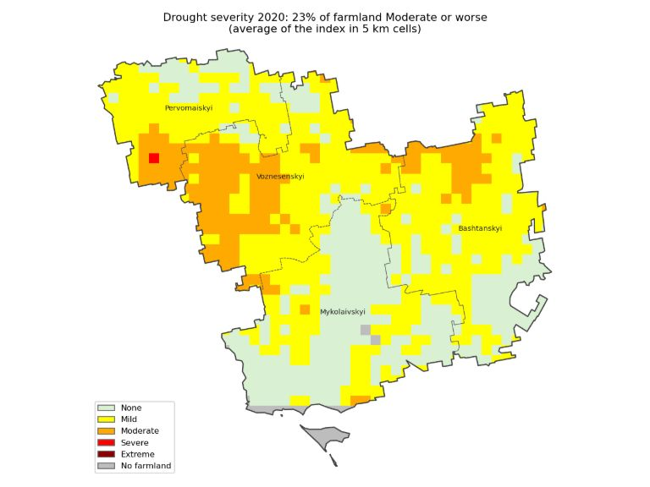
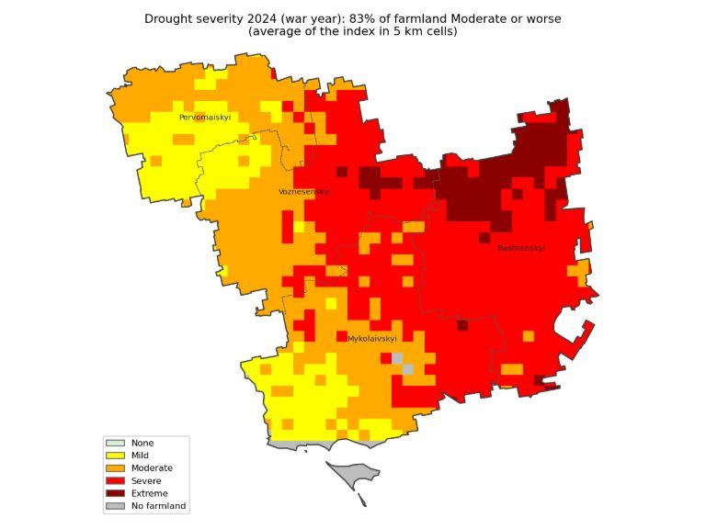
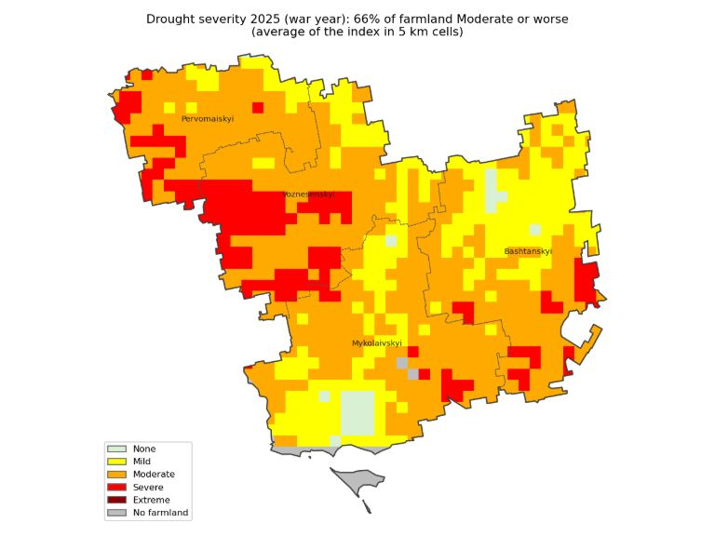
In the worst years, drought covered almost the whole region
2007
2012
2017
Worst years: 2007, 2024, 2012, 2025.
In those years, two out of three fields or more were dry or worse.
COLOUR KEY
2018
2020
2024
Normal
A little dry
Dry
Very dry
Extremely dry
Not farmland
Each colour compares the year with what is normal for that same place.
2025

Slide 3
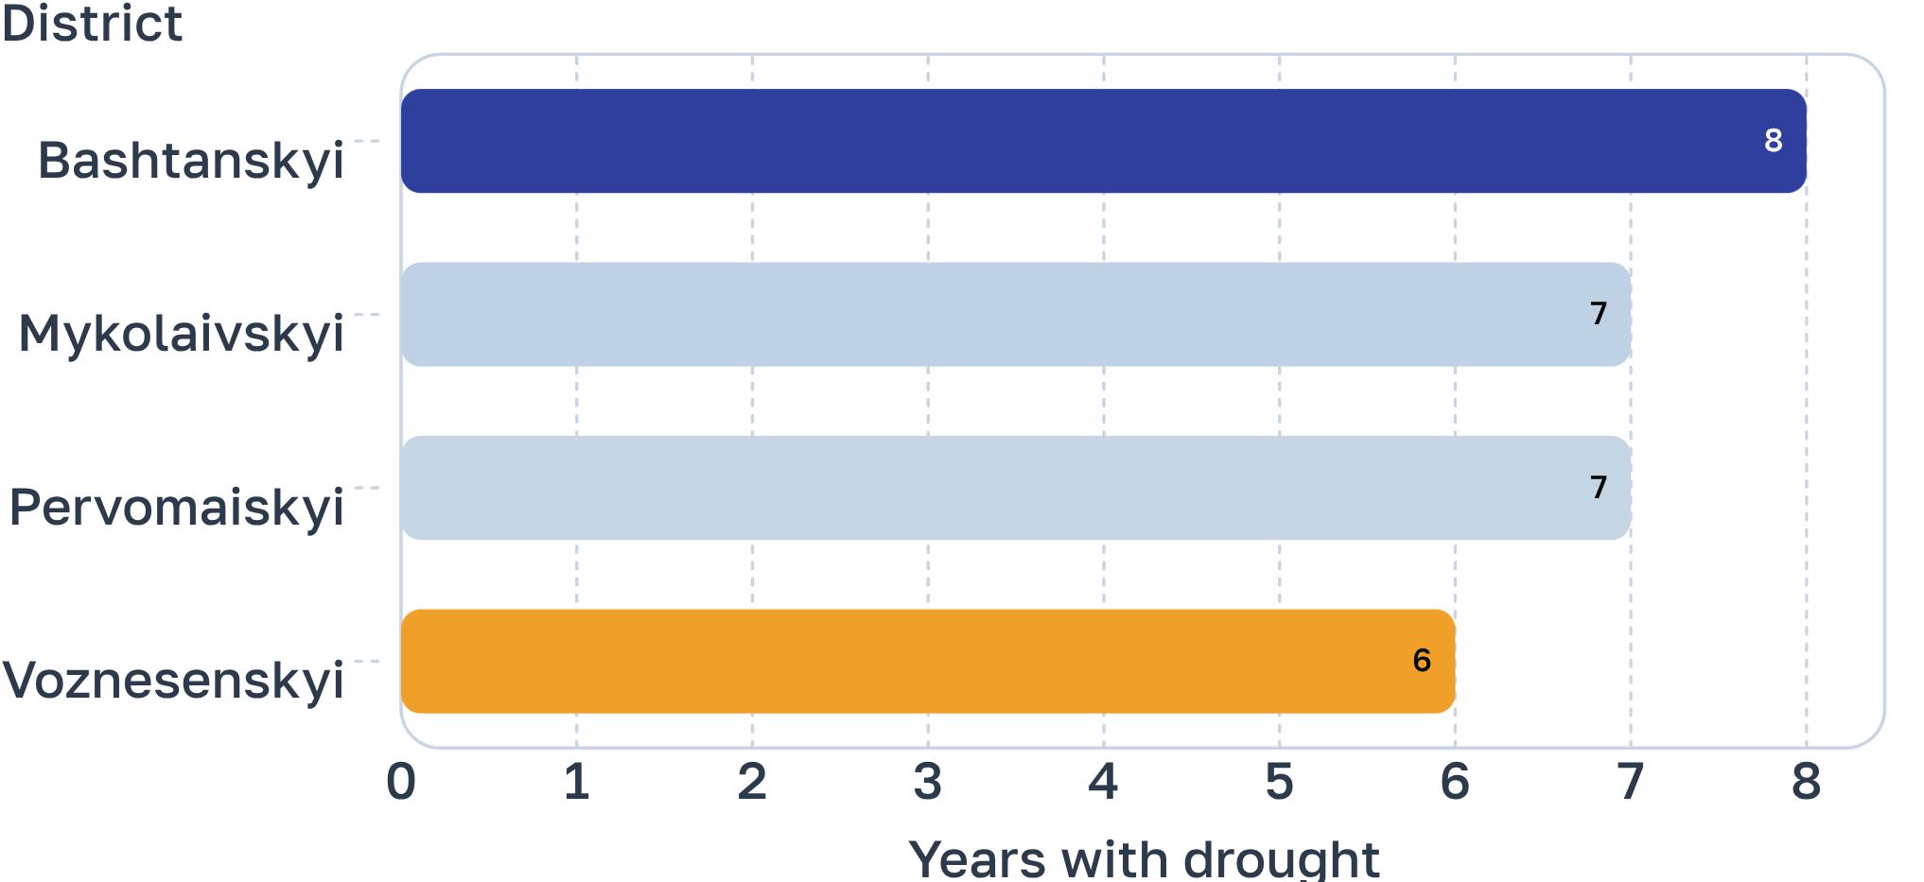
No district is safe.
All four districts are affected
Years with drought, out of 26.
Which one suffers most changes from year to year.
Dry years often come in pairs:
2017–2018
2024–2025.

Slide 4




Keep the soil covered.
Sow thinner, and test it first.
What farms in the south are doing about drought
Skip plowing where you can and leave crop residue on top. A farm in Pervomaisk district has used no-till since 2018 and could still sow on time in dry springs.
Some southern farms sow winter wheat at 2-3 million seeds per hectare instead of 4 million. Try it on one field before changing all of them.
Don't bet on one crop.
Match fertiliser to the water.
In 2025 sunflower gave only 0.2 t/ha on some Mykolaiv fields. Farms say soybean needs irrigation here. Mix crops, rotate deep-rooted and shallow-rooted ones, and consider winter crops and peas.
In a dry year water limits the yield, so extra nitrogen is wasted. One Mykolaiv-area farm cut its nitrogen by about half.
Plan for a dry year every four years.
Sow when the soil is ready, not by the calendar.
Examples from farms in southern Ukraine (SuperAgronom, 2024-2025). Options to discuss with your agronomist. They do not guarantee yield.
Soil covered with residue keeps its moisture, so you can pick the sowing day to suit it.

