Slide 1
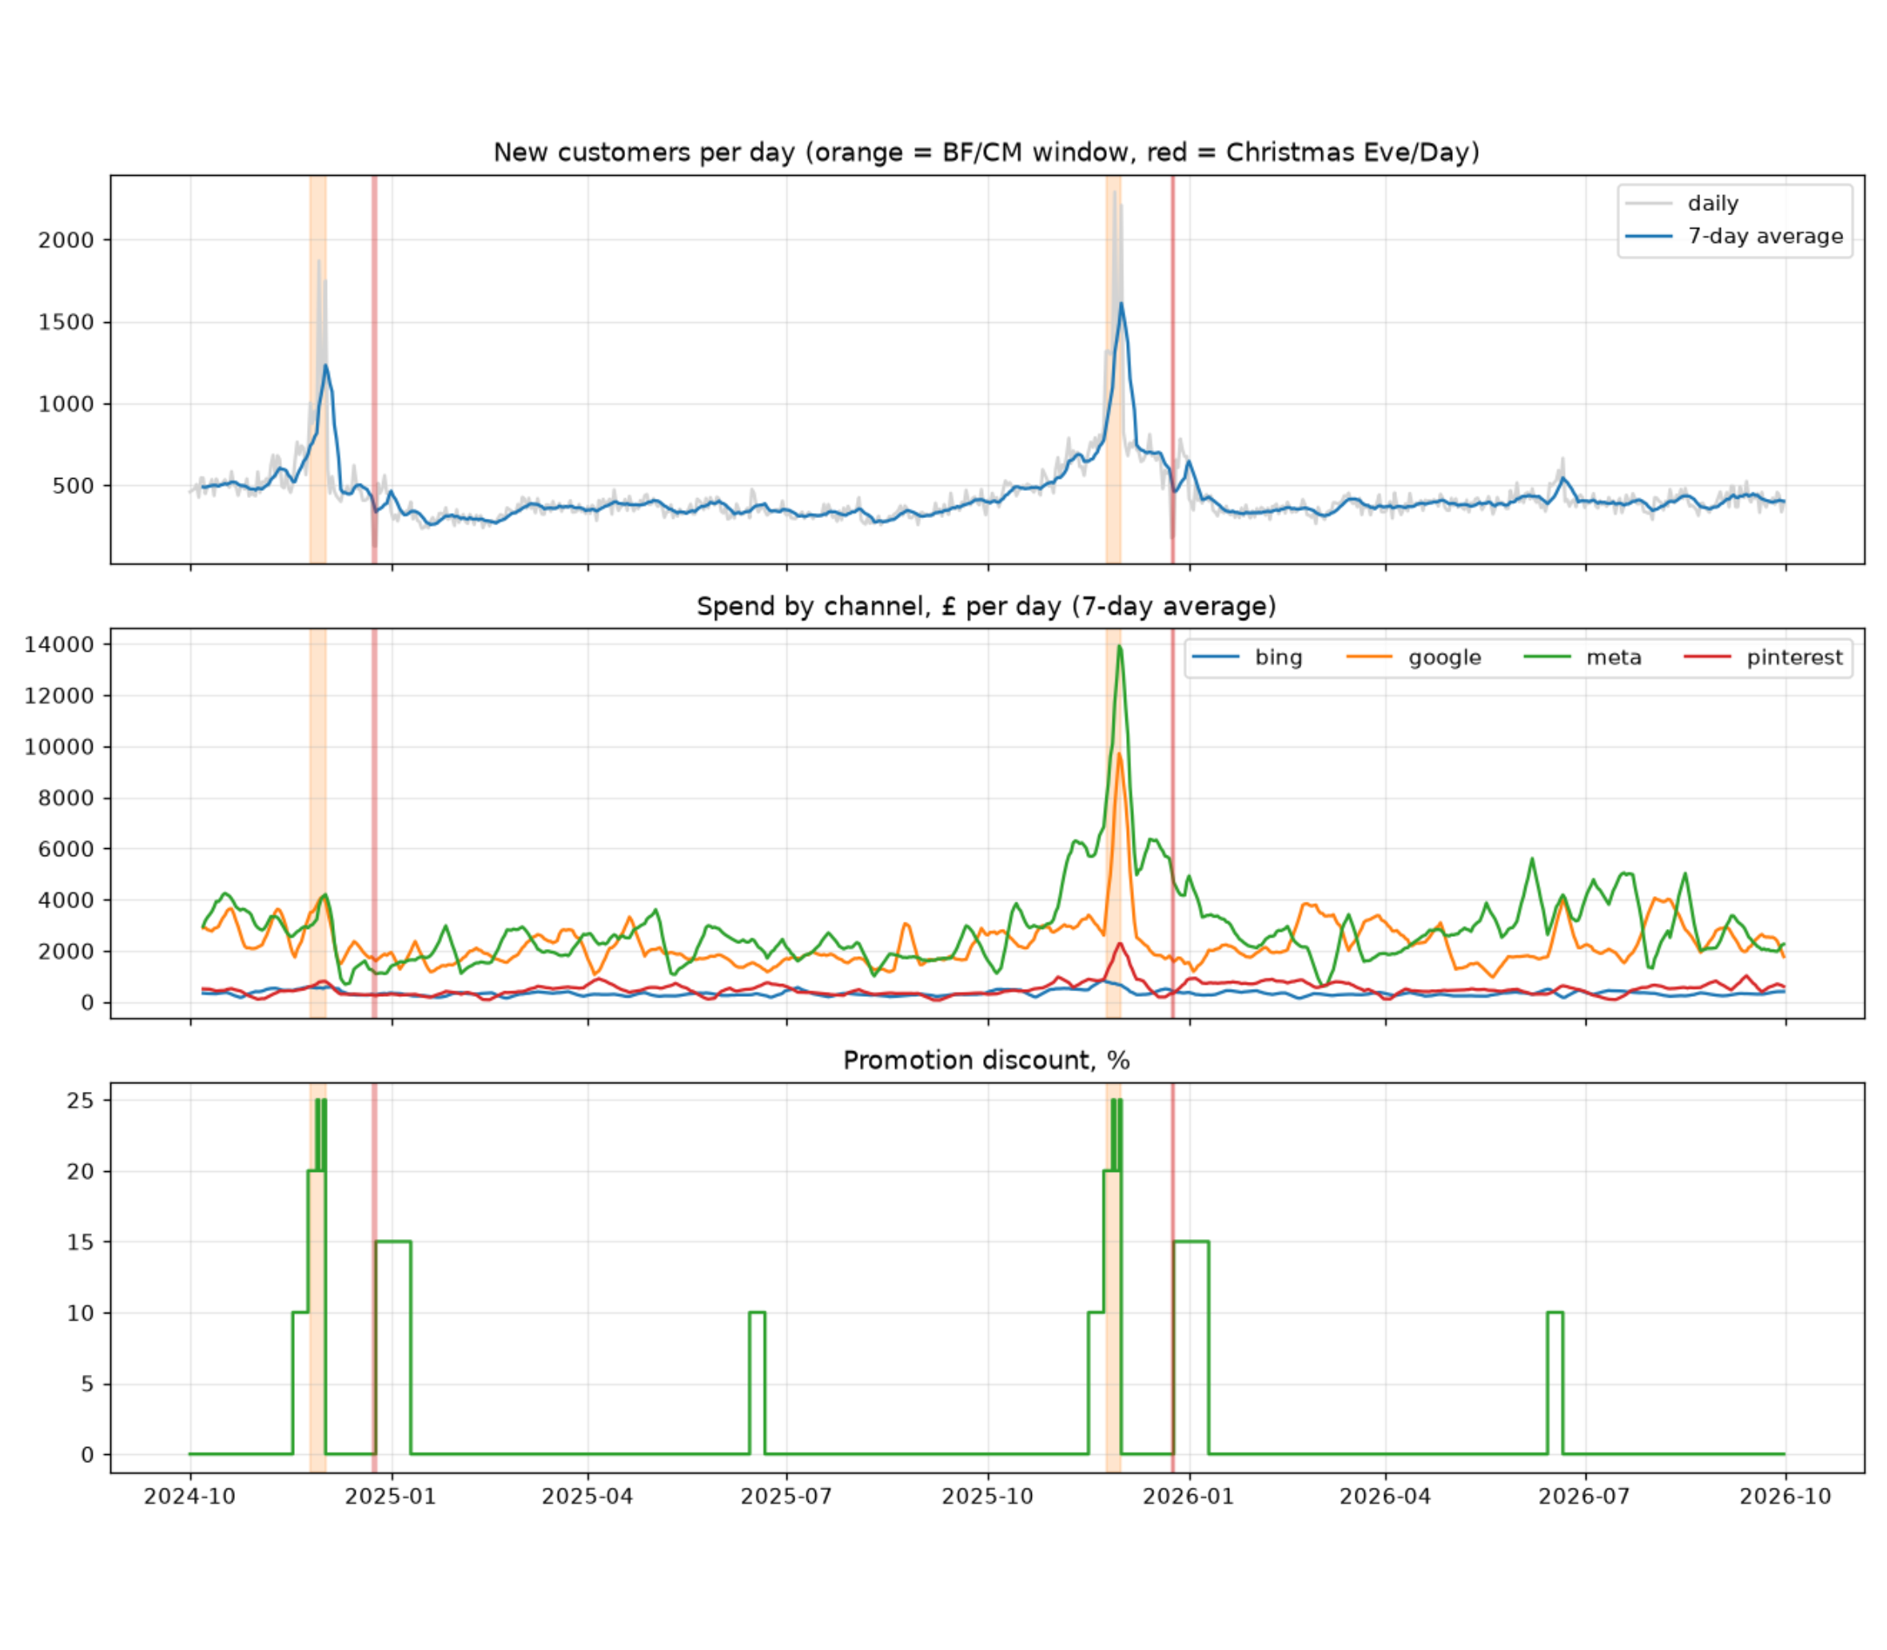
MARKETING MIX MODEL
Where to add budget to win new customers under £40
Marketing mix model, daily data October 2024 to September 2026
The question is which channels to scale, hold or reduce.

Slide 2
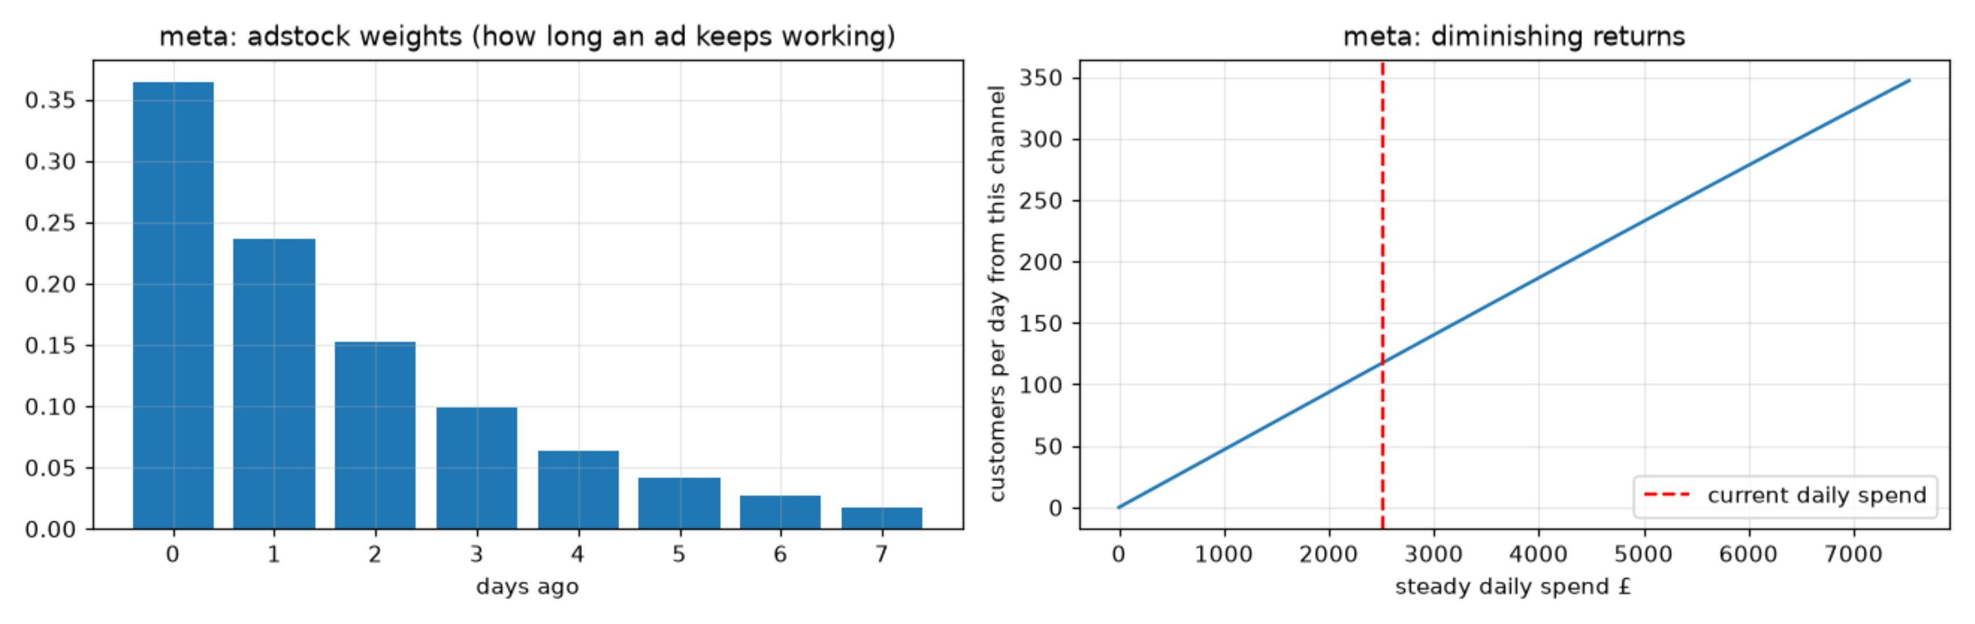
MODEL MECHANICS
How the model works
Predicts daily new customers from spend in Bing, Google, Meta and Pinterest.
Separates baseline, seasonality, promotions and Black Friday / Cyber Monday.
Adstock: Meta’s ads keep working for days; half the effect is gone after about 1.6 days.
Saturation: Meta’s response is almost a straight line up to 2.5× today’s spend.
Each estimate is a range, not a single number.
2

Slide 3
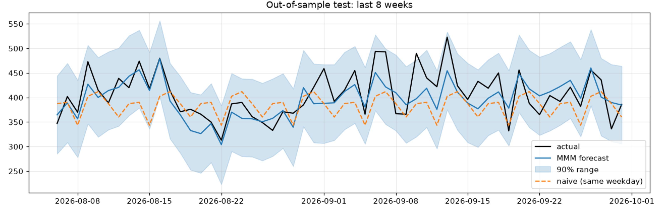
VALIDATION
Can we trust the model?
Data checks: 10 of 10 passed. No gaps, duplicates or unit problems found.
The sampler converged: max r-hat 1.005, no divergences.
On the last 8 weeks held out from training, model average error 6.2%; simple forecasts scored 9.1–9.5%.
The model beat the simple forecasts in all 8 weeks.
Limit: ranges cover parameter uncertainty only, not the risk that the model structure is wrong.
Metric | Model | Same weekday, last 4 weeks | Flat 28-day average
MAE (customers/day) | 25.7 | 38.6 | 40.4
MAPE | 6.2% | 9.1% | 9.5%
RMSE | 32.8 | 47.9 | 51.9
3

Slide 4
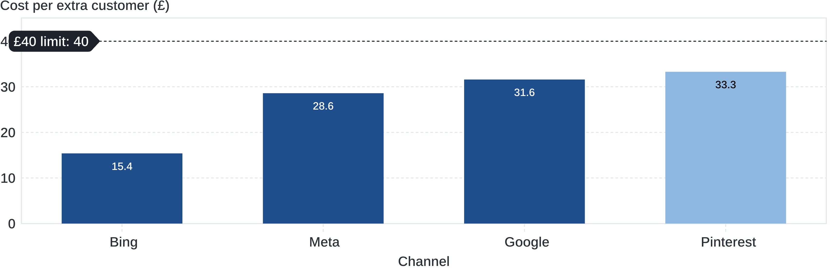
MARGINAL ECONOMICS
One extra customer costs £15–£33 today, all under £40
Bing £15, Meta £29, Google £32, Pinterest £33 per extra customer (+10% step).
Google reaches £40 at about 1.5× today’s spend; Pinterest is least certain (71% chance of staying below £40).
Cost per extra customer, +10% step
4

Slide 5
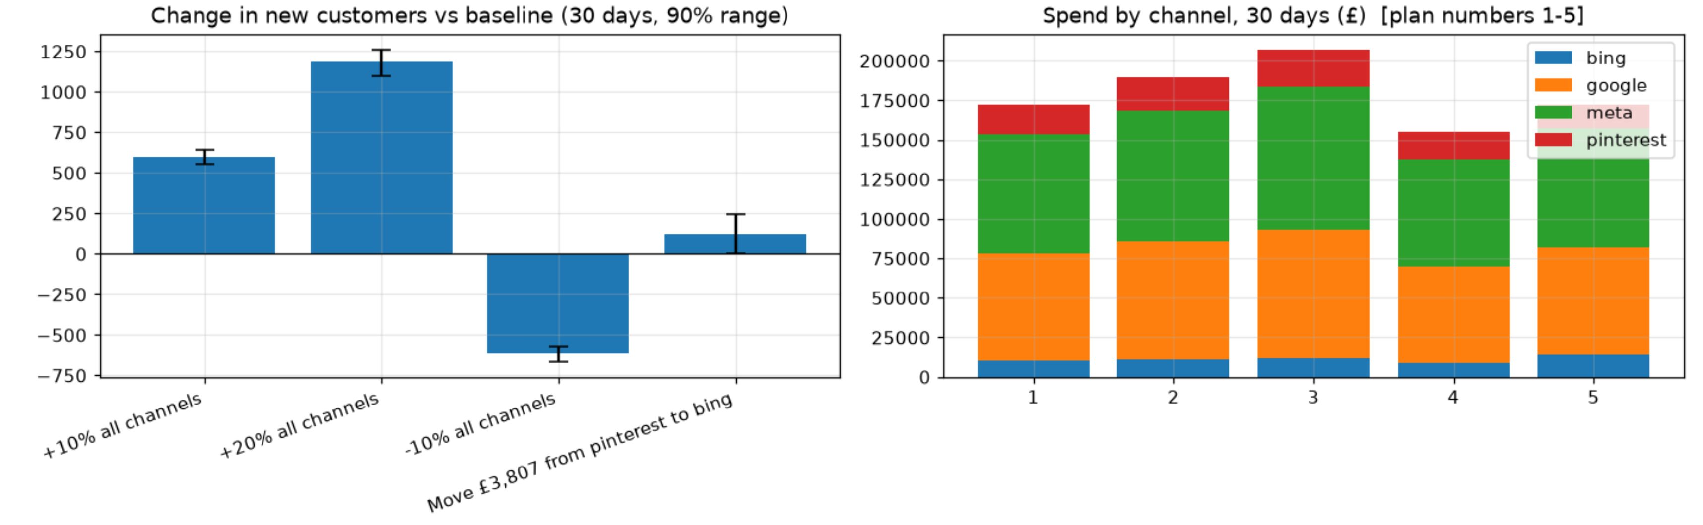
Scenario (30 days) | Spend change | Extra new customers (90% range) | Cost per extra customer
Keep spend (baseline 12,558) (1) | £0 | n/a | n/a
+10% all channels (2) | +£17.2k | +600 (557 to 641) | £28.7
+20% all channels (3) | +£34.4k | +1,183 (1,098 to 1,262) | £29.1
−10% all channels (4) | −£17.2k | −616 (−663 to −568) | £28 saved per customer lost
Move £3.8k Pinterest → Bing (5) | £0 | +127 (0 to 245) | n/a
SCENARIO PLANNING
Adding 10–20% across channels brings about 600–1,200 more customers
Add budget to Meta first, then Bing; grow Google only to about 1.5× today’s spend; hold Pinterest, and do not cut, since every customer costs under £40
The reallocation range includes zero, so the gain is not certain.
5

Slide 6
Test a 20% Meta increase before scaling further
Acquiring a single customer costs Meta approximately £29,
below the £40 limit, so it is the first place to test more budget.
PLAN
Meta increase | Extra spend | Extra customers | Cost per extra customer
+10% | £7.5k | 263 | £28.6
+20% (test) | £15.1k | 526 | £28.6
+40% | £30.1k | 1,050 | £28.7
+80% | £60.2k | 2,093 | £28.8
Test: Meta +20% for 30 days, £75.3k → £90.3k (+£15.1k)
Expected: about 526 extra customers (range 488 to 566)
Success: cost per extra customer at or below £40; reduce if above £40 for two weeks
LIMITS
The range shows uncertainty in the estimate, not whether the model itself is right
Only two Black Fridays in the data
Correlation is not causation; the test will confirm the effect
Measure weekly with control regions kept at the old budget → review after 7 days → decide after 30 days
Model estimate. The test will confirm or correct it.

