Slide 1

Rollerball
THE SOGGY ZEBRAS
Jonathan Cowles, Angela Root, Dawson Canby, Courtney Torres, Jordan Peterson

Slide 2
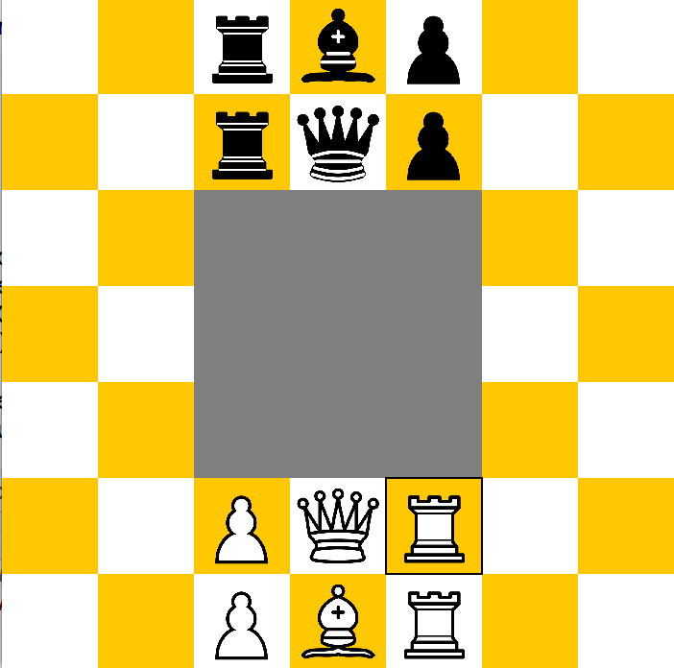
Rollerball Review

Slide 3
Recap
7x7 Game Board with 3x3 hole in the center
Pieces for each color
1 King
1 Bishop
2 Rooks
2 Pawns
If a pawn reaches the other teams starting locations of their pawns, they can be promoted to a Bishop or Rook.
Player wins by putting other teams King in checkmate.

Slide 4
GUI Technologies
Java Swing
JFrame for window
JPanel for rendering of board
JPanel with a CardLayout for menus
Each menu is a “card” in a “deck” that can be flipped through
This makes it easy to switch between the login/register/load game menus

Slide 5
Server-Client Technologies
Sockets
Server Sockets
Threading for sending and receiving messages
File input/output streams
Object input/output streams

Slide 6
Design Class Diagrams

Slide 7
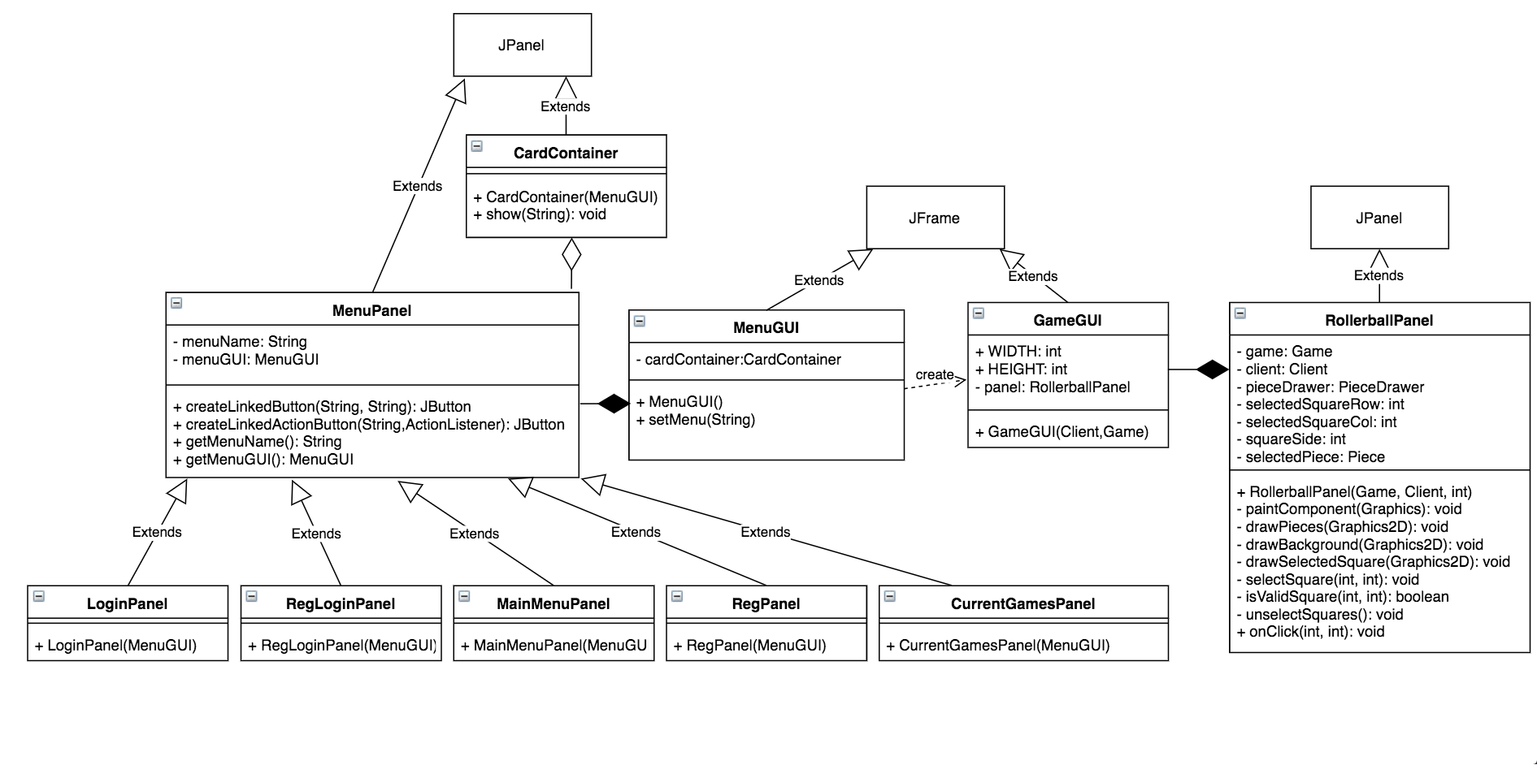
GUI System
CardContainer holds MenuPanels and allows transitions between them
RollerballPanel represents the canvas that the game is drawn on and handles input
MenuGUI and GameGUI represent the actual windows that the menu and game will be displayed in
MenuPanel is extended to create menus with specific functions (register/login/load game)

Slide 8
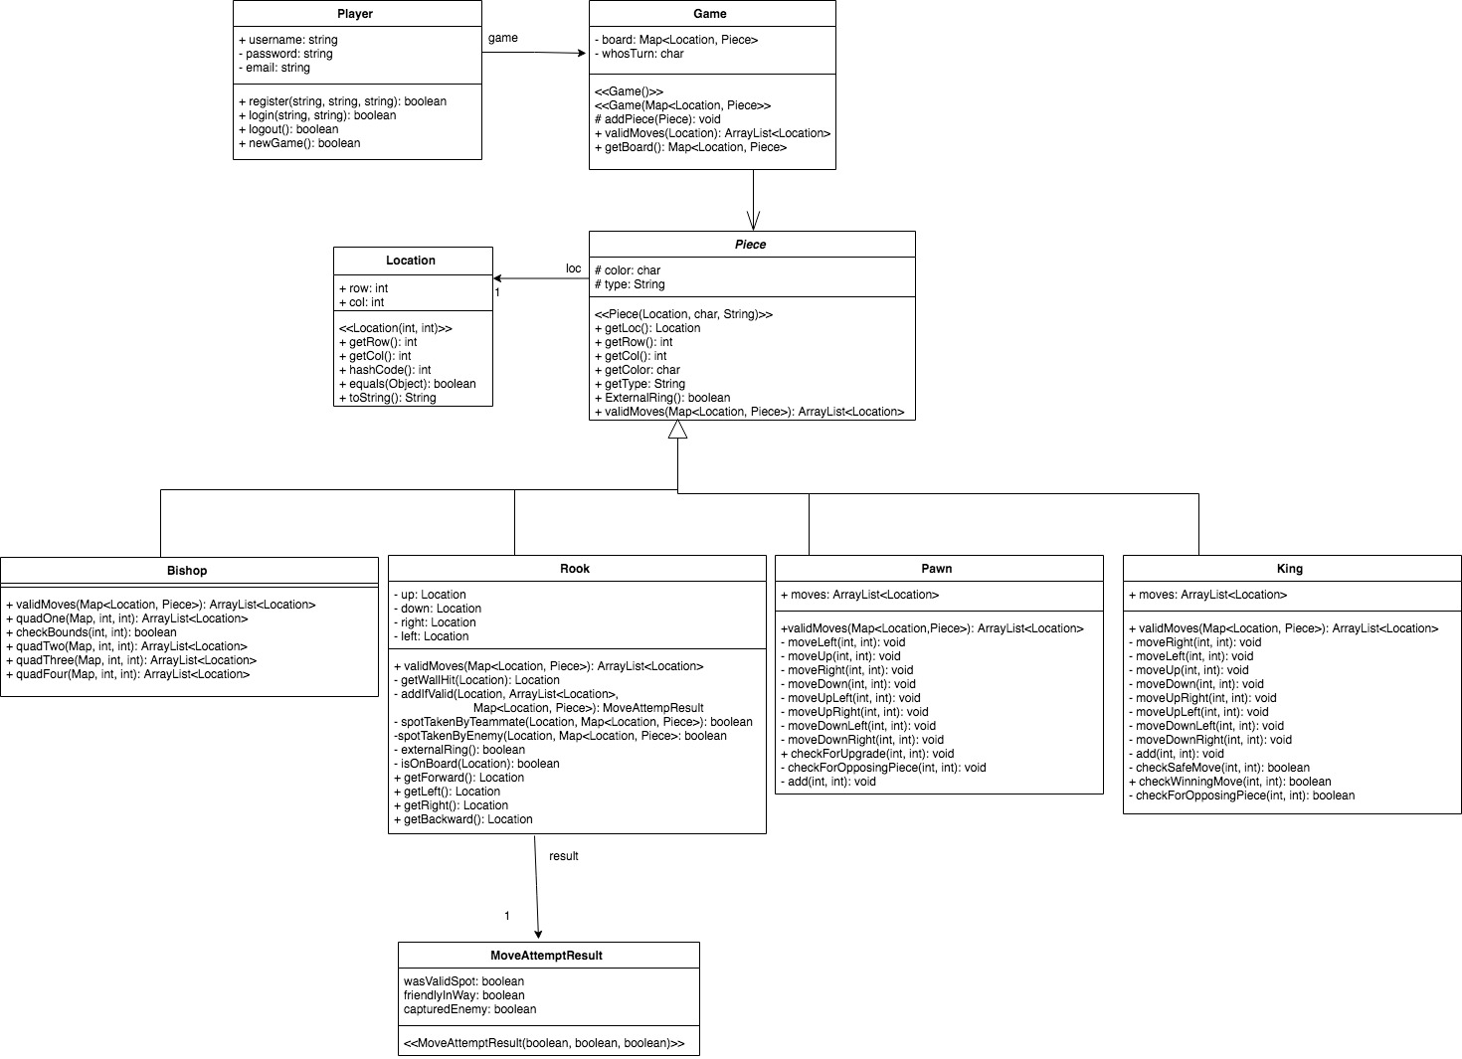

Slide 9
Domain Model Diagram Updates

Slide 10
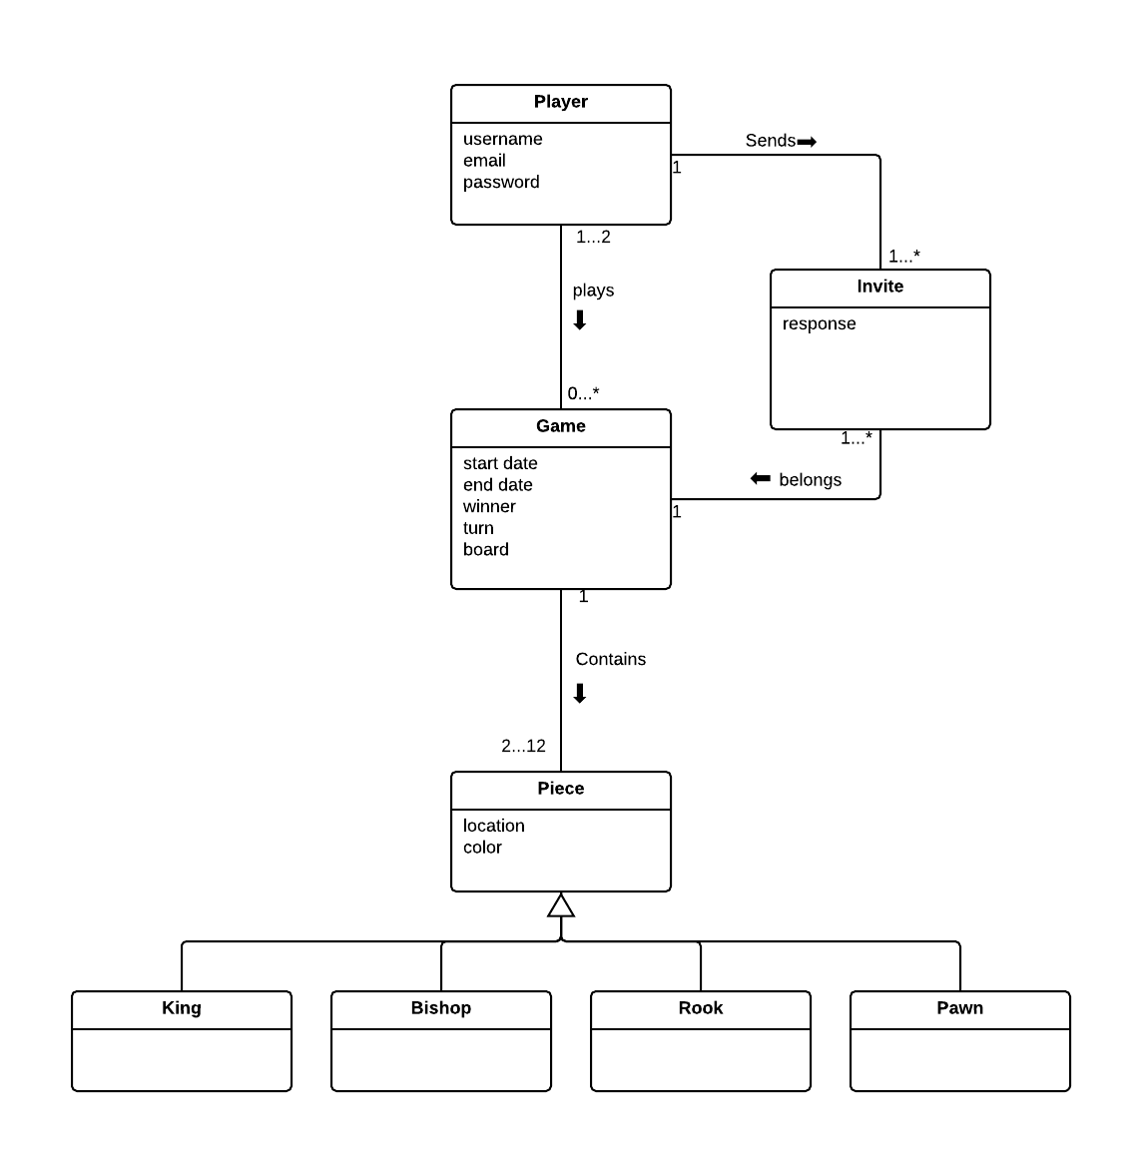
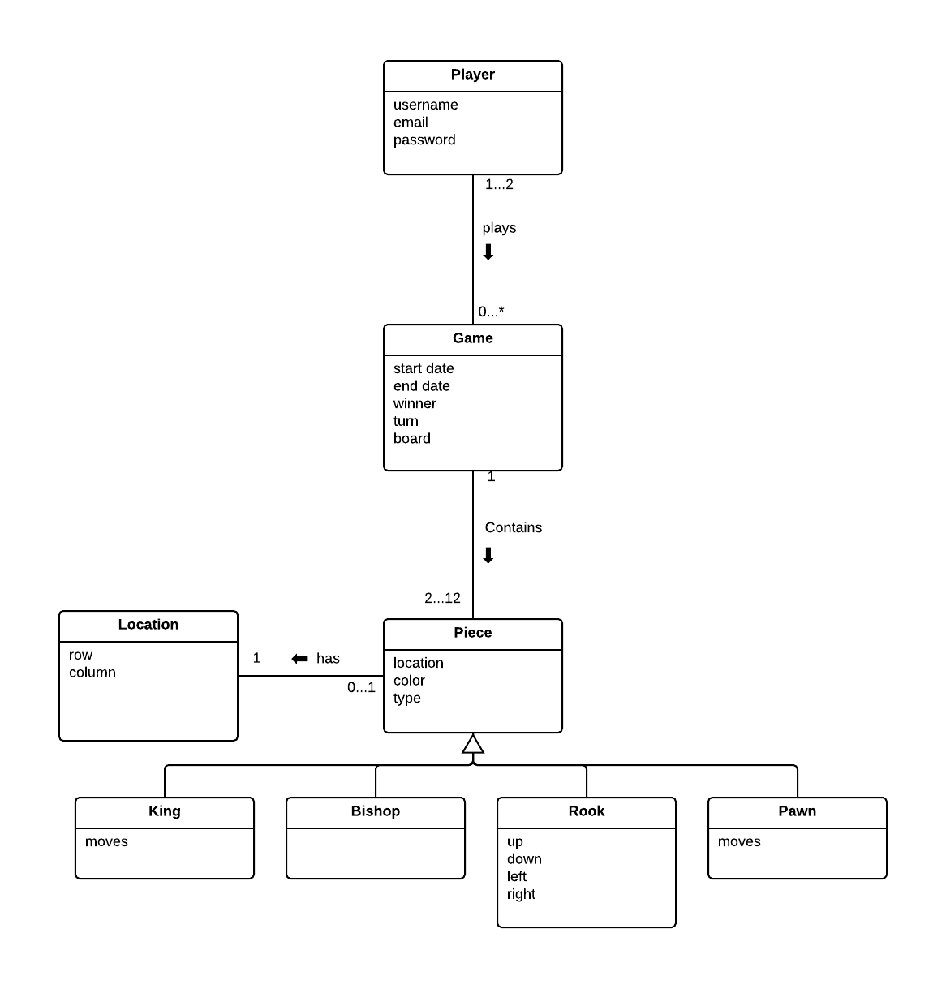
Before
After

Slide 11
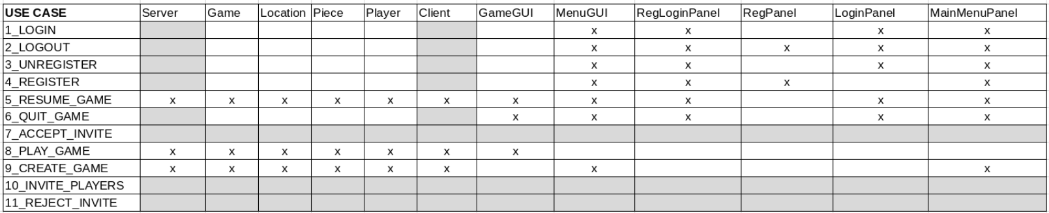
Traceability Matrix

Slide 12
System Sequence Diagrams

Slide 13
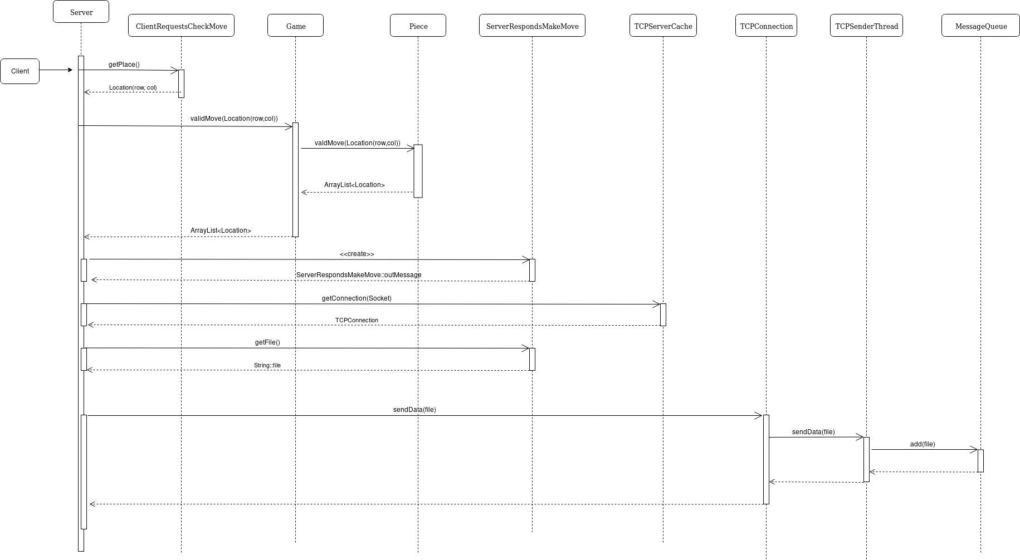
System Sequence Diagram: checkValidMoves (Server)

Slide 14
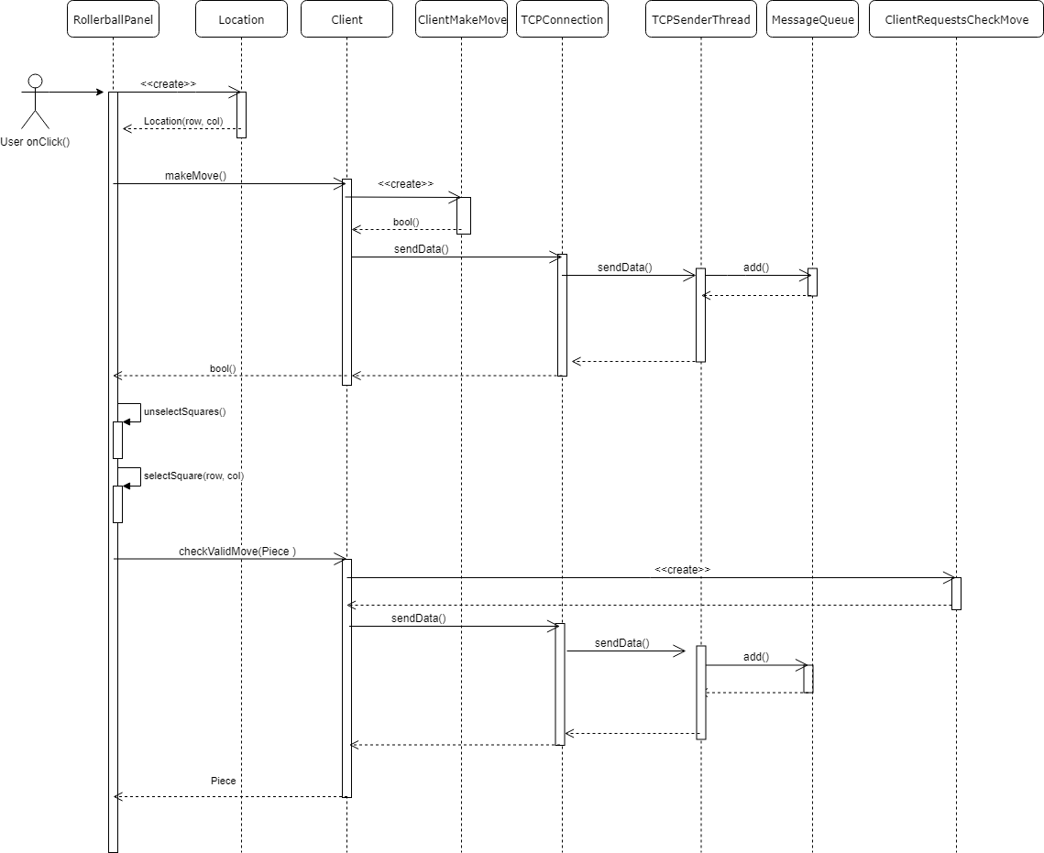
System Sequence Diagram: onClick (RollerballPanel)

Slide 15
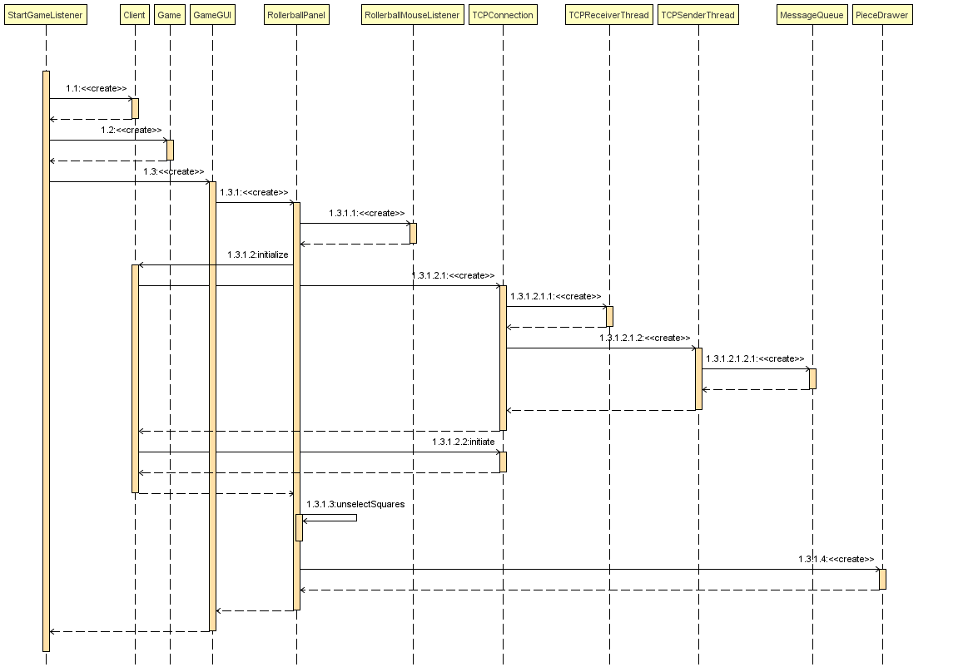
System Sequence Diagram: newGame (StartGameListener)

