Slide 1
Rollerball
Angela Root, Courtney Torres, Dawson Canby, Jonathan Cowles, Jordan Peterson (AKA The Soggy Zebras)

Slide 2
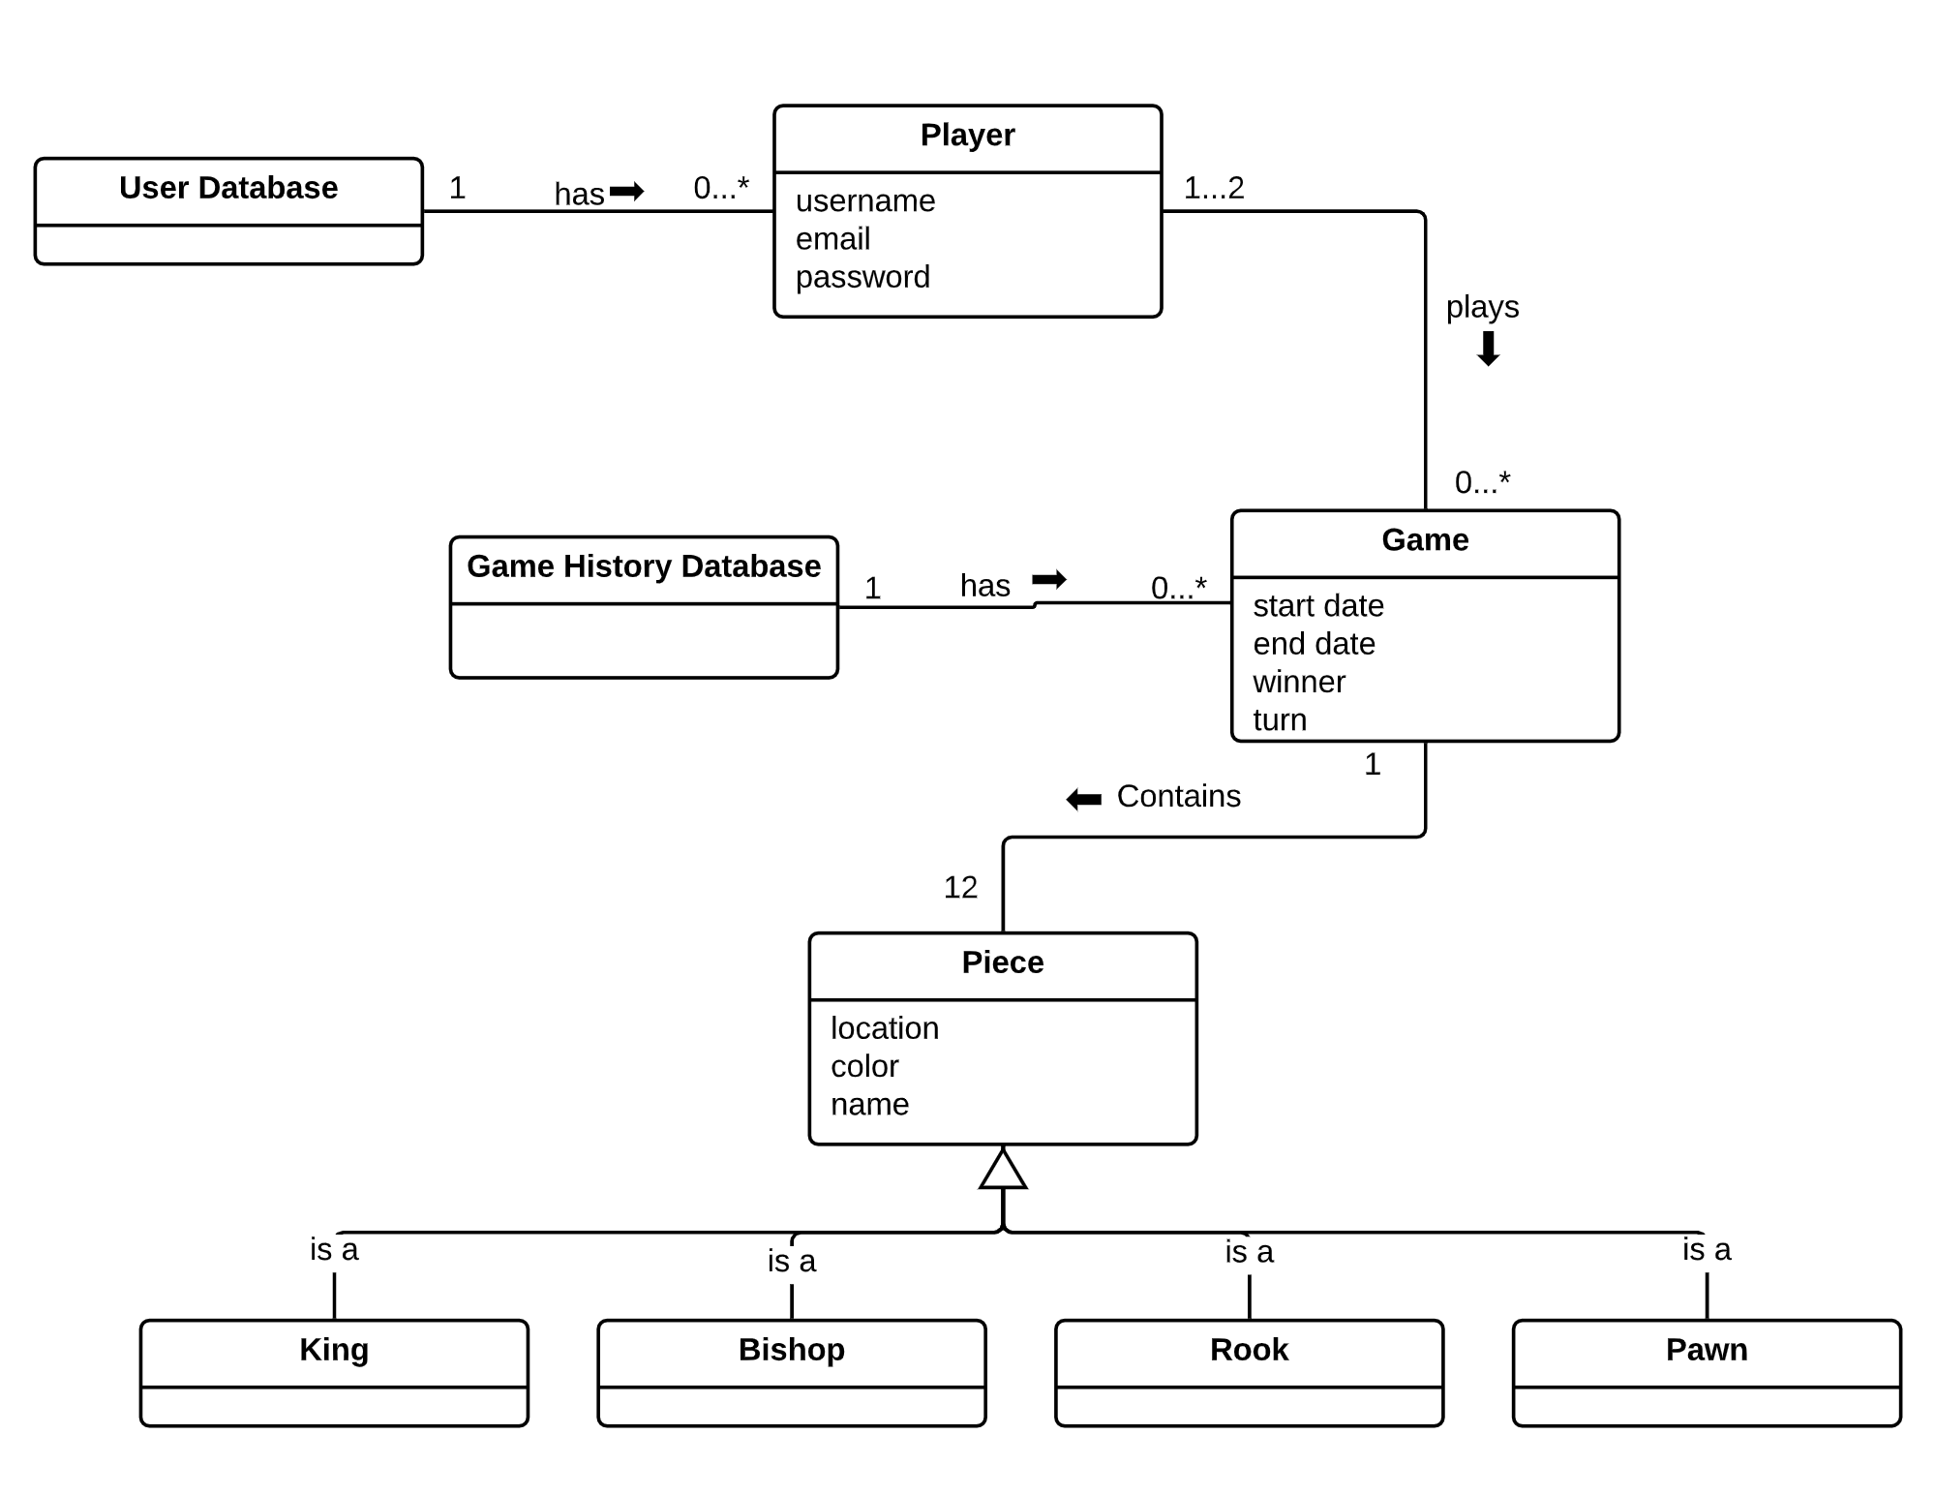

Slide 3
Use case id: | 8
Use case name: | Play game
Brief description: | Two players take turns taking actions. The game ends when a win condition is met for one of the players
Type: | User Goal
Primary actors: | Player
Secondary actors: | User database, Game history database
Pre-conditions: | 1. Player is logged in 2. Both players have joined a game against each other
Main flow: | 1. System checks if it is the player’s turn a. The system notifies the player that it can move 2. Player takes a move 3. System checks impact of the move a. Win condition is not met, next players turn, repeat step 1 and 2 b. Win condition is met 4. Game ends
Alternate flow: | 1. Player does not make a move a. The system waits for the player to move 2. During player’s move, player leaves the game a. The game is over 3. During player’s move, other player leaves the game a. The game is over 4. Move is invalid a. Player is notified of invalid move
Post-conditions: | The game is over and the game history database records the results

Slide 4
Use case id: | 7
Use case name: | Accept Invite
Brief description: | A player will be able to accept an invite sent from another player
Type: | User Goal
Primary actors: | Player
Secondary actors: | None
Pre-conditions: | 1. The player must be logged in 2. The invite must not be accepted by anyone else
Main flow: | 1. System validates the invite 2. The player accepts invite 3. System cancels all other game invites
Alternate flow: | 1. Invite is not valid The game is not accepted The game is not started 2. The player does not accept the invite Reject Invite.
Post-conditions: | 1. The game was accepted 2. The game is started

Slide 5
Use case id: | 5
Use case name: | Resume game
Brief description: | The player may resume a game that has already been started.
Type: | User Goal
Primary actors: | Player
Secondary actors: | Game History Database
Pre-conditions: | 1. A game must already be started 2. A player must be logged in
Main flow: | 1. The player resumes the game 2. The game history database updates the state of the game
Alternate flow: | 1. The game does not exist
Post-conditions: | 1. The game will be resumed

