Slide 1
Rollerball
Angela Root, Courtney Torres, Dawson Canby, Jonathan Cowles, Jordan Peterson (AKA The Soggy Zebras)

Slide 2
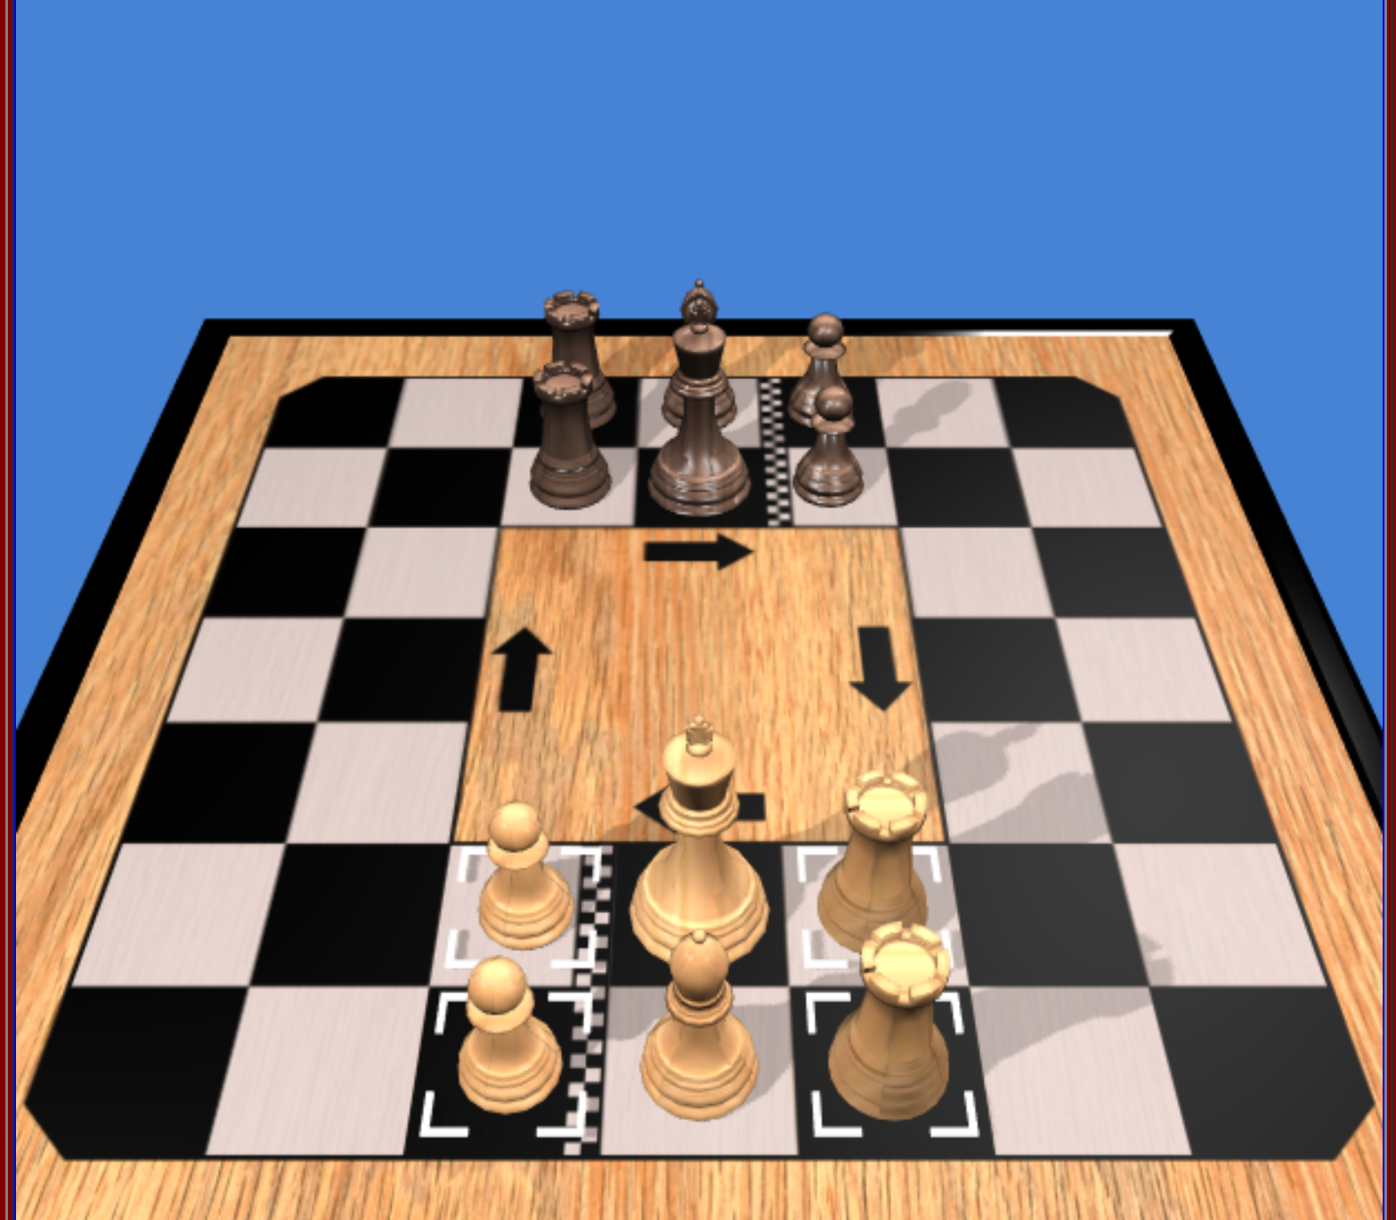

Slide 3
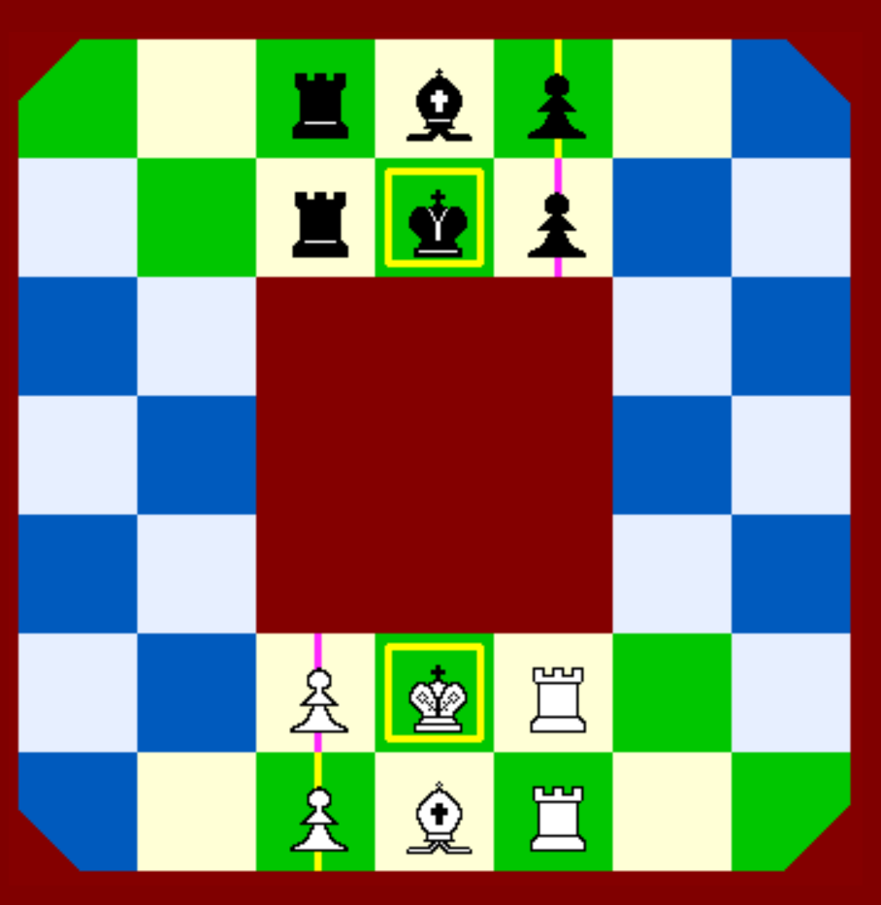
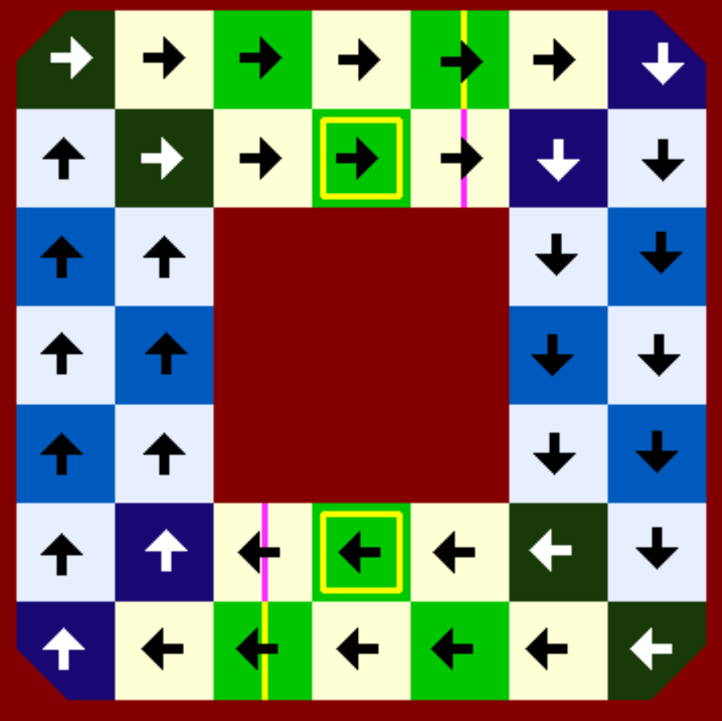
Rules:
Each side has 6 pieces only: 1 King, 1 Bishop, 2 Rooks and 2 Pawns.af
The play is mostly clockwise
All pieces change their orientation (rotating 90° clockwise) when they land on a corner or bend space
Main directions on the board. The squares where direction changes are shown with white arrows

Slide 4
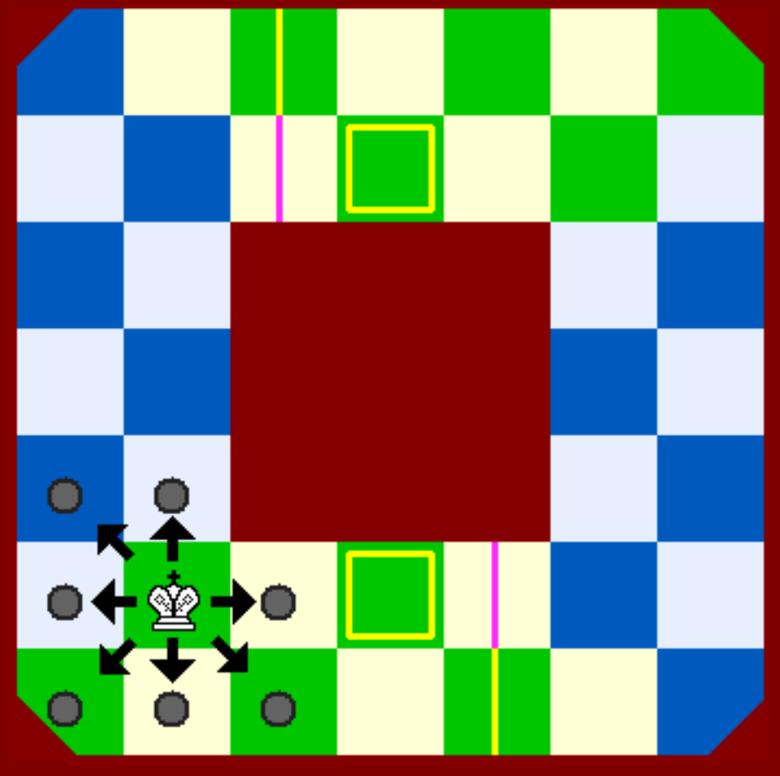
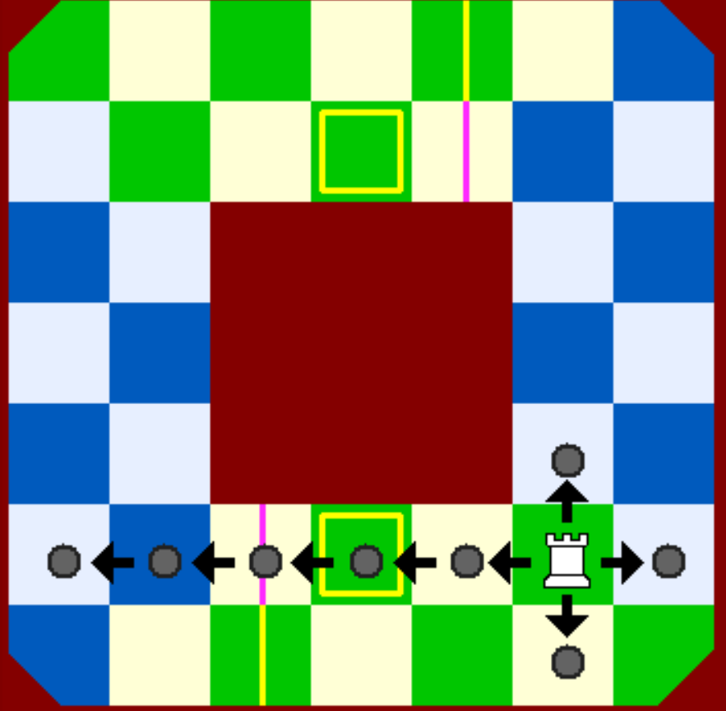
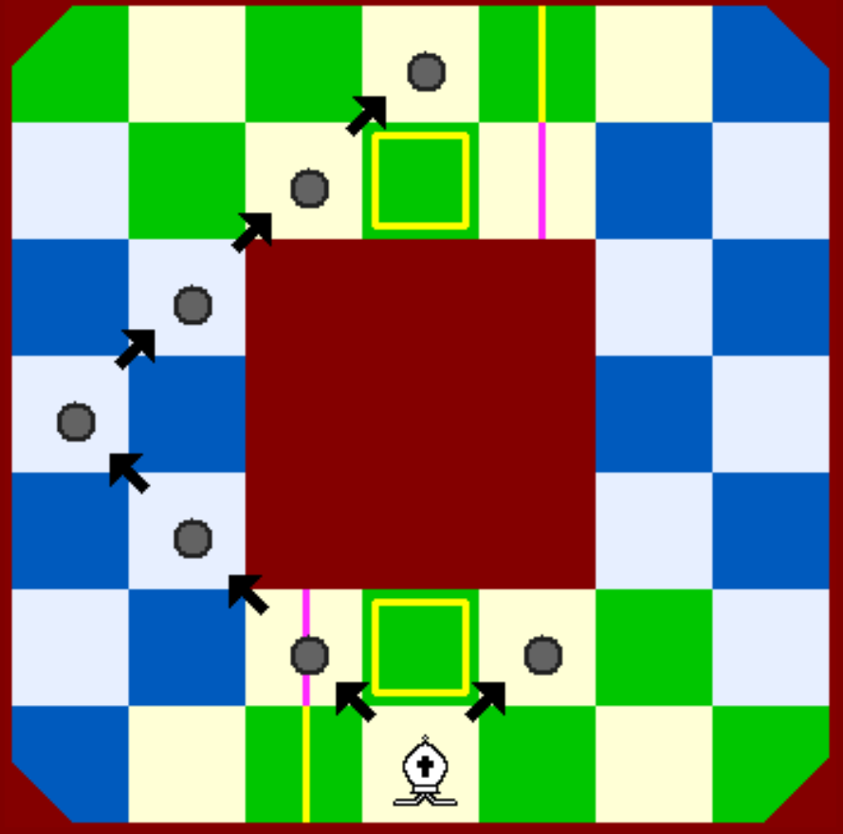
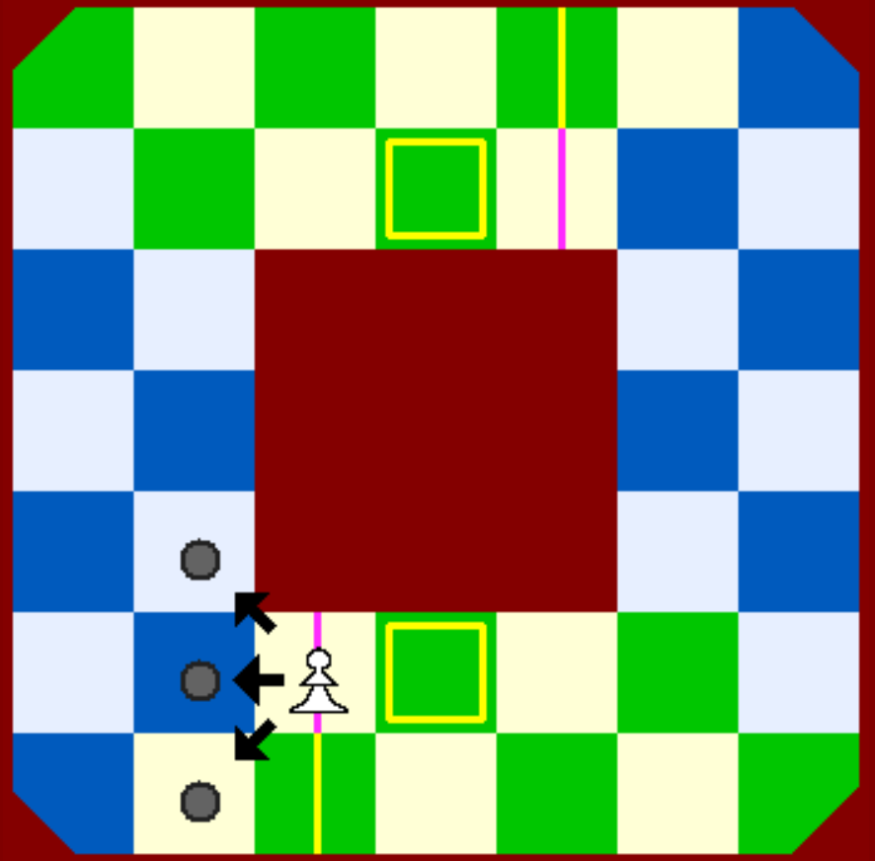
King: moves and captures to any adjacent square but never to a square where it can be captured. It is the only piece to have a symmetric move.
Pawn: moves and captures forward straight or diagonally. When reaching the starting square of opposite Pawns it promotes to either a Rook or a Bishop. (Promotion to a Bishop upon dark squares is not recommended)
Rook: slides any number of squares forward or sideways along the row or column. Also, it can move 1 square only orthogonally backward. It never slides backward. On the external ring, they have one rebound allowed on the corners of the board.
Bishop: slides diagonally forward any number of squares with one rebound allowed on the sides, external and internal, of the board. Also, it can move 1 square diagonally backward. It never slides diagonally backward.

Slide 5
End of Game
Checkmate the opposite King
When the King reaches the starting square of the opposite King, but only if it has turned clockwise.

Slide 6
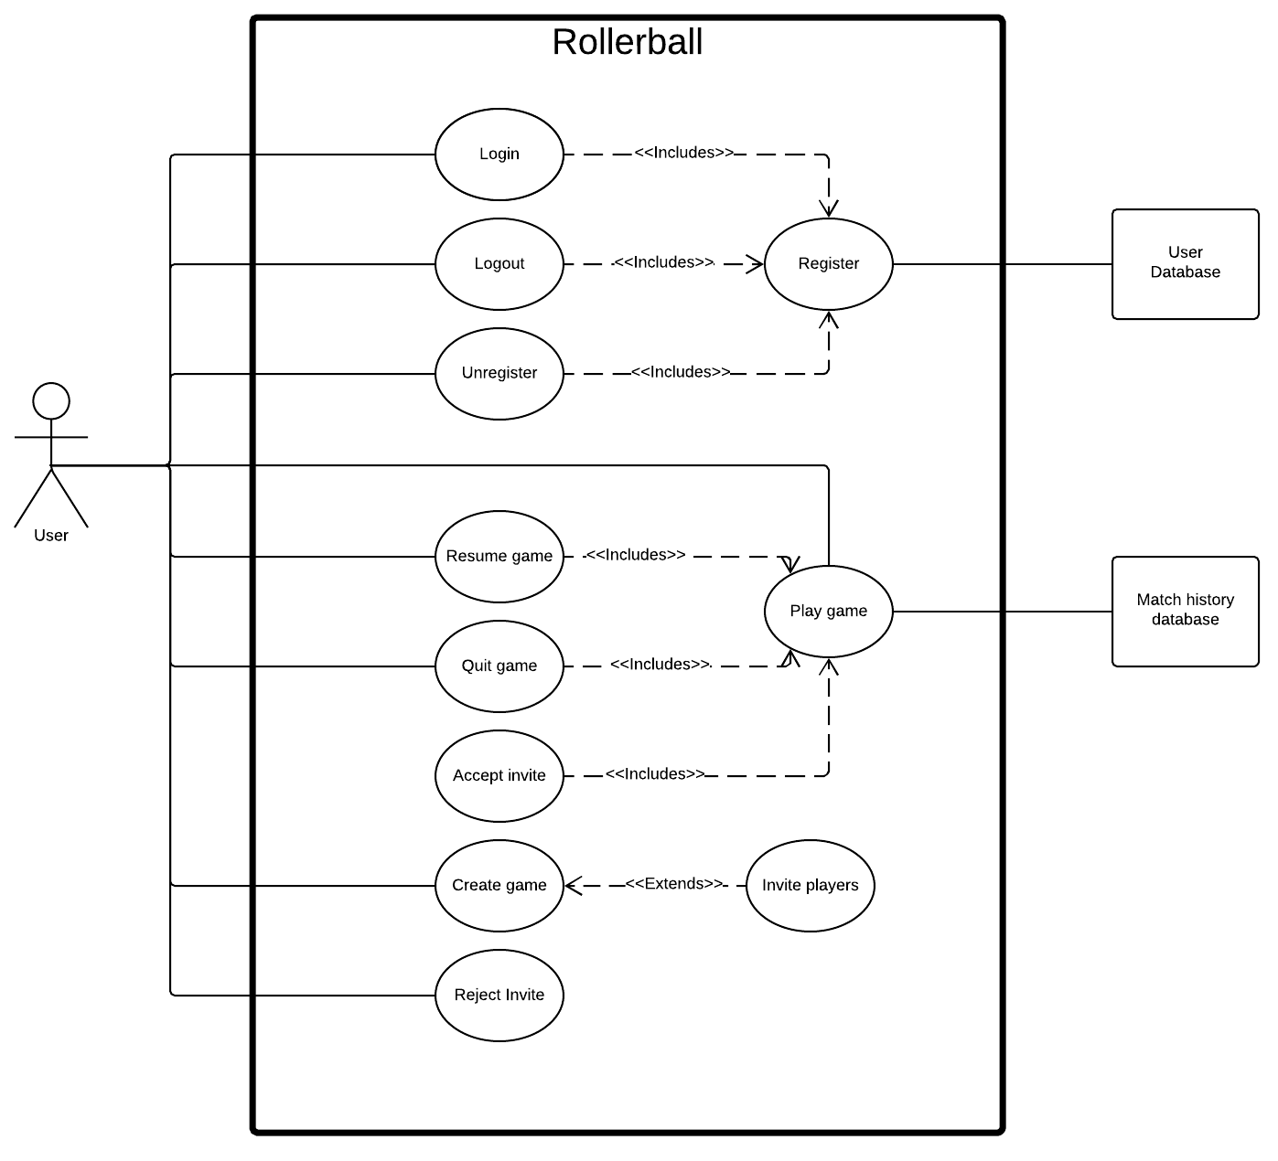
Use case diagram

Slide 7
Use cases:

Slide 8
Use case id: | 10
Extension use case: | Invite players
Brief description: | When a match is created, player may invite other players to join.
Type: | User Goal
Primary actors: | Player
Secondary actors: | User database
Pre-conditions: | 1. Player has created a new game. 2. Player is logged in. 3. Invited player(s) exists.
Main flow: | 1. Player selects one or more players to invite to play. 2. Invite is sent to other players immediately.
Alternate flow: | 1. Player cancels create game. Created game is erased.
Post-conditions: | 1. A new game has been created with invites sent to other players.

Slide 9
Use case id: | 4
Use case name: | Register
Brief description: | The user creates an account with a unique username, email, and password.
Type: | User Goal
Primary actors: | Player
Secondary actors: | User database
Pre-conditions: | 1. Username must be unique. 2. Email must be unique. 3. Password must be at least 8 alphanumeric characters including at 4. Least one special character.
Main flow: | 1. User provides email, username, and password. 2. Server checks for unique username and email. 3. Server updates User database. 4. User is registered
Alternate flow: | 1. Username is not unique Server responds with an error Restart registration process 2. Email is not unique. Server responds with an error Restart registration process
Post-conditions: | 1. Player is registered

Slide 10
Use case id: | 6
Use case name: | Quit game
Brief description: | Quit the game that the player is currently in.
Type: | User Goal
Primary actors: | Player
Secondary actors: | Match history database
Pre-conditions: | 1. The player is in a game
Main flow: | 1. The player chooses to quit the game 2. The match history database is updated to show that the player left 2. The other player is notified that the player quit
Alternate flow: | 1. The player decides not to quit the game
Post-conditions: | 1. The player can no longer play the game 2. The match history database shows that the player quit 3. The other player has been notified that the player quit

