Slide 1


Altitude Accidents
All narrative accident data
Text-Parsing
Fire / Fume Accidents
Animal Accidents

Slide 2


Altitude Accidents
All narrative accident data
Fire / Fume Accidents
Animal Accidents

Slide 3

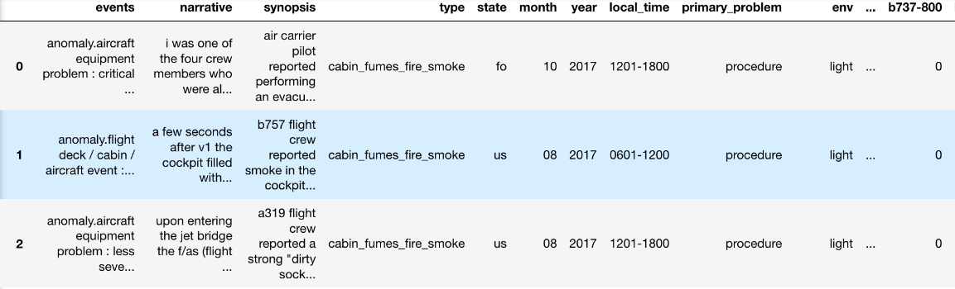
Altitude Accidents
Altitude Accidents
Fire / Fume Accidents
Text-Parsing
Fire / Fume Accidents
Parsed Narrative Data
Animal Accidents
Animal Accidents

