Slide 1

24-Bit Multi-Mode Processor
CE222 — Computer Organization & Assembly Language
Muhammad Shariq Usman (2024465) | Sohaib Bin Tausif (2024595)
Instructor: Prof. Dr. Ghulam Abbas | Cyber Security Section
GHULAM ISHAQ KHAN INSTITUTE OF ENGINEERING SCIENCES AND TECHNOLOGY

Slide 2
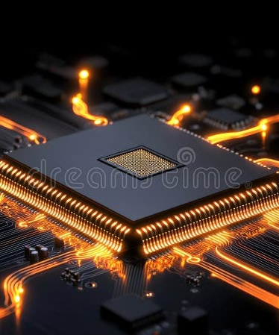
INDEX
01 —— Architecture Overview
02 —— Addressing Modes
03 —— Bus System & ALU Design
04 —— Control Unit & Timing
05 —— I/O & System Integration

Slide 3
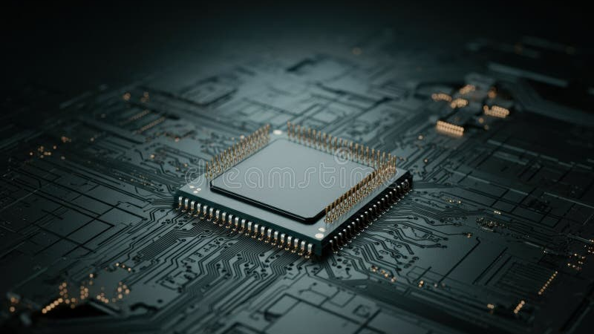
CHAPTER
01
Architecture Overview
Stored program organization, memory architecture, and register file design

Slide 4

Stored Program Organization
Built on the stored program concept — both instructions and data reside in unified memory. The processor fetches instructions sequentially via the Program Counter, decodes through the Control Unit, and executes via microoperations.
A single 4096 x 24-bit memory serves both purposes. Reprogrammability is achieved by simply loading different instructions.
24-BIT INSTRUCTION FORMAT
Opcode | Mode | Rd | Rs | Address
5-bit | 2-bit | 3-bit | 2-bit | 12-bit
bits 23-19 | bits 18-17 | bits 16-14 | bits 13-12 | bits 11-0

Slide 5

Memory & Register Organization
Memory: 4096 locations x 24 bits = 12,288 bytes. All memory access routes exclusively through the Address Register (AR).
Stack: R7 initialized at 0xFFF (4095), grows downward through 0xF00-0xFFF.
REGISTER ORGANIZATION
Register | Acronym | Size | Purpose
Program Counter | PC | 12-bit | Next instruction address
Zero Register | ZR (R0) | 24-bit | Permanently 0, read-only
General Purpose | R1-R5 | 24-bit | Operands and results
Link Register | LR (R6) | 24-bit | Return address for CALL
Stack Register | SR (R7) | 24-bit | Stack pointer @ 0xFFF
Address Register | AR | 12-bit | Only memory address bus
Instruction Reg | IR | 24-bit | Current instruction

Slide 6
CHAPTER
02
Addressing Modes
Three addressing modes and the expanded instruction set architecture

Slide 7
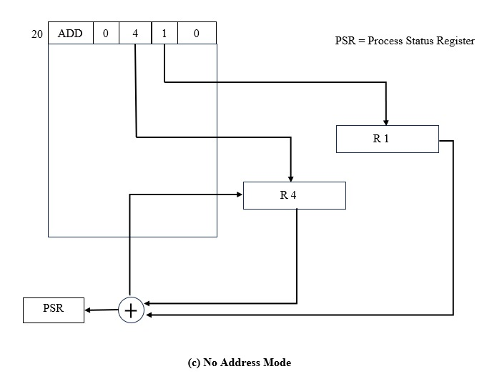
No Address Mode (NA)
Figure 1 — Register-to-register operation with no memory access
When mode = 00, the ALU reads operands directly from Rs and Rd registers. Results are written back to Rd.
Fastest mode : zero memory accesses eliminate all memory latency.
Supported instructions: ADD, SUB, AND, OR, XOR, NOT, MOV, CIL, CIR
Example: ADD R2,R3 — R2=15, R3=10, result 25 stored in R2. No memory access required.

Slide 8
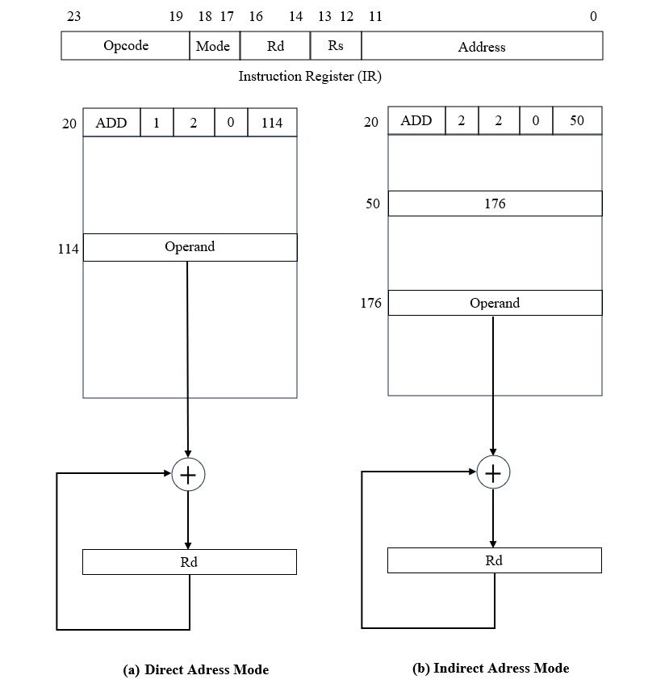
Direct & Indirect Access
Figure 2 — DMA (left) vs IMA (right) memory access patterns
DMA (Mode 01): Address field contains the exact memory address. One memory access — load address into AR, retrieve operand. Used by LOAD and STORE.
IMA (Mode 10): Address field points to a pointer containing the actual address. Two memory accesses — slower but enables dynamic address resolution.
Speed ranking: NA > DMA > IMA

Slide 9
Complete Instruction Set
23 INSTRUCTIONS ACROSS 5 CATEGORIES
Symbol | I=0 | I=1 | Description
ADD | 1xxx | 9xxx | Add Rs to Rd, store in Rd, update PSR
SUB | 2000 | A000 | Subtract Rs from Rd, store in Rd, update PSR
AND | 0xxx | 8xxx | Bitwise AND, store in Rd, update PSR
LOAD | 5xxx | Bxxx | Load 24-bit value from memory into Rd
STORE | 3xxx | Cxxx | Store Rd value into memory at address
OR | 7300 |  | Bitwise OR, store in Rd, update PSR
XOR | 7500 |  | Bitwise XOR, store in Rd, update PSR
NOT | 7200 |  | Bitwise complement of Rd, update N,Z
SHL | 7008 |  | Shift left, fill 0, discard MSB
SHR | 7010 |  | Shift right, fill 0, discard LSB
CIL | 7600 |  | Rotate left, MSB wraps to LSB
CIR | 7680 |  | Rotate right, LSB wraps to MSB
CALL | 7780 |  | Subroutine call via stack
RET | 77C0 |  | Return via stack
JMP/JZ/JN/JC | 7700+ |  | Conditional and unconditional branches
PUSH | 7F00 |  | Decrement R7, store value of Rd at memory address pointed to by R7
POP | 7F80 |  | Load value from memory address pointed to by R7 into Rd, increment R7
HLT | 7001 |  | Halt processor execution, clear I bit in PSR to disable interrupts
ION | 7040 |  | Set PSR[I] to 1, enable interrupts
IOF | 7080 |  | Clear PSR[I] to 0, disable interrupts

Slide 10
CHAPTER
03
Bus System & ALU
Common bus architecture and the three-unit ALU design

Slide 11
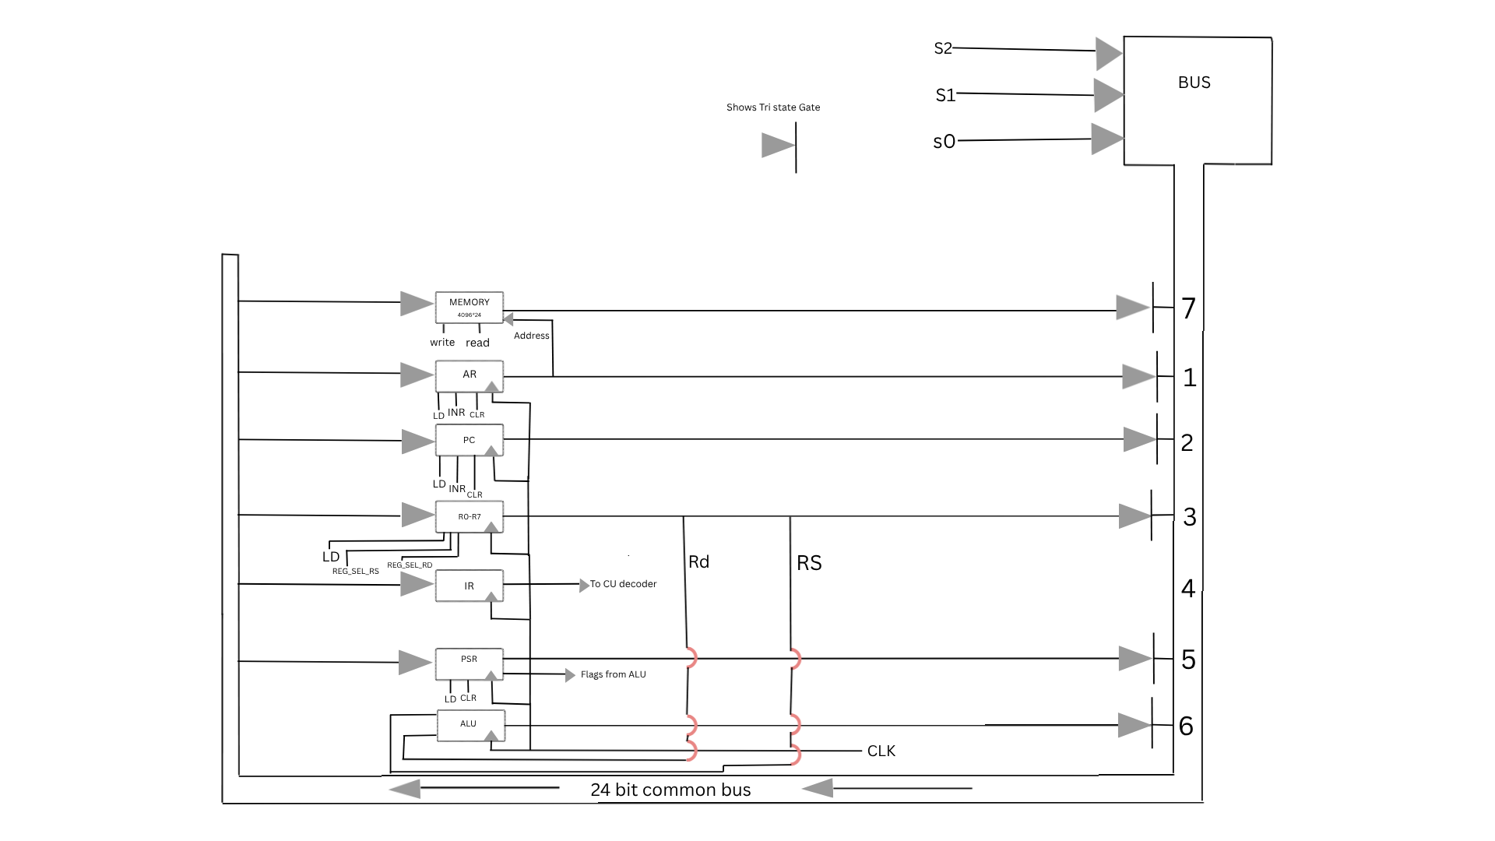
Common Bus System
Figure 3 — Tri-state 24-bit bus connecting all major components
Tri-state gate buffers control which component drives the bus. Three modes: logic high, logic low, and high impedance (effectively disconnects the component).
Controlled by S0, S1, S2 from the Control Unit. Seven components connected: Memory(7), AR(1), PC(2), R0-R7(3), PSR(5), ALU(6).
Key design: IR bypasses the bus — its fields route directly to CU decoders via dedicated internal lines.
S2 | S1 | S0 | Component Enabled
0 | 0 | 0 | None
0 | 0 | 1 | AR(Address Register)
0 | 1 | 0 | PC(Program Counter)
0 | 1 | 1 | R0-R7 (Register File)
1 | 0 | 0 | IR (feeds CU directly no bus output)
1 | 0 | 1 | PSR (Process Status Register)
1 | 1 | 0 | ALU output
1 | 1 | 1 | Memory output

Slide 12
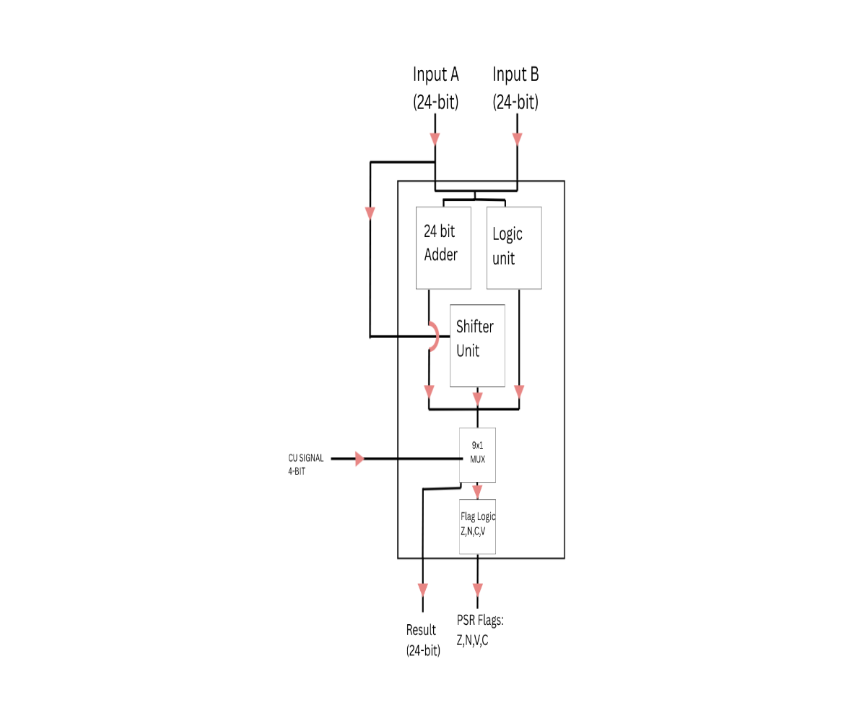
ALU Design Overview
Figures 4-6 — Three parallel functional units with multiplexer selection
The 24-bit ALU accepts two operands: Input A from Rd and Input B from Rs. A 4-bit CU signal selects the operation.
Three parallel units:
• Adder-Subtractor — ADD, SUB, INC
• Logic Unit — AND, OR, XOR, NOT
• Shift Unit — CIL, CIR, SHL, SHR

Slide 13
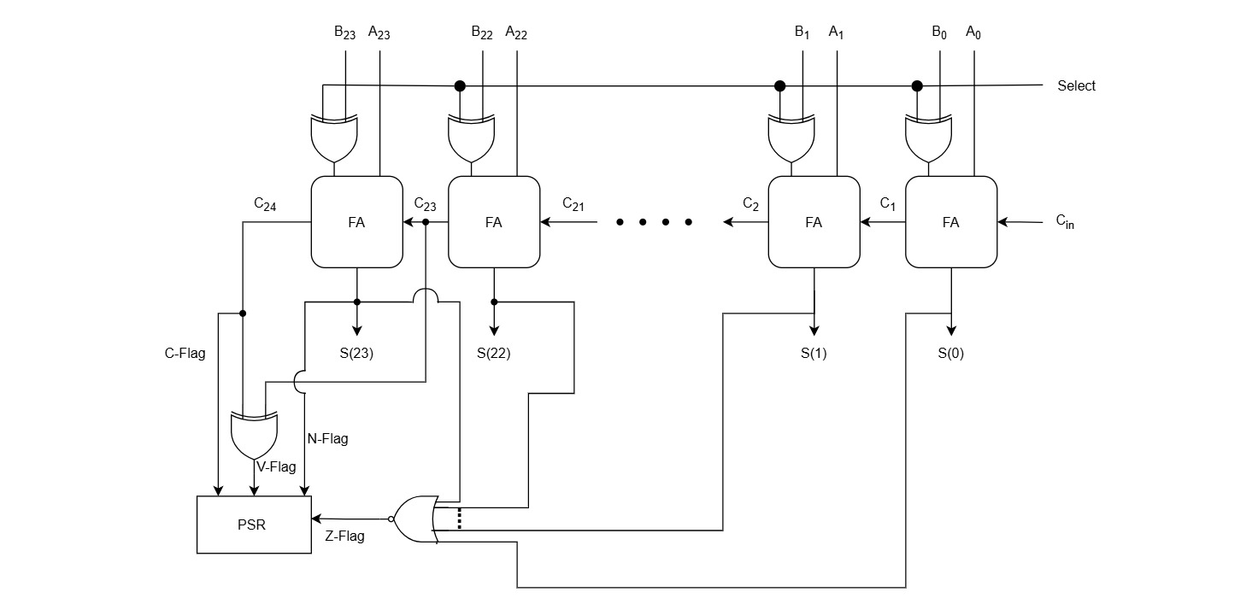
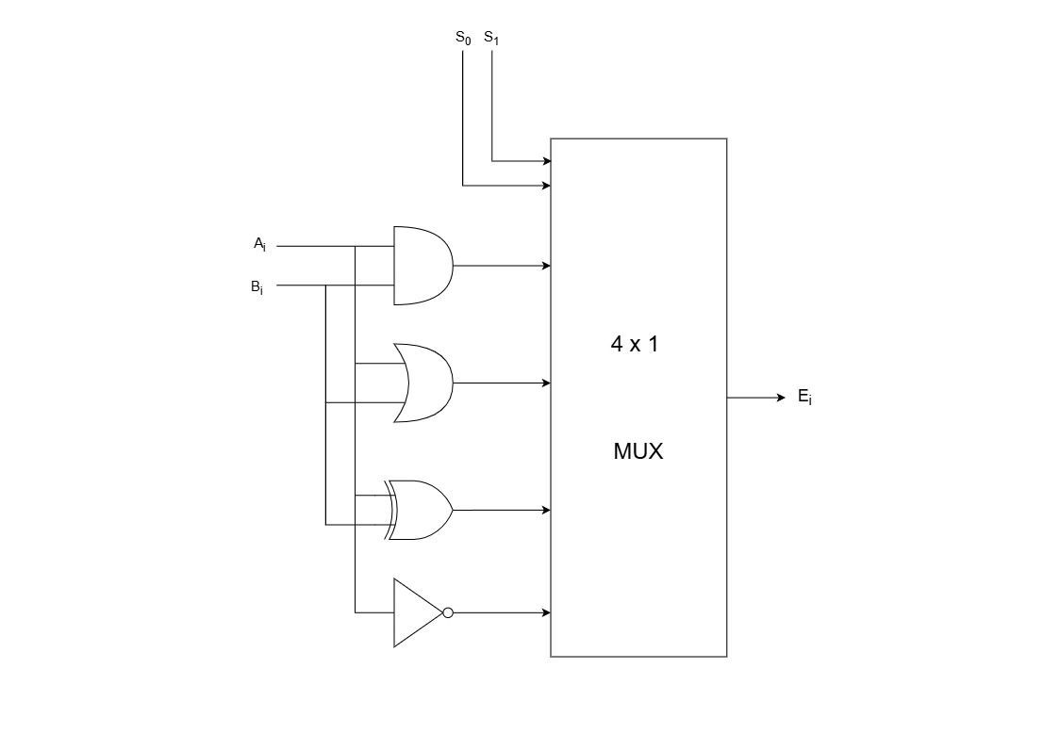
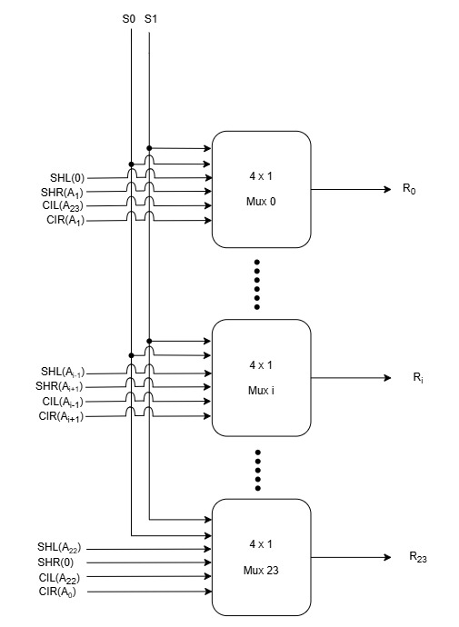
ALU Functional Units
Figures 7-9 — Adder-Subtractor, Logic Unit, and Shift Unit circuits
Adder-Subtractor
24-bit ripple-carry with C/V flags
Logic Unit
24 AND/OR/XOR gates + 24 NOT gates
Shift Unit
24 parallel 4x1 MUXes for all shifts

Slide 14
CHAPTER
04
Control & Timing
Hardwired control unit, timing signals, and instruction execution flow

Slide 15
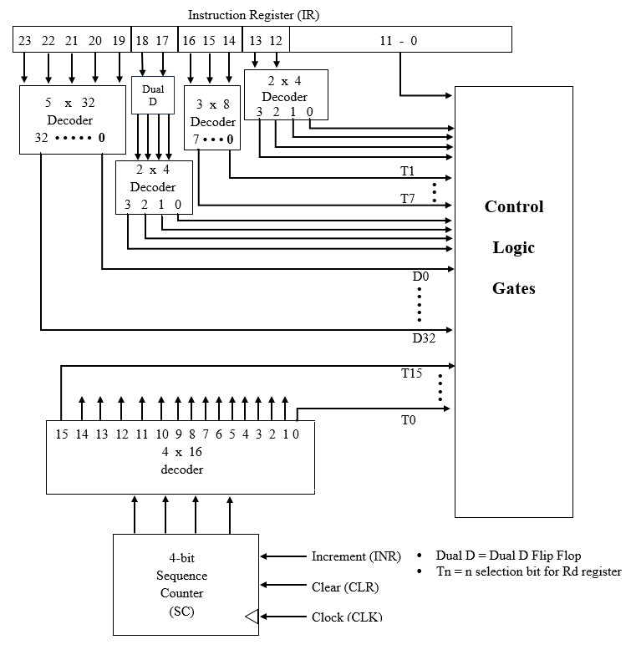
Control Unit Design
Figure 10 — Hardwired control unit with 8 subsystems
Hardwired architecture — control signals generated directly by combinational logic, no microprogram memory lookup. Faster execution, fixed instruction set.
8 Subsystems:
• 4-bit Sequence Counter + 4x16 Timing Decoder
• 5x32 Instruction Decoder (D0-D31)
• 2x4 Mode Decoder + Dual D Flip-Flop
• 3x8 Rd Decoder + 2x4 Rs Decoder
• Combinational Control Logic Gates

Slide 16
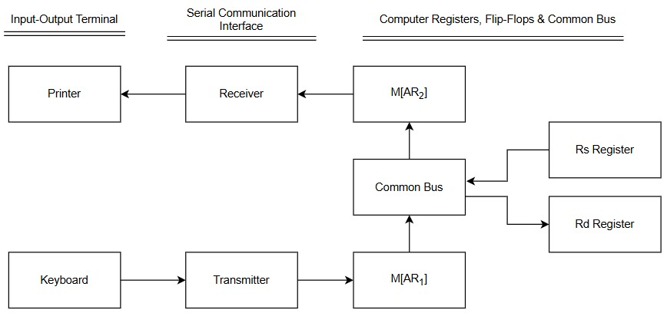
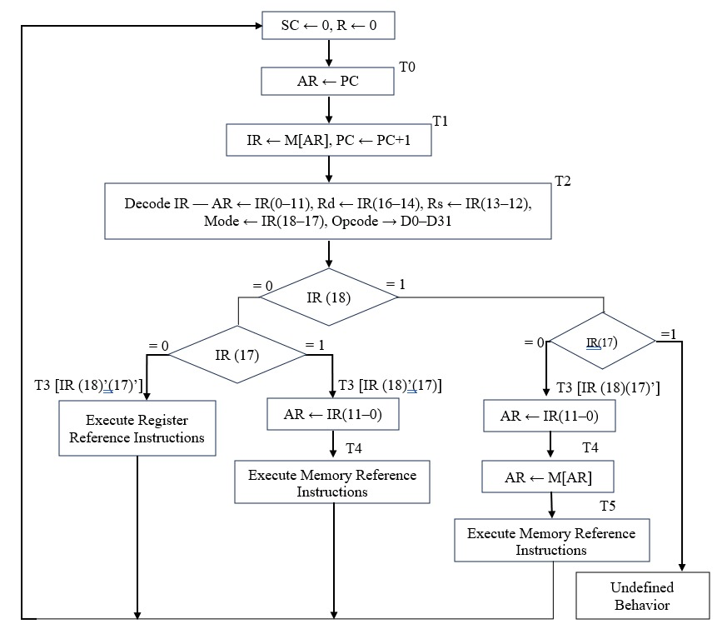
Timing & Instruction Cycle
Figures 11-13 — Timing signals and execution flowcharts
Fetch (T0-T1): AR←PC, then IR←M[AR] and PC←PC+1
Decode (T2): All fields decoded simultaneously — opcode→D0-D31, mode→M0-M3, Rd, Rs, address→AR
Execute (T3+): Varies by instruction. Register ops finish at T3; memory ops need T4-T5. SC resets to 0 when done.
Timing diagram shows T0-T4 sequential activation. D3 (STORE) remains high from T2 through T4. CLR SC signal resets the counter at execution end.

Slide 17
CHAPTER
05
I/O & System Integration
Input/output handling, interrupts, and complete system description

Slide 18
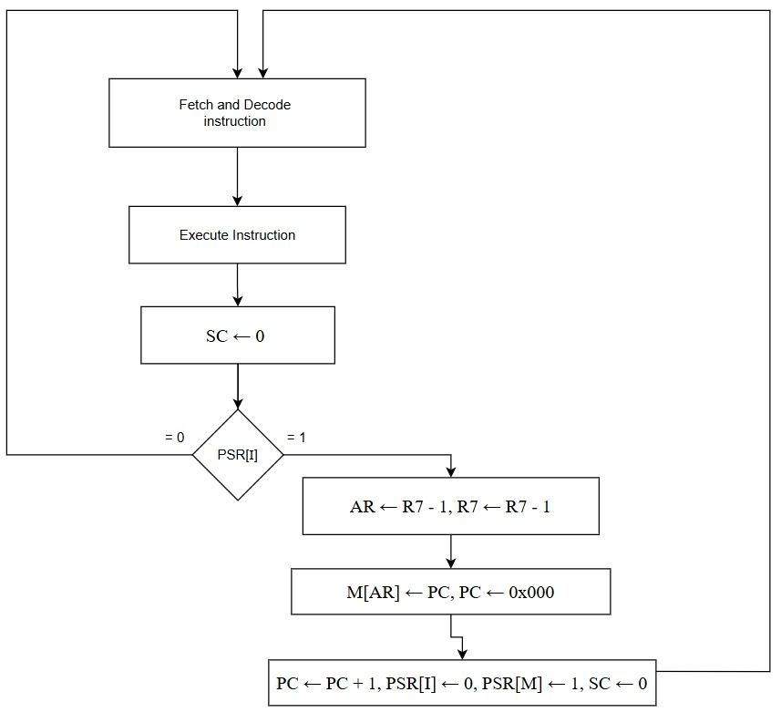
I/O & Interrupt Handling
Figures 14-15 — I/O configuration and interrupt cycle
Programmed I/O: CPU directly controls data transfer. IN reads 8 bits from input device to Rd[0-7]. OUT sends Rs[0-7] to output device.
Interrupt-Driven I/O: When PSR[I]=1 and a device requests interrupt, the processor completes current instruction, saves state, and jumps to ISR.
Interrupt Cycle (RT0-RT2):
• RT0: AR←R7-1, R7←R7-1
• RT1: M[AR]←PC, PC←0x000
• RT2: PC←PC+1, PSR[I]←0, PSR[M]←1

Slide 19
Complete Computer Description
SYSTEM SUMMARY & KEY INNOVATIONS
Memory Unit
4096 x 24-bit unified memory. All access via AR.
Register File
Eight 24-bit GPRs. R0=ZR, R6=LR, R7=SP@0xFFF.
Process Status Register
8-bit PSR with Z,N,C,V flags + I interrupt bit..
ALU
24-bit combinational: Adder, Logic, Shift units in parallel.
Control Unit
Hardwired with 5x32, 2x4, 3x8, 2x4 decoders + 4x16 timing + SC.
Common Bus
24-bit tri-state bus. IR bypasses bus via dedicated CU lines.
I/O System
Programmed and interrupt-driven I/O via IN/OUT/ION/IOF.
Innovations over Mano
8 GPRs vs 1 ACC | Full PSR vs E-FF | 23 instr + CALL/RET/PUSH/POP

Slide 20
ANY QUESTIONS?
Muhammad Shariq Usman (2024465) | Sohaib Bin Tausif (2024595)
CE222 — Computer Organization & Assembly Language
GHULAM ISHAQ KHAN INSTITUTE OF ENGINEERING SCIENCES AND TECHNOLOGY

