Slide 1
HOSPITAL MANAGEMENT SYSTEM
DATABASE SYSTEM LAB FINAL PROJECT
SYED SOHAIB HASSAN CS181027
MUHAMMAD MANSOOR CS181073
MUHAMMAD FAZEEL CS181010
SHAHROZ HASAN KHAN CS181052

Slide 2
INTRODUCTION:
A Hospital Management System is an integrated information system for managing all aspects of a hospital's operations. It includes electronic patient’s health records and doctors’ records etc. The system also provides excellent security of data at every level of user-system interaction. It also provides less paper work.

Slide 3
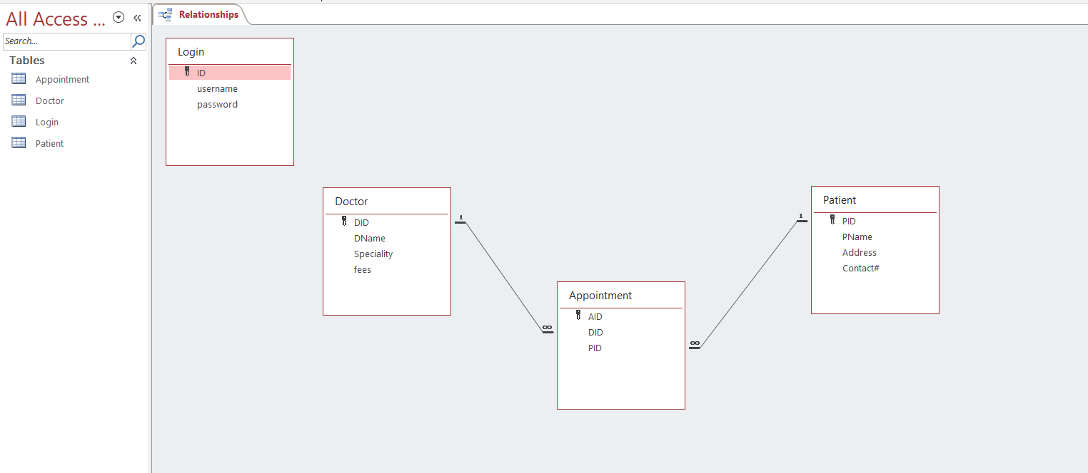
ERD:

Slide 4
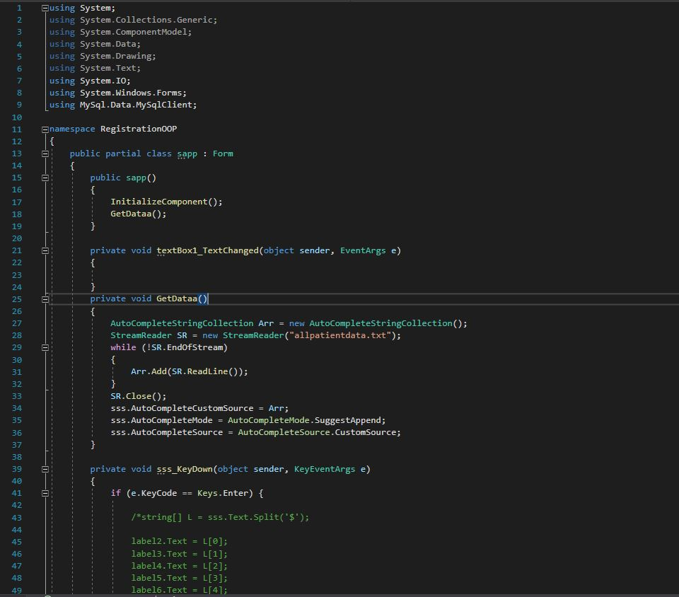
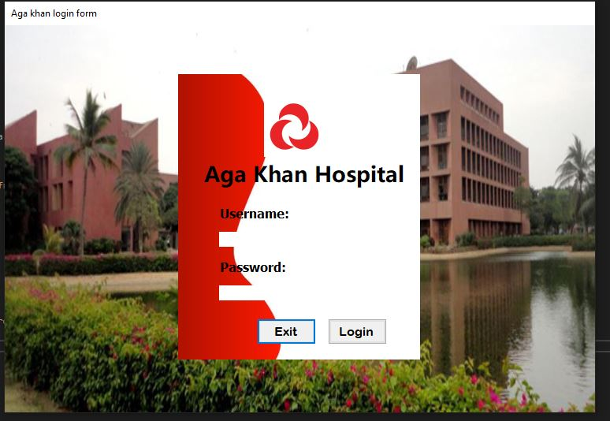

Slide 5
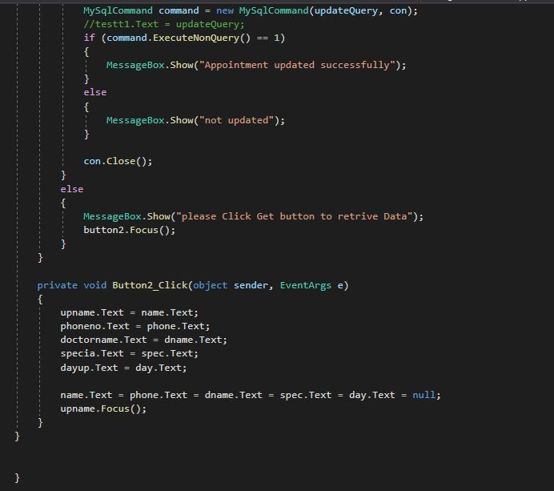
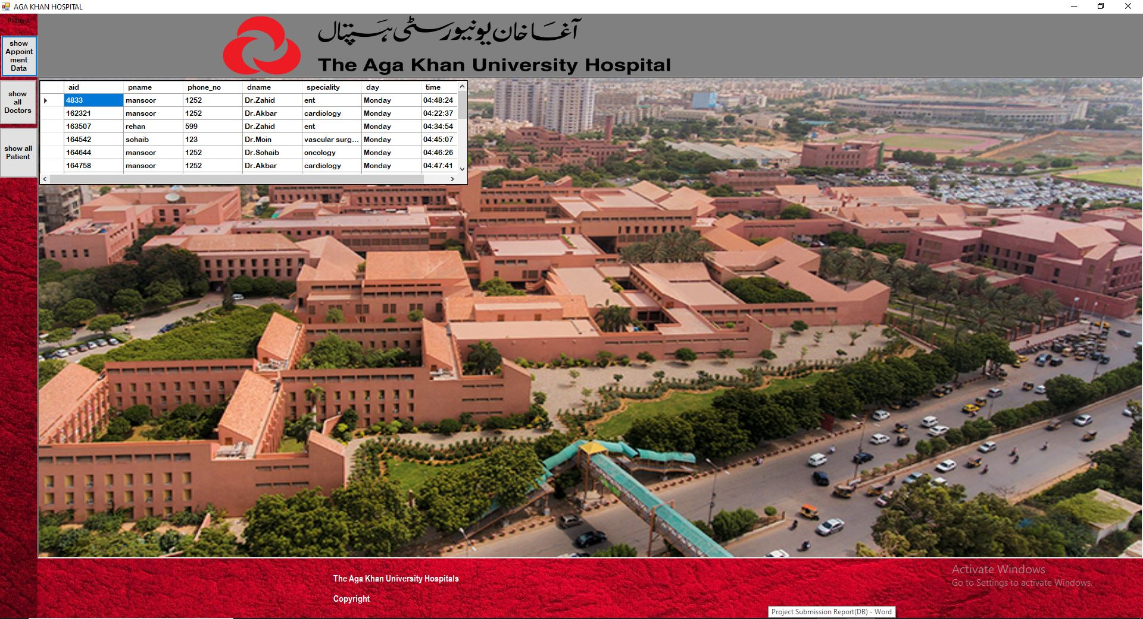

Slide 6
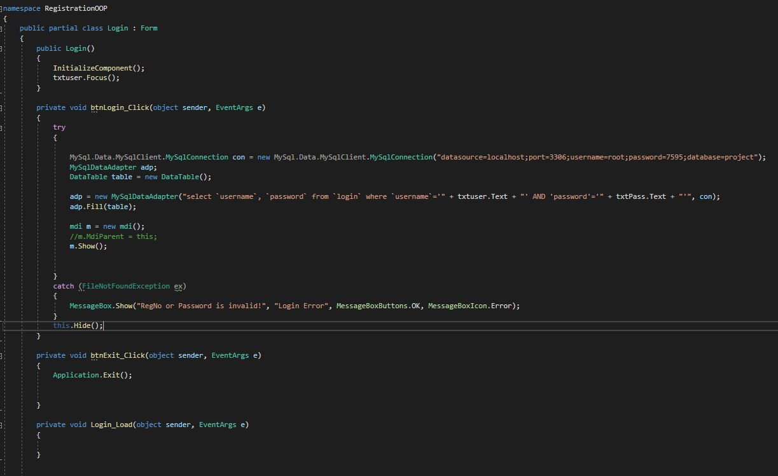
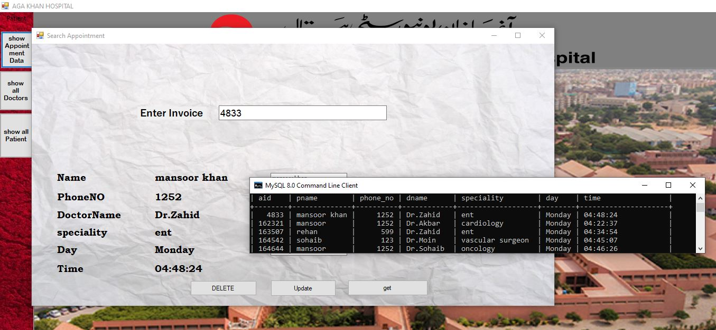

Slide 7
CONCLUSION
Implementation of hospital management system project helps to store all the kinds of records, provide coordination and user communication, implement policies, improve day-to-day operations.
THANKYOU

