Slide 1
TRAFFIC FLOW PREDICTION
Using Deep Learning
LSTM vs GRU vs Transformer — benchmarked on METR-LA (Los Angeles highway sensors)
Sohaib | AI Automation Engineer | Deep Learning Project Presentation

Slide 2
PROBLEM & DATASET
Forecasting Highway Speed From Sensor History
Dataset
Target
Task
METR-LA — 207 real loop-detector sensors on LA highways, 5-minute readings, Mar–Jun 2012. This project uses a real 1,025-timestep slice (full 34k-row file needs Google-Drive access unavailable here).
Network-average speed (mph). Speed is the standard forecasting target in the METR-LA literature — congestion shows up as a speed drop through the fundamental traffic-flow relationship.
Predict speed 5 minutes ahead from the last 60 minutes of history + calendar/lag/rolling features. Bonus: extend to 30- and 60-minute horizons.

Slide 3
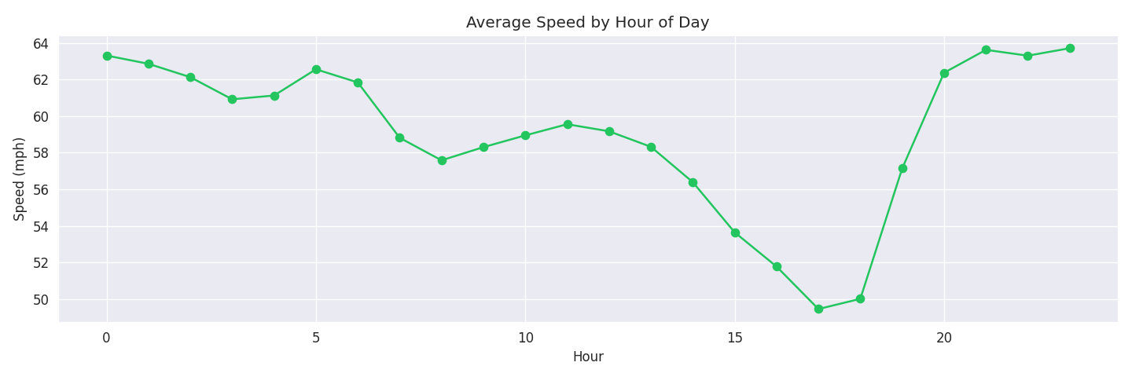
EXPLORATORY DATA ANALYSIS
Clear Diurnal Pattern, Sentinel Missing Values
0.0 mph readings (~2.8%) are a sensor-dropout sentinel, not real data
Speeds cluster 55–70 mph (free flow), heavier low-speed tail = congestion
AM/PM commute dips are visible → motivates hour-of-day features
Nearby sensors are highly correlated (spatial redundancy)

Slide 4
METHODOLOGY
Preprocessing & Feature Engineering
1
Missing values
1
Lag features
0 → NaN → time-aware interpolation (30-min limit) → edge-fill
t-1, t-2, t-3, t-6, t-12 (5–60 min back)
2
Outliers
2
Rolling stats
Domain-based clip to [0, 80] mph
30-min & 60-min rolling mean/std (shift(1), no leakage)
3
Calendar features
3
Sequencing
hour_sin / hour_cos (cyclical), is_weekend
60-min lookback (12 steps) → 5-min-ahead target
4

Slide 5
MODELS
Three Sequence Architectures, Same Inputs & Splits
LSTM
GRU
Transformer
3-gate recurrent unit (input, forget, output). Strong at long-range dependencies.
2-gate recurrent unit (update, reset). Fewer parameters → less overfitting on small data.
Self-attention + positional encoding. No recurrent bias — needs more data to shine.
Linear head → speed (mph)
Linear head → speed (mph)
Linear head → speed (mph)

Slide 6
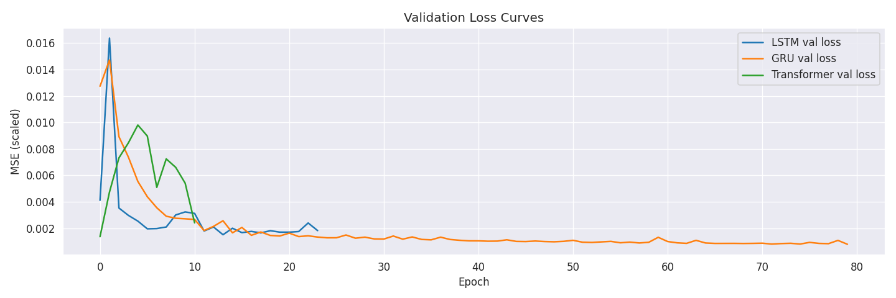
METHODOLOGY
Hyperparameter Tuning (LSTM & GRU)
Narrow grid search — hidden_size × num_layers, selected by validation MSE. Kept deliberately small: with ~700 training sequences, an exhaustive search tunes to validation noise more than it informs architecture choice.
Model | hidden_size | num_layers | Val MSE (best)
LSTM | 32 | 1 | 0.00151
GRU | 32 | 1 | 0.00105 ⭐ best overall
6

Slide 7
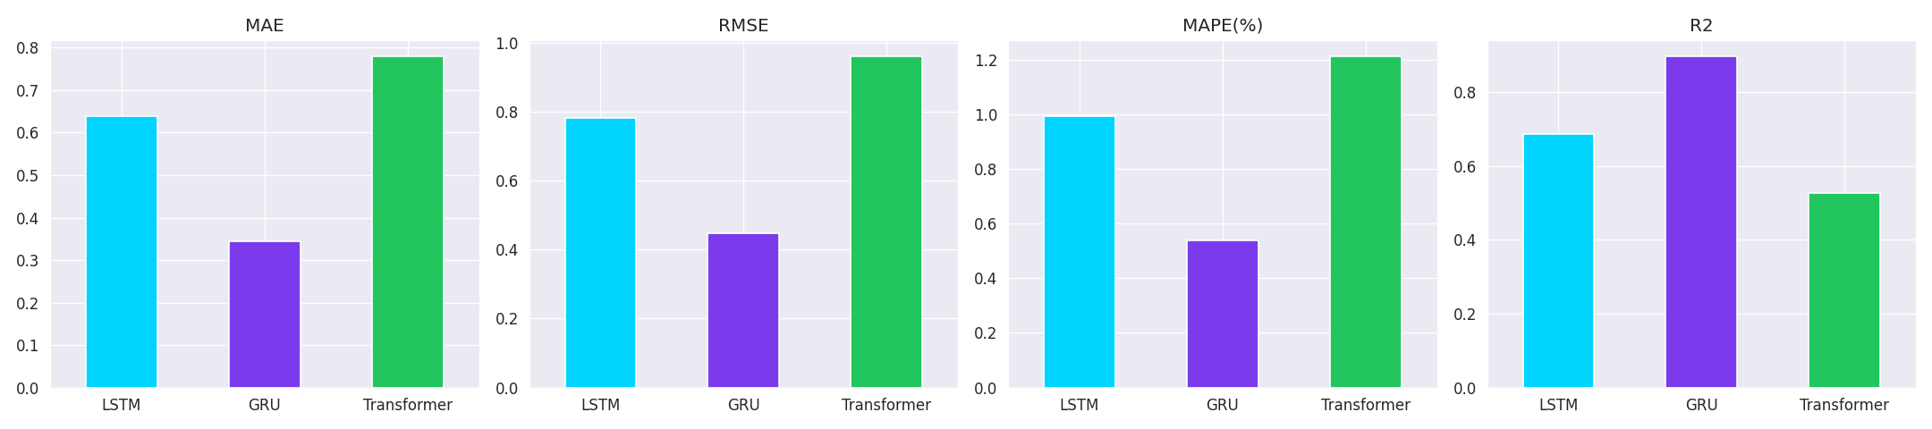
RESULTS
GRU Wins Clearly on the Held-out Test Set
Model | MAE (mph) | RMSE (mph) | MAPE (%) | R²
GRU | 0.34 | 0.45 | 0.54 | 0.90
LSTM | 0.64 | 0.78 | 0.99 | 0.69
Transformer | 0.78 | 0.96 | 1.21 | 0.53

Slide 8
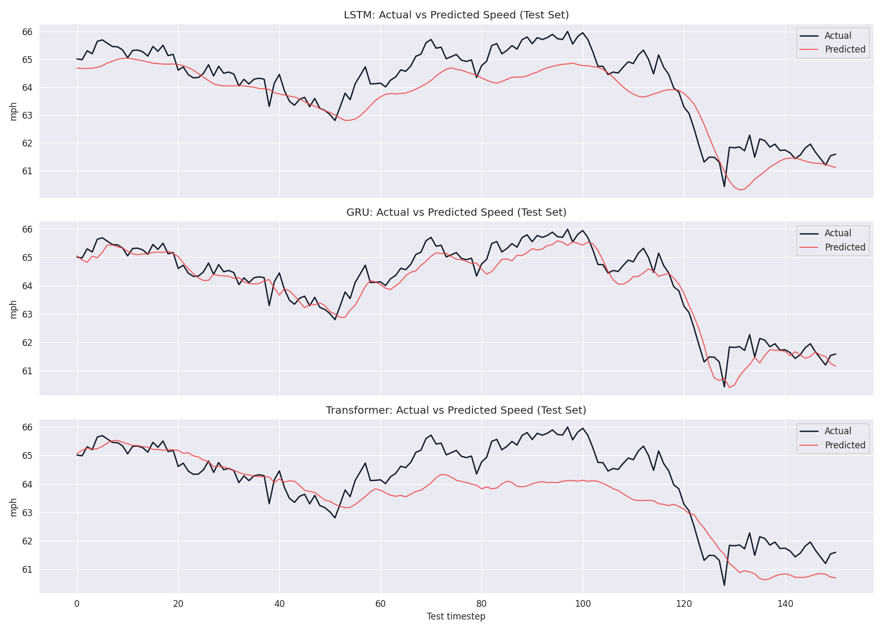
RESULTS
Why GRU Wins Here
GRU has ~25% fewer parameters than LSTM at the same hidden size → lower-variance fit on only ~700 training sequences
LSTM's extra cell-state gate is built for long dependencies — barely used by a 60-min lookback, so it mostly adds noise here
Transformer has no recurrent inductive bias — needs far more data to learn temporal locality from scratch
Expect this ranking to shift toward Transformer on the full 34k-row dataset with a graph-aware spatial component

Slide 9
CONCLUSION
Takeaways & Where This Goes Next
Bottom line
Future work
On limited data, GRU is the pragmatic choice for short-horizon forecasting. Transformers need volume — and ideally spatial structure — to earn their flexibility.
Train on the full 34,272-row METR-LA release
Graph neural network (DCRNN / Graph WaveNet) to model all 207 sensors jointly
Recursive/seq2seq decoder for longer multi-step horizons
Wrap saved models in a live Streamlit dashboard
Bonus delivered
30-min and 60-min direct multi-step GRU forecasts, with error growing predictably with horizon length.

