Slide 1
IMPACT OF DATA AUGMENTATION ON CNN PERFORMANCE AND ROBUSTNESS
From Geometric Transformations to Robust CNNs
Submitted to
Dr Jameel Malik
Associate Professor, SEECS
CS867 Computer Vision · Fall 2026
By
Sohaib Aamir (538108)
Abdul Rafeh (450126)
Mahmoob Ul Hassan (624084)
Notes:
Introduce the group. One-line pitch: in Lecture 7 we warped images with 3x3 matrices; we show that the same matrices, applied at random during training, make a CNN more accurate and far more robust, and we measured by how much.

Slide 2
INTRODUCTION
Where this topic came from
Data augmentation
  Create new training images by transforming existing ones; the label stays the same.
Geometric (position, size, viewpoint)
  Translation, rotation, scale, shear, flip, homography → needs warping + interpolation.
Photometric (lighting, camera)
  Brightness, contrast, saturation, noise → per-pixel, no warping.
Our task
  Explain the maths, implement both on a CNN, and prove the gain with numbers.
“Toh jo image hai na, uski na ye saari augmentation hai.”
Lecture 7 · Geometric Transformations, slides 15–16 (similarity → affine)
Every transformation we wrote as a 3×3 matrix is also a way to make a new, correctly-labelled training image.
Notes:
Sir introduced this topic on the similarity and affine slides. A cat rotated by 10 degrees is still a cat, so the lecture's matrices give us free labelled data. Our job: explain the maths and prove it helps a CNN.

Slide 3
PROBLEM STATEMENT
Overfitting with limited data
  A CNN with 6.5M parameters can memorise 10,000 images: 100% train accuracy.
  But it only reaches 78.5% on images it has not seen.
Fragile inference under distribution shift
  Real test images are rotated, shifted, zoomed, darker or noisier than the training set.
  An un-augmented CNN loses up to half its accuracy under these shifts.
Goal
  Use the transformations of Lecture 7 as augmentation and measure, on a fixed held-out test set, how much accuracy and robustness improve.
21.5 pts
train–test gap without augmentation
−51%
accuracy drop on rotated + dark images
Notes:
These two numbers come from our own baseline run: no augmentation, 10k training images. They motivate the rest of the talk.

Slide 4
THEORETICAL FOUNDATION
The transformation hierarchy, from translation to homography

Slide 5
TRANSFORMATION HIERARCHY
Each step adds freedom, and a new augmentation
Transform | Top two rows of the 3×3 matrix | DoF | Min. point pairs | As an augmentation
Translation | [ 1 0 tx ; 0 1 ty ] | 2 | 1 | Random shift / crop
Euclidean (rigid) | [ cosθ −sinθ tx ; sinθ cosθ ty ] | 3 | 2 | Rotate + shift
Similarity | [ s·cosθ −s·sinθ tx ; s·sinθ s·cosθ ty ] | 4 | 2 | + zoom in / out
Affine | [ a b c ; d e f ] | 6 | 3 | + shear, aspect change, flip
Homography | [ a b c ; d e f ] and bottom row [ g h 1 ] | 8 | 4 | Viewpoint / perspective change
Rule: each point pair (x, y) ↔ (x′, y′) gives 2 equations, so the minimum is ⌈DoF ÷ 2⌉ pairs. Rigid has 3 DoF → 1 pair gives only 2 equations, so 2 pairs are needed. Homography is defined up to scale: 9 entries, last fixed to 1 → 8 unknowns.
Notes:
This answers the in-class question on how many points are needed: count degrees of freedom, divide by two, round up.

Slide 6
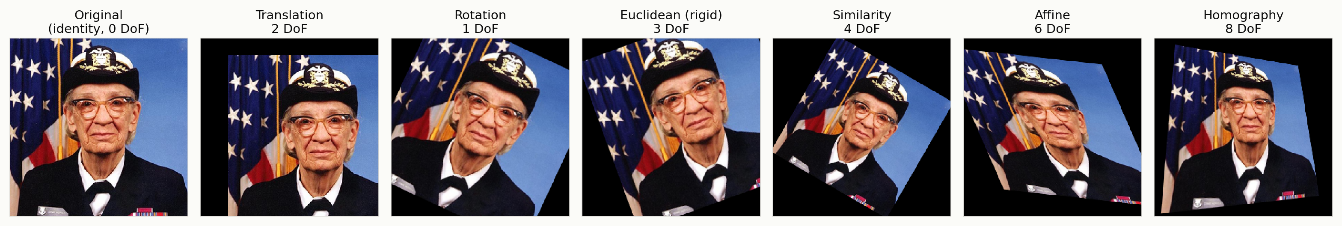
TRANSFORMATIONS IN ACTION
Generated by our from-scratch NumPy code (src/geometry.py)
Rigid & similarity
Affine
Homography
Keep angles. Only position, orientation and size change.
Keeps parallel lines parallel: a square becomes a parallelogram.
Keeps only straight lines: a square becomes any quadrilateral.
Notes:
Every panel uses inverse warping with bilinear interpolation. Black regions are pixels whose source falls outside the image.

Slide 7
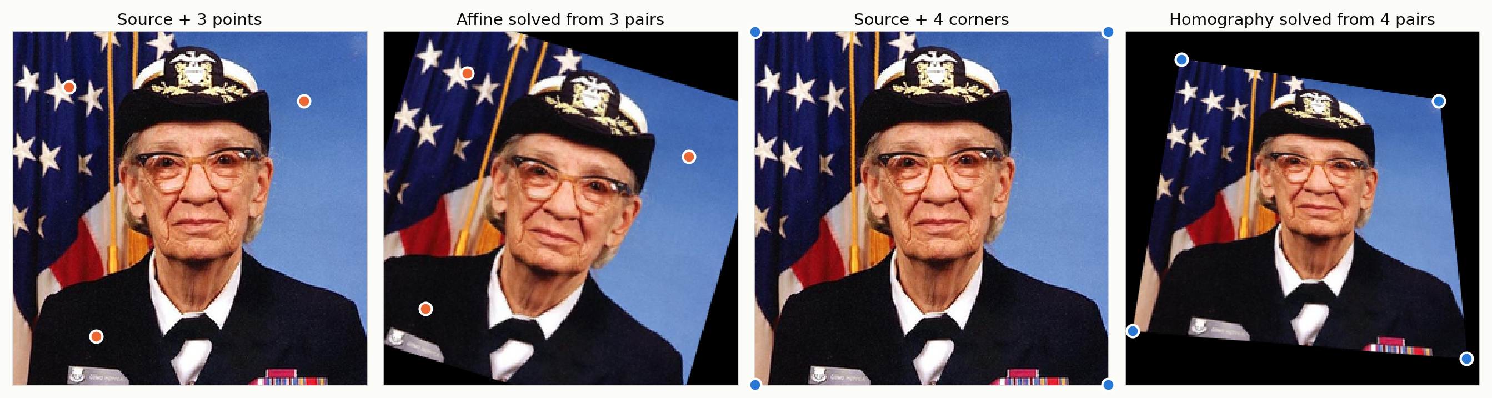
SOLVING FROM POINT PAIRS
3 pairs fix an affine, 4 pairs fix a homography
Affine: least squares
Homography: DLT
Stack 2 rows per pair → 6×6 system A·p = b. Max error on targets: 2e-13 px.
8×9 system A·h = 0 → h = last singular vector of A (SVD), divide by h₃₃. Max error: 3e-10 px.
Notes:
With exactly the minimum number of pairs the fit is exact; errors are floating-point rounding. With more pairs least squares averages noise, which leads to RANSAC.

Slide 8
HOMOGRAPHY
Simulating a new camera viewpoint
⎡wx′⎤ ⎡a b c⎤ ⎡x⎤
⎢wy′⎥ = ⎢d e f⎥ ⎢y⎥
⎣ w ⎦ ⎣g h 1⎦ ⎣1⎦
Projective mapping between planes
  Two images taken from the same centre of projection are related by a homography.
As augmentation
  A small random H = the same object seen from a slightly different angle. We keep g, h ≈ ±0.0008 per pixel on 32×32 images.
Used beyond augmentation
  Panoramas / mosaics, and SuperPoint’s homographic adaptation for self-supervised keypoints.
x′ = (ax + by + c) / (gx + hy + 1)
g and h make the divisor change across the image, so parallel lines can meet: perspective.
Notes:
This is where the lecture was heading: mapping one projective plane to another from the same centre of projection.

Slide 9
MATHEMATICAL MECHANICS
Forward vs inverse warping and interpolation

Slide 10
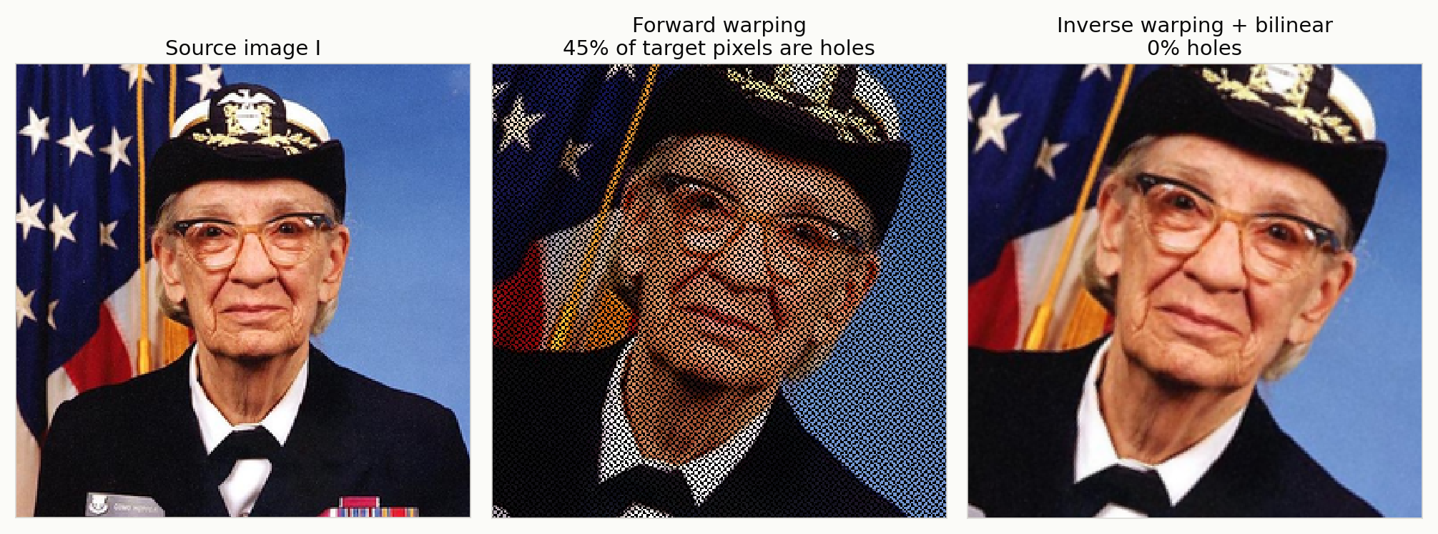
FORWARD VS INVERSE WARPING
Forward warping leaves holes; inverse warping can’t
Forward: x′ = H·x
Inverse: x = H⁻¹·x′
Push each source pixel to its nearest target. Zoom 1.35× + rotate 20° → 45% of targets get nothing.
Pull: every target asks where it came from, then interpolates. 0% holes, used by every augmentation library.
Notes:
Zooming in creates more target pixels than source pixels, so pushing can never fill them all. Inverse warping visits every target pixel exactly once.

Slide 11
INTERPOLATION METHODS
Inverse warping lands between pixels, so we interpolate
Nearest neighbour · 1 px
Bilinear · 4 px
Bicubic · 16 px
f(x,y) = I[round(y), round(x)]
f = f00(1−x)(1−y) + f10·x(1−y)
+ f01(1−x)y + f11·xy
f = Σi Σj w(x−i)·w(y−j)·I[j,i]
Keys kernel, a = −0.5
Fastest. Copies values, so edges turn blocky and jagged.
Linear in x, then in y. Smooth, slightly soft. The default in most libraries.
Cubic fit per row, then across rows. Sharpest edges; can overshoot.
All three are written from scratch in src/geometry.py; the CNN pipeline uses the same three modes through grid_sample.
Notes:
Bilinear matches the lecture's Q11/Q12/Q21/Q22 derivation. Bicubic fits a cubic through 4 points in each of 4 rows, then one more cubic across: 16 neighbours.

Slide 12
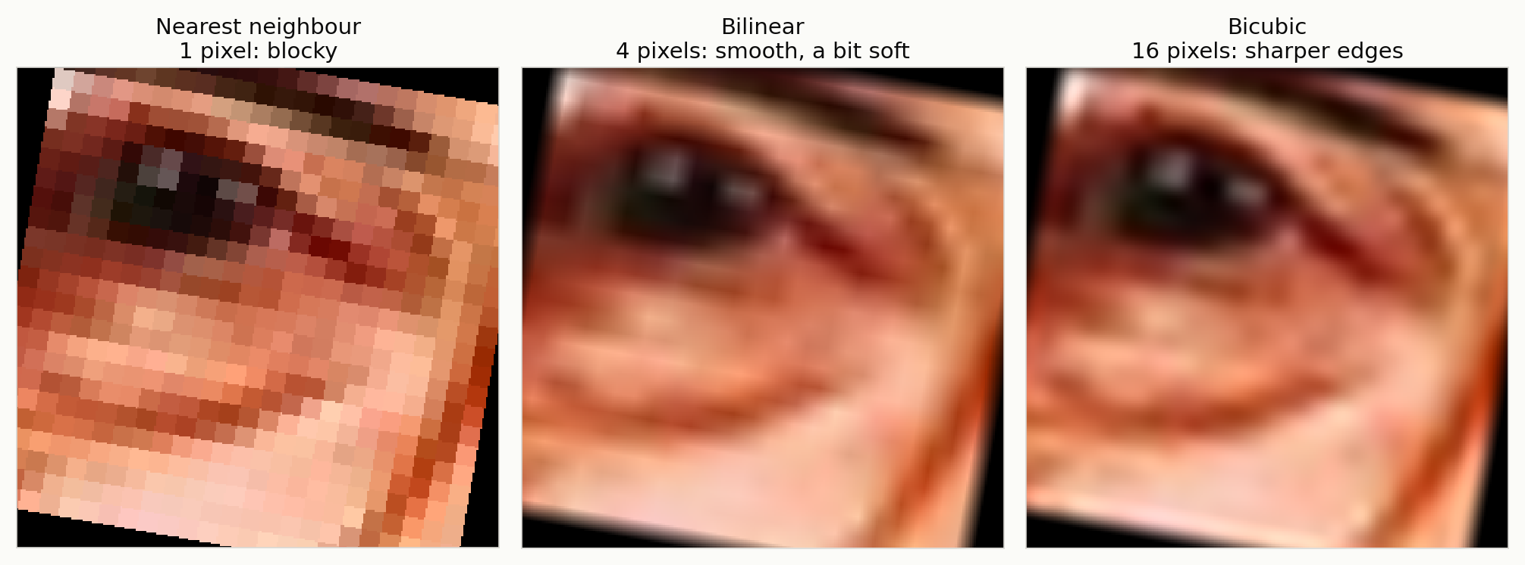
INTERPOLATION RESULTS
Same warp, three interpolators (24×24 crop, zoom 10.7×, rotate 10°)
At augmentation scale (small warps of 32×32 images) the difference is far smaller; we test whether it changes accuracy in the ablation.

Slide 13
METHODOLOGY
Geometric + photometric augmentation inside a CNN pipeline

Slide 14
GEOMETRIC AUGMENTATION PIPELINE
One random 3×3 matrix per image, every epoch
H = C · P · T · R · Sh · S · F · C⁻¹
Term | Meaning | Random range (32×32 image) | Lecture transform
F | Horizontal flip | p = 0.5 | Affine (scale x by −1)
S | Uniform scale | 0.85 – 1.15 | Similarity
Sh | Shear | ±10° | Affine
R | Rotation | ±15° | Euclidean
T | Translation | ±4 px (12.5%) | Translation
P | Perspective g, h | ±0.0008 | Homography
C moves the origin to the image centre. Applied by inverse warping: H⁻¹ + grid_sample interpolation, on the GPU (src/augment.py).
Notes:
We multiply the lecture's matrices into one homography per image with fresh random parameters each time the image is used. Rotating about the centre needs translate, rotate, translate back: C and C inverse.

Slide 15
PHOTOMETRIC AUGMENTATION
Changes pixel values, not pixel positions
Operation | Pixel rule | Random range
Brightness | I′ = β · I | β ∈ [0.7, 1.3]
Contrast | I′ = α (I − μ) + μ | α ∈ [0.7, 1.3], μ = mean gray
Saturation | I′ = s (I − gray) + gray | s ∈ [0.7, 1.3]
Sensor noise | I′ = I + σ · N(0, 1) | σ ∈ [0, 0.04]
Grayscale | I′ = 0.299R + 0.587G + 0.114B | p = 0.1
Geometric answers
Where is the object, how big, and from which angle?
Photometric answers
What lighting, which camera, how much sensor noise?
Notes:
Photometric changes need no warping: each output pixel depends only on the same input pixel. Both kinds keep the label unchanged.

Slide 16
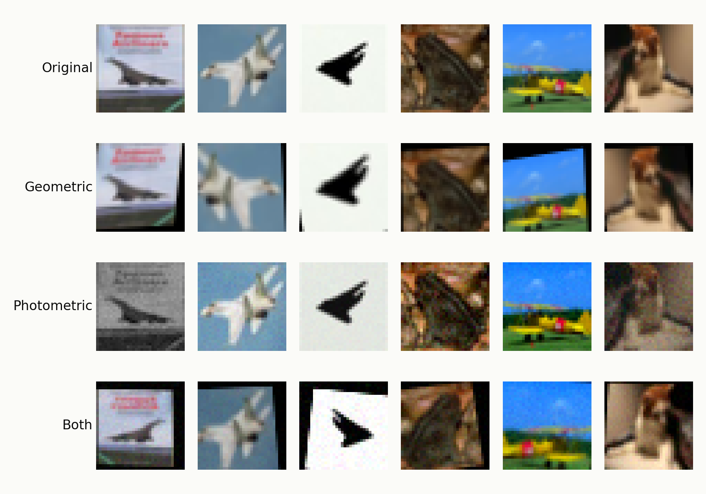
WHAT THE CNN ACTUALLY SEES
Real output of our GPU pipeline on CIFAR-10
New random draw every epoch
  60 epochs = 60 different versions of each training image.
Black corners = inverse warp outside the source
  Exactly like the lecture’s rotated cat.
The label never changes
  A tilted, darker plane is still a plane.

Slide 17
EXPERIMENTAL SETUP
A controlled comparison: only the augmentation changes
Data: CIFAR-10
Model & training
Compared settings
10,000 training images (low-data regime)
5,000 validation images, held out
10,000 test images, never used in training
ResNet-9 style CNN, 6.5M parameters, no dropout
SGD + Nesterov, one-cycle LR 0.05, weight decay 5e-4, batch 256, 60 epochs
RTX 4090
None · Geometric · Photometric · Both
3 seeds each → mean ± std
13 test-time shifts for robustness
Training accuracy is measured on clean training images, so the train–test gap is an honest measure of overfitting.

Slide 18
RESULTS
Overfitting, accuracy and robustness on unseen data

Slide 19
RESULTS
Training curves: augmentation closes the train–validation gap
Notes:
Mean of 3 seeds. Without augmentation the network hits 100.0% train accuracy while validation stalls near 79.3%: memorisation. With geometric + photometric augmentation, train accuracy stays lower (98.6%) but validation rises to 86.0%, and the final validation loss falls from 0.65 to 0.43.

Slide 20
RESULTS
Accuracy and overfitting on the unseen test set (mean of 3 seeds)
Augmentation | Train acc. | Val. acc. | Val. loss | Test acc. | Train–test gap
No augmentation | 100.0% | 79.3% | 0.652 | 78.5 ± 0.3% | 21.5 pts
Geometric | 98.8% | 84.6% | 0.528 | 83.6 ± 0.3% | 15.2 pts
Photometric | 100.0% | 78.9% | 0.689 | 77.9 ± 0.1% | 22.1 pts
Geometric + photometric | 98.6% | 86.0% | 0.431 | 85.4 ± 0.2% | 13.2 pts
+6.9 pts
test accuracy (78.5% → 85.4%)
−8.3 pts
train–test gap (21.5 → 13.2): less overfitting
Geometric augmentation gives most of the gain on clean CIFAR-10; photometric adds robustness to lighting and noise (next slide).
−34%
final validation loss

Slide 21
RESULTS
Robustness: accuracy under 13 test-time shifts
Mean over 13 shifts
  58.8% → 81.3%
Rotate 15° + dark
  38.7% → 80.8% (+42.1 pts)
Blur, never seen in training
  43.4% → 72.7% (+29.3 pts): the robustness transfers
Notes:
Each test image is shifted deterministically and the trained model is evaluated without retraining. Blur was never used as an augmentation, so its gain shows the model learned more general features, not just the specific shifts.

Slide 22
RESULTS
Which augmentation buys which robustness?
Augmentation | Clean | Geometric shifts (7) | Photometric shifts (3) | Blur (unseen) | Rotate + dark
No augmentation | 78.5 | 64.3 | 55.9 | 43.4 | 38.7
Geometric | 83.6 | 82.1 | 61.1 | 66.7 | 70.7
Photometric | 77.9 | 63.1 | 73.0 | 56.9 | 59.8
Geometric + photometric | 85.4 | 82.6 | 80.9 | 72.7 | 80.8
Geometric augmentation → geometric robustness
  Rotations, zoom, shear, perspective: 64.3% → 82.1%.
Photometric augmentation → lighting / noise robustness
  Dark, low contrast, noise: 55.9% → 73.0%.
Combining both covers both, and the combined shift
  Rotate + dark: 38.7% → 80.8%.

Slide 23
RESULTS
Ablations: interpolation method and training-set size
Interpolator inside the warp (seed 0)
More real data vs augmentation (test acc. %)
Interpolator | Test acc. % | Mean shifted acc. %
Nearest | 85.9 | 77.4
Bilinear | 85.3 | 81.2
Bicubic | 86.4 | 80.3
Training images | No augmentation | Geometric + photometric
10,000 | 78.5 | 85.4
45,000 | 87.7 | 92.4
Interpolation: Bicubic is best, but the spread is only 1.1 pts, much smaller than the +6.9 pts from augmenting at all (single seed per interpolator).
Data size: augmentation adds +6.9 pts with 10k images and still +4.7 pts with 45k. Augmented 10k (85.4%) recovers much of what 4.5× more real data gives (87.7%).

Slide 24
STATE-OF-THE-ART BENCHMARK
Our pipeline vs. the augmentation methods used in current research

Slide 25
MODERN AUGMENTATION METHODS
What current research uses, and what each one changes
Method | Year | Core idea | Family
Crop + flip | 2016 | Random 32×32 crop of a 4-px padded image + horizontal flip | Standard baseline
Ours | 2026 | Random homography H = C·P·T·R·Sh·S·F·C⁻¹ + photometric jitter | Geometric + photometric
AutoAugment | 2019 | Policy of 25 two-op sub-policies found by reinforcement learning | Learned policy
RandAugment | 2020 | N = 2 random ops at one global magnitude M = 9; no search | Simplified policy
TrivialAugment | 2021 | One random op at a random magnitude per image; zero parameters | Parameter-free policy
AugMix | 2020 | Mix 3 random op chains + Jensen–Shannon consistency loss | Robustness
Mixup / CutMix | 2018 / 2019 | Blend two images, or paste a patch; labels mixed in proportion | Label mixing
All plus “Combined” = TrivialAugment + Random Erasing + CutMix/Mixup (a modern training recipe).
Notes:
Every method shares one model, optimiser, schedule, data split and number of epochs; only the augmentation changes. Policy methods use torchvision's reference implementations; AugMix uses the paper's JSD loss with weight 12 and excludes ops that overlap CIFAR-10-C.

Slide 26
BENCHMARK PROTOCOL
Standard data, standard robustness test, more metrics
Data
Training
Metrics
Full CIFAR-10: 45,000 train / 5,000 validation / 10,000 test
CIFAR-10-C: 15 corruptions × 5 severities × 10,000 = 750,000 test images
ResNet-9, 60 epochs, one-cycle SGD, identical for all 9 methods
2 seeds per method · checkpoints saved and scored on CIFAR-10-C
Clean test accuracy (+ flip test-time augmentation)
ECE: calibration error (↓)
mCA / mCE on CIFAR-10-C (the standard robustness score)
CIFAR-10-C (Hendrycks & Dietterich, ICLR 2019) is the benchmark AugMix and later robustness papers report on.

Slide 27
RESULTS
State-of-the-art comparison (mean of 2 seeds, full CIFAR-10)
Method | Test acc. % | + flip TTA % | ECE % ↓ | 13 shifts % | CIFAR-10-C mCA %
Crop + flip | 93.8 ± 0.1 | 94.3 | 1.6 | 76.6 | 73.0
Ours | 93.2 ± 0.1 | 93.6 | 1.3 | 90.1 ★ | 86.0
AutoAugment | 94.7 ± 0.0 ★ | 95.0 | 0.8 | 84.3 | 81.0
RandAugment | 94.6 ± 0.0 | 94.9 | 1.0 | 83.0 | 81.1
TrivialAugment | 94.4 ± 0.0 | 94.9 | 0.6 | 86.8 | 83.3
AugMix | 94.3 ± 0.1 | 94.8 | 0.5 ★ | 87.8 | 87.0 ★
Mixup | 93.5 ± 0.2 | 94.1 | 15.8 | 78.7 | 76.6
CutMix | 94.1 ± 0.0 | 94.6 | 9.8 | 74.7 | 70.5
Combined | 92.9 ± 0.1 | 93.3 | 15.9 | 84.2 | 81.3
★ = best in column

Slide 28
RESULTS
Clean accuracy vs. accuracy on CIFAR-10-C corruptions
Most robust: AugMix
  87.0% on CIFAR-10-C vs 73.0% for crop + flip (+14.0 pts).
Robustness gap
  Every method loses accuracy under corruption; the drop ranges from 7.2 to 23.6 pts.
Ours ranks 2 of 9
  86.0% mCA (+13.0 pts vs the baseline).

Slide 29
RESULTS
Where the robustness comes from: corruption family and severity
Notes:
Shown: the baseline, our pipeline, and the most robust state-of-the-art method (AugMix). Our pipeline's largest gain over the baseline is on noise corruptions (+28.1 pts). At severity 5, AugMix keeps 79.1% vs 56.6% for the baseline.

Slide 30
WHAT THE BENCHMARK SHOWS
94.7%
87.0%
0.5%
best clean accuracy: AutoAugment
best CIFAR-10-C: AugMix
lowest calibration error: AugMix
Modern policies vs the standard recipe
  5 of 8 methods beat crop + flip on clean accuracy (93.8%): AutoAugment, RandAugment, TrivialAugment, AugMix, CutMix.
Our from-scratch pipeline
  Clean 93.2% (rank 8/9), CIFAR-10-C 86.0% (rank 2/9), our 13 shifts 90.1% (rank 1/9).
Cost
  Minutes per run: Crop + flip 3.4 · Ours 4.2 · AutoAugment 5.9 · RandAugment 3.1 · TrivialAugment 4.2 · AugMix 15.3 · Mixup 3.9 · CutMix 3.6 · Combined 4.1.

Slide 31
KEY TAKEAWAYS
+6.9
−8.3
+22.5
pts test accuracy (10k-image study)
pts train–test gap (21.5 → 13.2)
pts accuracy under 13 shifts (10k study)
The lecture’s matrices are the augmentation
  Translation → rotation → similarity → affine → homography, applied by inverse warping with interpolation.
Augmentation reduces overfitting
  Lower train accuracy, higher validation and test accuracy, lower validation loss.
Augmentation makes inference robust
  Geometric → viewpoint robustness; photometric → lighting/noise robustness; together they also help on an unseen shift (blur).
Against the state of the art
  On CIFAR-10-C our pipeline ranks 2 of 9 (86.0% vs 73.0% for crop + flip; best: AugMix + JSD (2020), 87.0%), at 1.5 pts lower clean accuracy than the best (AutoAugment (2019)).

Slide 32
LIMITATIONS & FUTURE WORK
One dataset, one architecture, short schedule
  CIFAR-10, ResNet-9, 60 epochs. Papers train WideResNets for 200 epochs, where strong policies gain more.
Our own 13 shifts overlap with some augmentations
  So the standard CIFAR-10-C benchmark is the fairer robustness test.
Label-changing transforms
  Large rotations or flips can change the label for digits or text (6 ↔ 9); ranges must suit the task.
Bigger models and ImageNet-scale data
  WideResNet-28-10 / ViT, ImageNet-C, and generative (diffusion) augmentation.
Learned warps
  Make our homography ranges learnable (e.g. spatial transformer / adversarial augmentation).
Test-time augmentation
  Average predictions over several warps of the test image.

Slide 33
DEMO: CODE WALKTHROUGH
Inverse warping in 8 lines (src/augment.py)
def inverse_warp(x, H, mode="bilinear"):
B, _, h, w = x.shape
ys, xs = meshgrid(arange(h), arange(w))
dst = stack([xs, ys, ones]) # each output pixel
src = inv(H) @ dst # where it came from
sx, sy = src[0]/src[2], src[1]/src[2]
grid = normalise(sx, sy) # to [-1, 1]
return grid_sample(x, grid, mode) # interpolate
Live demo (optional)
  python src/demo_transforms.py
  → all theory figures in seconds
Full experiment
  bash run_all.sh
  → training, robustness suite, tables
Project folder
  src/ · figures/ · results/ · README.md

Slide 34
REFERENCES
J. Malik, CS867 Lecture 7: Geometric Transformations, NUST SEECS, 2026.
R. Szeliski, Computer Vision: Algorithms and Applications, 2nd ed., 2022 (ch. 3.6 warping, 8.1 alignment).
R. Hartley, A. Zisserman, Multiple View Geometry in Computer Vision, 2nd ed., 2004 (ch. 4, DLT).
R. Keys, “Cubic convolution interpolation for digital image processing,” IEEE TASSP, 1981.
A. Krizhevsky, “Learning multiple layers of features from tiny images” (CIFAR-10), 2009.
C. Shorten, T. Khoshgoftaar, “A survey on image data augmentation for deep learning,” J. Big Data, 2019.
D. Hendrycks, T. Dietterich, “Benchmarking neural network robustness to common corruptions and perturbations,” ICLR 2019.
E. D. Cubuk et al., “AutoAugment: learning augmentation policies from data,” CVPR 2019; “RandAugment,” CVPRW 2020.
S. Müller, F. Hutter, “TrivialAugment: tuning-free yet state-of-the-art data augmentation,” ICCV 2021.
D. Hendrycks et al., “AugMix: a simple data processing method to improve robustness and uncertainty,” ICLR 2020.
H. Zhang et al., “mixup,” ICLR 2018; S. Yun et al., “CutMix,” ICCV 2019; Z. Zhong et al., “Random Erasing,” AAAI 2020.

Slide 35
ANY QUESTIONS?
Thank you
Notes:
Likely questions: Why not just train on the test shifts? (Cheating; blur shows transfer to an unseen shift.) Why does flip help? (CIFAR objects are left-right symmetric; not true for digits or text.) Can augmentation hurt? (Yes, if it changes the label.)

