Slide 1

Stockout Why
OPEN AGENT HACKATHON 2026 · TRACK 2: THE AGENT THAT CAN EXPLAIN WHY
PRIMARY CAUSE
PO-506 took 19 days
against a quoted 7
[supported] late vs promise
[supported] demand rose 1.20x
...but not sufficient
[ruled out] reorder point
[ruled out] order raised late
nemotron yes
An AI agent that explains why a product ran out, and cites the rows behind every claim.
Zetaris
Meterless H-MEM
Meterless Nightshift
NVIDIA Nemotron
Sohaib Aamir
AI Backend Engineer, NCAI, NUST · linkedin.com/in/sohaib-aamir
Notes:
Stockout Why answers one question a shop owner actually asks: why did this product run out? It names the cause, shows how it decided, and cites the query rows behind every claim. Built for Track 2 of the Open Agent Hackathon 2026 on Zetaris, Meterless H-MEM, Meterless Nightshift and NVIDIA Nemotron.

Slide 2
An empty shelf has two suspects
THE PROBLEM
SUSPECT 1
?
SUSPECT 2
?
The supplier was late
Demand spiked
Blame demand instead and you over-order: cash tied up in stock you didn't need, while the late supplier goes unchallenged.
Blame the supplier instead and you start a dispute you can't prove, and the shelf empties again the next time demand jumps.
Most tools rank plausible causes. A plausible cause isn't a proven one. Stockout Why proves which cause mattered, and shows the rows.
Notes:
When a shelf empties there are usually two explanations: the supplier delivered late, or demand jumped. Guess wrong either way and it costs you: excess stock and cash on one side, an unfair dispute on the other. A list of plausible causes doesn't settle it. We wanted an agent that proves which cause mattered.

Slide 3
One question in, a verdict with receipts out
WHAT IT DOES
From the live report for SKU-1041 (abridged)
1
The verdict
The primary cause, computed from the company's own records. Same data, same answer, every time.
WHY DID SKU-1041 RUN OUT?
Stock reached zero on 2026-09-03 for 8 days.
PRIMARY CAUSE
PO-506 took 19 days against a quoted 7.
Repairing it alone prevents the stockout.
[supported] Delivery 12 days past its promise
[supported] Demand rose 1.20x, not sufficient
[ruled out] Reorder point too low
[ruled out] Order raised late
E1 On-hand stock, SKU-1041: 180 rows, b4dc2ddd8aa8
2
The reasoning
Every candidate cause tested and marked supported or ruled out, with the numbers that decided it.
3
The evidence
The SQL, row count and result hash behind each claim, so anyone can re-run it in Zetaris.
Notes:
Ask about one SKU and you get three things. A verdict, computed from the records, not guessed. The reasoning: every candidate cause tested, with the numbers. And the evidence: each claim names the Zetaris query, its row count and a hash of the result, so a sceptical buyer can re-run it.

Slide 4
Counterfactuals, not weights
HOW IT DECIDES
The agent replays the stock history with one cause repaired at a time.
The primary cause is the one whose repair alone would have prevented the stockout.
Contributing causes are real but not sufficient; the rest are ruled out, with numbers.
Cause tested | What the records show | Verdict
Supplier took longer than its quoted lead time | 19 days against a quoted 7. Arriving in 7 days (2026-08-30) avoids the stockout | Primary
Delivery missed its promised date | Promised 2026-08-30, arrived 2026-09-11: 12 days late | Contributing
Demand rose before the stockout | 32.8 vs 27.5 units/day (1.20x, under the 1.5 spike line). The shelf empties even at the lower rate | Contributing
Reorder point too low | 336 units covers 7 days at 32.8/day (230 needed) | Ruled out
No order raised at the reorder point | Crossed on 2026-08-23; PO-506 raised the same day | Ruled out
19 days
PO-506's lead time, against a quoted 7
Notes:
This is the core idea. Instead of scoring causes, the agent replays history with one cause repaired at a time. If fixing the supplier's lead time alone prevents the stockout, that is the primary cause. Demand did rise, so a plausibility scorer would blame it, but the shelf empties even at the earlier, lower rate, so it is contributing, not sufficient. Everything in this table comes from the live report.

Slide 5
Four layers, one door to the data
ARCHITECTURE
DATA
CORE
BUILD
POWER
Zetaris
Counterfactual replay
Meterless H-MEM
Nemotron via Nightshift
Six retail tables, federated as one datasource. Seven fixed, read-only queries; every read is an evidence record.
History re-run with one cause repaired at a time. Deterministic: no model in the verdict.
Remembers past verdicts per supplier and learns from analyst feedback. 13/13 conformance.
Writes the plain-words explanation, fact-checked before it is shown. Never decides.
Output verdict · reasoning · re-runnable evidence · a memory for next time
Notes:
Four layers. Zetaris is the only door to the data. The core reaches the verdict deterministically. H-MEM remembers what earlier investigations concluded. Nemotron, through Nightshift, writes the explanation, and only the explanation.

Slide 6
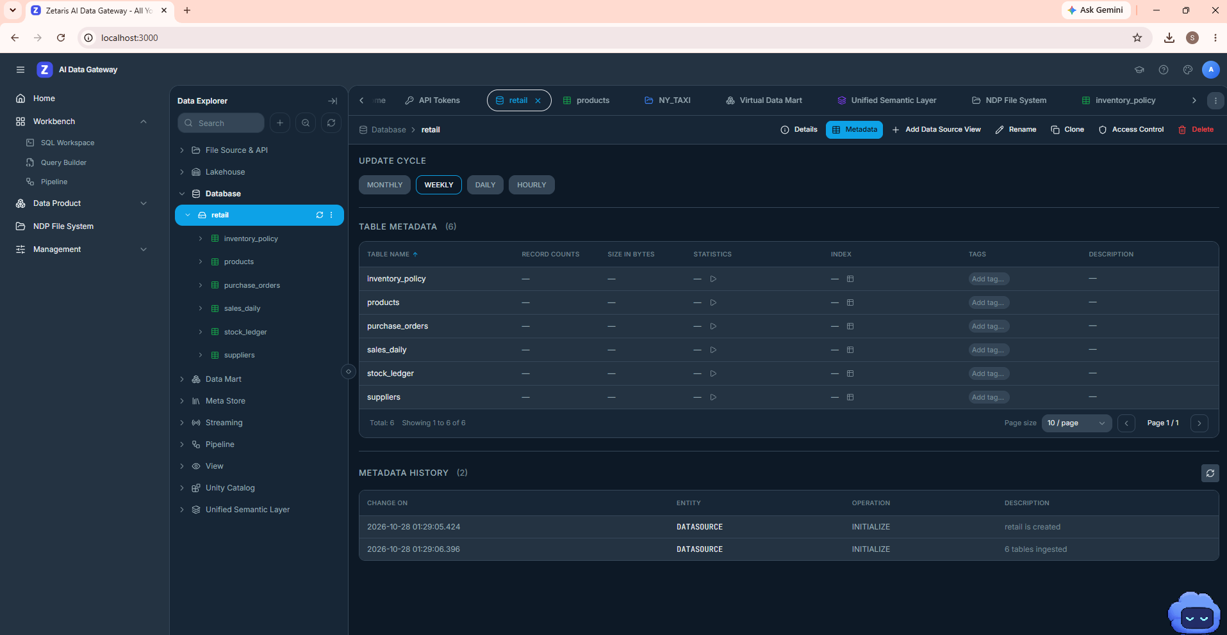
Zetaris is the only door to the data
DATA · ZETARIS
Six tables in a retail Postgres, registered in Zetaris as the datasource retail
Seven fixed, read-only queries. The agent chooses one; it can't write SQL
Every read returns its SQL, rows, result hash and timestamp
The loader counts each table back through Zetaris: all six match
Zetaris Data Explorer: the retail datasource and its six tables (local install)
Notes:
The business tables live in a retail database that Zetaris federates. The agent never touches the database directly and never writes SQL: it picks from a fixed allowlist of read-only queries. Every read comes back as an evidence record, which is what lets the report cite its sources.

Slide 7
Memory that compounds
BUILD · METERLESS H-MEM
13/13
official H-MEM conformance cases, on the canonical upstream runner
Our own implementation, written against the published spec
Each verdict is stored with its lineage, per supplier
The next investigation recalls it, ranked by confidence
Analyst feedback moves confidence by the spec's exact deltas
Spec deltas, as measured by npm run smoke and the CLI
Notes:
H-MEM is the Meterless memory engine. We implemented it ourselves from the spec, and it passes all 13 cases on the official conformance runner. In the product, each verdict is remembered with its lineage. Run the same supplier again and it comes back. An analyst confirming it moves confidence from 0.70 to 0.75; marking it wrong drops it to 0.50.

Slide 8
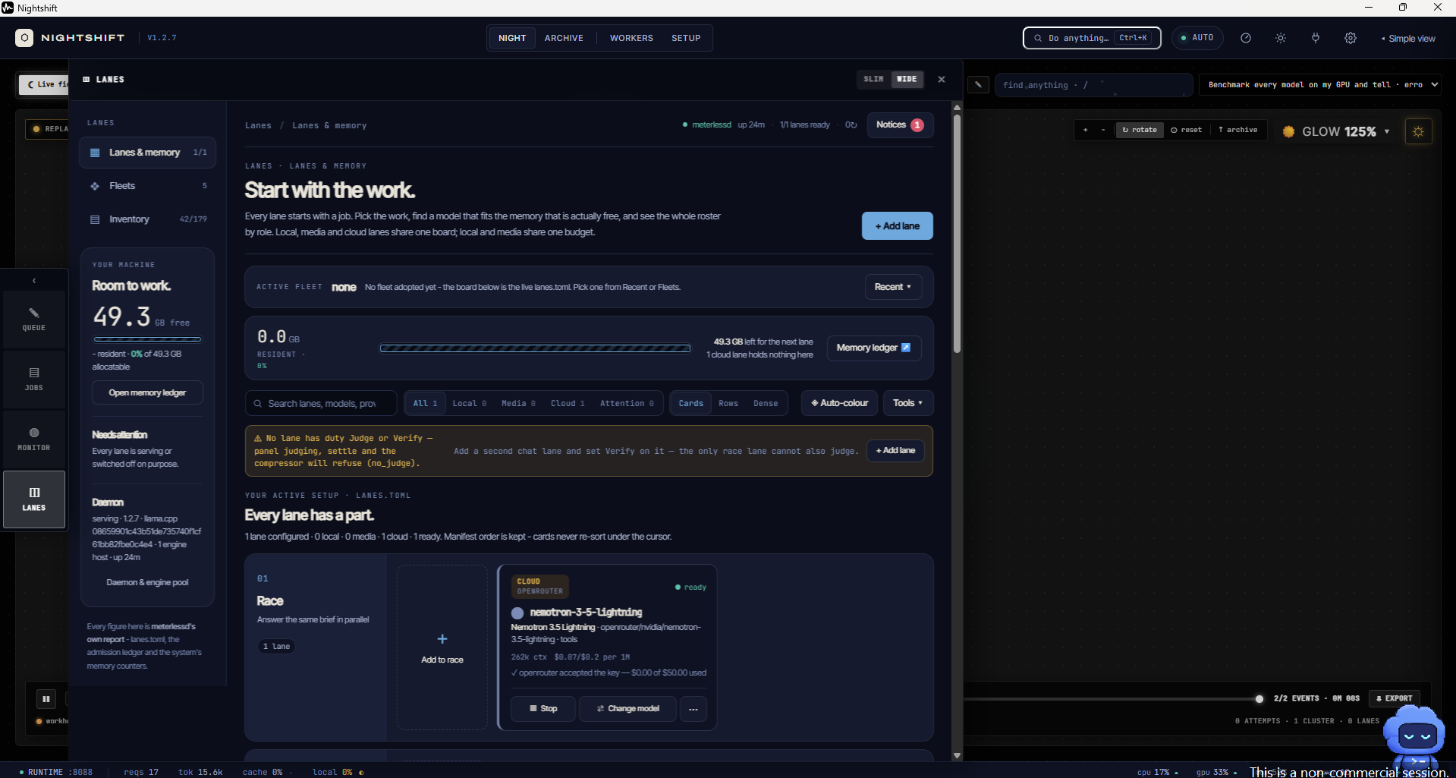
Nemotron explains; the records decide
POWER · NEMOTRON VIA NIGHTSHIFT
MODEL CALL
requested openrouter/nvidia/nemotron-3.5-lightning
answered openrouter/nvidia/nemotron-3.5-lightning
receipt rcpt_req_udaamg4e
nemotron yes
Nightshift is the app's primary AI provider, over its OpenAI-compatible Runtime
The model is pinned to Nemotron, and the report logs the model that actually answered
Nightshift lane: NVIDIA Nemotron 3.5 Lightning via OpenRouter, ready
Provider keys stay in Nightshift; the app holds only the Runtime URL and token
Notes:
Nightshift is the app's AI provider. Its lane runs NVIDIA Nemotron 3.5 Lightning. Because a routing mode could land on a different model, the report records the model that actually answered and Nightshift's receipt. Nemotron's job is bounded on purpose: it explains the verdict, it never reaches it.

Slide 9
Every model sentence is checked before it's shown
TRUST
1
Claim checker
2
Discard, don't caveat
Every number and date must appear in the findings or the evidence. Dates in words, ordinals and thousands are read too.
Prose with one unsupported figure is thrown away, and the computed wording is shown instead.
3
No cut-off answers
4
A bounded role
Empty or truncated replies are retried, up to three times, and never published.
The model writes the explanation only. An outage degrades the prose, never the verdict.
“Every one of the 16 figures above was checked against the evidence before publishing.”
From the live report's explanation section
Notes:
A track about explaining why can't tolerate a fluent sentence with an invented number. So every figure Nemotron writes is checked against the evidence. One unsupported number and the whole explanation is discarded in favour of the computed wording. Empty or cut-off replies are retried, never published.

Slide 10
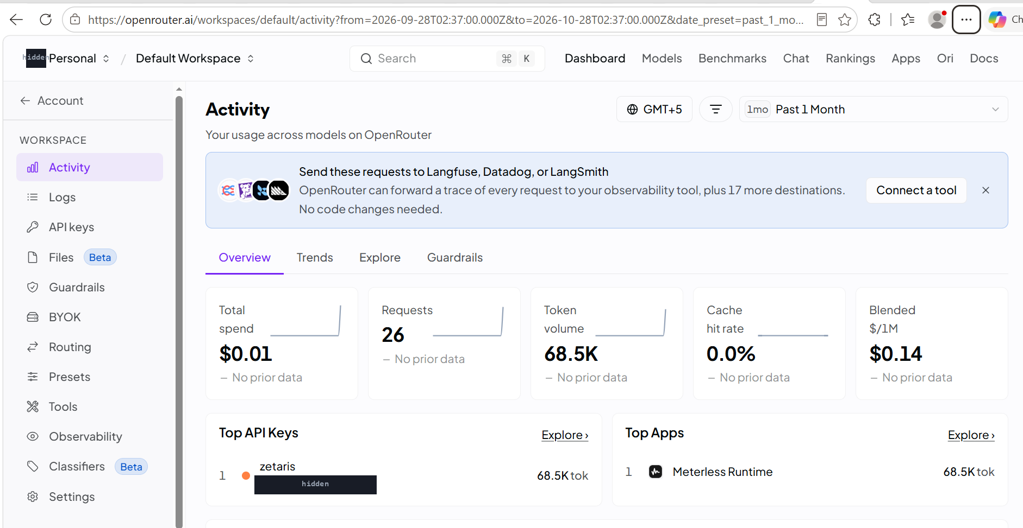
Verified on a live stack
PROOF
6/6
39/39
13/13
setup checks
tests passing
H-MEM conformance
npm run smoke: Zetaris, Nightshift + Nemotron, H-MEM
npm test, from a clean clone
the canonical upstream runner
Live and sample mode reach the same verdict, word for word
All six tables count back exactly through Zetaris
Nemotron answers through Nightshift, every figure verified
Notes:
Everything here was run on this machine against live services. The setup check passes all six, including a real Nemotron request. 39 tests pass from a clean clone, and the H-MEM engine passes the official conformance runner. OpenRouter's activity confirms the requests came from the Meterless Runtime.

Slide 11
What we don't claim
HONEST LIMITS
!
Synthetic data
!
One true cause exercised
!
Local Zetaris only
180 days simulated day by day, with one injected fault and one distractor. No claim about a real retailer's books.
All five causes are tested, but only the lead-time slip is exercised as the true cause.
The live path is verified against Zetaris running in Docker, not a hosted instance.
!
Simple recall
!
Figures, not wording
!
Variable latency
H-MEM's embedder is a bag-of-words projection: it matches shared vocabulary, not paraphrase.
The claim checker stops invented numbers, not a correct number in a loosely worded sentence.
Nemotron via OpenRouter takes 6 s to about 2 minutes, depending on the upstream provider. The app retries.
Notes:
We'd rather say this plainly than have judges find it. The data is synthetic. Only one fault type is the true cause. Zetaris is verified on a local install. The memory's recall is lexical. The checker checks numbers, not phrasing. And Nemotron's latency varies with the upstream provider, so the app retries.

Slide 12
Run it yourself
TRY IT
Sample mode: no keys, no network
Live mode: Zetaris + Nightshift
$ npm install
$ npm run gen-data
$ npm run investigate -- --sku SKU-1041 --sample
$ npm test
$ cp .env.example .env
$ npx tsx scripts/register_zetaris.ts --execute
$ npm run smoke
$ npm run investigate -- --sku SKU-1041 --explain
Code: github.com/SohaibAamir28/stockout-why
Needs Node 22. Live mode also needs a local Zetaris install and Meterless Nightshift; provider keys go in Nightshift's Providers tab, never in .env.
Notes:
Sample mode runs anywhere with Node 22: no keys and no network, and it reaches the same verdict as the live path. Live mode needs Zetaris and Nightshift running locally; the loader registers the retail database and checks every table, and the smoke test confirms the whole stack.

Slide 13
Sohaib Aamir
BUILT BY
AI Backend Engineer, NCAI, NUST
MS Computer Science, NUST (2025–2027)
“I build AI systems that have to work on real, messy data, and I measure where they fail.”
1st place, AI for Connectivity Hackathon 2025
Global Nominee, NASA Space Apps 2024
All 9 puzzles solved, Harvard CS50x Puzzle Day 2025
linkedin.com/in/sohaib-aamir · github.com/SohaibAamir28/stockout-why
Stockout Why: the agent that can explain why.
Notes:
I'm Sohaib Aamir, an AI backend engineer at NCAI, NUST, and an MS computer science student. My work is AI that has to hold up on messy, real data, and measuring where it fails, which is exactly what this agent's claim checker and honest-limits section are about. Thank you.

