Slide 1

Customer Credit Card Transactions:
A Data Analysis Project
"Unveiling Patterns and Trends in Spending"
Report By:
Sohaib Muhammad Khan

Slide 2



Introduction
This report provides an analysis of credit card spending behavior based on a dataset of credit card transactions. The insights were generated using a dashboard created in Power BI, which connects to an SQL Server Management Studio containing the uploaded CSV file. The analysis includes various dimensions such as revenue, interest earned, transaction amounts, customer demographics, and spending patterns.

Slide 3
Project Objective
To develop a comprehensive credit card weekly dashboard that provide real-time insights into key performance metrics and trends, enabling stakeholders to monitor and analyze credit card operations effectively.
Tools Utilized
Microsoft Excel
SQL
Power Bi

Slide 4
Tools and Methodology
A CSV file containing the data was used as the primary data source.
The CSV file was uploaded to an SQL Server Management Studio
to manage and manipulate the data efficiently.
DAX queries were employed within Power BI to generate new columns and measures, providing deeper insights and refined data visualization.
Power BI was utilized to create the dashboard for visualizing key insights.

Slide 5
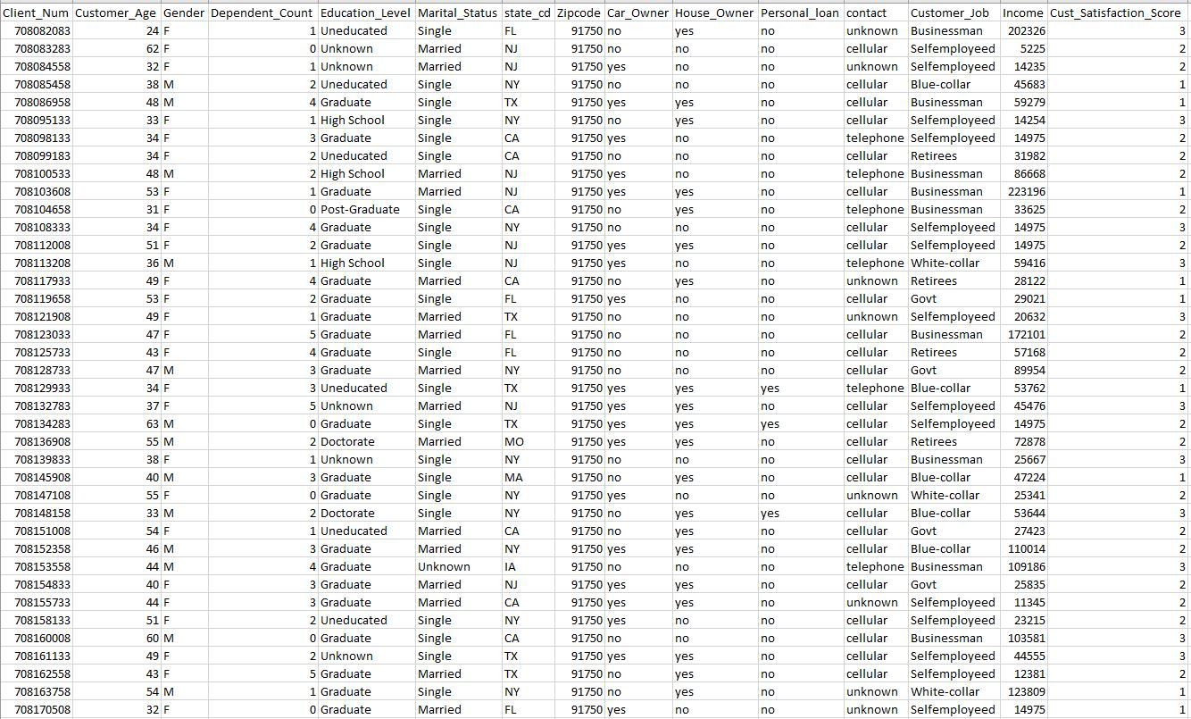
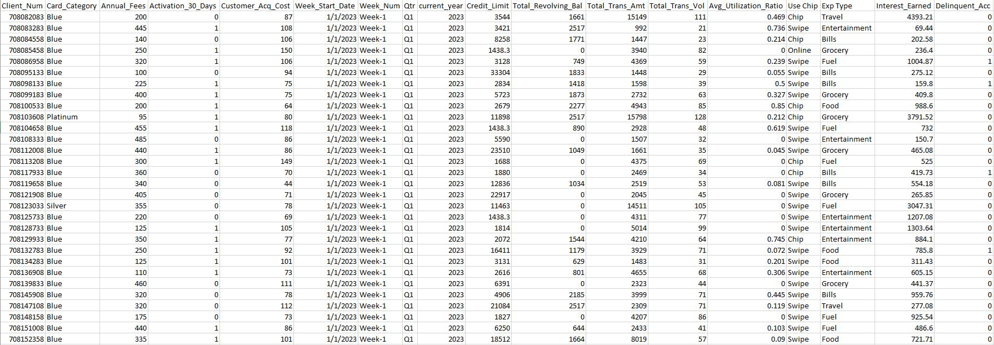
Excel CSV Files Example
To illustrate the data used in the analysis, the following is a sample of the CSV file uploaded to SQL Server. These files contains credit card transaction data, which is used for analyses and visualizations in the Power BI dashboard.
These tables provides a snapshot of the types of data included in the CSV file, such as transaction details, customer demographics, and expenditure categories.
customer.csv
credit_card.csv

Slide 6
Loading CSV Data into SQL Server
To efficiently manage and analyze the credit card transaction data, the CSV file is loaded into SQL Server. This process involves creating the necessary database and tables, importing the data, and preparing it for connection with Power BI. Below are the steps involved:
Create Database and Tables
Import Data from CSV File
Connect to Power BI

Slide 7
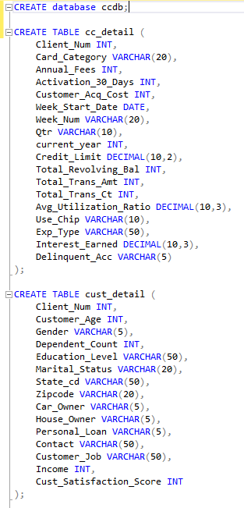
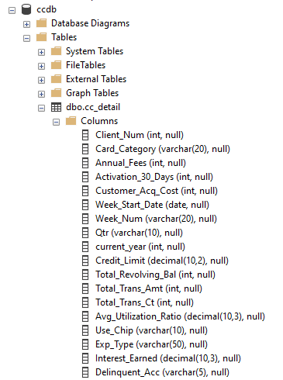
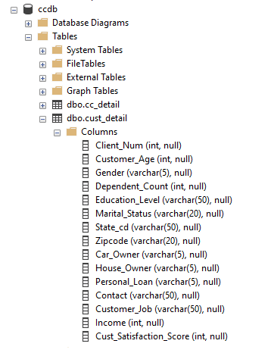
Create Database and Tables
First, we create a new database in SQL Server to store the credit card transaction data. Then, we define the structure of the tables according to the schema of the CSV file. The following SQL queries are used to create the database and tables:

Slide 8
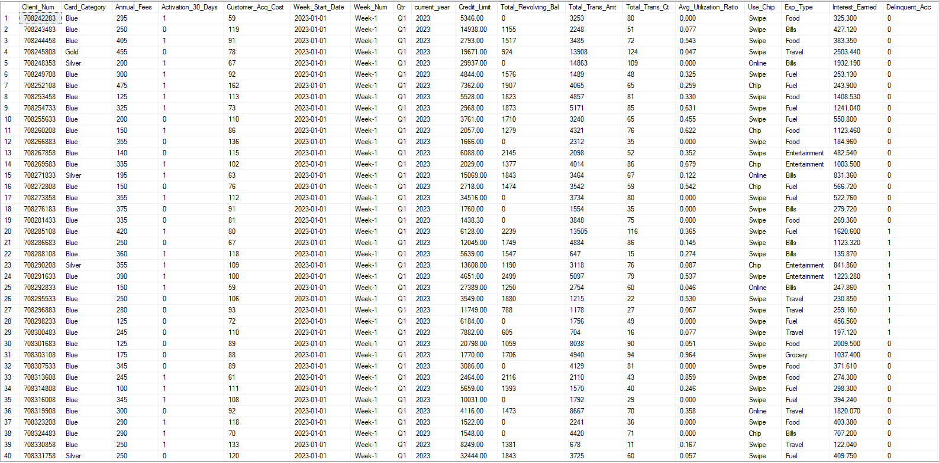
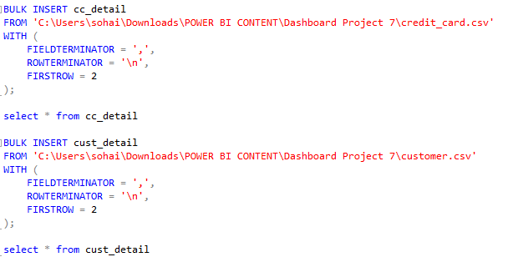
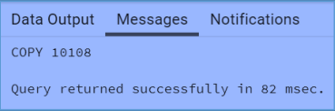
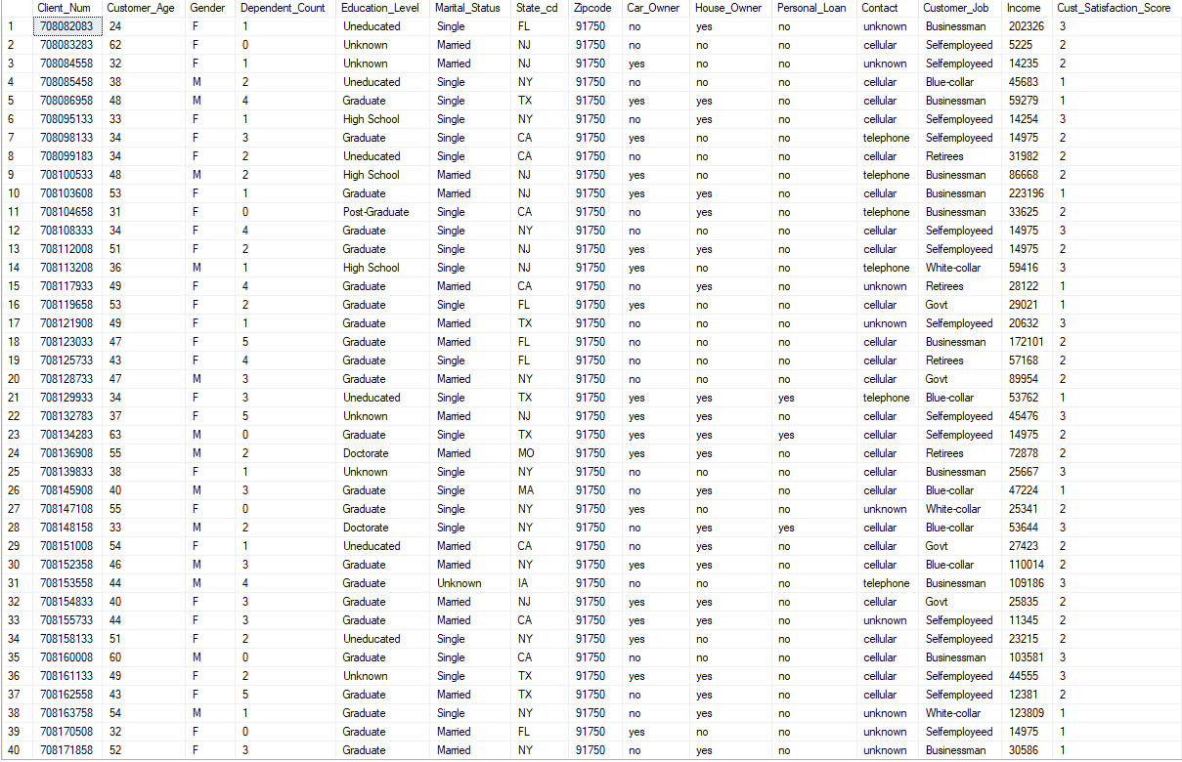
Import Data from CSV Files
After creating the database and tables, the next step is to import the data from the CSV file into the SQL Server tables. This can be done using SQL Server Management Studio (SSMS) or T-SQL commands. An example T-SQL command for importing data is:
cc_detail
cust_detail

Slide 9
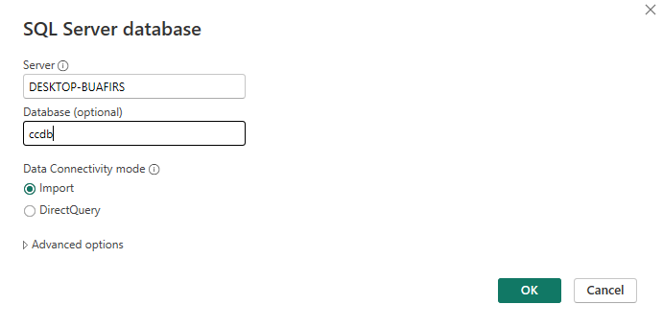
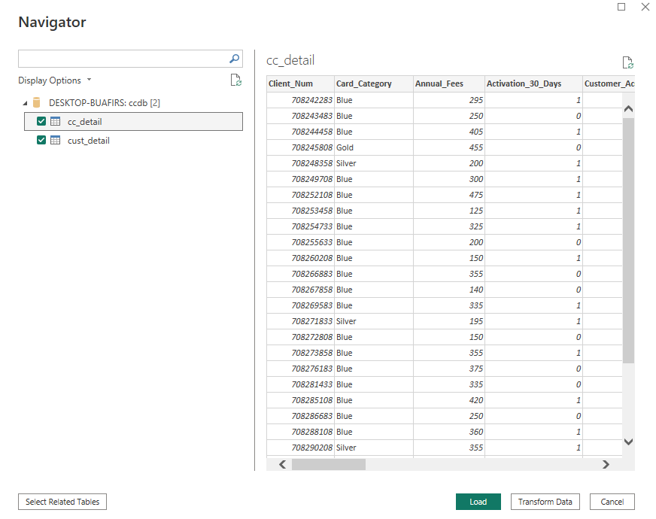
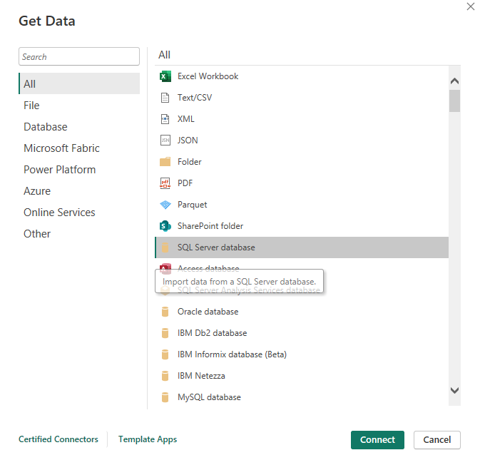
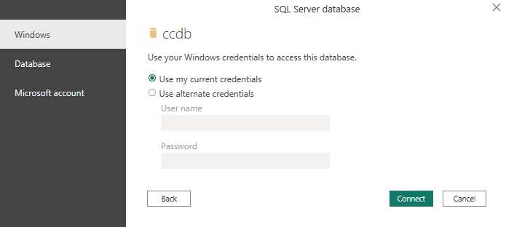
Connect Power BI
Once the data is successfully imported into SQL Server, it can be connected to Power BI. In Power BI Desktop, use the SQL Server connector to establish a connection, select the relevant tables, and start building the dashboard and reports based on the imported data.

Slide 10
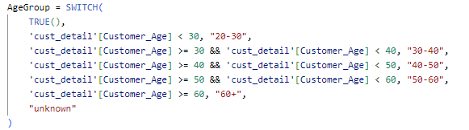
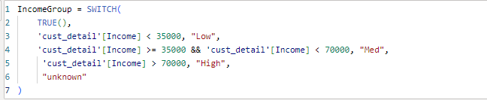
DAX Queries Implementation and Explanation
To enhance our analysis and provide more granular insights into credit card spending behavior, we used Data Analysis Expressions (DAX) in Power BI. DAX allows us to create calculated columns and measures that summarize, filter, and manipulate data dynamically. The following DAX queries have been implemented to derive key metrics for our dashboard:
Purpose: Categorizes customers into age groups to analyze spending patterns by age demographic.
Purpose: Segments customers by income levels to assess revenue contributions from different income brackets.

Slide 11


Purpose: Calculates total revenue generated from fees, transactions, and interest to measure overall financial performance.
Purpose: Computes the total revenue for the current week to analyze recent spending trends and patterns.
Purpose: Determines the revenue for the previous week, allowing for week-over-week performance comparisons.
These DAX queries enable dynamic analysis and visualization, making it easier to identify trends, patterns, and anomalies in credit card spending behaviors across different customer segments.

Slide 12

Key Insights
Overview Metrics
Revenue: Total revenue from credit card transactions is reported at 55 million.
Interest Earned: The total interest earned from credit card transactions amounts to 7.8 million.
Income: The total income from all credit card-related activities stands at 576 million.
Customer Happiness Score: The average customer happiness score is recorded at 3.19.

Slide 13

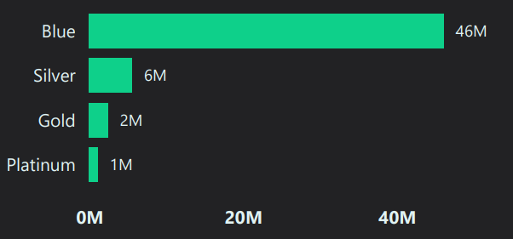
Revenue Analysis by Different Segments
Gender: Revenue is almost equally split between male and female customers, with females slightly ahead.
Card Category: The highest revenue is generated from Blue cardholders (46 million), followed by Silver (6 million), Gold (2 million), and Platinum (1 million) cardholders.

Slide 14
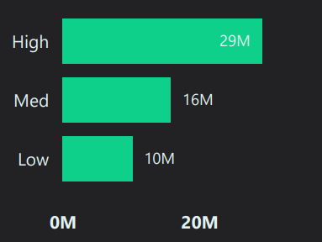
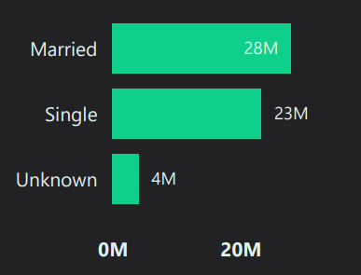
Income Group: High-income groups contribute the most to revenue (29 million), followed by medium (16 million) and low-income groups (10 million).
Marital Status: Married customers contribute 28 million to the revenue, followed by single customers at 23 million.

Slide 15
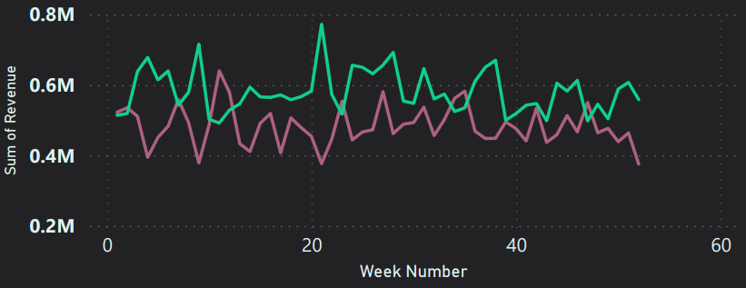
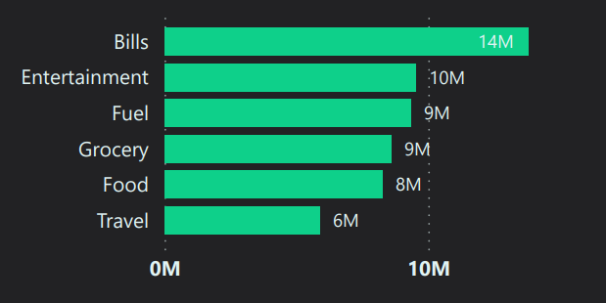
Spending Patterns and Trends
Weekly Revenue: Revenue shows fluctuations across weeks, indicating varying spending behaviors.
Expenditure Type: The highest revenue by expenditure type is from bills (14 million), followed by entertainment (10 million) and fuel (9 million).

Slide 16
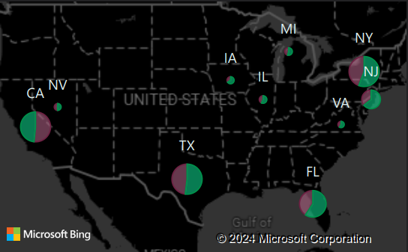
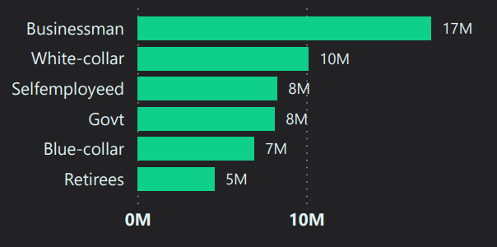
Geographic Insights: The dashboard includes a map showing revenue distribution by state, highlighting areas with the highest credit card spending filtered by gender.
Job Type: Business professionals contribute the most to revenue (17 million), followed by white-collar workers (10 million).

Slide 17
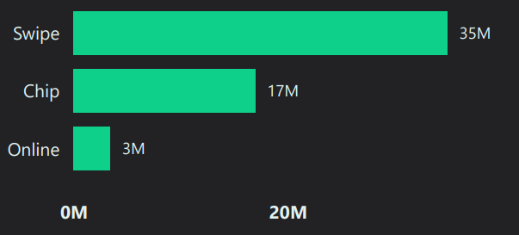
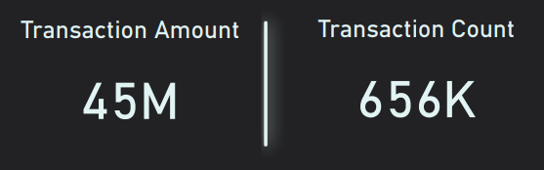
Transaction Behavior
Use of Card: Swipe transactions generate the highest revenue (35 million), followed by chip and online transactions.
Transaction Amount and Count: The dashboard shows both the transaction amount and count, allowing for a comprehensive view of credit card usage.

Slide 18
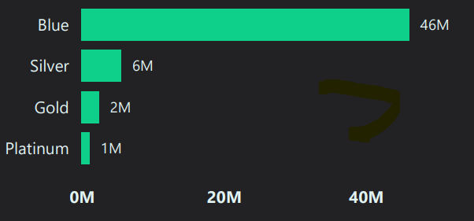
Key Drivers and Anomalies
Potential anomalies, such as low revenue from high-value card categories like Gold and Platinum, suggest further investigation may be needed.

Slide 19
Recommendations
Based on the insights from the dashboard, there are a few key recommendations to consider that could help improve overall credit card performance and customer engagement:
Targeted Marketing: Focus on high-income and high-spending customers by tailoring marketing efforts with personalized offers, exclusive benefits, and loyalty programs to maximize revenue from these segments.
Customer Engagement: Enhance engagement strategies for lower-spending segments, such as Gold and Platinum cardholders, by encouraging increased usage through exclusive experiences, additional rewards, or personalized financial services.
Promotion of Online Transactions: Boost online transaction revenue by promoting online card usage with special incentives like cashback rewards, discounts at online retailers, or double rewards points. This encourages more online spending while offering convenience and security.
Implementing these strategies can optimize credit card operations and improve customer satisfaction and loyalty.

Slide 20
Conclusion
In developing the credit card spending analysis dashboard, I utilized SQL Server to manage the data and Power BI to visualize the insights. This dashboard provides a detailed overview of customer behavior and spending patterns, allowing for a deeper understanding of the factors driving revenue. The insights generated can help in making informed strategic decisions and refining customer engagement strategies to maximize revenue and improve customer satisfaction.

