Slide 1
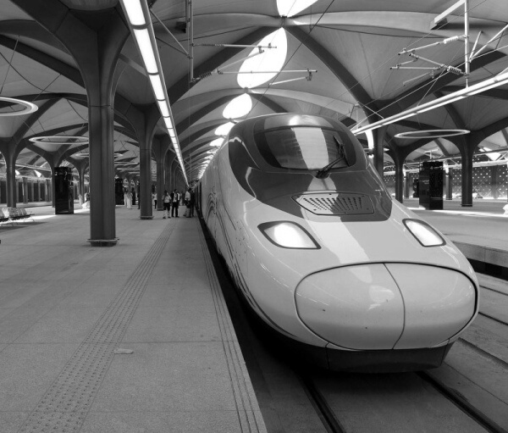
01
MTA EDA PROJECT
SOHAIB BAKR ALBAKRI
T5 Bootcamp 2021

Slide 2
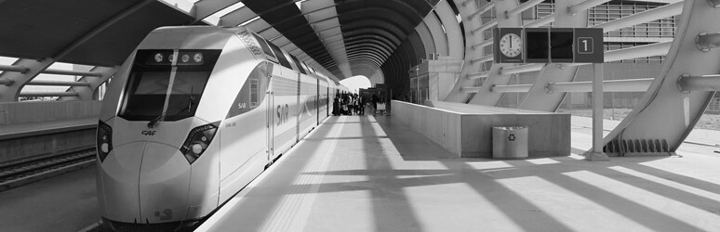
02
- There is variation in the stations traffic
- Most of the people uses the same stations daily
- The Shops in less crowded stations are losing
Problem
SOHAIB BAKR ALBAKRI

Slide 3

03
How we work
SOHAIB BAKR ALBAKRI
PHASE 1
PHASE 2
PHASE 3
PHASE 4
PHASE 5
Data Exploring and cleaning
Fix and remove any noisy rows
Calculate exact entries and exits
Find total traffic for each station
Find top/bottom five stations

Slide 4
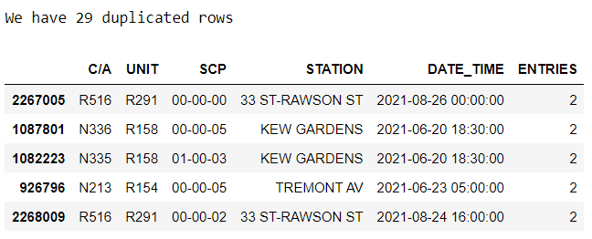
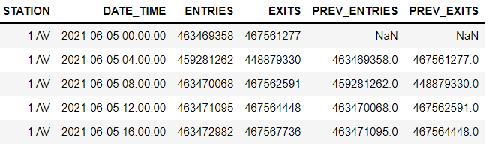
04
CLEANING
SOHAIB BAKR ALBAKRI

Slide 5
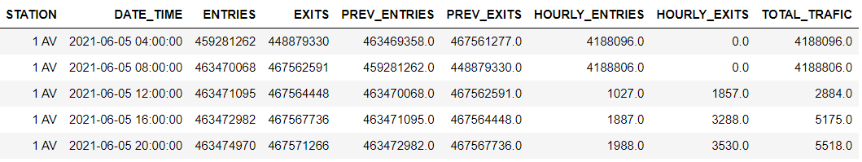
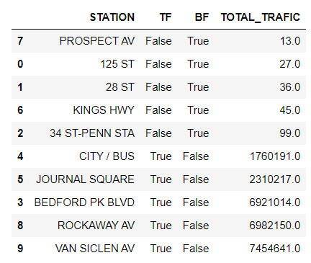
05
DELIVERED COLUMNS
SOHAIB BAKR ALBAKRI

Slide 6
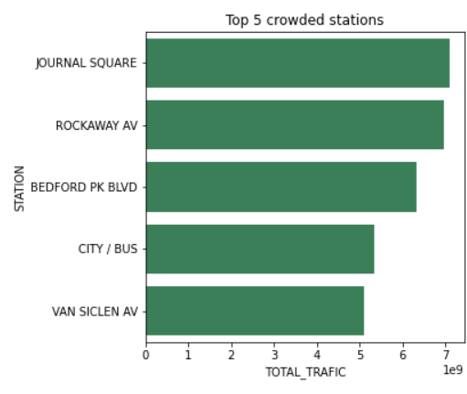
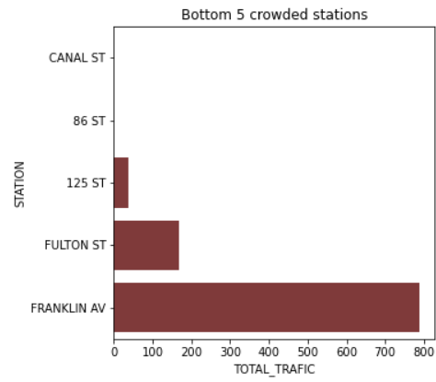
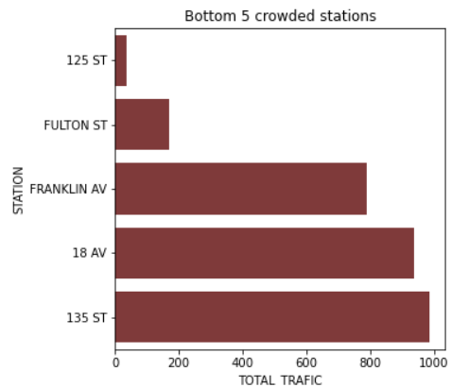
06
COMPARISON
TOP 5 STATIONS
BOTTOM 5 STATIONS
BOTTOM 5 STATIONS

Slide 7
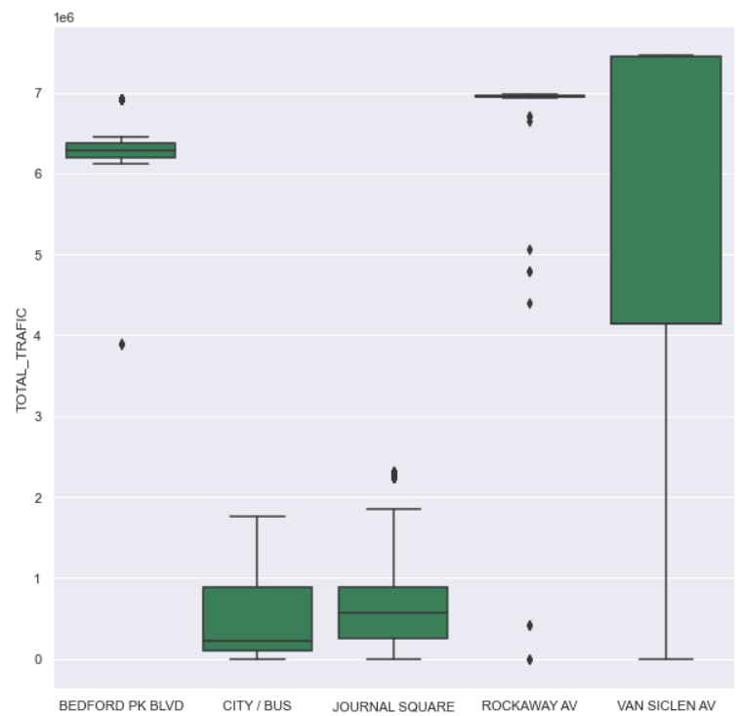
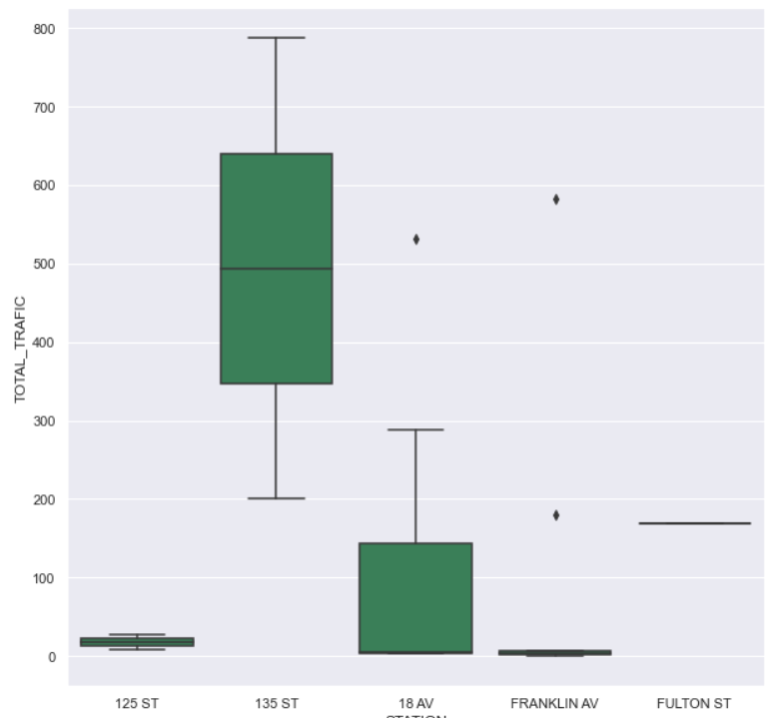
07
FIND OUT LAYERS
TOP 5 STATIONS
BOTTOM 5 STATIONS

Slide 8
08
WHAT IS THE FINAL RESULT?
CONCLUSION
SOHAIB BAKR ALBAKRI
HOW WE CAN SOLVE THE PROBLEM?

Slide 9
02
- What is the final result?
- How we can solve the problem?
Conclusion
SOHAIB BAKR ALBAKRI

