Slide 1

Explainable AI-Based
Depression Risk Prediction System
End-to-End Machine Learning Application using XGBoost, SHAP, FastAPI & Streamlit
Momin Sohail Amir
Data Science • Digital Ipsum Pvt. Ltd.

Slide 2
01 — MOTIVATION
The Problem
Mental health conditions are widespread but frequently under-diagnosed and under-reported
Traditional screening relies on manual clinical assessment — slow, subjective, and not scalable
Early risk signals often exist in everyday lifestyle and behavioural data, but go unused
A gap exists for accessible, data-driven tools that flag risk early — without replacing clinical judgment
Any automated tool must be transparent: a “black box” prediction is not trustworthy in a health context
EXPLAINABLE AI — DEPRESSION RISK PREDICTION
2 / 18

Slide 3
02 — GOAL
Project Objective
Predict
Classify mental health risk into Low, Moderate, or High categories using lifestyle, psychological, and work-related indicators
Explain
Apply SHAP so every prediction is interpretable — the model should be accurate and understandable, not a black box
Deploy
Ship a working product — a FastAPI backend and Streamlit frontend — rather than leaving the model in a notebook
EXPLAINABLE AI — DEPRESSION RISK PREDICTION
3 / 18

Slide 4
03 — DATA
Dataset Overview
25,000 records × 25 features — demographic, lifestyle, psychological & work-related
Target variable: mental_health_risk (Low / Moderate / High)
Clean dataset — zero missing values, zero duplicates
Synthetically generated data, disclosed upfront for evaluation transparency
Target Class Distribution
37.4%
47.3%
15.3%
LOW RISK
MODERATE RISK
HIGH RISK
Visual Split
Feature Categories
Demographic
Lifestyle
Moderate class imbalance is present — High Risk makes up only 15.3% of records. This is addressed later through weighted precision/recall/F1 rather than accuracy alone.
age, gender, marital status, education
sleep, activity, screen time
Psychological
Work & Financial
anxiety, stress, mood, panic history
job stress, satisfaction, working hours
EXPLAINABLE AI — DEPRESSION RISK PREDICTION
4 / 18

Slide 5
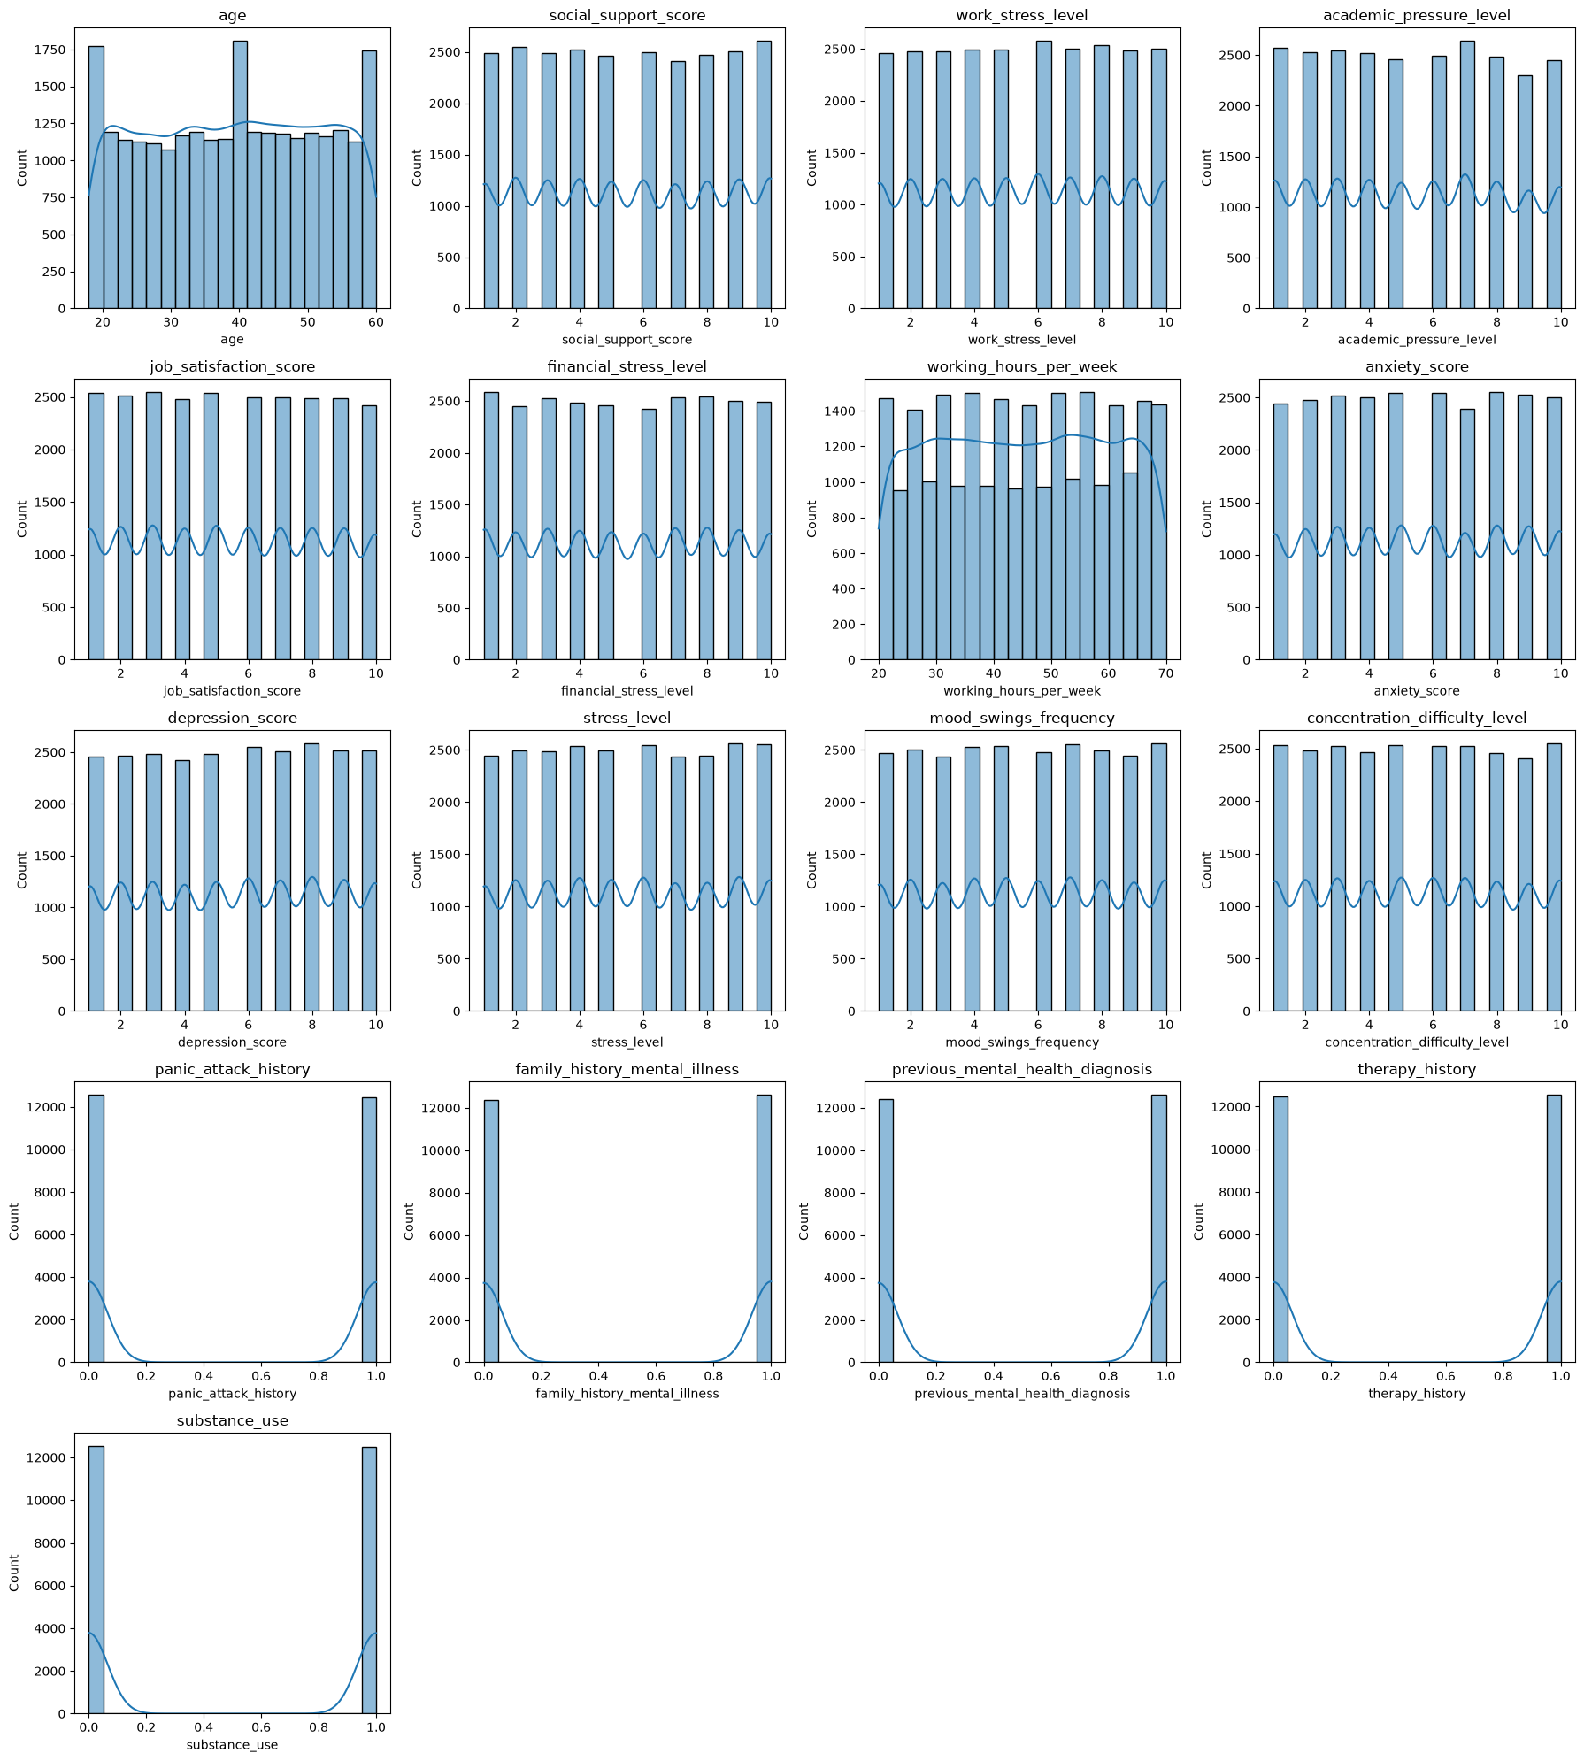
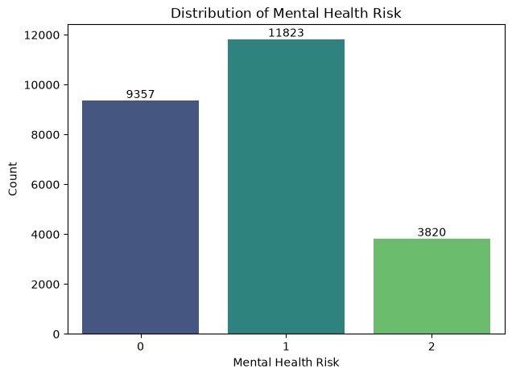
04 — EXPLORATORY ANALYSIS
EDA — Feature Distributions
Numerical features show mostly uniform spread — expected given synthetic generation
Boxplot analysis found no significant outliers requiring treatment
Binary indicators (panic history, substance use, etc.) validated as clean 0/1 values
Conclusion: minimal cleaning required before modeling
Fig. Target class distribution
Fig. Distribution of numerical features (notebook output)
EXPLAINABLE AI — DEPRESSION RISK PREDICTION
5 / 18

Slide 6
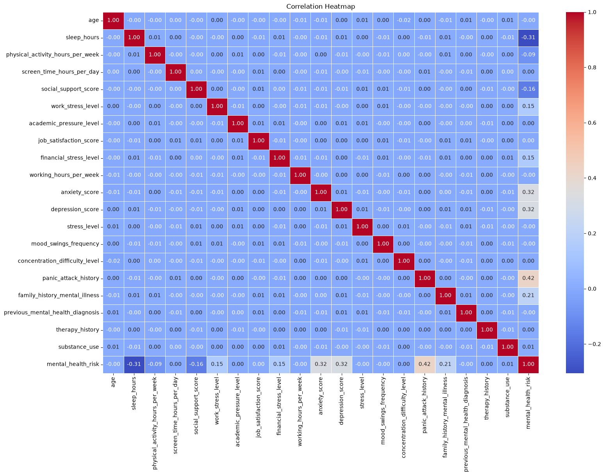
04 — EXPLORATORY ANALYSIS
EDA — Correlation with Target
Positively correlated with risk:
Work stress, financial stress, screen time, anxiety & depression scores
Negatively correlated with risk:
Sleep hours, social support, job satisfaction
These early signals are later confirmed by SHAP — a strong internal consistency check
Strongest Correlations with Risk
Panic Attack History
Anxiety Score
+0.42
+0.32
Depression Score
Sleep Hours
Fig. Correlation heatmap across numerical features
+0.32
−0.31
EXPLAINABLE AI — DEPRESSION RISK PREDICTION
6 / 18

Slide 7
05 — PREPARATION
Data Preprocessing Pipeline
Stratified 80 / 20 train-test split to preserve class ratios
Numerical features → StandardScaler
Categorical features → OneHotEncoder (unknown categories handled safely)
Binary features → passed through unchanged
All steps wrapped in a single scikit-learn / imbalanced-learn Pipeline object — reused identically at inference time
Raw Input
25 features
▼
Column
Transformer
Scale + Encode
▼
Pipeline
Preprocessor + Model
▼
Ready for
Training
Consistent train/serve
EXPLAINABLE AI — DEPRESSION RISK PREDICTION
7 / 18

Slide 8
06 — MODELING
Model Building — Algorithms Compared
Four algorithms trained on the identical preprocessing pipeline & split for a fair comparison
Logistic Regression — linear baseline
Decision Tree — simple non-linear benchmark
Random Forest — ensemble of trees
XGBoost — gradient-boosted ensemble, industry standard for tabular data
Evaluated on Accuracy, Precision, Recall & F1 (weighted) to account for class imbalance
EXPLAINABLE AI — DEPRESSION RISK PREDICTION
8 / 18

Slide 9
06 — MODELING
Model Comparison Results
XGBoost wins on every metric
99.88% accuracy, 0.9988 weighted F1
5-fold cross-validation confirms stability: 99.86% ± 0.05%
Logistic Regression underfits — non-linear feature interactions are essential here
XGBoost selected for hyperparameter tuning & deployment
EXPLAINABLE AI — DEPRESSION RISK PREDICTION
9 / 18

Slide 10
07 — OPTIMIZATION
Hyperparameter Tuning
RandomizedSearchCV: 20 candidate combinations × 5-fold CV = 100 model fits
Search space: n_estimators, max_depth, learning_rate, subsample, colsample_bytree
Chosen over GridSearchCV for a broad search at a fraction of the compute cost
0.9971
BEST CROSS-VALIDATION ACCURACY
0.9988
Best Parameters Found
n_estimators | 200
max_depth | 5
learning_rate | 0.1
subsample | 1.0
colsample_bytree | 0.8
FINAL TEST ACCURACY (TUNED MODEL)
EXPLAINABLE AI — DEPRESSION RISK PREDICTION
10 / 18

Slide 11

07 — OPTIMIZATION
Final Model Performance
99.88%
1.00
1.00
1.00
ACCURACY
PRECISION (WTD)
RECALL (WTD)
F1-SCORE (WTD)
Per-class performance (test set, n = 5000)
Low Risk — precision 1.00, recall 1.00
Moderate Risk — precision 1.00, recall 1.00
High Risk — precision 1.00, recall 0.99 (hardest class — smallest, 15.3% of data)
Reading the Numbers Honestly
Near-perfect accuracy reflects the clean, synthetic nature of the dataset — not a claim of real-world generalization. Deployment on real clinical data would need re-validation.
EXPLAINABLE AI — DEPRESSION RISK PREDICTION
11 / 18

Slide 12
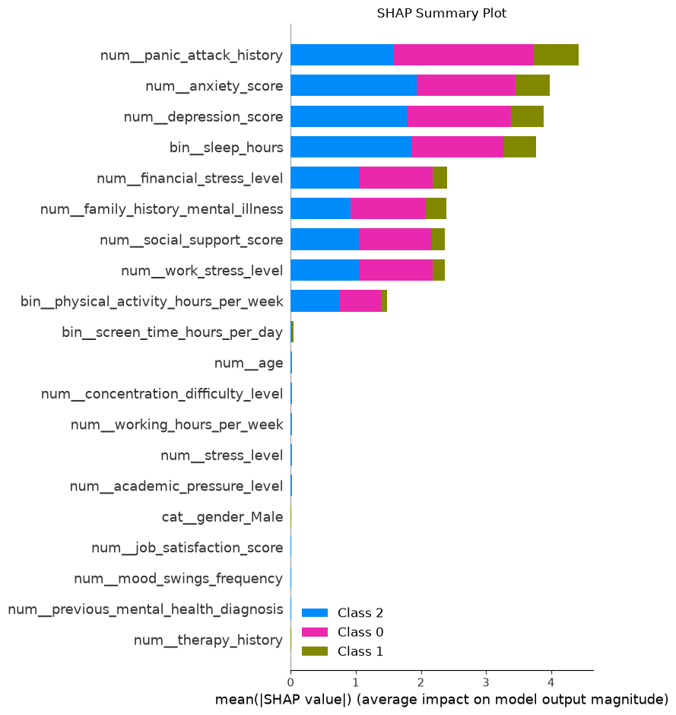
08 — EXPLAINABILITY
Explainable AI — Global View (SHAP)
Built with shap.TreeExplainer on the tuned XGBoost model
Top drivers: Panic Attack History, Anxiety Score, Depression Score, Sleep Hours, Financial Stress
Minimal impact: Therapy History, Previous Diagnosis, Age, Gender
Confirms the model relies on psychological & lifestyle signals — not demographic bias
Fig. SHAP summary plot (test set)
EXPLAINABLE AI — DEPRESSION RISK PREDICTION
12 / 18

Slide 13
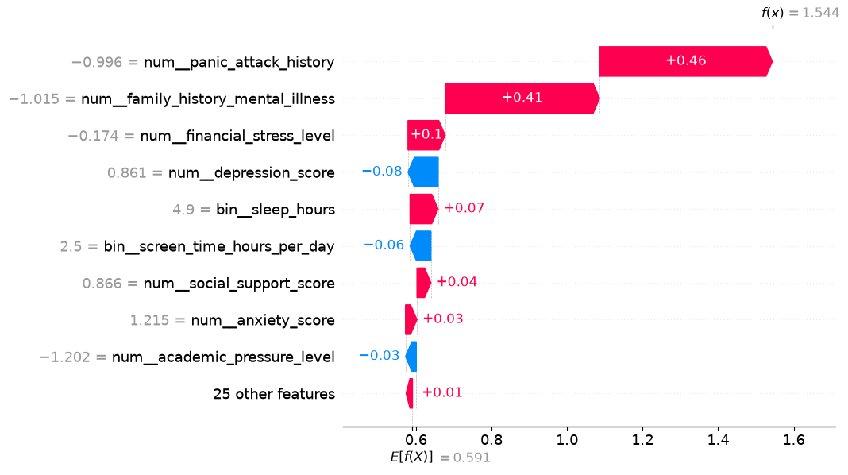
08 — EXPLAINABILITY
Explainable AI — Individual Prediction (SHAP)
Shows exactly how each feature pushed one prediction toward its risk class
Powers the “Key Factors” explanation returned to end users, not just an internal diagnostic
Builds trust — every result is traceable to specific inputs
Fig. SHAP waterfall plot for a single test instance
EXPLAINABLE AI — DEPRESSION RISK PREDICTION
13 / 18

Slide 14



09 — DEPLOYMENT
System Architecture
▶
▶
Streamlit
Frontend
FastAPI
Backend
Saved Pipeline
+ SHAP
Multi-step questionnaire UI
/predict endpoint (REST)
XGBoost model, feature names, risk map
User completes questionnaire in Streamlit → payload sent to FastAPI → model + SHAP run server-side → prediction, confidence & key factors returned → rendered back in Streamlit
EXPLAINABLE AI — DEPRESSION RISK PREDICTION
14 / 18

Slide 15
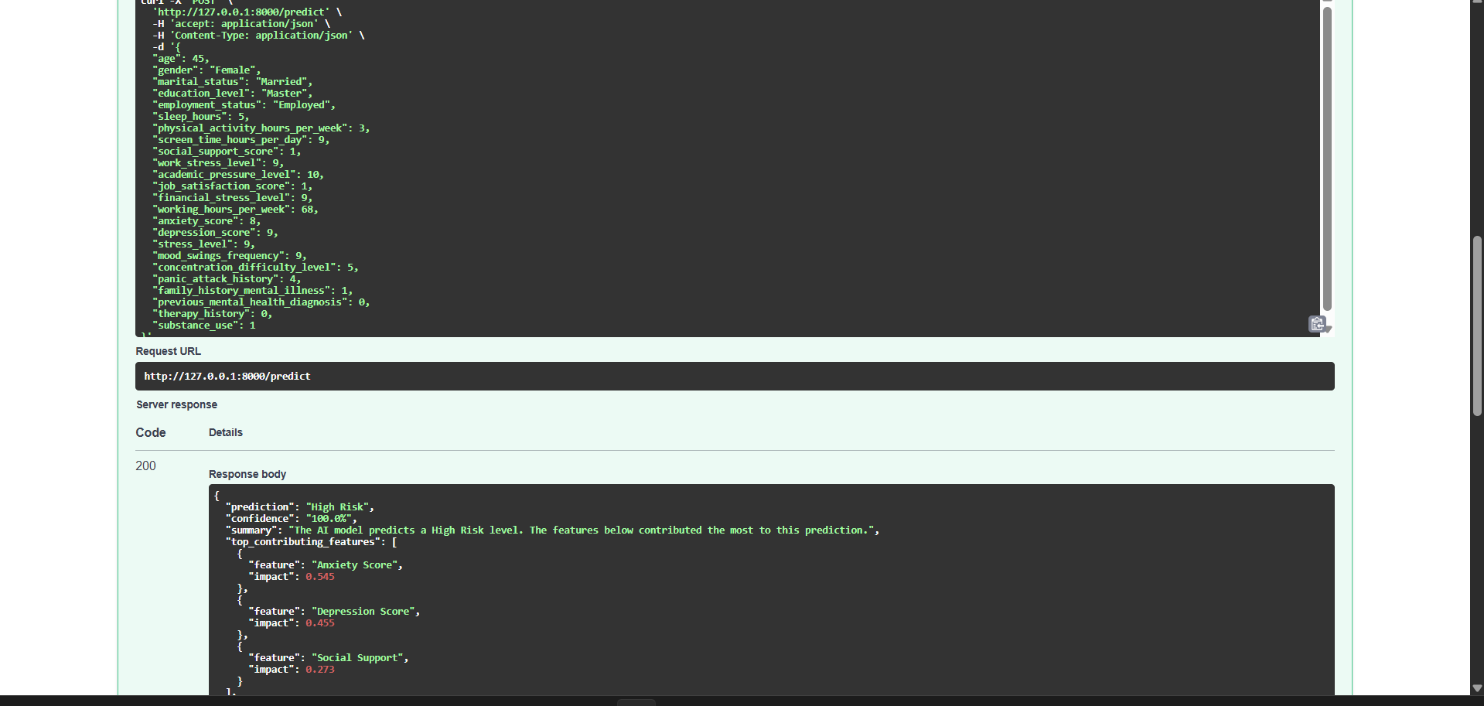
09 — DEPLOYMENT
FastAPI Backend
REST API with interactive Swagger / OpenAPI documentation
POST /predict accepts all 25 raw questionnaire inputs as JSON
Returns prediction, confidence %, plain-language summary, and top contributing SHAP features
Explainability is computed live, per request — not pre-cached
Fig. /predict request & JSON response (Swagger UI)
EXPLAINABLE AI — DEPRESSION RISK PREDICTION
15 / 18

Slide 16
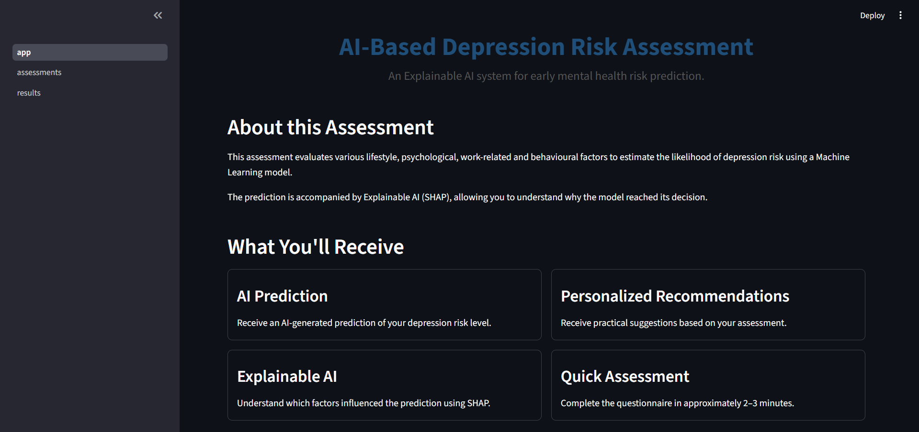
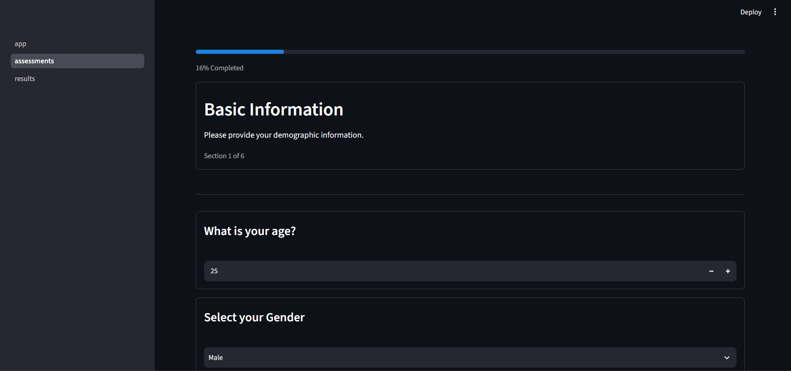
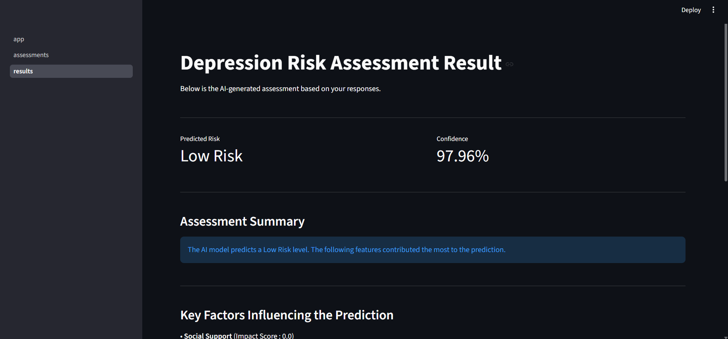
09 — DEPLOYMENT
Streamlit Frontend
Landing page introduces the tool and sets expectations (2–3 min, AI + Explainable AI)
Multi-step questionnaire across 6 sections with a progress indicator
Results page shows predicted risk, confidence %, and top contributing factors in plain language
Landing Page
Assessment Flow
Results Page
EXPLAINABLE AI — DEPRESSION RISK PREDICTION
16 / 18

Slide 17
10 — REFLECTION
Challenges & Learnings
Synthetic data limits
Near-perfect accuracy does not guarantee real-world generalization
Class imbalance
High Risk class underrepresented (15.3%) — monitored via precision/recall, not accuracy alone
Key takeaway
Learned to combine modeling, explainability, and deployment into one cohesive, usable product — not just a notebook exercise
EXPLAINABLE AI — DEPRESSION RISK PREDICTION
17 / 18

Slide 18


Conclusion & Future Scope
What was delivered:
An end-to-end explainable ML system — from raw data to a deployed, interactive application
Future scope:
Validation on real-world clinical data
User authentication & secure data handling
Model monitoring, drift detection & retraining pipeline
Automated report generation for each assessment (PDF/summary export)
Cloud deployment (containerization + CI/CD)
Report Generation in PDF format.
Thank You
Questions & Discussion
EXPLAINABLE AI — DEPRESSION RISK PREDICTION
18 / 18

