Slide 1
TEXT PROCESSING -NLP
Mohammad Sohail
( 21N31A66B4 )
Mohammad Sohail

Slide 2
WHAT IS NLP ?
NLP – Natural Language Processing
It is a field of artificial intelligence that focuses on the interaction between computers and humans through natural language.
The goal of NLP is to enable computers to understand, analyze and interpret human language.
Mohammad Sohail

Slide 3
APPLICATIONS OF NLP
01.
02.
03.
VIRTUAL ASSISTANTS
CUSTOMER SUPPORT
EMAIL FILTERING
04.
05.
06.
TEXT PROCESSING
SEARCH ENGINES
TEXT AUTOCORRECT
Siri, Google Alexa
Amazon Chatbot
Gmail - Spam Box
Tokenization, Stemming
Google, Bing
Smartphone Keyboard
Mohammad Sohail

Slide 4
Text Processing
Text Processing in NLP is a process of preparing and analyzing textual data to extract meaningful insights that help to build models.
It’s main goal is to convert raw text into structured format that can be used for various NLP tasks.
Mohammad Sohail

Slide 5
Steps Involved In Text Processing
3. Removing Punctuations
1. Data Collection
2. Word Tokenizaton
6. Stemming
4. Stop Words Removal
5. Conversion to Lower Case
7. Lemmatization
8. TF – IDF
Mohammad Sohail

Slide 6
Step1.
Data Collection
Data can be collected through various methods such as APIs, web scraping, and pre-existing datasets.
Data Set : Spam.csv
dataset: https://www.kaggle.com/datasets/uciml/sms-spam-collection-dataset
CODE
import pandas as pd
data=pd.read_csv('spam.csv',encoding="ISO-8859-1")
Mohammad Sohail

Slide 7
Step2.
Removing Punctuations
Removal of unnecessary punctuations.
CODE
import string
string.punctuation
def removePunctuation(text):
punctuationfree="".join([i for i in text if i not in string.punctuation])
return punctuationfree
data['cleaned_msg']=data['v2'].apply(lambda x:removePunctuation(x))
Mohammad Sohail

Slide 8
Step3.
Word Tokenization
Splitting text into individual words.
CODE
from nltk.tokenize import word_tokenize
def tokenize_words(text):
words = word_tokenize(text)
return words
data['tokenized_msg']=data[‘cleaned_msg'].apply(lambda x:tokenize_words(x))
Mohammad Sohail

Slide 9
Step4.
Stop Word Removal
Stop words are considered to be of little value in helping algorithms understand the content and meaning of the text.
CODE
from nltk.corpus import stopwords
stopwords = nltk.corpus.stopwords.words(‘ english ’)
def remove_stopwords(text):
output= [i for i in text if i not in stopwords]
return output
data['no_stopwords']= data['tokenized_msg'].apply(lambda x:remove_stopwords(x))
Mohammad Sohail

Slide 10
Step5.
Lower Case Conversion
Converting the tokens into lower case letters.
CODE
data['lowerCase_msg']=data[‘no_stopwords'].apply(lambda x:x.lower())
data[[‘no_stopwords','lowerCase_msg']].set_index(data['v1'])
Mohammad Sohail

Slide 11
Step6.
Stemming
It is the process of converting each word into its root form.
CODE
from nltk.stem import PorterStemmer
porter_stemmer = PorterStemmer()
def stemming(text):
stem_text = [porter_stemmer.stem(word) for word in text]
return stem_text
data['msg_stemmed']=data[‘lowerCase_msg'].apply(lambda x: stemming(x))
Mohammad Sohail

Slide 12
Step7.
Lemmatization
It is the process of converting each word into its root form.
It results in more accurate and meaningful reductions than stemming
CODE
from nltk.stem import WordNetLemmatizer
wordnet_lemmatizer = WordNetLemmatizer()
def lemmatizer(text):
lemm_text = [wordnet_lemmatizer.lemmatize(word) for word in text]
return lemm_text
data['msg_lemmatized']=data['msg_stemmed'].apply(lambda x:lemmatizer(x))
Mohammad Sohail

Slide 13
Final Outcome
Final Data Obtained :
Tokenized
Cleaned
Processed
Meaningful
Accurate
Mohammad Sohail

Slide 14
Final Data Usage
The data is further converted into numerical form with the help TF-IDF method.
The numerical data will be integrated into various models like Chatbots, virtual assistants, sentimental analysis models.
Mohammad Sohail

Slide 15
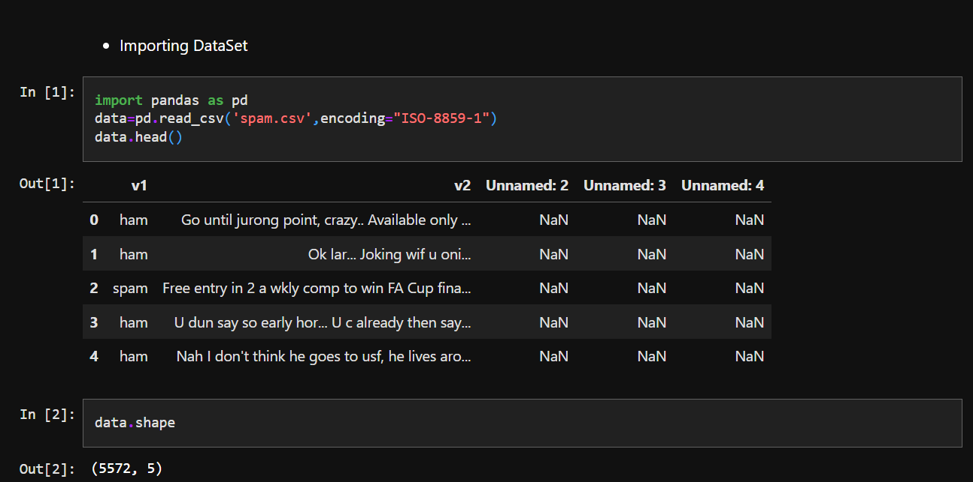
PROGRAM
Mohammad Sohail

Slide 16
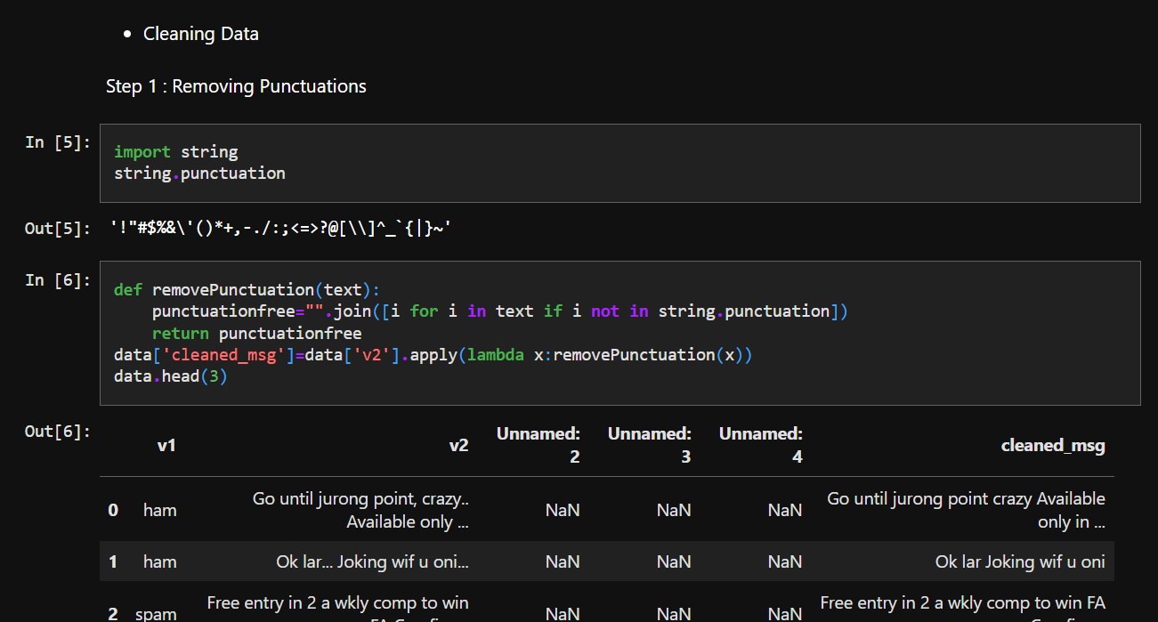
PROGRAM
Mohammad Sohail

Slide 17
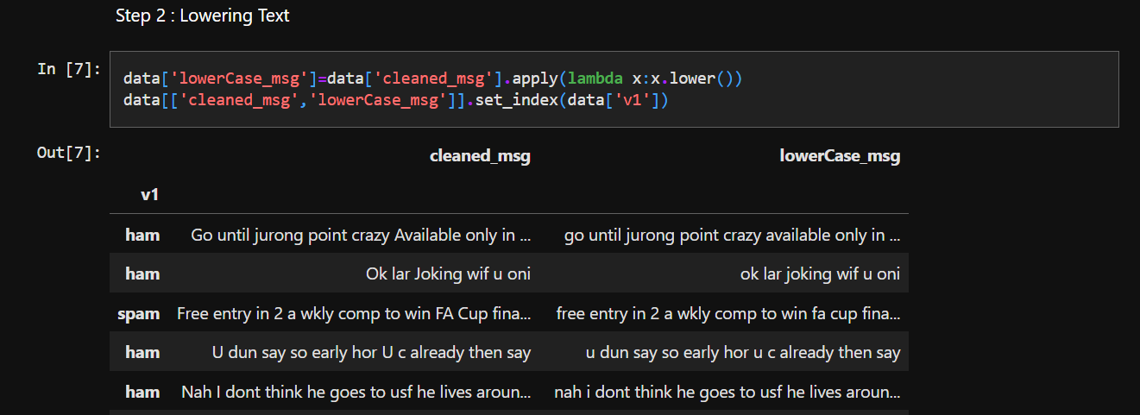
PROGRAM
Mohammad Sohail

Slide 18
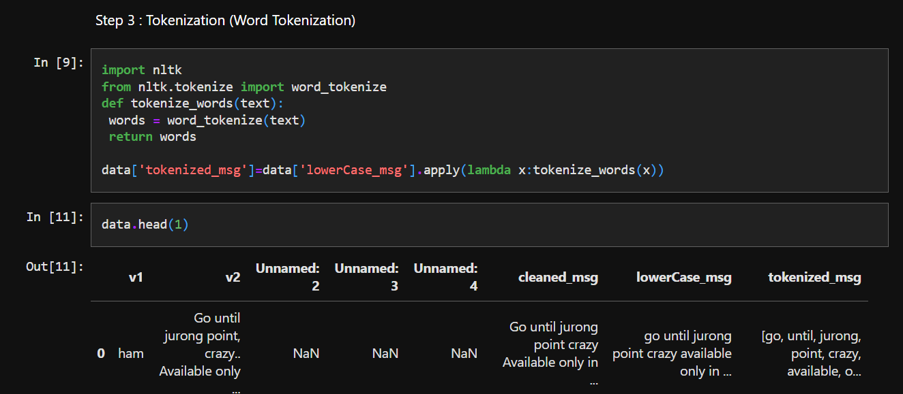
PROGRAM
Mohammad Sohail

Slide 19
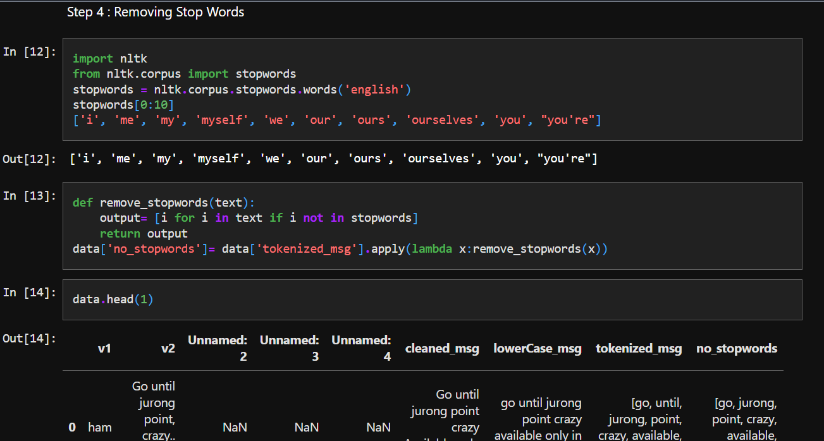
PROGRAM
Mohammad Sohail

Slide 20
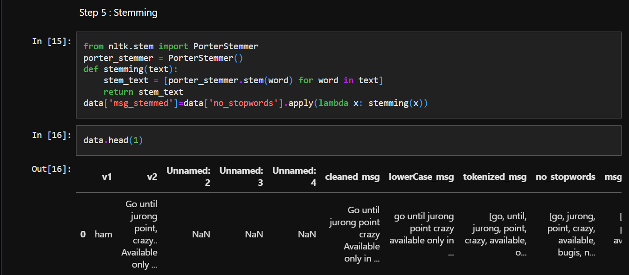
PROGRAM
Mohammad Sohail

Slide 21
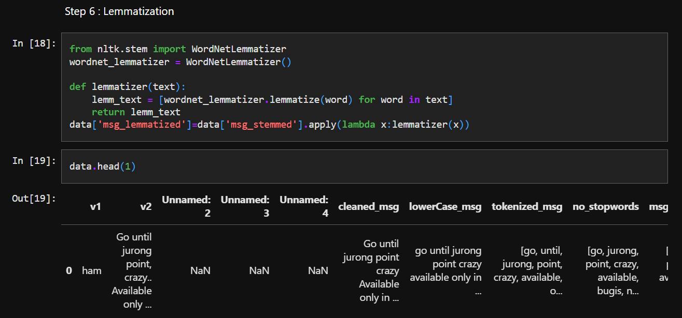
PROGRAM
Mohammad Sohail

Slide 22
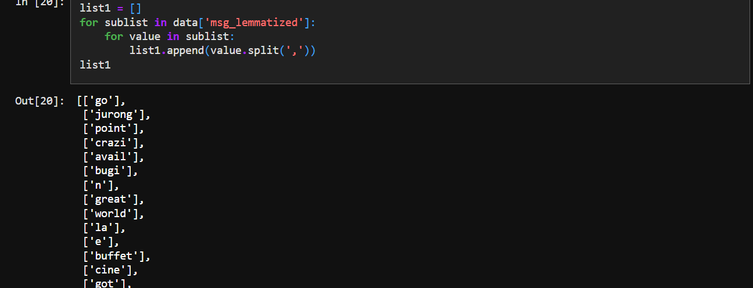
PROGRAM
Mohammad Sohail

Slide 23

https://github.com/Sohail7861/TextProcessingNLP.git
Mohammad Sohail

Slide 24
THANK YOU
MOHAMMAD SOHAIL (21N31A66B4)
Mohammad Sohail

