Slide 1

Internship Project

Slide 2

Student Name : SOHAIL AKHTAR ANSARI
Student ID : STU671533d5f3f321729442773
College Name : G.B.PANT INSTITUTE OF ENGINEERING AND TECHNOLOGY

Slide 3
CAPSTONE PROJECT SHOWCASE
Project Title : Energy Consumption Trend Analysis with Power BI
Abstract | Problem Statement | Project Overview | Proposed Solution | Technology Used | Modelling & Results | Conclusion | Q&A

Slide 4
Abstract
This project focuses on the development of an interactive Energy Consumption Dashboard using Power BI to analyze and optimize energy usage across various dimensions. The dashboard provides a detailed breakdown of energy consumption patterns by type (gas, electricity, water), location (cities, buildings), and time periods, offering insights into cost trends, unit consumption, and anomalies.
Key metrics such as total costs, units consumed, and energy rates are visualized to help businesses identify inefficiencies and areas for cost reduction. Advanced features like trend analysis, anomaly detection, and KPI tracking enable data-driven decisions aimed at improving energy efficiency and sustainability.

Slide 5
Problem Statement
Businesses often face challenges in monitoring and optimizing energy consumption due to the complexity and volume of data from multiple sources, energy types, and locations. Without effective tools for visualization and analysis, identifying trends, inefficiencies, and cost-saving opportunities becomes difficult.
This project aims to address these challenges by developing an interactive Power BI dashboard to analyze energy consumption data comprehensively. The dashboard will provide insights into total costs, unit consumption, and trends across gas, electricity, and water usage, helping businesses make informed decisions to improve energy efficiency, reduce costs, and enhance sustainability.

Slide 6
Project Overview
The Energy Consumption Dashboard project aims to create an interactive and user-friendly tool using Power BI to analyze energy usage data comprehensively. The dashboard focuses on visualizing key metrics, such as total costs, unit consumption, and energy rates, while uncovering trends and patterns across different energy types (gas, electricity, water), locations (buildings, cities, and countries), and time periods.
This project empowers businesses to monitor their energy consumption effectively, identify inefficiencies, and implement cost-saving measures. By incorporating advanced features like anomaly detection, KPI tracking, and trend analysis, the dashboard provides actionable insights into energy efficiency and sustainability.
Additionally, the project explores the potential of integrating machine learning for predictive analytics and natural language processing (NLP) for conversational data exploration, further enhancing the tool's capabilities and user experience.

Slide 7
Proposed Solution
The solution involves creating an Energy Consumption Dashboard in Power BI to track and analyze energy usage (electricity, gas, and water) across cities and buildings. The dashboard offers interactive visualizations, allowing users to explore data by time, city, and building to understand consumption patterns and costs.
Key features include:
Data Integration: Consolidating energy consumption data.
Interactive Dashboards: Dynamic filters for detailed analysis.
Visualization: Clear charts showing trends and costs.
Cost Optimization: Identifying high-consumption areas to reduce costs.

Slide 8
Technology Used
Power BI:
Power BI is a business intelligence (BI) tool developed by Microsoft that facilitates connection to diverse data sources, enabling data analysis, the creation of interactive visualizations, and the sharing of insights. Its user-friendly design, streamlined architecture, and robust visualization features empower users to extract meaningful insights from their data, supporting more informed decision-making and enhancing business performance.

Slide 9
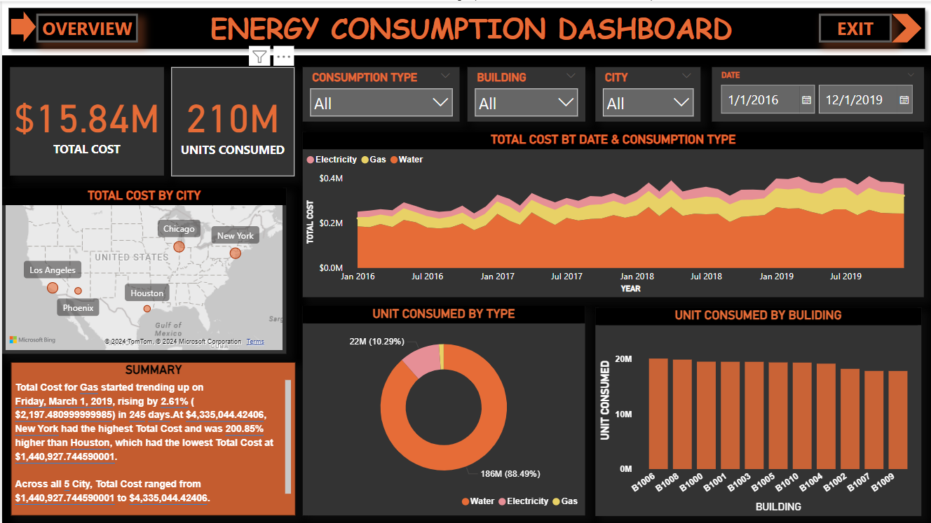
Modelling & Results

Slide 10
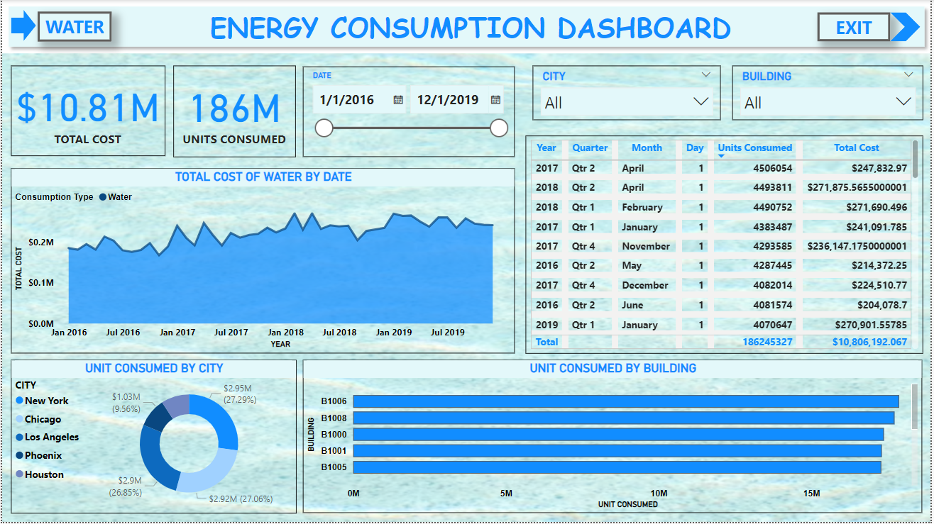
Modelling & Results
Overview Metrics: Displays total cost ($10.81M) and total units consumed (186M) for the selected time.
Cost Trend: A line graph tracks fluctuations in water consumption costs over time, with a clear visualization of seasonal variations.
Consumption by City: A breakdown of water consumption by city, highlighting the highest consumers—New York, Chicago, and Los Angeles.
Consumption by Building: A bar chart shows water usage across buildings, helping identify which buildings use the most water.
Interactive Filters: Allows users to filter data by date, city, and building for in-depth analysis.

Slide 11
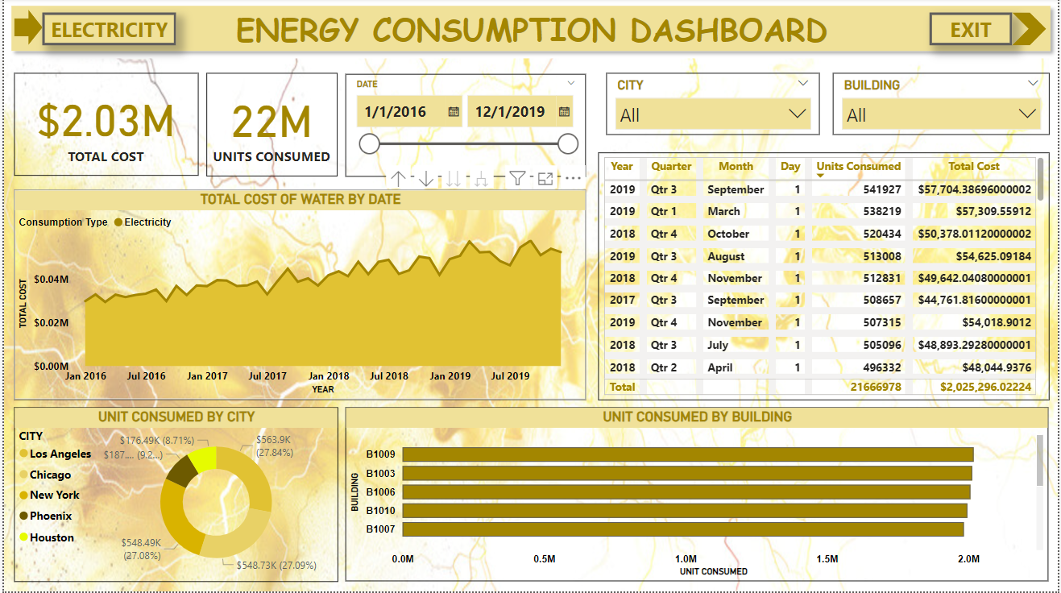
Modelling & Results
Overview Metrics: Displays the total cost ($2.03M) and total units consumed (22M) for electricity over the selected time range.
Cost Trend: A line chart tracks the total electricity consumption cost over time, showing trends and fluctuations across different periods.
Consumption by City: The dashboard breaks down electricity consumption by city, with Los Angeles and Chicago being the highest consumers, highlighting the impact of location on energy use.
Consumption by Building: A bar chart shows electricity consumption across buildings, revealing the buildings with the highest electricity usage.
Interactive Filters: Provides the ability to filter by date, city, and building to explore specific data points in more detail.

Slide 12
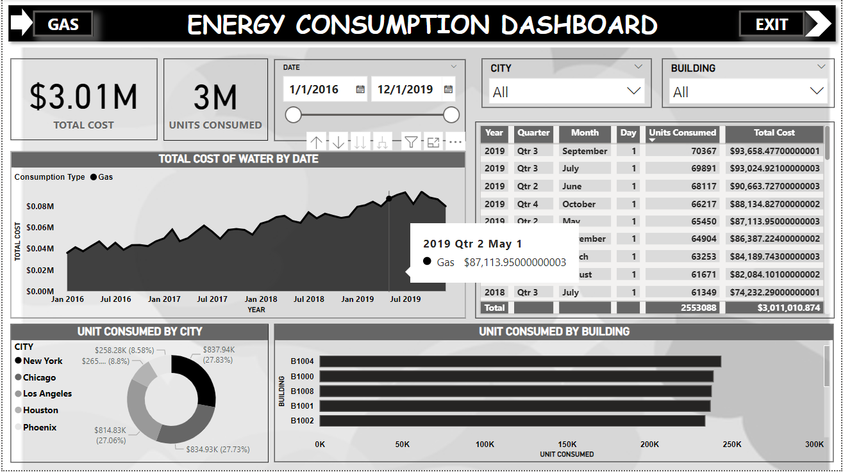
Modelling & Results
Overview Metrics: Displays total cost ($3.01M) and total units consumed (3M) for the selected period.
Cost Trend: A line graph shows the fluctuations in the total cost of gas consumption over time, with a focus on key dates.
Consumption by City: A breakdown of gas consumption across cities, with New York, Chicago, and Los Angeles consuming the most gas.
Consumption by Building: A bar chart highlights gas usage across different buildings, showing how much each building consumes.
Interactive Filters: Allows users to filter data by date, city, and building for a more granular view.

Slide 13
Conclusion
The Energy Consumption Dashboard developed using Power BI serves as a powerful tool for businesses to analyze and optimize their energy usage. By visualizing key metrics such as total costs, unit consumption, and energy rates, the dashboard provides actionable insights into trends, anomalies, and areas of inefficiency.
Overall, this project highlights the importance of leveraging data-driven decision-making to improve energy efficiency, reduce costs, and contribute to sustainability goals. Businesses can use the dashboard to identify opportunities for optimization and implement strategies for long-term savings and environmental impact reduction.

Slide 14
Thank You!
Notes:
Thank You !!

