Slide 1


-- Capstone Project
Optimizing Semiconductor manufacturing process through AI and ML
Sohail Mohammed
www.linkedin.com/in/sohailghousuddin

Slide 2
Content
01
Problem statement
The need and why
04
Modeling
With identified features, train model and compare the results
02
Exploratory Data Analysis
Feature Engineering
Results
05
Compare results and next step
03
Feature Selection techniques
Identify important features

Slide 3
Problem Statement
Problem statement
Select the most important signals to improve yield for chips manufacturing
Modeling Process
Feature engineering
Benefits
Cost Optimization: Reduce costs by focusing on the key features
Hyper parameter tuning
Modeling
Comparing the results
Time-to-Market: Accelerate the experimental process, enabling quicker decision-making and implementation.
Process Improvement: Enhance throughput and decrease learning time
Engineers currently face the challenge of discerning the critical signals from the non-essential ones, leading to inefficiencies in the process
Feature selection

Slide 4
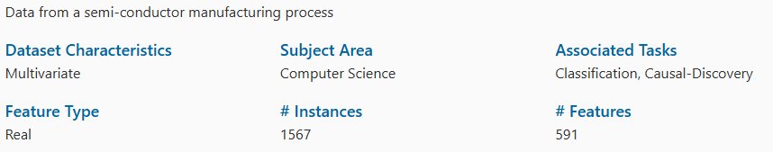
Dataset
A complex modern semi-conductor manufacturing process is normally under consistent surveillance via the monitoring of signals/variables collected from sensors and or process measurement points.
The dataset presented in this case represents a selection of such features where each example represents a single production entity with associated measured features and the labels represent a simple pass/fail yield

Slide 5
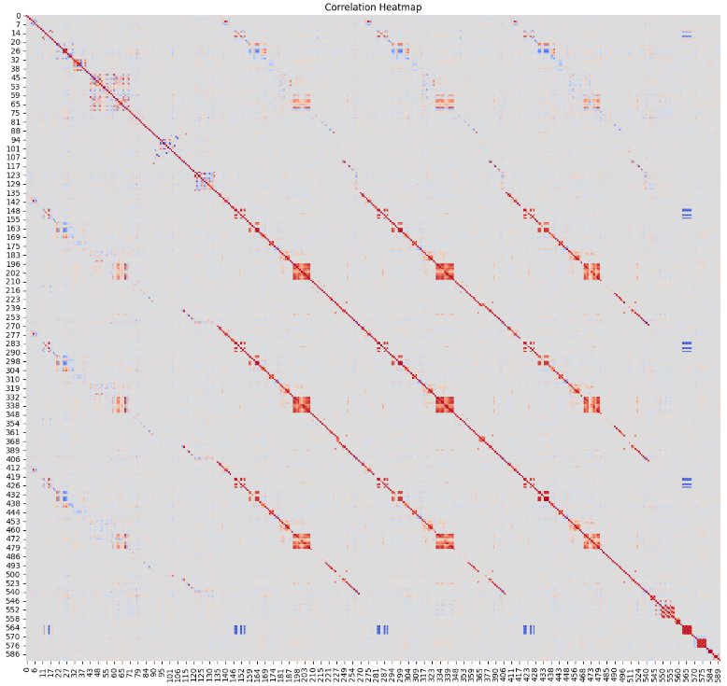
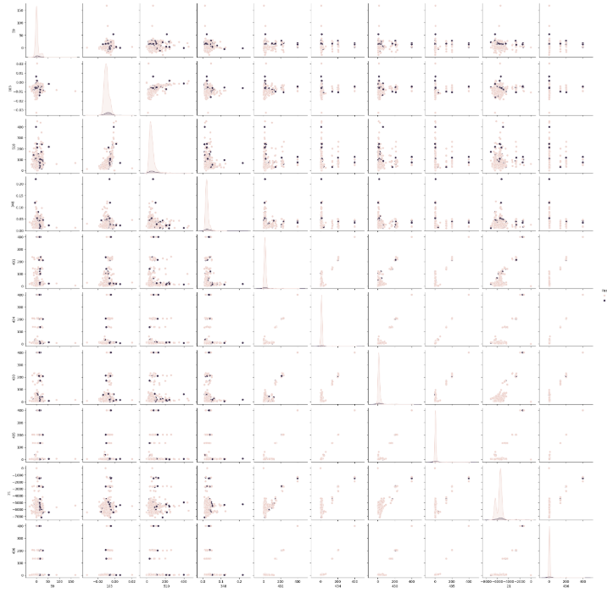
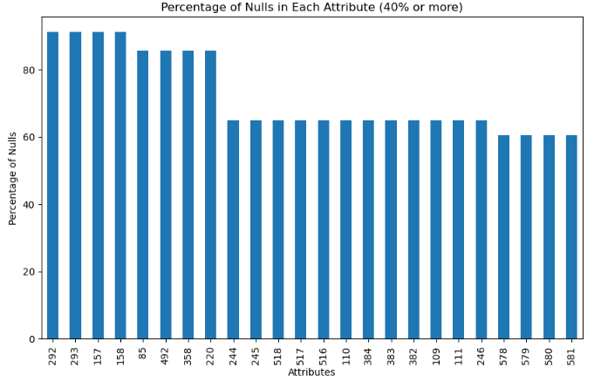
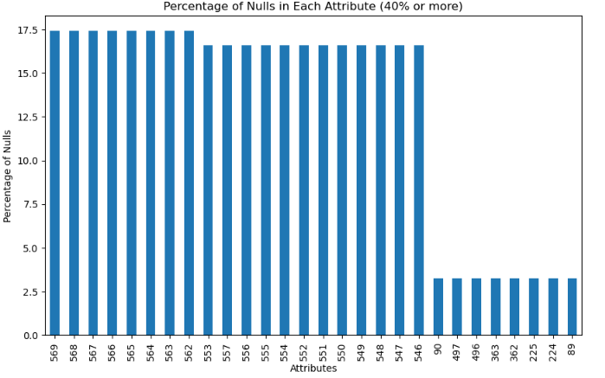
Exploratory Data Analysis
Drop columns which has 60% or more null values
Drop columns which has only one value
Use impute methods to fill the missing data
use correlation/collinearity and drop less important attributes
Addressing outliers
Result: Post EDA the features were dropped from 590 to 250 important features
Correlation
Heatmap
Addressing null values using Bayesian imputation method

Slide 6
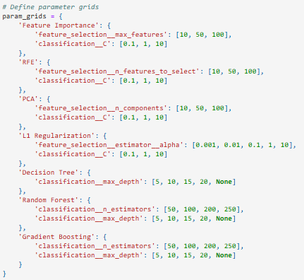
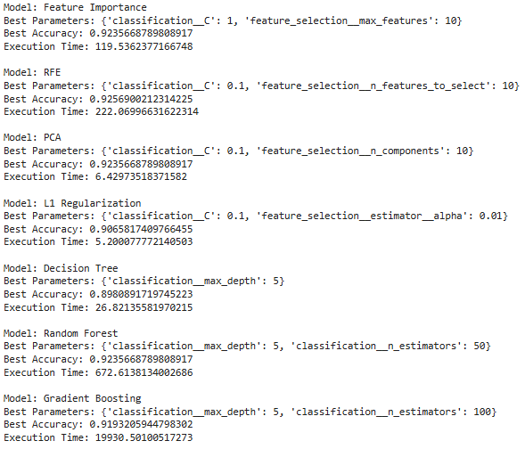
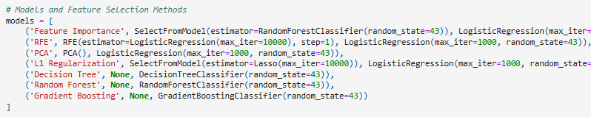
Feature Selection and Modeling

Slide 7
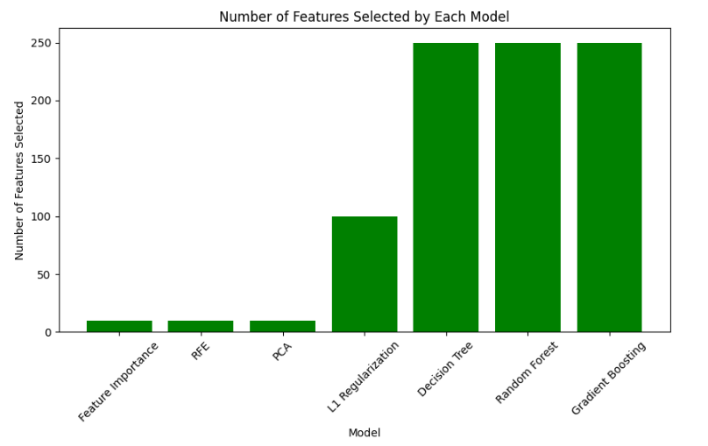
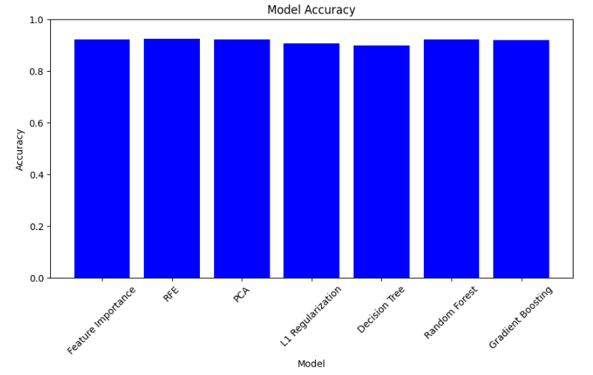
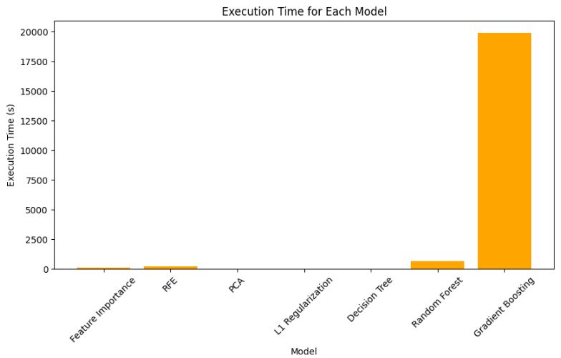
Results
Using different Features selections: all the methods highlighted 10 attributes as most important features
2. When we used different models to train, with 10 selected and rest 250 important features, the model accuracy was almost the same as you can see from the below graph

Slide 8
Conclusion
In this project, we employed various feature selection methods to identify the most important attributes for our model. The methods used included Recursive Feature Elimination (RFE), Principal Component Analysis (PCA), L1 Regularization, Decision Tree, Random Forest, and Gradient Boosting. Each method consistently highlighted 10 attributes as the most important features.
To evaluate the impact of feature selection, we trained different models using 10, 100 selected features and the full set of 250 features. The model accuracies were as follows:
Model | Attributes | Accuracy
Feature Importance | 10 | 0.9235
RFE | 10 | 0.9256
PCA | 10 | 0.9235
L1 Regularization | 100 | 0.906
Decision Tree | 250 | 0.898
Random Forest | 250 | 0.9235
Gradient Boosting | 250 | 0.9193
As illustrated in the graph, the accuracy scores for models trained with the selected features were almost identical to those trained with the full feature set. This indicates that the 10 selected features are sufficient to achieve high model performance, and including additional features does not significantly improve accuracy.
In summary, our comparison of selected features versus the full feature set demonstrates that feature selection can effectively reduce the dimensionality of the dataset without compromising model accuracy.

