Slide 1
Parabank Testing https://parabank.parasoft.com/parabank/index.htm
Presented by: Group 6
-Abdelrahman Mohamed (Team Leader)
-Sohaila Ahmed Gouda
-Raghad Tarek

Slide 2
Table of contents
Introduction
Objective and tools used
Manual testing
Automation testing
Postman for API and Selenium for UI
Test case design, test execution and defect logging

Slide 3
Introduction
Objective
End-to-end testing of Parabank web application using both manual and automated techniques.
Tools used:
Selenium, TestNG, Postman, JIRA, Maven and ExtentReports.

Slide 4
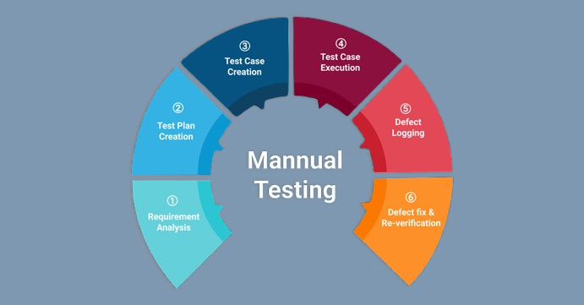
Manual Testing
What is manual testing?
It is a software testing approach where testers manually execute test cases without the use of automation tools or scripts. It involves human intervention to perform various testing activities, such as test case design, test execution, and defect reporting.

Slide 5
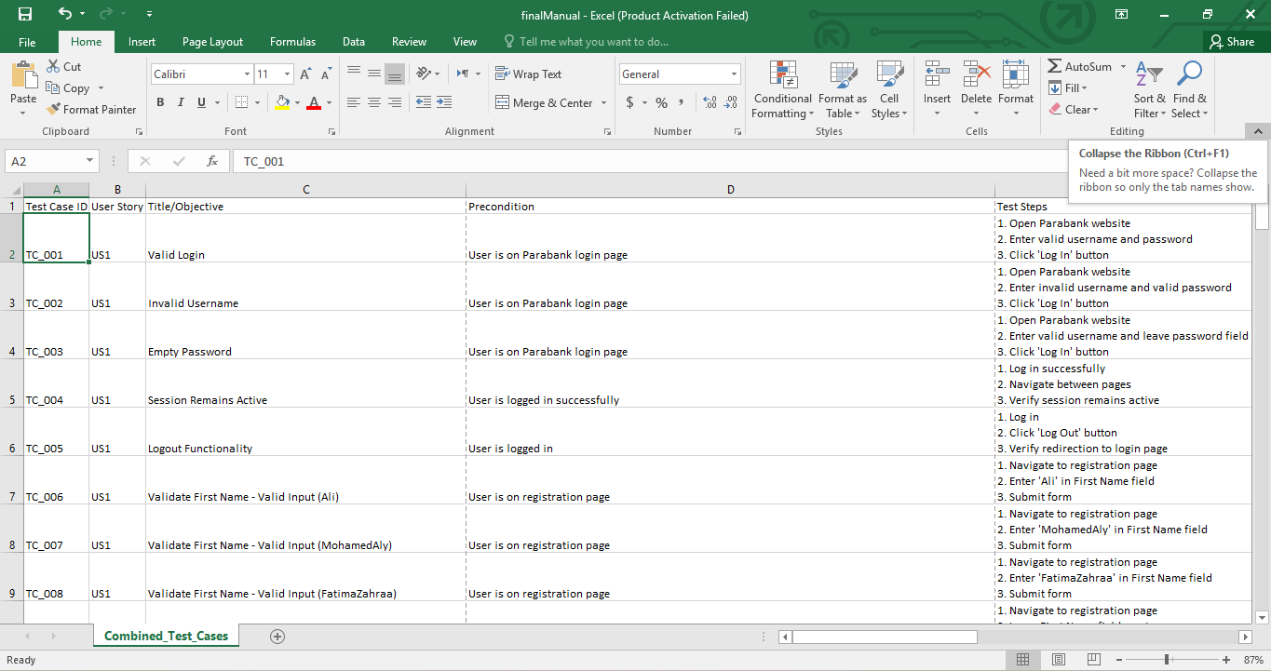
Test Case design

Slide 6
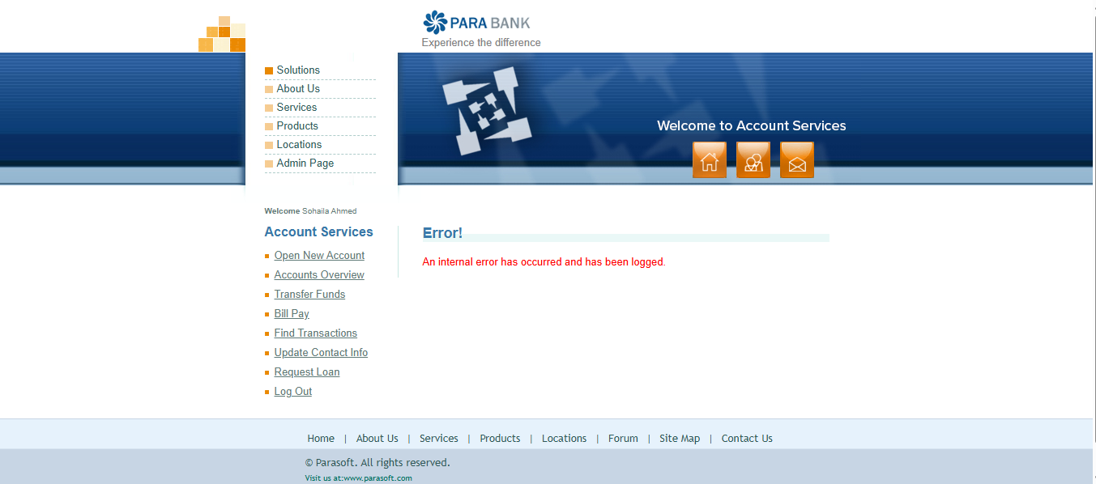
Test execution

Slide 7
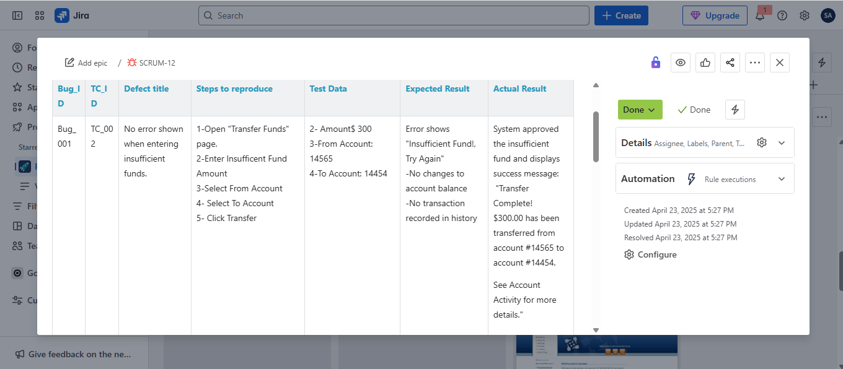
Defect logging

Slide 8
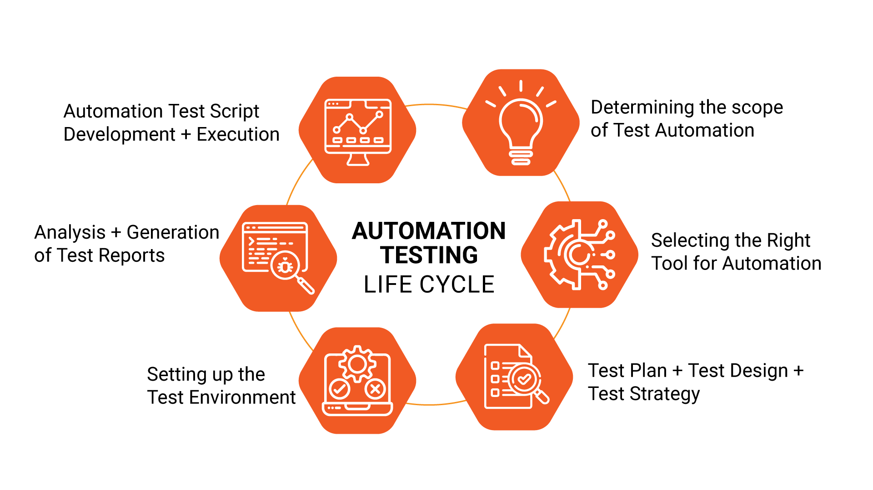
Automation Testing
What is automation testing?
It is the process of using tools and scripts to run test cases automatically, compare results, and generate reports – instead of doing it manually. It helps speed up testing, increase accuracy, and reduce human effort.

Slide 9
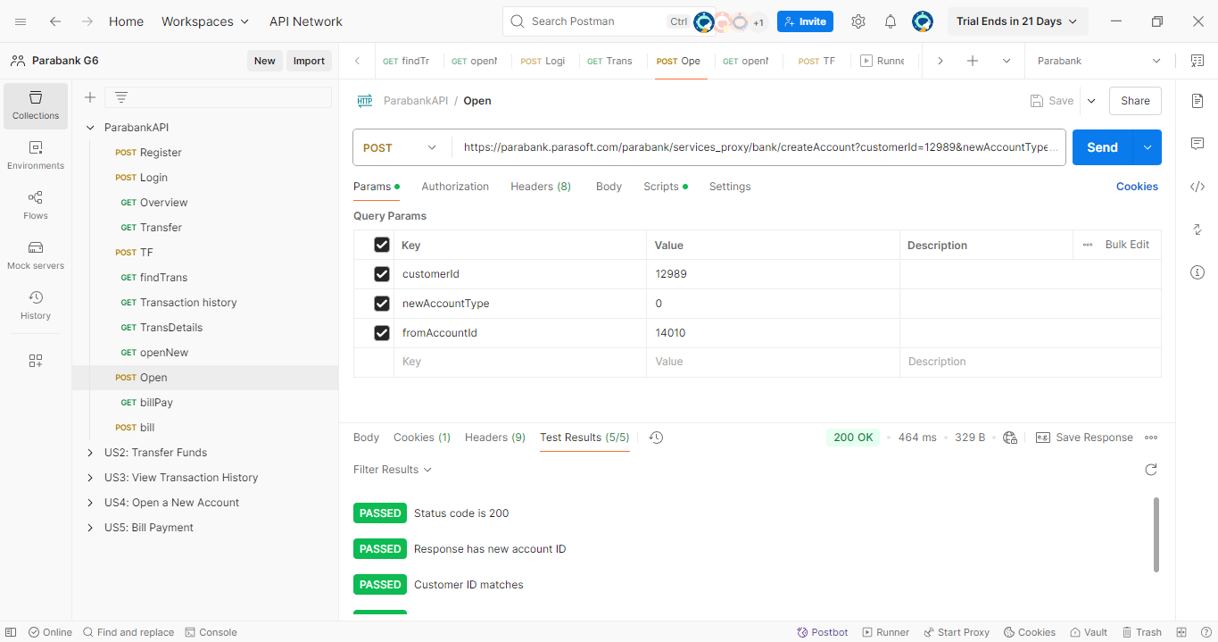
API Automation Testing

Slide 10
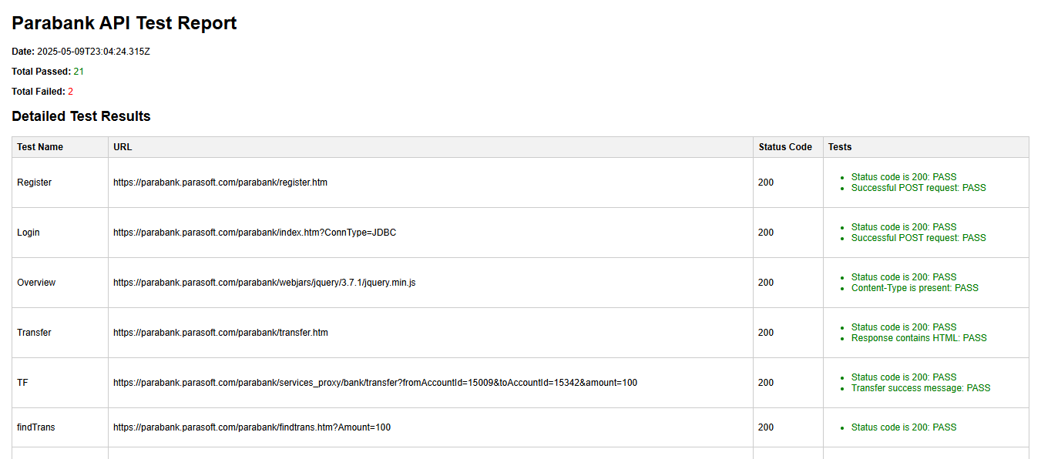
API Automation Testing

Slide 11
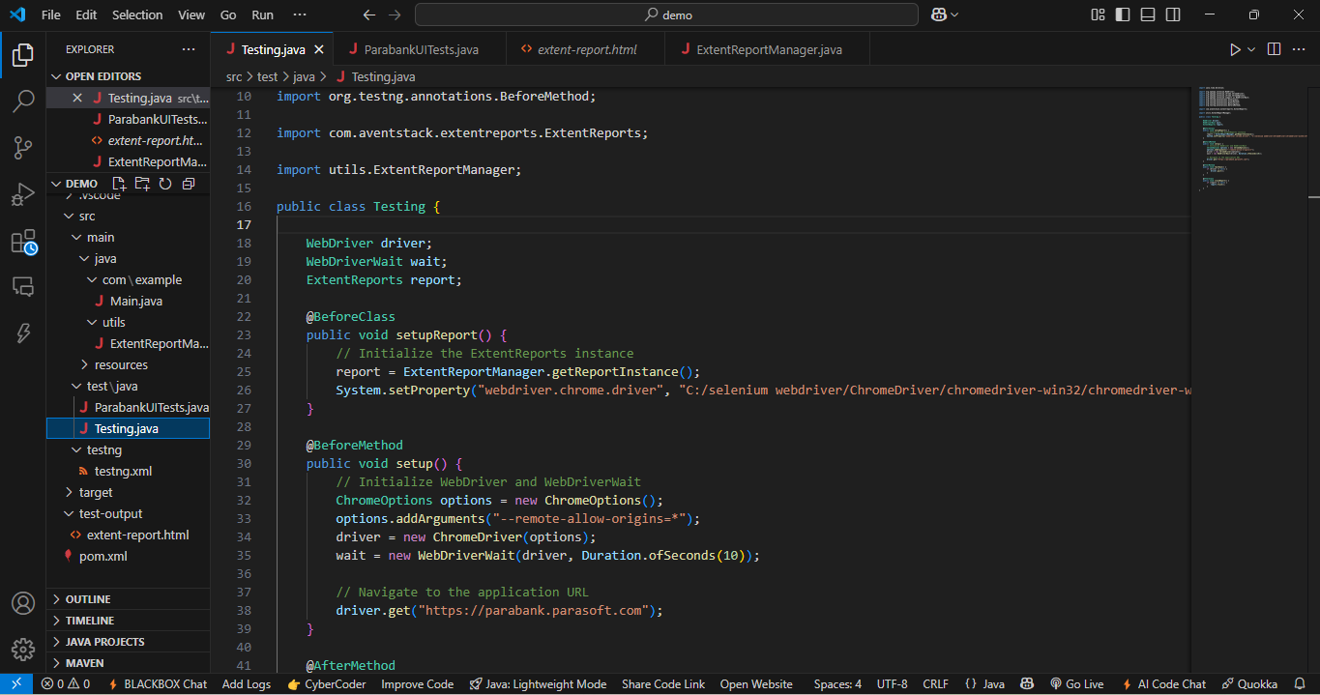
UI Automation Testing

Slide 12
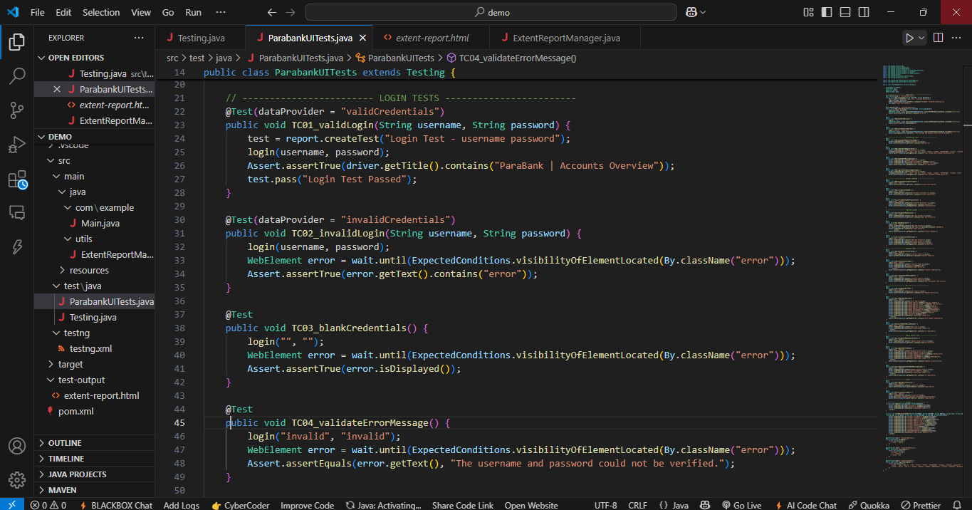
UI Automation Testing (test file)

Slide 13
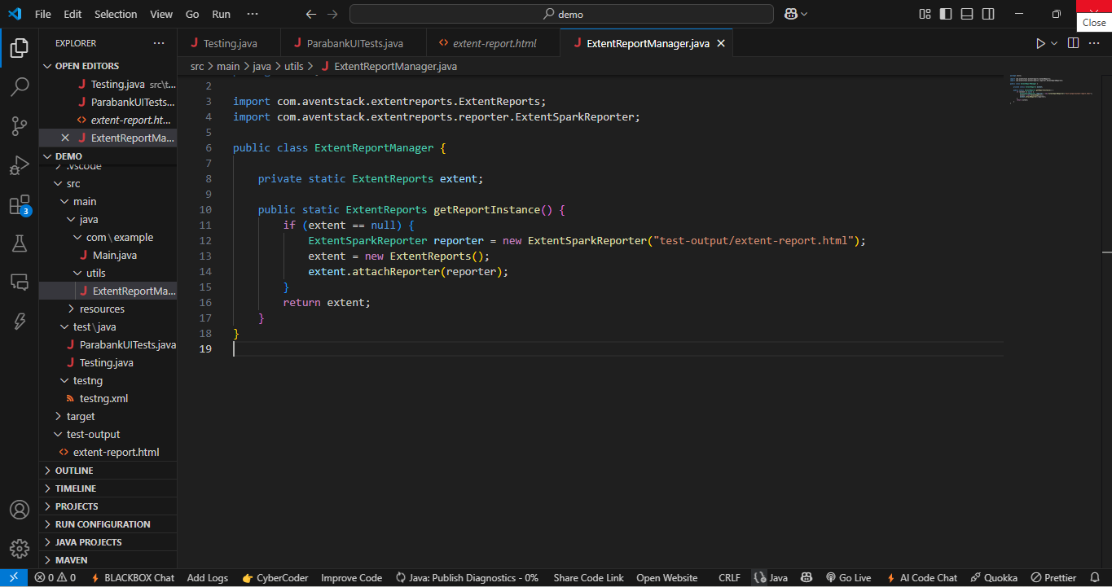
UI Automation Testing (ExtentReport )

Slide 14
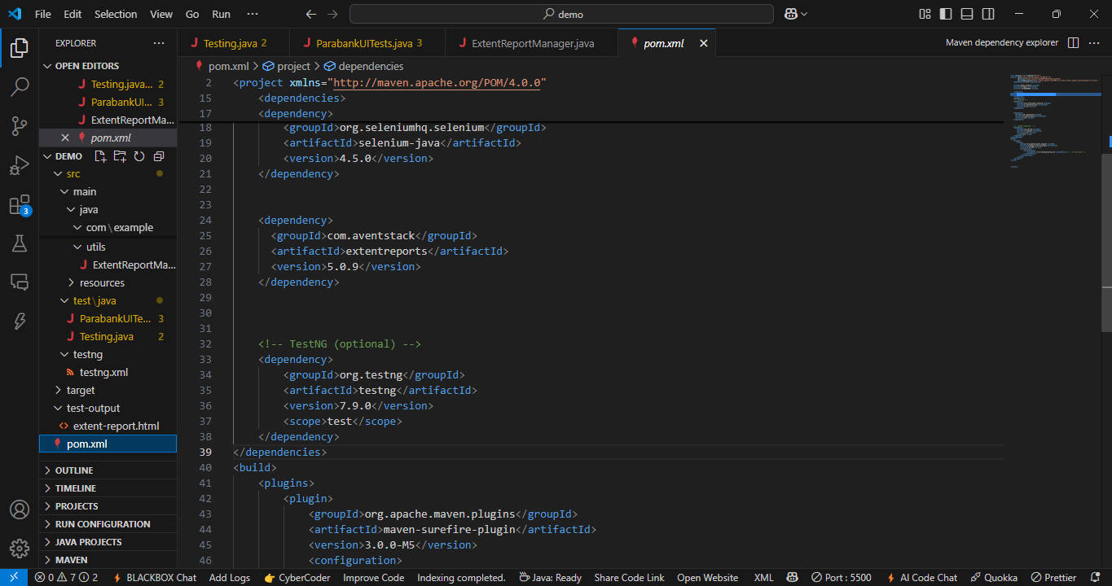
UI Automation Testing (POM file)

Slide 15
THANK YOU!

