Slide 1
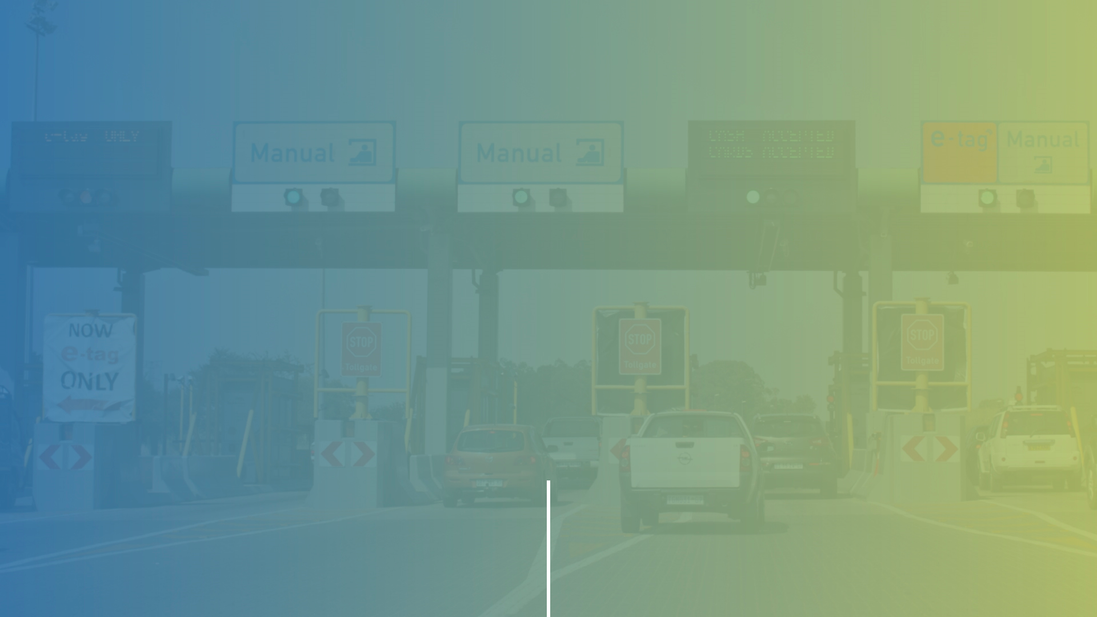
COMPANY PROFILE

Slide 2

ABOUT US
InstaToll Africa – An Established Market Leader
We have been leaders in the markets we operate in for the past 35 years. Our experience, financial strength and quality assurance certification make us an excellent choice for a successful partnership.
OUR MISSION
To be a globally competitive provider of intelligent transportation and road management systems solutions to our stakeholders based on innovative technologies and platforms.
OUR VISION
To be the leading African Transport and Infrastructure management systems company that consistently pursues sustainable growth and enhances corporate value.
OUR CORE VALUES
Our People
Commitment
Integrity
Innovation
Customer Focus
Team Work

Slide 3
KEY EVENTS - TIMELINE
1984
Interpark’s first toll operations project in South Africa
1987
Interpark forms Intertoll to take over growing toll operations business
1992
Intertoll goes international
1996
Intertoll secures its first concession in Europe
1997
Group Five buy controlling stake in Intertoll
2006
Intertoll Africa takes over toll system maintenance , E&M, maintenance and route patrol.
2009
Intertoll develops its own Toll manangement systetem and AVC
2011
Intertoll opens 840km project in Zimbabwe
2019
Mabentu consortium together with management take over Intertoll from Group Five.
2020
Intertoll changes its name to InstaToll
InstaToll develops renewable energy strategy based on its Zimbabwe implementations

Slide 4

A PROVEN INTERNATIONAL TRACK-RECORD
IN LARGE EMERGING COUNTRIES.
InstaToll Africa has extensive experience in emerging economies across Asia, South America and Africa spanning over two decades – in countries such as Brazil, India and Bangladesh. We have a unique ability to adapt to new environments and to develop a broad set of both operational and technical solutions for our clients.
Our strength resides in our established position as market leader. In South Africa, we operate 4 national toll roads of over 800 kilometers in partnership with The South African National Roads Agency SOC Ltd (SANRAL). We remain at the forefront of the roll-out of Electronic Toll Collection across the country.
InstaToll Group has three related companies Instatoll Africa (Pty)Ltd, formerly known as Intertoll Africa (Pty), Instatoll Zimbabwe (Pty) Ltd formerly known as Intertoll Zimbabwe (Pty) and Q-freeZonke (Pty)Ltd a 50/50 JV company between Q-free ASA a global supplier of Intelligent Transportation Systems and InstaToll Africa.

Slide 5
OUR AFRICAN FOOT PRINT
While deeply rooted in Southern Africa, InstaToll Africa has been actively involved on the North-South Corridor in countries such as Zimbabwe, Malawi, Zambia, Southern DRC and Tanzania. Furthermore, InstaToll Africa is making good progress in the West and Central African region, in both Anglophone and Francophone countries. We are steadily extending our footprint into East Africa.
PRODUCTS AND SERVICES TAILORED FOR THE CONTINENT
InstaToll Africa has developed its own toll collection system to enhance and mitigate the risk arising from poorly performing third-party toll-systems from subcontractors.
We develop tolling, energy, parking management and access control solutions engineered in Africa for Africa, which take into account the full life-cycle costs of the total solution. We develop products which are ‘’built to last’’ offering excellent value-for-money for all levels of functionality.
West Africa
East Africa
We have a growing national and international client base in Southern Africa, Western Africa and Eastern Africa.
Southern Africa

Slide 6
A UNIQUE APPROACH TO PARTNERSHIP
We pride ourselves in the ability to develop bespoke solutions to meet clients’ needs by tapping into our broad international network of partner financial institutions. We are deeply-rooted in a “perseverance” culture and the constant search for alignment of interests with our clients, in order to develop lasting, value-for-money solutions. InstaToll Africa enables Road Funds and Toll Road Developers to ‘internalize’ the tolling expertise within the Project Company and to mitigate the collection risk – a critical element for the “bankability” of many of these projects.
As an example: InstaToll Africa played a key role as a co-developer of the Zimbabwe Road Rehabilitation project, working with ZINARA in Zimbabwe to rehabilitate, maintain and operate the 840 km stretch of road from Plumtree to Mutare for a duration of 20 years through a Special Purpose Vehicle called Infralink.
We are the leading independent motorway operator in the Southern African region – with a strong development focus on the North-South Corridor Initiative. We are actively involved in numerous projects as co-developer and as operations & maintenance partner in roads, bridges and In order to expand our operations further into East Africa and West Africa.
Currently operating over 200 toll lanes and 1500 kilometers of road. InstaToll employs over 1000 employees in the Southern Africa region. InstaToll collects over five hundred thousand USD per day for its clients with the largest plaza processing 45000 vehicles per day.

Slide 7
PRODUCTS & SERVICES
Products and services include:
Toll Plaza Operations and Maintenance
Systems Supply
Routine Road Maintenance
Borders Post Management
Weigh Bridge Management
Parking Management and Access Control
Energy and Storage Solutions

Slide 8
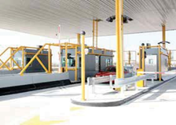
TOLLING
User pays Principle
Tolling equipment increases control by limiting losses – Financial Accountability
Tolling Solution – High Volume Processing
Ring fences revenue
Low cost of Operations – 10% of Revenue
Generates income to pay for Maintenance and Road
FDI spent on increasing road infrastructure and not maintenance
Reduces Unemployment
Reduces Maintenance Backlog

Slide 9

ROAD INFRASTRUCTURE
Road Infrastructure is needed to facilitate cross-border trade
Inter Africa Trade – 12%
Inter Europe Trade – 79%
Inter Asia Trade – 87%
Road Infrastructure reduces cost of trade
Improved economy and job creation along routes
Improved safety and reduced accidents
Lower vehicle operating costs
The main cost that negatively effects exports is the time of delivery and cost of transporting goods
Cost of transport in Africa as a percentage of total cost of goods – 40%

Slide 10

ROUTINE ROAD MAINTENANCE
Routine Road Maintenance (RRM) is critical for sustaining the quality and safety of roads in line with the original design and minimizing life-cycle as well as associated road user costs.
RRM comprises a range of small scale yet critical activities, such as roadside verge clearing and cutting back encroaching vegetation, cleaning of silted ditches and culverts and cleaning of all drainage structures, as well as clearing bridge drainage ports and scuppers, cleaning and repairing damage road signs, repairs of minor slopes failures, patching and pothole repair, and light grading/reshaping of unsealed surfaces.
We use these regular operations to identify periodic maintenance needs and to use labour-intensive methods, especially through employment from communities, local skills development and capacity-building programmes.

Slide 11

ENERGY AND STORAGE
InstaToll Energy provides energy solutions
Embedded Solar Energy Solution through IPP structure
The RSA manufacturing industry has been challenged for a while with increasing costs of electricity above inflation and recently the rolling load shedding due to Eskom inefficiencies.
In order to assist the industry, InstaToll Energy has partnered with industry experts and funders to provide embedded solar power to the manufacturing sector.
Understanding that most businesses will not have funds to finance their own energy migration from Eskom, it has partnered with Capital providers to offer a holistic solution that requires no capital from the business owners. The clients have to sign a power purchase agreement with InstaToll Energy (IE) and provide the roof space for IE to install the solar panels or land where possible.
We do the feasibility study upon signing an NDA or MOU for the project.
Once the project has been scoped and terms agreed we will raise the necessary capital and do a turnkey solution.
We will bill for electricity consumed at competitive rates and maintain the system through its life for an agreed fee.
Each project is unique and structured according to the feasibility and needs of the client.
Peak Shaving and Energy Saving
Peak Shaving and Energy security during Load Shedding

Slide 12
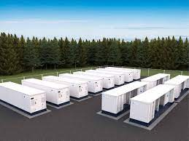
BATTERY ENERGY STORAGE AND PEAK SAVING
Battery Energy Storage Leasing
The RSA manufacturing industry has been challenged the rolling load shedding due to Eskom inefficiencies. Therefore, a use of generators has increased their costs substantially
Municipalities are not able to provide electricity consistently to their clients due to loadshedding as a result clients are moving to solar. Thus, they will lose paying clients over the long term.
Hospitals and other social infrastructure are impacted by loadshedding
Megaflex rate of Eskom where clients are charged higher prices at Peak is a challenge . We need to shave peak through charging at off-peak and releasing at Peak
Eskom produces Electricity at night also while there are few users but are not saving it for use later. Battery Energy storage can help
The REIPPs don’t have storage and there is a need to store energy produced for later use.
We believe that the battery Energy Storage Leasing Facility can assist these industries to avoid load shedding but also reduce their costs of diesel and peak costs.

Slide 13
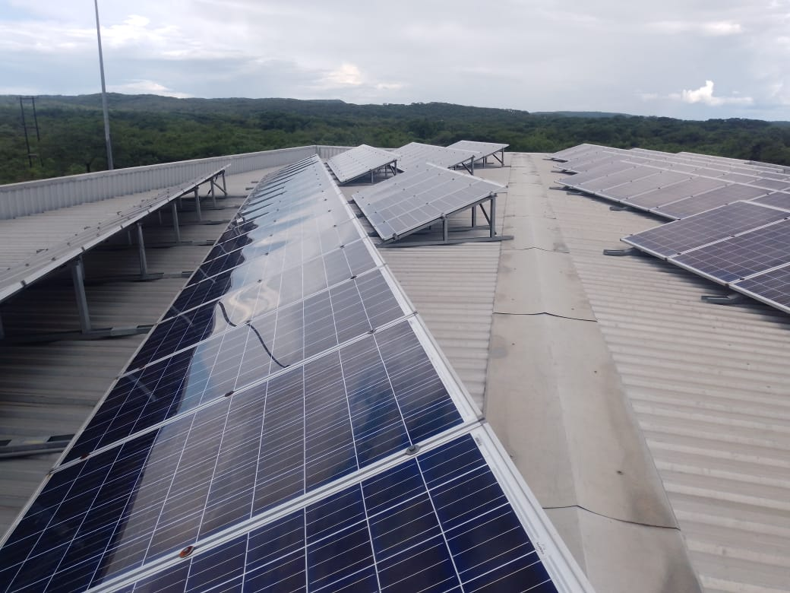
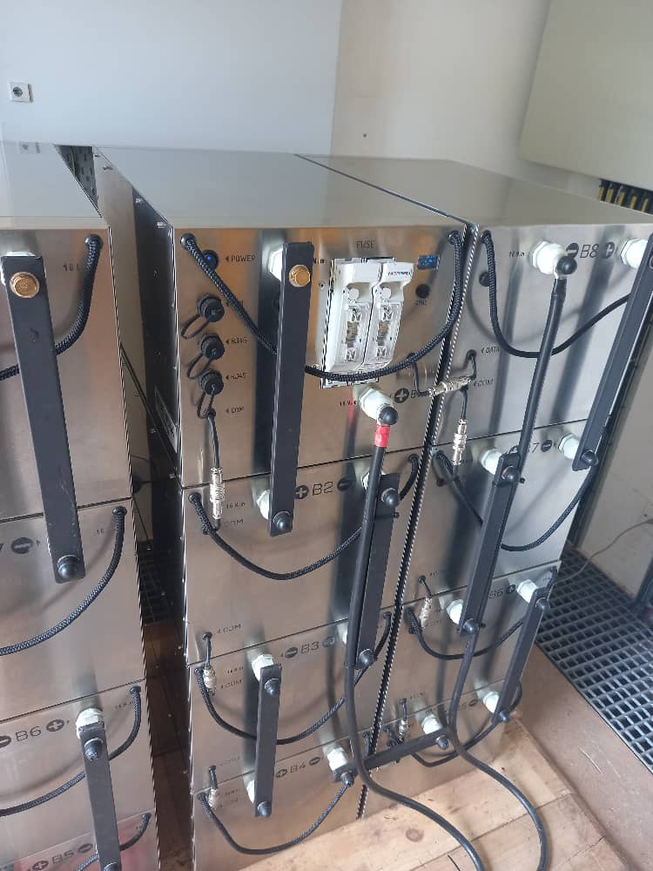
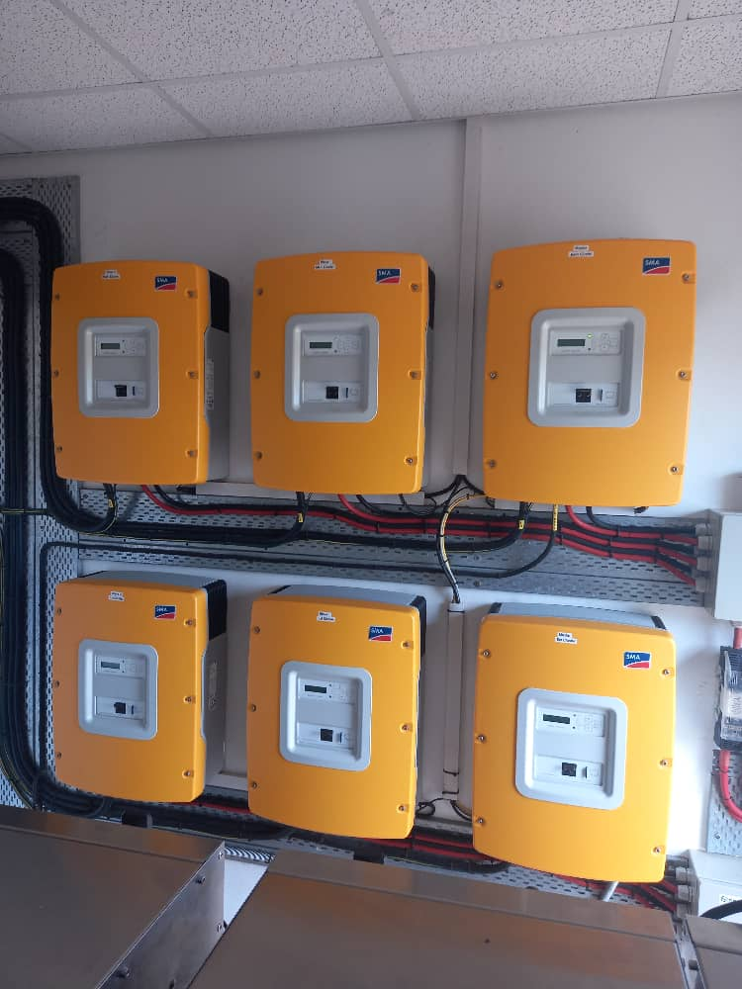
INSTATOLL ZIMBABWE SOLAR PROJECT
Invertor
Each plaza has 6 Sunny Island 5.5KVA Invertors
InstaToll Plazas each have 144 panels mounted on the lanes canopy with a capacity of 248w each and we operate a total of 9 plazas
Batteries
BYD and Blue Nova Lithium Ion batteries 920ah per battery
Two banks, each with 8 batteries

Slide 14
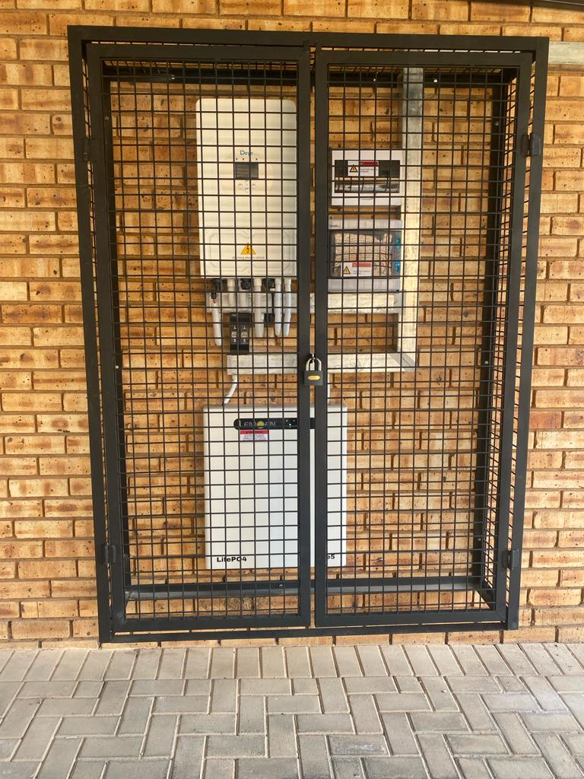
ADVANTAGES OF INSTATOLL POWER SYSTEM
Not reliant on power utilities shutdowns
It is a vast, inexhaustible, and clean renewable energy source, and also contributes towards green life credentials for the company.
Maintenance is easy and modular, in that if faults occur it only affects the single station.
Our system makes use of reputable brands for our batteries and invertors, that are intelligent enough to adapt to new technologies and innovations.
Low long overrun costs, as major costs only apply on installation and maintenance.
The concept is that you can put up a toll plaza anywhere without dependency on power utility companies or municipalities.

Slide 15
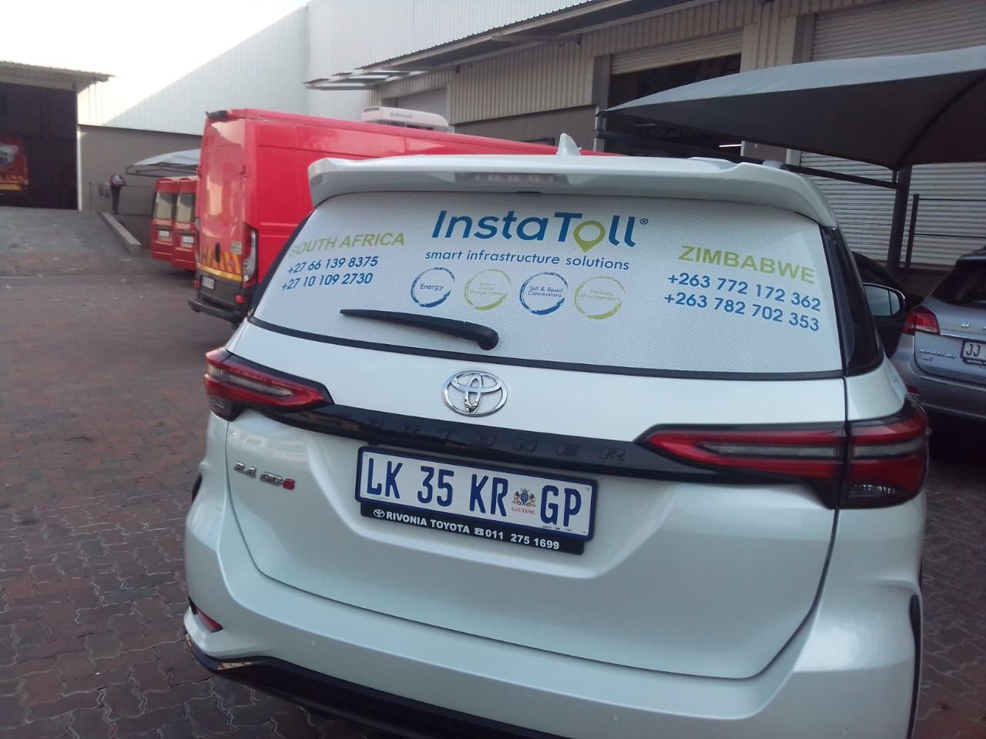
ADVANTAGES OF INSTATOLL BATTERY ENERGY STORAGE SYSTEM
Safe Energy from Utility or Solar and release when there is load shedding or at Peak
Safe costs during Peak
Energy security during load shedding.
Can be integrated with a Solar System easily.
Easy to Install
Low maintenance costs
No noise pollution
No carbon emitted

