Slide 1
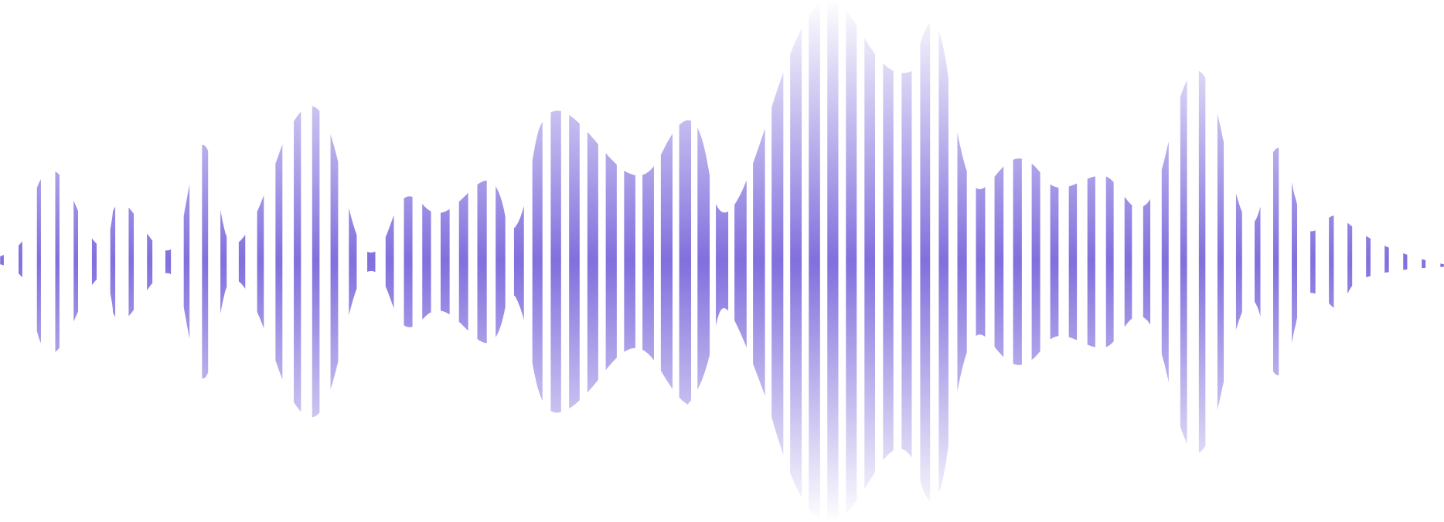

TRANSLYTIC
AI BASED VIDEO TRANSLATION
&
CAPTION TOOL

Slide 2
Problems
SOLUTIONS
The Problem
The Solution
VIDEO CONTENT IS OFTEN INACCESSIBLE TO NON-NATIVE SPEAKERS OR HEARING-IMPAIRED VIEWERS.
EXISTING TOOLS REQUIRE MANUAL SUBTITLE CREATION, EXPENSIVE SOFTWARE, OR ONLINE UPLOADS THAT RAISE PRIVACY CONCERNS.
NO SIMPLE SOLUTION EXISTS THAT COMBINES TRANSCRIPTION + TRANSLATION + PLAYBACK IN ONE PLACE.
TRANSLYTIC IS A FULLY CAPABLE APPLICATION THAT -
AUTOMATICALLY EXTRACTS AUDIO AND TRANSCRIBES SPEECH USING OPEN-AI WHISPER.
TRANSLATES SUBTITLES INTO 10 LANGUAGES VIA GOOGLE TRANSLATE.
PLAYS THE VIDEO WITH LIVE SYNCED CAPTIONS AND AI GENERATED DUBBED AUDIO IN MULTIPLE LANGUAGES

Slide 3
Key Features
Everything you need in one app
Synced Captions & Audio
Auto Transcription
Multiple Languages
Speech-to-text powered by OpenAI Whisper (base model)
Hindi, Marathi, Spanish, French, German, Arabic & more
Real-time subtitles + voice sync
Full Playback
Controls
AI Voice Dubbing
Export SRT
Generates translated voice using AI ( gTTS + audio sync )
Save subtitle files for use in any video editor
Play, Pause, Stop and a seekbar for navigation

Slide 4


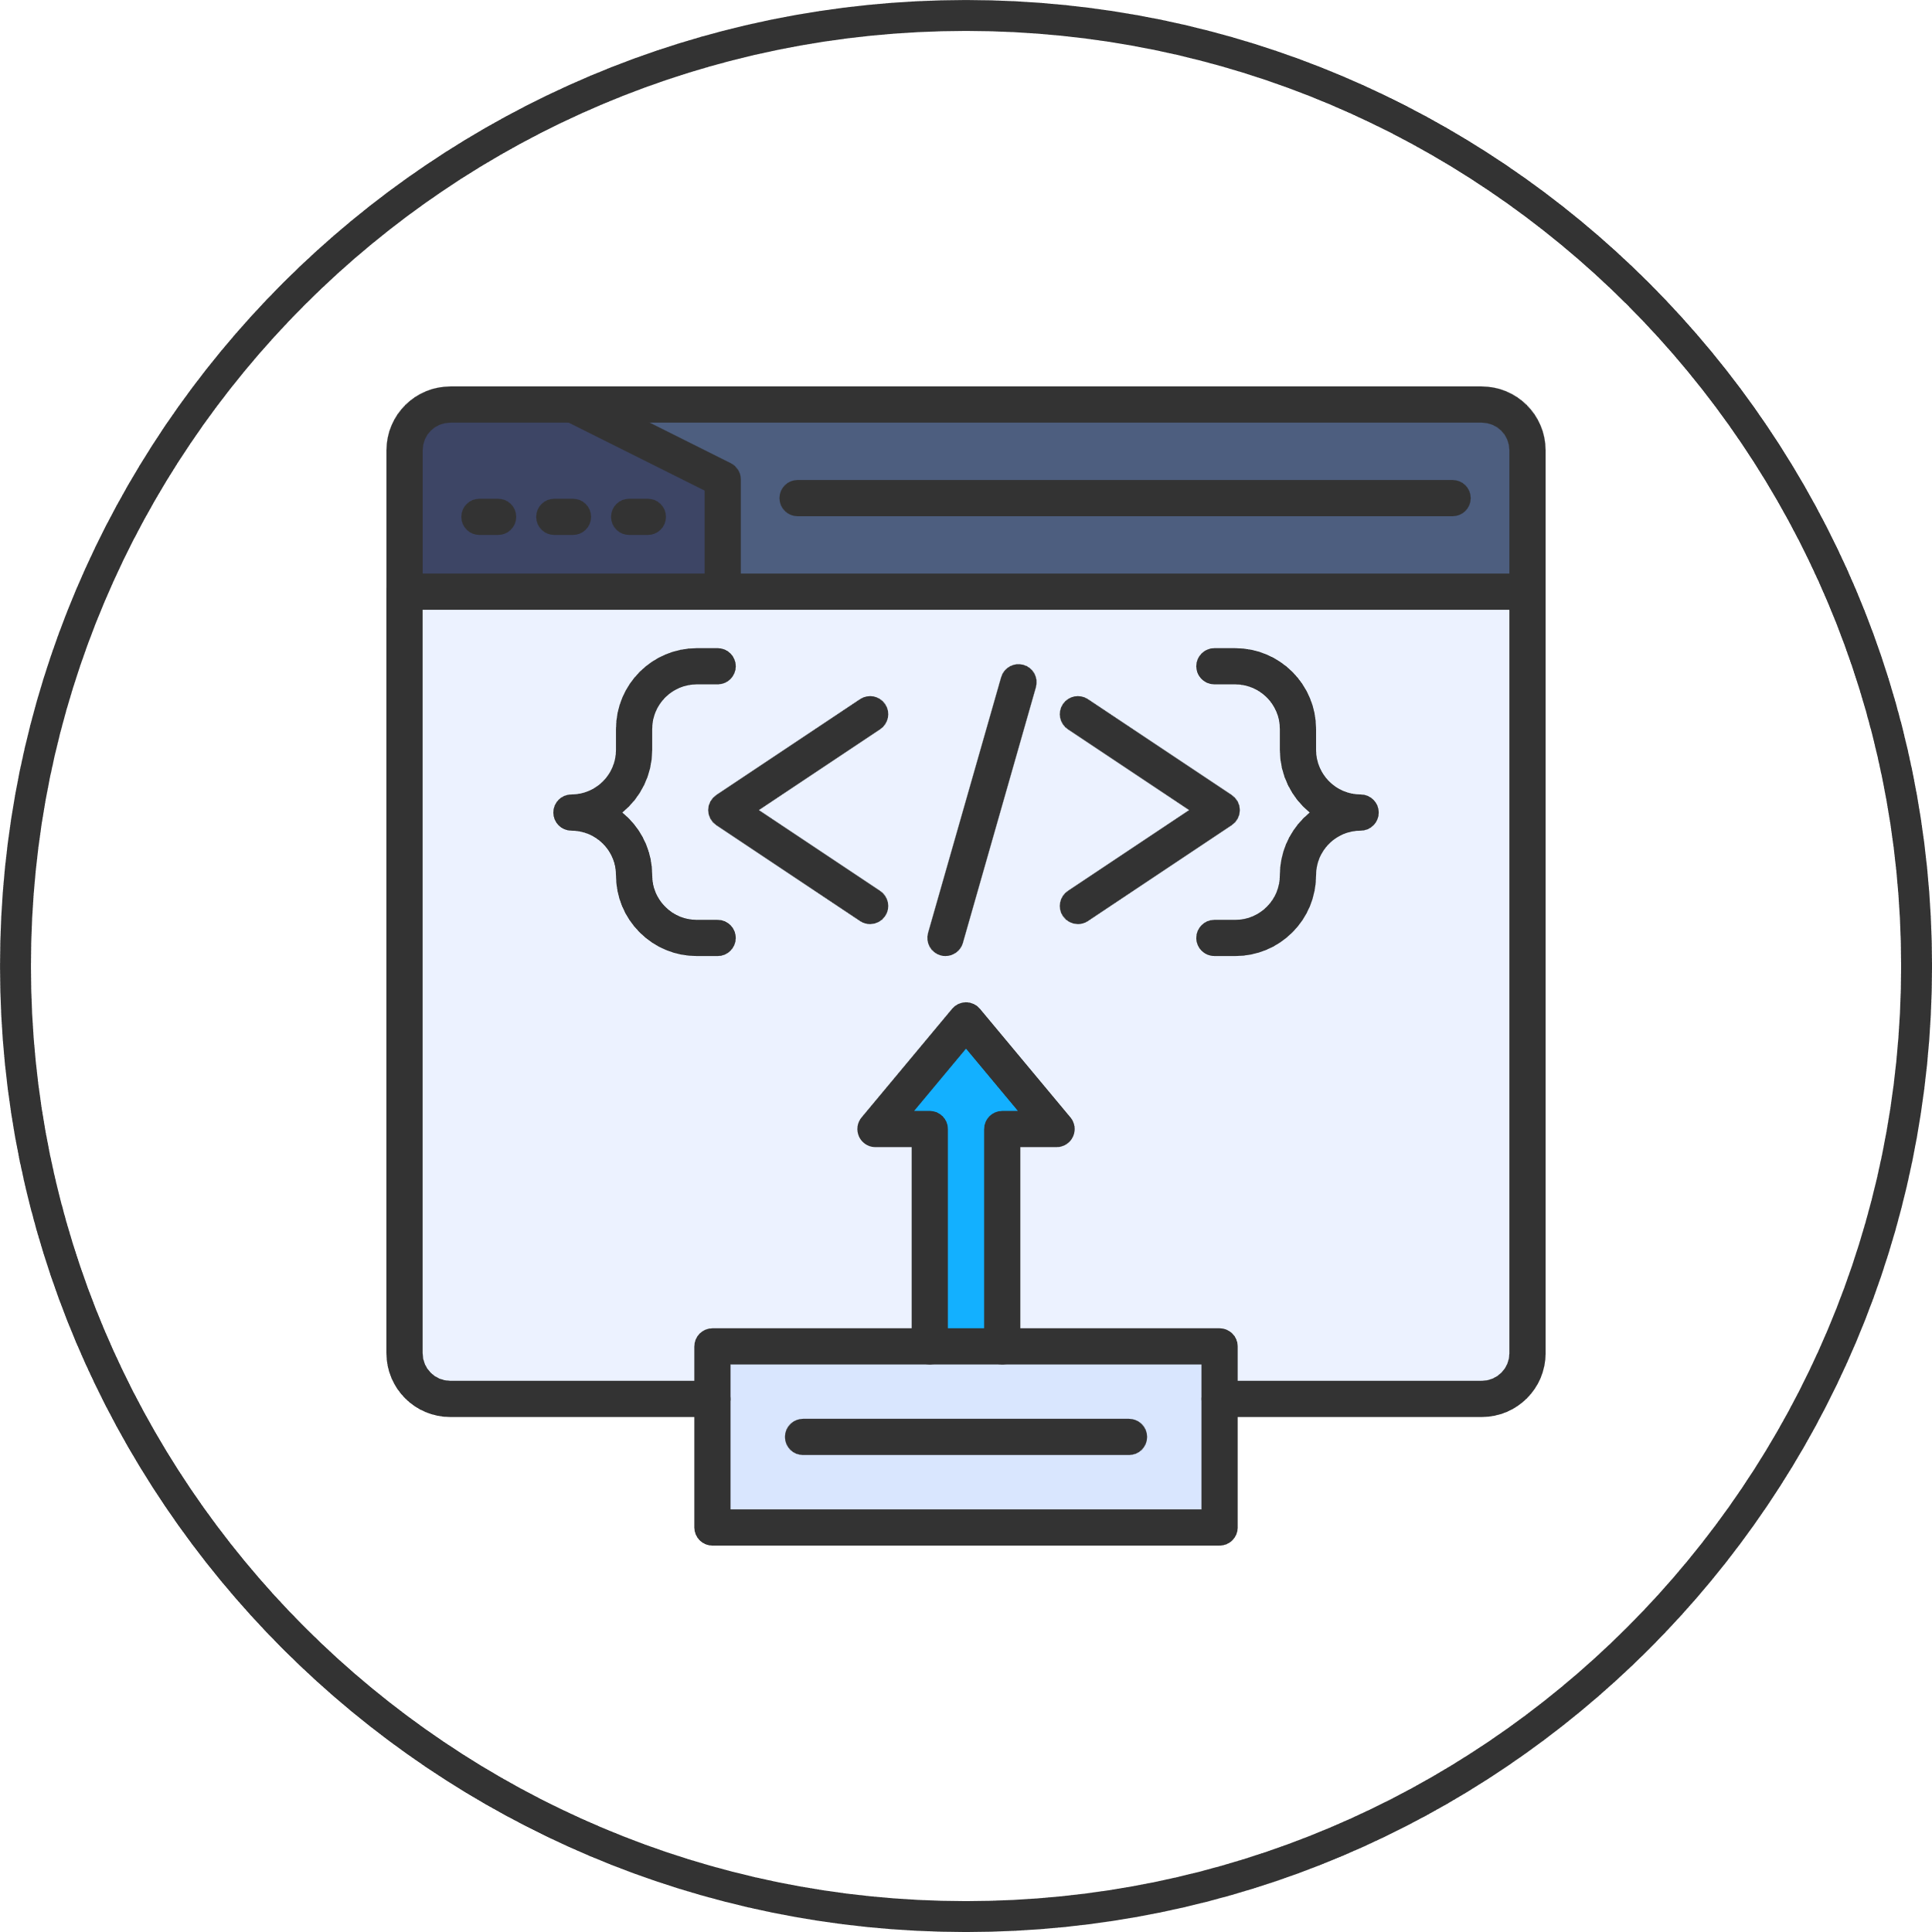


How it Works
4 Step Automted pipeline triggered by a single button click
Extract Audio
Transcribe Speech
FFmpeg + MoviePy
Translate Text
The app strips the audio track from the selected video file and saves it as a temporary WAV file for processing.
Generate Voice
& Play
OpenAI Whisper
Google translate
Whisper AI to convert speech into text. It also gives timestamps, which helps us sync captions perfectly with the video
Each caption segment is then translated into the selected language while preserving timing for synchronization
gTTS + Pygame + OpenCV
Creates AI-generated voice from translated text and plays it with synced captions.

Slide 5
Tech Stack & Architecture
LIBRARIES, TOOLS AND HOW THEY CONNECT
Dependencies
/1
OpenAi - Whisper
Speech to text engine
Architecture
/2
Deep translator
Google Translate wrapper
app.py
/3
moviepy
Audio extraction
FFmpeg / MoviePy
/4
pygame
Audio playback
/5
opencv - python
Video frame rendering
Whisper Model
/6
pillow
Image display on canvas
Deep-translator
/7
torch
Required backend for Whisper
/8
ffmpeg (system)
Audio/video processing
gTTS + pydub
/8
gTTs
AI voice generation
pygame + OpenCV
/8
pydub
Audio processing & merging

Slide 6
Summary
What Translytic Delivers
🎥 Wide Format Support - Compatible with MP4, MOV, AVI, MKV, and WebM video formats
🌍 Multilingual Translation - Supports 10+ languages including Hindi, Marathi, Spanish, French, and more
⚙️ Automated AI Pipeline - Seamless 4-step process: Audio Extraction → Transcription → Translation
🔊 AI Voice Dubbing – Converts translated text into synchronized speech
💾 Subtitle Export - Generate and download industry-standard .SRT files for use in any video editing tool
🖥️ Cross-Platform Compatibility - Runs smoothly on Windows, macOS, and Linux

Slide 7

Scope
Future Scope
🌐 Convert into a web-based platform (React + FastAPI)
⚡ Add real-time live streaming captions (YouTube, Zoom, etc.)
📝 Provide editable subtitle editor inside the app
☁️ Cloud storage for saving and accessing processed videos

Slide 8
References
Real-time Speech-to-Speech Translation
SeamlessM4T—Massively Multilingual & Multimodal MachineTranslation
Direct Models for Simultaneous Translation & Automatic Subtitling
SBAAM! Eliminating Transcript Dependency in Automatic Subtitling
Leveraging Broadcast Subtitle Transcripts for Automatic Speech Recognition and Subtitling
Text with Knowledge Graph Augmented Transformer for Video Captioning
Accurate and Fast Compressed Video Captioning
Video-Guided Machine Translation: A Survey of Models
A Deep Learning Framework for Real-Time Video Captioning and Multilingual Translation
Ensemble-based Multilingual Video Captioning with Multimodal Integration
LongCaptioning: Unlocking the Power of Long Video Captioning
Generative AI for Video Translation: A Scalable Architecture...
MV-GPT: End-to-End Generative Pre-training for Multimodal Video Captioning
Center-Enhanced Video Captioning with Multimodal Semantic Alignment
Gen AI Multilingual Audio Dubbing and Synthesis
AI-Powered Real-Time Video Caption Recommendation System
AI Enhanced Video Language Translation
Automated Caption Generation for Video Call with Language Translation
Real Time Video Captioning Using Deep Learning
Video Captioning Method Based on Semantic Topic Association

Slide 9
Thank You

