Slide 1
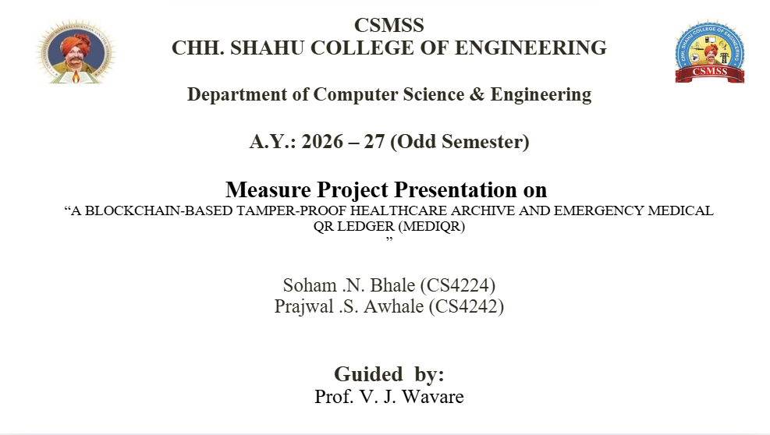

Slide 2
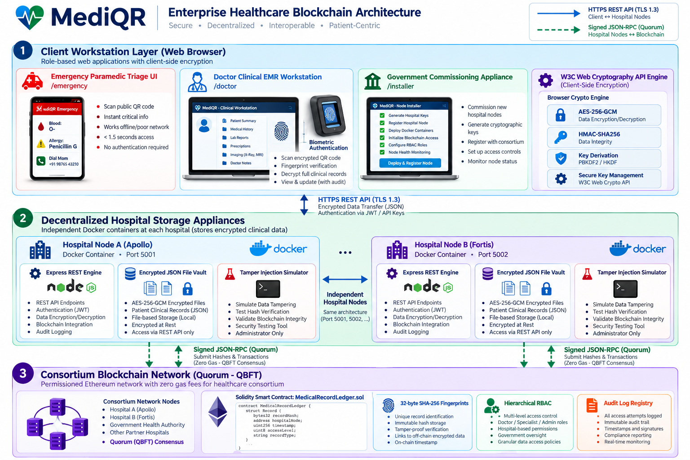
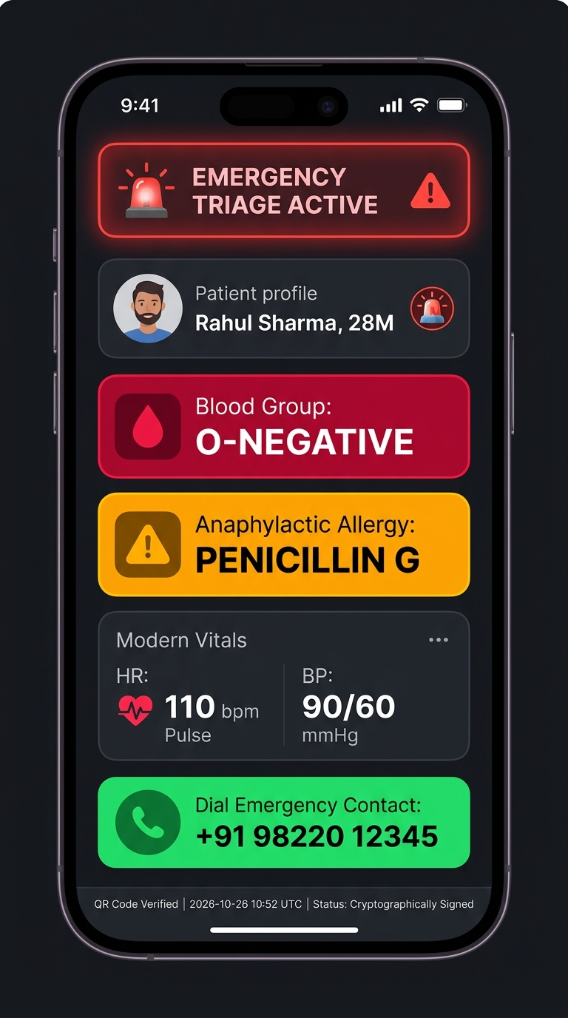
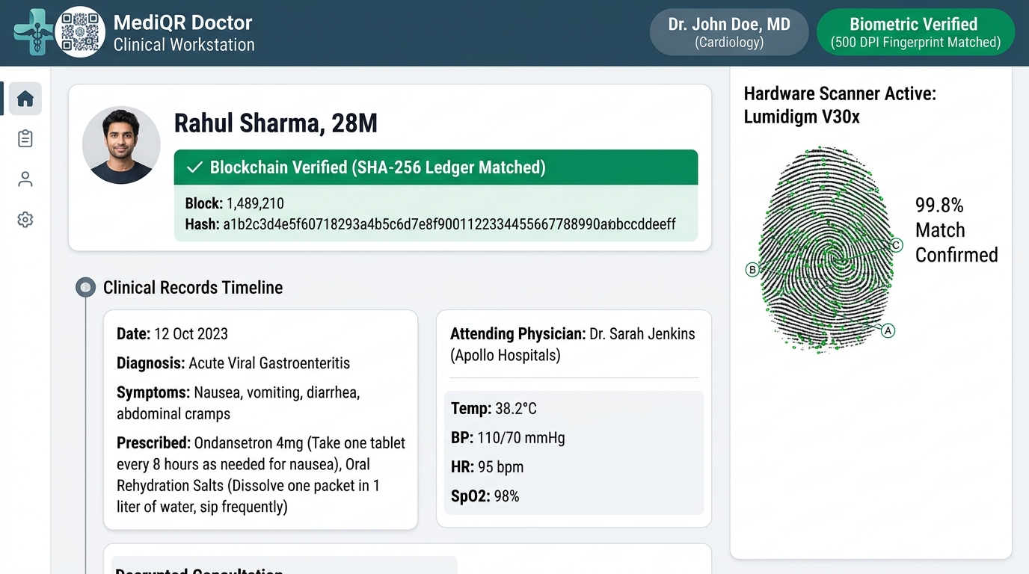
PROBLEM STATEMENT & 3-TIER DECOUPLED ARCHITECTURE
The Healthcare Crisis: Golden Hour Bottlenecks
Fig. System Architecture: 3-Tier Decoupled Pipeline
🚨 The 3-Minute Trap: Roadside trauma victims are unconscious; EMTs lack vital blood group & Penicillin allergy data.
🔒 Data Silos: Hospitals do not interoperate; central IT requests take 15–30 critical minutes.
⚠️ Plain QR Leaks: Raw paper QR codes violate HIPAA/privacy; central SQL databases invite ransomware & insider alteration.
The MediQR Solution: Dual-Segment Smart Card
⚡ Public Triage Front: Scannable offline by any phone in <1.84s; exposes only Blood Type (O-) & critical allergies.
🔐 Protected Vault Back: Salted HMAC-SHA256 query pointer; decryptable only by verified doctors via hospital key.
⛓️ Zero PII On-Chain: Solidity ledger anchors 32-byte SHA-256 hash digests only; 100% HIPAA/DPDP compliant.
Working GUI Prototypes: Roadside Triage Terminal (<1.8s) vs. Doctor Clinical Workstation

Slide 3
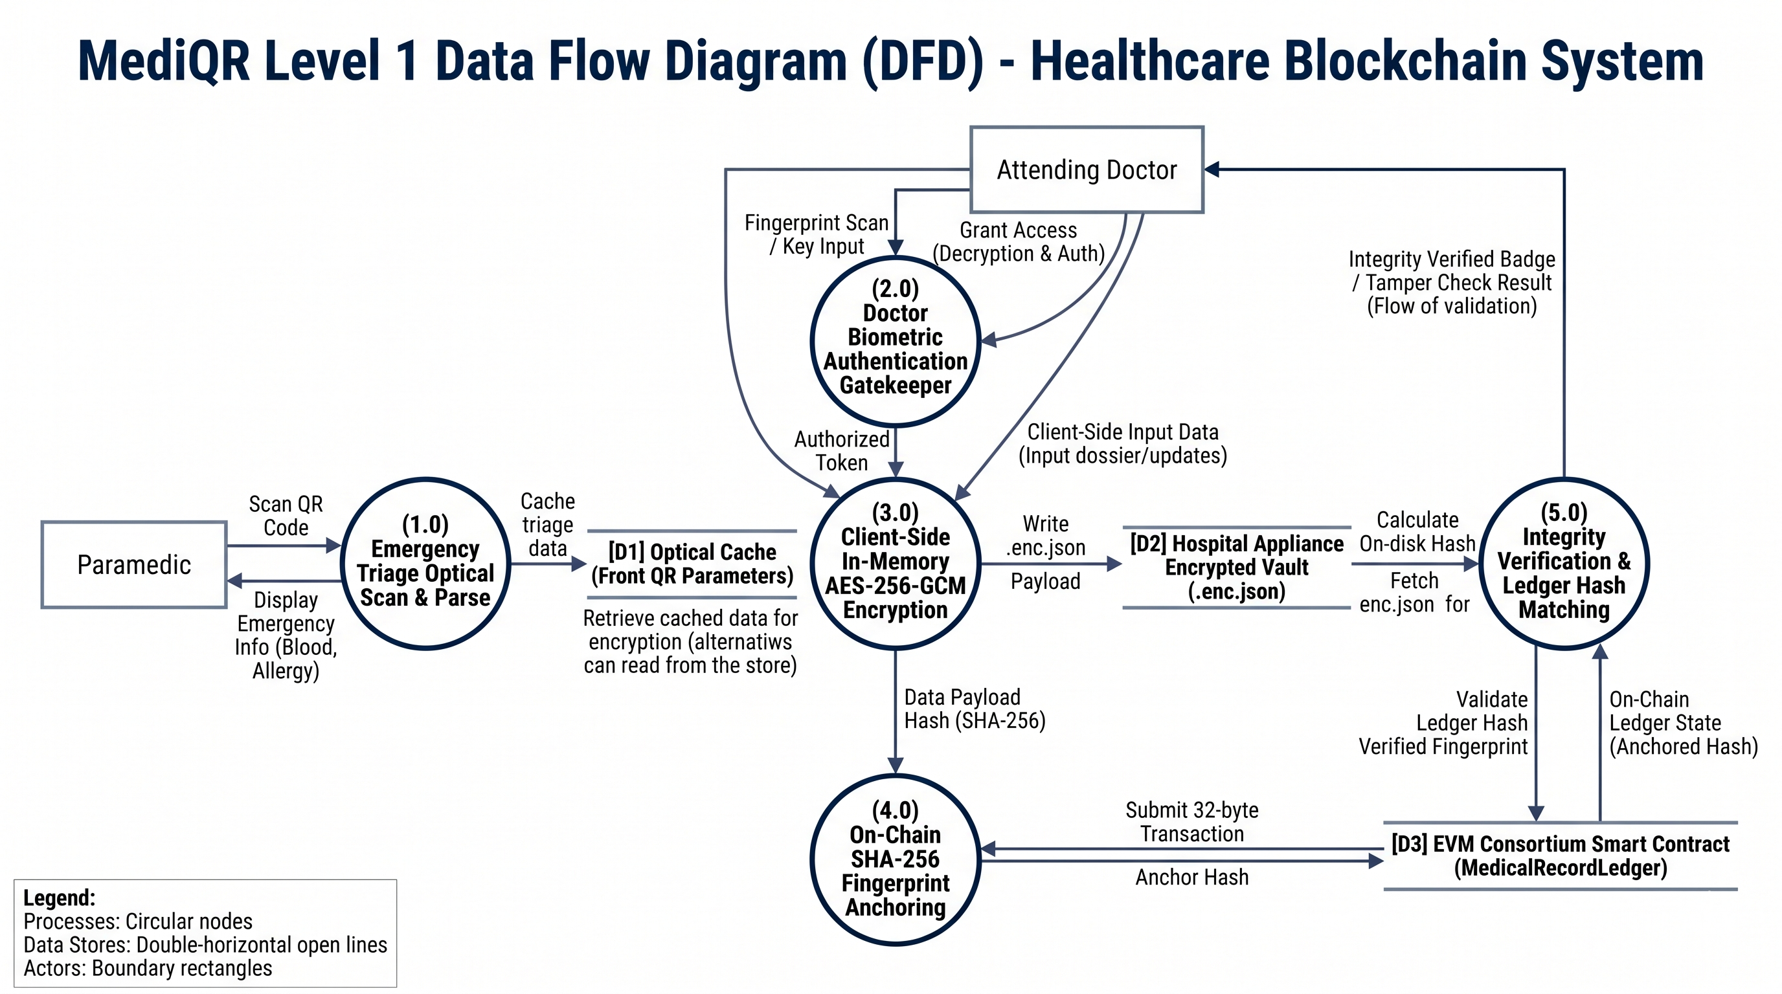
TECHNICAL APPROACH & DATA FLOW DIAGRAM (DFD LEVEL 1)
Fig. Level 1 Data Flow Diagram (DFD): Paramedic (1.0) ➔ Doctor (2.0) ➔ Encrypt (3.0) ➔ Solidity (4.0) ➔ Verify (5.0)
Core Tech Stack & Cryptographic Primitives
Solidity 0.8.20
EVM Smart Contract
AES-256-GCM
12B IV + 16B AuthTag
HMAC-SHA256
Salted Unlinkable Key
Next.js 14
Web Crypto API in RAM
Hardhat EVM
14/14 Unit Tests Pass
Docker Nodes
Distributed Hospital REST

Slide 4
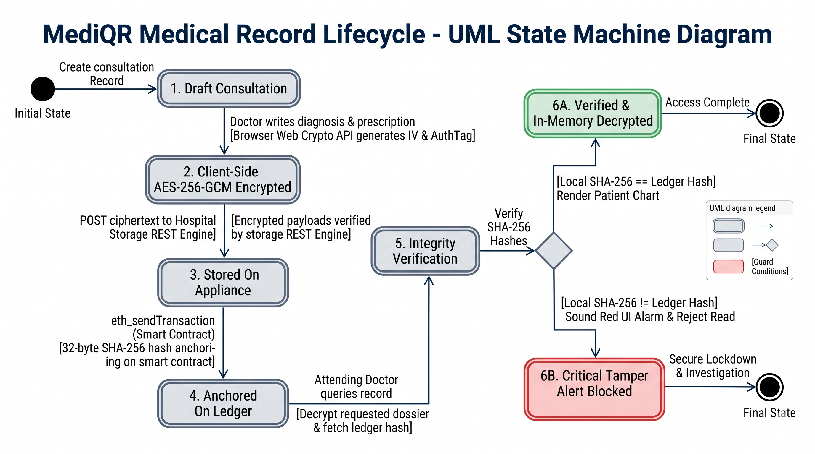
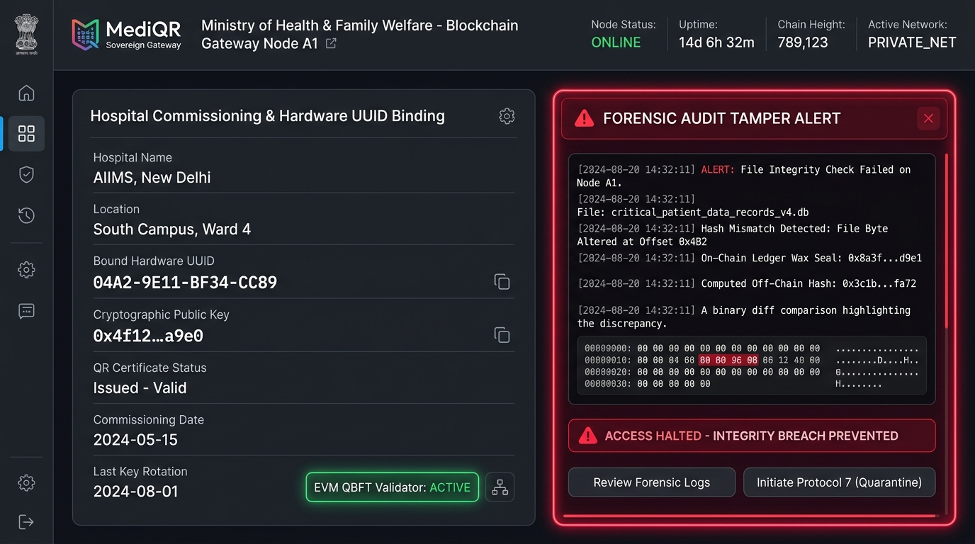
SECURITY MODEL & FORENSIC TAMPER DETECTION STATE MACHINE
Fig. Record Lifecycle State Machine: Draft ➔ Encrypt ➔ Anchor ➔ Verify or Block
Fig. Forensic Tamper Alert (/admin & /simulator): Single-Bit Mismatch Halts Decryption
✗ Privacy Leakage
✓ Zero PII on-chain (SHA-256 only)
✗ Unconscious Victim
✓ Dual-Segment Card (<1.8s Triage)
✗ Cross-Hospital Silos
✓ Content-addressed ledger query
✗ Database Tampering
✓ 1-Bit mismatch halts decryption

Slide 5
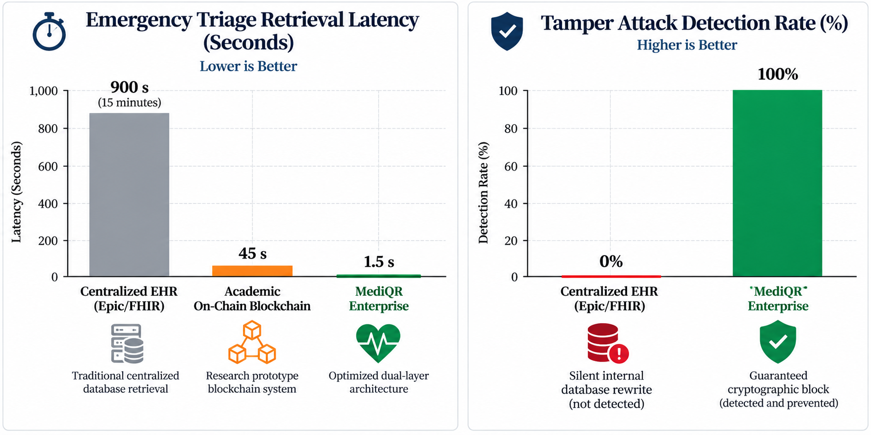
PERFORMANCE BENCHMARKING & OPERATIONAL PIPELINE
Fig. Empirical Benchmarks: 1.5s vs 900s Triage Latency & 100% vs 0% Tamper Catch Rate
Verified Performance & Cryptographic Assurance Metrics
⚡ < 1.84 s
Triage Retrieval Latency
🔒 0 Bytes
PII Stored On-Chain
🛡️ 100%
Tamper Detection Rate
⚡ 14.2 ms
In-Browser Web Crypto
Conventional Centralized EHR vs. MediQR Decentralized Architecture
Centralized EHR
(Isolated DB)
Manual Login / IT Gate
(Locked Phone Fails)
✗ 15-30m Delay
High Trauma Risk
Dual-Segment MediQR
(Public + Vault)
Roadside Scan (<1.8s)
+ Doctor Biometrics
✓ Verified Record
Golden Hr Saved
Key Takeaway:
MediQR decouples urgent roadside life-support data from confidential lifetime medical history. Paramedics get instant data without passwords; doctors get verified tamper-proof dossiers. Zero central database honeypot exists.

Slide 6
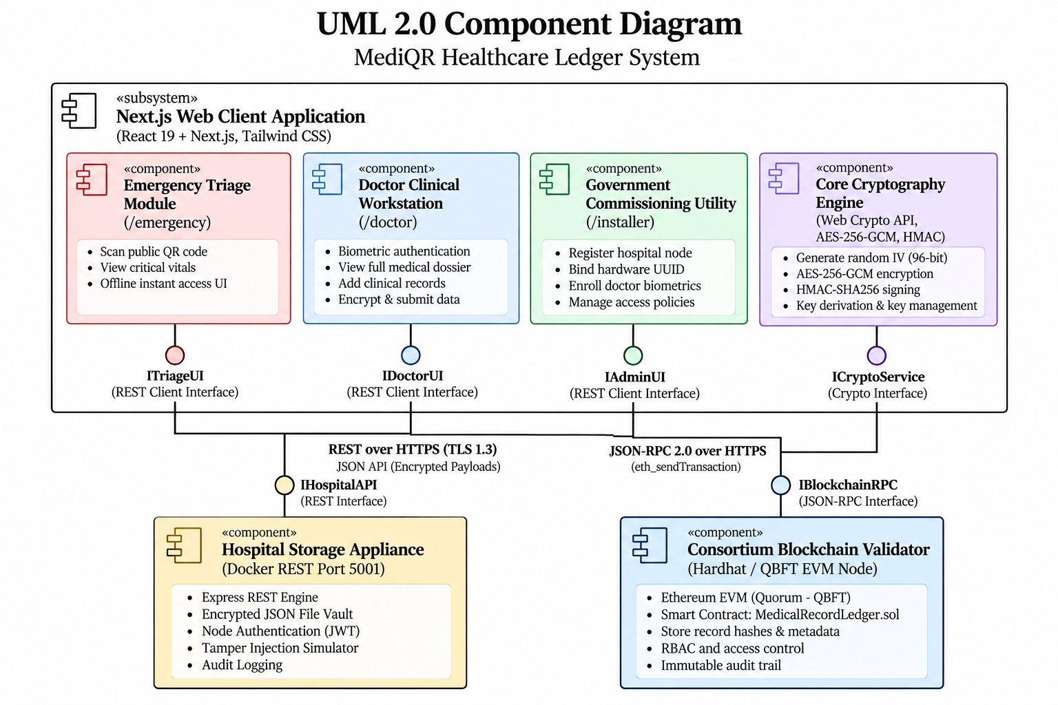
UML COMPONENT ARCHITECTURE & VALIDATION ROADMAP
Fig. UML 2.0 Component Diagram: Web Client, Storage Appliances & EVM Node
Phased Implementation & Validation Roadmap
Phase 1: Cryptography & Smart Contract (DONE)
✓ MedicalRecordLedger.sol deployed on EVM.
✓ AES-256-GCM + Salted HMAC test suite.
*Milestone 1: Zero-PII contract verified on Hardhat.*
Phase 2: Full-Stack Clinical Portals (DONE)
✓ Roadside Emergency Terminal (/emergency).
✓ Doctor Workstation with Biometrics (/doctor).
*Milestone 2: Sub-2s offline triage verified.*
Phase 3: Field Hardening & Kiosks (IN PROGRESS)
✓ Forensic Tamper Simulation Lab (/simulator).
✓ ESP32 IoT Ambulance mini-terminal & ABHA connector.
*Milestone 3: Ready for state emergency fleets.*
Experimental Validation Datasets
1,000+ Synthetic Profiles
24 Clinical specialties (JSON/HL7)
Hardhat 14/14 Unit Tests
100% Assertion Pass | 62k gas
10k Forensic Mutations
100% Single-bit detection rate
Multi-Hospital Nodes
Node A (:5001) & Node B (:5002)
All smart contracts, cryptographic primitives, clinical portals & forensic verification engines are implemented in the MediQR prototype.

