Slide 1
Comparisons

Slide 2
Paper 1
Parallel FFT processors have been used
Each Image has been divided into equally sized subsets (2,4,8)
Each image subset is given as input to a FFT processor

Slide 3
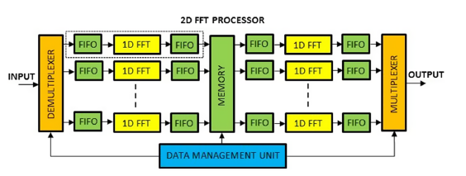

Slide 4
Paper 1->2D-FFT- 3.8ms (40MHz, 1 PE)
Paper 1->2D-FFT- 0.96ms (80MHz, 1 PE)
Our Project->2D-FFT- 0.33ms (100MHz, 1 PE)
Our Optimized Project->2D-FFT- 0.211ms (100MHz, 4 PE- not entirely)
Optimized Project-> 2D-FFT- 0.0889ms (100MHz, 4 PE)

Slide 5
Paper 2
Paper 2-> Ref. Image size-> 32 x 32 (4096px)
-> 2nd Image size-> 256 x 32 (8192px)
Paper 2-> Latency for Cross-Correlation-> 28.6us (250 MHz clock)
Our project-> Ref. Image size-> 128 x 128 (16384px)
->2nd Image size-> 128 x 128 (16384px)
Our project-> Latency for Cross-Correlation-> 0.505ms (100MHz clock)
After partial optimization-> Latency-> 0.383ms (100MHz clock)
After Complete optimization-> Latency-> 0.13795ms (100MHz clock)

