Slide 1
Implemetation of Cross- Correlation of two Images on FPGA
Soham Das¹, Kirti Khandelwal¹, Nanditha Rao¹, D.V.S. Phanindra², Rengaswamy Sridharan²
¹International Institute of Information Technology Bangalore, ²Indian Institute of Astrophysics Bangalore

Slide 2
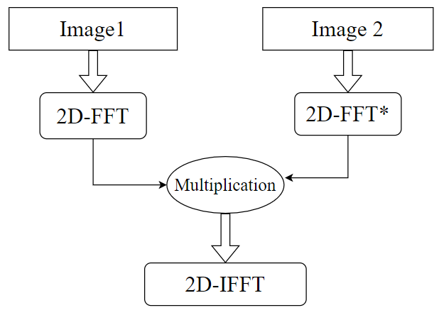
Introduction
MOTIVATION: In Solar Adaptive Optics, Cross- Correlation is a very fundamental concept that is used to detect the shift between the pixels of numerous digital images taken in burst mode. The Software- based Cross- Correlation is a satisfactory option when the sub- apertures are small in number.
But, when the number of sub- apertures are large in number as well as the number of images, there comes a dire need for hardware accelerated (FPGA) computations, for example, in case of the National Large Solar Telescope (NLST).
OBJECTIVE: To create the verilog code for the Cross- Correlation between two images, implement it on a FPGA board and there by, get the shift between the two images.
The Cross- Correlation between two images gives a peak value, whose position when detected gives us the shift of the image with respect to the Reference image.
Here, two images of pixel size 128x128 are taken and their 2D-FFTs are calculated. Then the conjugate of the 2D-FFT of the Reference image(Image2 in Fig.1) is calculated, followed by a pixel by pixel multiplication of the of the conjugate 2D-FFT of Reference image and the 2D-FFT of the image whose shift we want to find w.r.t. the Reference image. Finally, the 2D-IFFT is done on the multiplied result.
Fig.1: Block Diagram of Cross- Correlation

Slide 3
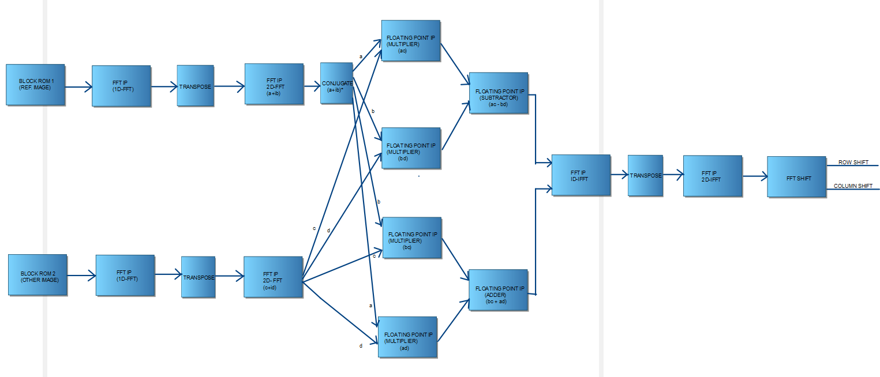
Block Diagram of the Verilog Flow
(173.99-337.83)us
(174.07-337.91)us
(0.01-16385)us
(4.99-168.83)us
(168.99-332.83)us
(173.97-337.81)us
(174.19-338.03)us
(343.09-506.93)us
(174.07-337.91)us
(179.18-343.02)us
(348.07-511.91)us
(348.08-511.92)us
(174.07-337.91)us
(0.01-16385)us
(4.99-168.83)us
(168.99-332.83)us
(173.97-337.81)us
(174.19-338.03)us
(174.07-337.91)us

Slide 4
Profiling
Time taken from first output till the last output
Block ROM- (0.01-163.85)us
FFT IP(1D-FFT)- (4.99-168.83)us
Transpose Block- (168.99-332.83)us
FFT IP(2D-FFT)- (173.97-337.81)us
Conjugate Block- (173.99-337.83)us
Floating Point Multiplier IPs- (174.07-337.91)us
Floating Point Subtractor IP- (174.19-338.03)us
Floating Point Adder IP- (174.19-338.03)us
FFT IP(1D-IFFT)- (179.18-343.02)us
Transpose Block- (343.09-506.93)us
FFT IP(2D-IFFT)- (348.07-511.91)us
FFT Shift- (348.08-511.92)us
(174.07-337.91)us

Slide 5
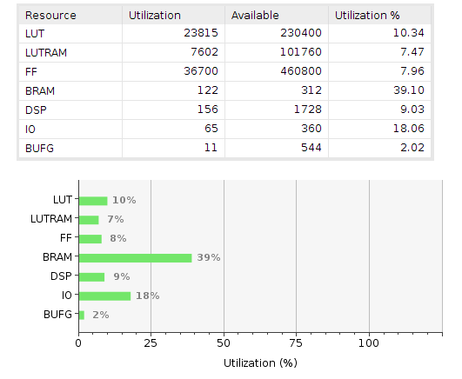
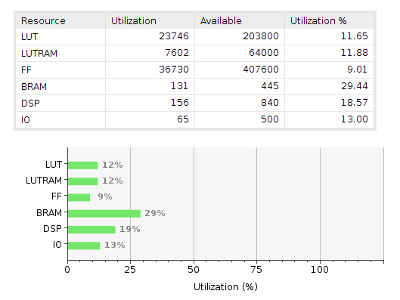
Resource Utilization from Synthesis
CURRENT STATUS: The Verilog code for the Cross- Correlation between two digital images has been created with multiple successful simulations with different inputs. The code has been then optimized in terms of simulation time and resource utilization (synthesized on a Kintex-7 FPGA KC705 Evaluation Kit & also on ZC104 Evaluation Board). Also, along with Cross- Correlation, the concept of FFT Shift has been incorporated to get the amount of shift in the desired format.
Fig.2: Resource Utilization – ZCU104
Fig.3: Resource Utilization – KC705

Slide 6
Conclusion
The entire Phase Correlation along with the FFT Shift which gives the final output in the form of the shift in ‘Row’ and ‘Column’ between the two input images takes a simulation time of 0.512ms.
Also, the Verilog flow has been synthesized using Xilinx Vivado 2019.1 on two different FPGA boards- Kintex-7 KC705 Evaluation Board and the Zync Ultrascale ZCU104 Evaluation Board.
(174.07-337.91)us

Slide 7
THANK YOU

