Slide 1
Module 3
Selvamurugan Kasi
Assistant Professor
Computer Engineering
SIGCE

Slide 2
Servlet

Slide 3
What is Servlet?
Servlet technology is used to create a web application (resides at server side and generates a dynamic web page).
Servlet technology is robust and scalable because of java language.
Before Servlet, CGI (Common Gateway Interface) scripting language was common as a server-side programming language.

Slide 4
Servlet
Servlet is a technology which is used to create a web application.
Servlet is an API that provides many interfaces and classes including documentation.
Servlet is an interface that must be implemented for creating any Servlet.
Servlet is a class that extends the capabilities of the servers and responds to the incoming requests. It can respond to any requests.
Servlet is a web component that is deployed on the server to create a dynamic web page.

Slide 5
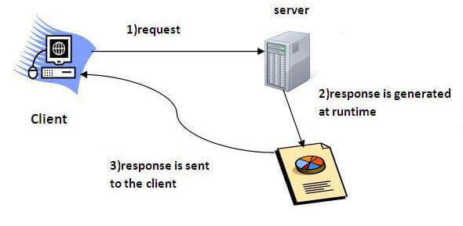

Slide 6
CGI Vs. Servlet
Parameter | CGI | Sevlet
Basic | Each clients request creates its own process | Process are created depending on the type of the client request
Platform dependency | Platform dependent | Does not rely on the platform
Creation of process | Each client request creates its own process | Depending on the type of the client request
Conversion of the script | Present in the form of executables | Compiled to java Byte code
Runs on | Separate process | JVM
Security | More vulnerable to attacks | Can resist attacks
Speed | Slower | Faster
Processing of script | Direct | Before running the script it is translated and compiled
Portability | Cannot be ported | Portable

Slide 7
Advantages of Servlet
Persistent
Portable
Powerful
Safety
Integration
Extensibility
Inexpensive
Secure
Performance
Server independent
Protocol independent

Slide 8
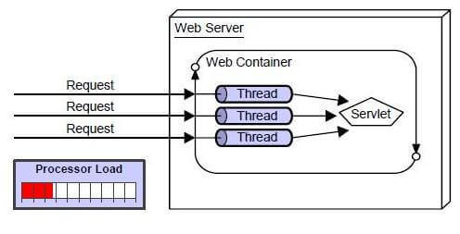
Advantages of Servlet
Better performance: because it creates a thread for each request, not process.
Portability: because it uses Java language.
Robust: JVM manages Servlets, so we don't need to worry about the memory leak, garbage collection , etc.
Secure: because it uses java language.

Slide 9
Disadvantages of Servlet
The process of servlet designing is complicated and slows down the applications
The complex business logics written make it difficult to understand the servlet
It is very difficult for enhancement and bug fixing in servlet applications.
The servlet technology has requirement of comparatively more steps to develop.
Also servlet need too long time for development

Slide 10
Java Servlet Architecture
Servlet are used to perform client request and response tasks dynamically.
Servlets can be used to perform tasks like/;-
Control the flow of the application
Generate dynamic web content
Server-side load balancing.
Implement business logic

Slide 11
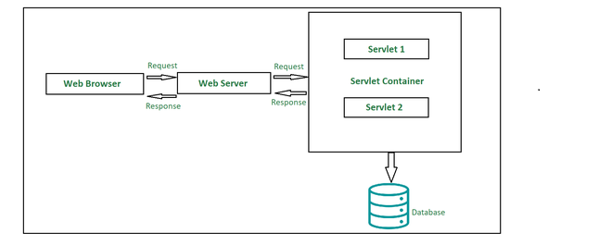
Components of Sevlet Architecture

Slide 12
1. Client
The client shown in the architecture above is primarily working as a medium who is sending out HTTP requests over to the web server and again processing the response it gets back from the server.
As we can see in the diagram, our client here is the web browser.
2. Web Server
Primary job of a web server is to process the requests and responses that a user sends over time and maintain how a web user would be able to access the files that has been hosted over the server.
The server we are talking about here is a software which manages access to a centralized resource or service in a network..
There are precisely two types of web servers:
Static web server
Dynamic web server

Slide 13
3. Web Container
Web container is another typical component in servlet architecture which is responsible for communicating with the servlets.
Two prime tasks of a web container are:
Managing the servlet lifecycle
URL mapping
Web container sits at the server-side managing and handling all the requests that are coming in either from the servlets or from some JSP pages or potentially any other file system.

Slide 14
Architecture of package
There are Four potential ways in which we can employ to create a servlet:
Servlet Interface
Generic Servlet
HTTP Servlet
MyServlet

Slide 15
Servlet Interface
Servlet Interface (from javax.servlet package)
The Servlet interface is part of the javax.servlet package and provides the basic structure for all servlets.
Key Methods of Servlet Interface:
public interface Servlet {
void init(ServletConfig config) throws ServletException;
ServletConfig getServletConfig();
void service(ServletRequest req, ServletResponse res) throws ServletException, IOException;
String getServletInfo();
void destroy();
}

Slide 16
2.Generic Servlet
GenericServlet is an abstract class in the javax.servlet package.
It provides a simplified implementation of the Servlet interface, making it easier to create servlets.
It's protocol-independent (not specific to HTTP) — unlike HttpServlet, which is HTTP-specific.
📦 Package:
java
javax.servlet.GenericServlet

Slide 17
3. HTTP Servlet
HttpServlet is an abstract class that extends GenericServlet.
It is HTTP protocol-specific, designed to handle HTTP requests like GET, POST, PUT, DELETE, etc.
Part of the javax.servlet.http package.
📦 Package:
java
javax.servlet.http.HttpServlet

Slide 18
MyServlet
MyServlet is just a user-defined name for your servlet class.
It usually extends HttpServlet or implements Servlet, depending on your needs.
The most common and recommended way is to extend HttpServlet for handling web-based (HTTP) requests.

Slide 19
Example Program
Example: MyServlet Using HttpServlet
import javax.servlet.http.*;
import javax.servlet.*;
import java.io.*;
public class MyServlet extends HttpServlet {
protected void doGet(HttpServletRequest req, HttpServletResponse res) throws ServletException, IOException {
res.setContentType("text/html");
PrintWriter out = res.getWriter();
out.println("<h2>Welcome to MyServlet!</h2>");
}
}

Slide 20
Servlet Execution

Slide 21
Servlet Request Flow
The client sends a request.
Web Server accepts the request and forwards it to the web container.
Web container searches web.xml file for request URL pattern and gets the address of the servlet.
If the servlet is not yet instantiated, it will be instantiated and initialized by calling the init() method.
The container calls public service() by passing ServletRequest and ServletResponse objects.
Public service() method typecast ServletRequest and ServletResponse object to HttpServletRequest and HttpServletResponse objects respectively.

Slide 22
Servlet Request Flow
Public service() method calls protected service().
Protected service() method checks the client request & corresponding doGet(), doPost() method is called.
The request is handled by sending the result generated by doGet(), doPost() to the client.

Slide 23
Life Cycle of a Servlet (Servlet Life Cycle)
The web container maintains the life cycle of a servlet instance. Let's see the life cycle of the servlet:
Servlet class is loaded.
Servlet instance is created.
init method is invoked.
service method is invoked.
destroy method is invoked.

Slide 24
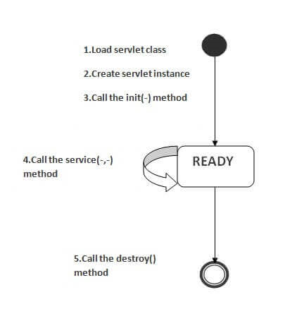

Slide 25
1) Servlet class is loaded
The classloader is responsible to load the servlet class. The servlet class is loaded when the first request for the servlet is received by the web container.
2) Servlet instance is created
The web container creates the instance of a servlet after loading the servlet class. The servlet instance is created only once in the servlet life cycle.
Play Videox
3) init method is invoked
The web container calls the init method only once after creating the servlet instance. The init method is used to initialize the servlet. It is the life cycle method of the javax.servlet.Servlet interface. Syntax of the init method is given below:
public void init(ServletConfig config) throws ServletException

Slide 26
4) service method is invoked
The web container calls the service method each time when request for the servlet is received.
If servlet is not initialized, it follows the first three steps as described above then calls the service method.
If servlet is initialized, it calls the service method. Notice that servlet is initialized only once.
The syntax of the service method of the Servlet interface is given below:
public void service(ServletRequest request, ServletResponse respo
throws ServletException, IOException

Slide 27
5) destroy method is invoked
The web container calls the destroy method before removing the servlet instance from the service.
It gives the servlet an opportunity to clean up any resource for example memory, thread etc.
The syntax of the destroy method of the Servlet interface is given below:
public void destroy()

Slide 28
GET and POST
Two common methods for the request-response between a server and client are:
GET- It requests the data from a specified resource
POST- It submits the processed data to a specified resource

Slide 29
FORM GET AND POST ACTIONS
GET method type and doGet() method
The doGet() method in servlets is used to process the HTTP GET requests. So, basically, the HTTP GET method should be used to get the data from the server to the browser. Although in some requests, the GET method is used to send data from the browser to the server also.
The data that is being submitted to the server will be visible in the URL using query parameters like this “http://localhost:8080/HelloServlet/hello?myParam=myValue”.
So, if you are sending any sensitive information like passwords, you should not use the GET method as the data entered can be clearly visible in the browser URL.

Slide 30
FORM GET AND POST ACTIONS
POST method type and doPost() method
The doPost() method in servlets is used to process the HTTP POST requests.
It is used to submit the data from the browser to the server for processing.
The data submitted with POST method type is sent in the message body so it is secure and cannot be seen in the URL.
HTML fields data such as Text field, Checkbox, Radio button, Dropdown, etc., values in the servlet.

Slide 31
Get vs. Post
GET | POST
1) In case of Get request, only limited amount of data can be sent because data is sent in header. | In case of post request, large amount of data can be sent because data is sent in body.
2) Get request is not secured because data is exposed in URL bar. | Post request is secured because data is not exposed in URL bar.
3) Get request can be bookmarked. | Post request cannot be bookmarked.
4) Get request is idempotent . It means second request will be ignored until response of first request is delivered | Post request is non-idempotent.
5) Get request is more efficient and used more than Post. | Post request is less efficient and used less than get.

Slide 32
Session Tracking in Servlets
Session simply means a particular interval of time.
Session Tracking is a way to maintain state (data) of an user. It is also known as session management in servlet.
Http protocol is a stateless so we need to maintain state using session tracking techniques.
Each time user requests to the server, server treats the request as the new request.
So we need to maintain the state of an user to recognize to particular user.

Slide 33
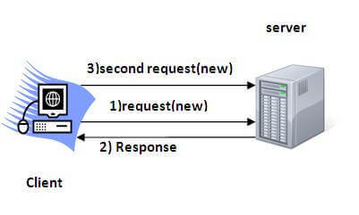
Session Tracking in Servlets

Slide 34
Session Tracking Techniques
There are four techniques used in Session tracking:
Hidden Form Field
URL Rewriting
HttpSession
Cookies

Slide 35
1) Hidden Form Field
Hidden Form Field
In case of Hidden Form Field a hidden (invisible) textfield is used for maintaining the state of an user.
In such case, we store the information in the hidden field and get it from another servlet.
This approach is better if we have to submit form in all the pages and we don't want to depend on the browser.
Let's see the code to store value in hidden field.
<input type="hidden" name="uname" value="Vimal Jaiswal"> Here, uname is the hidden field name and Vimal Jaiswal is the hidden field value.

Slide 36
Real application of hidden form field
It is widely used in comment form of a website.
In such case, we store page id or page name in the hidden field so that each page can be uniquely identified.
Advantage of Hidden Form Field
It will always work whether cookie is disabled or not.
Disadvantage of Hidden Form Field:
It is maintained at server side.
Extra form submission is required on each pages.
Only textual information can be used.

Slide 37
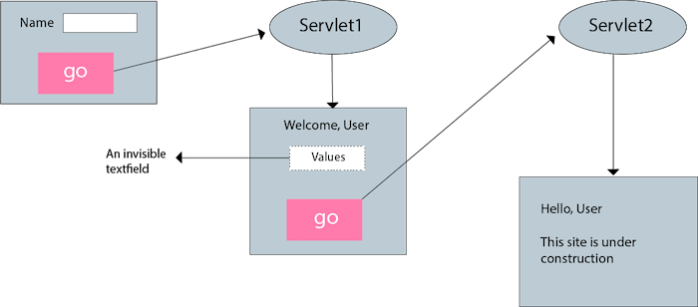
Example of using Hidden Form Field

Slide 38
2)URL Rewriting
In URL rewriting, we append a token or identifier to the URL of the next Servlet or the next resource.
We can send parameter name/value pairs using the following format:
url?name1=value1&name2=value2&??
A name and a value is separated using an equal = sign, a parameter name/value pair is separated from another parameter using the ampersand(&).
When the user clicks the hyperlink, the parameter name/value pairs will be passed to the server.
From a Servlet, we can use getParameter() method to obtain a parameter value.

Slide 39
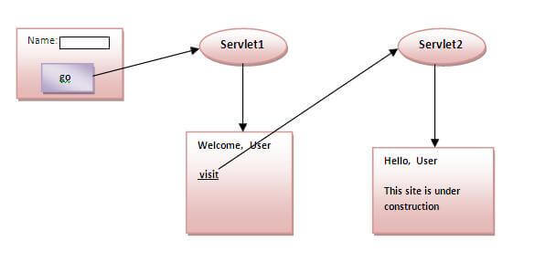
2)URL Rewriting

Slide 40
2)URL Rewriting
Advantage of URL Rewriting
It will always work whether cookie is disabled or not (browser independent).
Extra form submission is not required on each pages.
Disadvantage of URL Rewriting
It will work only with links.
It can send Only textual information.

Slide 41
3) HttpSession interface
In such case, container creates a session id for each user.
The container uses this id to identify the particular user.
An object of HttpSession can be used to perform two tasks:
bind objects
view and manipulate information about a session, such as the session identifier, creation time, and last accessed time.

Slide 42
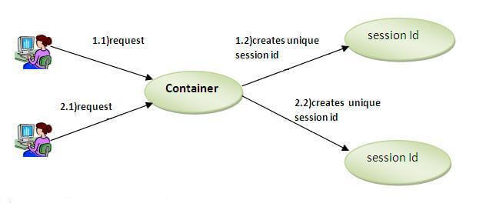
3) HttpSession interface

Slide 43
How to get the HttpSession object ?
The HttpServletRequest interface provides two methods to get the object of HttpSession:
1. public HttpSession getSession():
Returns the current session associated with this request, or if the request does not have a session, creates one.
2. public HttpSession getSession (boolean create):
Returns the current HttpSession associated with this request or, if there is no current session and create is true, returns a new session.

Slide 44
Commonly used methods of HttpSession interface
public String getId():Returns a string containing the unique identifier value.
public long getCreationTime():Returns the time when this session was created, measured in milliseconds since midnight January 1, 1970 GMT.
public long getLastAccessedTime():Returns the last time the client sent a request associated with this session, as the number of milliseconds since midnight January 1, 1970 GMT.
public void invalidate():Invalidates this session then unbinds any objects bound to it.

Slide 45
4 Cookies in Servlet
A cookie is a small piece of information that is persisted between the multiple client requests.
A cookie has a name, a single value, and optional attributes such as a comment, path and domain qualifiers, a maximum age, and a version number.

Slide 46
How Cookie works
By default, each request is considered as a new request.
In cookies technique, we add cookie with response from the servlet. So cookie is stored in the cache of the browser.
After that if request is sent by the user, cookie is added with request by default. Thus, we recognize the user as the old user.

Slide 47
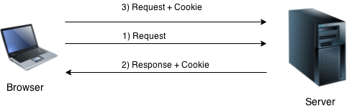

Slide 48
Types of Cookie
There are 2 types of cookies in servlets.
Non-persistent cookie
Persistent cookie
Non-persistent cookie
It is valid for single session only. It is removed each time when user closes the browser.
Persistent cookie
It is valid for multiple session . It is not removed each time when user closes the browser. It is removed only if user logout or signout.

Slide 49
Advantage of Cookies
Simplest technique of maintaining the state.
Cookies are maintained at client side.
Disadvantage of Cookies
It will not work if cookie is disabled from the browser.
Only textual information can be set in Cookie object.

Slide 50
Apache Tomcat websever

Slide 51
Installing and Configuring Apache Tomcat websever

Slide 52
What is Tomcat?
It is an open-source Java servlet container that implements many Java Enterprise Specs such as the Websites API, Java-Server Pages and last but not least, the Java Servlet.
We can use it to host code based on Java.
Apache tomcat server can be used to handle both static and dynamic pages.
Pages generated using HTML are static pages, and the pages generated using Servlet and JSP are dynamic pages.
It is not more configurable and robust.
When it comes to serving static content, Speed is slower.

Slide 53
What is Tomcat?
The complete name of Tomcat is "Apache Tomcat" it was developed in an open, participatory environment and released in 1998 for the very first time.
It began as the reference implementation for the very first Java-Server Pages and the Java Servlet API.
However, it no longer works as the reference implementation for both of these technologies, but it is considered as the first choice among the users even after that.

Slide 54
what exactly is Apache tomcat?
If you are a little familiar with the websites or have some basic knowledge about the websites, you must have heard about the HTTP protocol or may also know what actually are they.
If you want to provide any web-services such as you want to provide a simple static content possibly by using HTML (or Hypertext Markup Language), or maybe you just want to send data from a server to point you, so you necessarily need a server and that server is HTTP (HyperText transfer protocol).
So, as we all know that if anyone wants to make a simple, static website, he definitely requires an HTTP

Slide 55
What exactly is Apache tomcat?
Server, but if he wants to make website dynamic, he has to use servlet. We use the HTTP server if we want to send simple data.
If we want to send dynamic data or to make our website dynamic, we need to use the servlet.
Hence, we need an HTTP server and what else we need is a container where we will run or servlet, so when we combine the HTTP
Server and the servlet (or we can say servlet container), they both combine to become a single server know as tomcat server.

Slide 56
Steps to download and install the Tomcat on Windows 10 operating system
There are many versions of the Tomcat available with different features on its website.
You can choose the version according to your requirements, but we suggest you download the latest stable version.

Slide 57
Step 1.
Open the Google Chrome or any of your web browser and type "download Tomcat for windows" in the search box. You can also go directly on Tomcat's website by clicking on this https://tomcat.apache.org/download-90.cgi#9.0.38

Slide 58
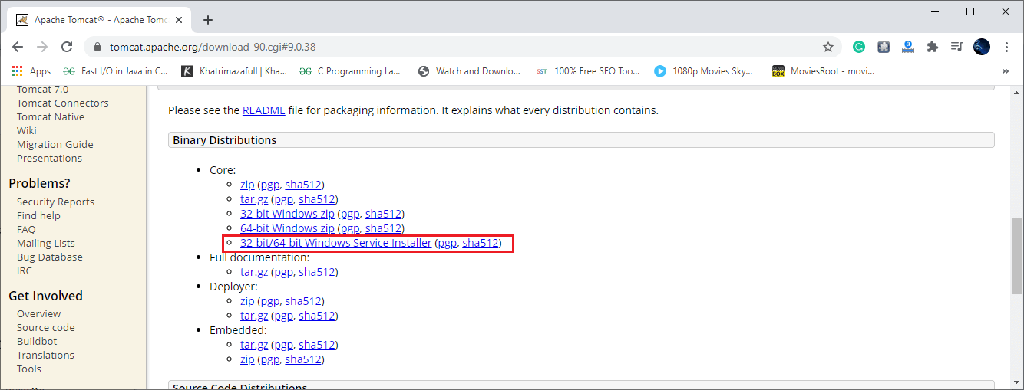
Now download any version of Tomcat you want:

Slide 59
Step 2.
Go to Download and click on the downloaded file and wait for little until the installation process starts.

Slide 60
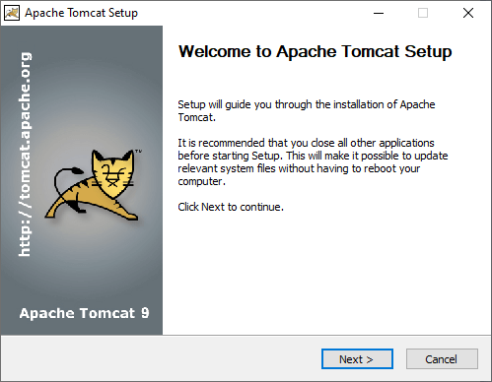
Step 3. Once the installation process gets started, click on the "Next" button, as shown below:

Slide 61
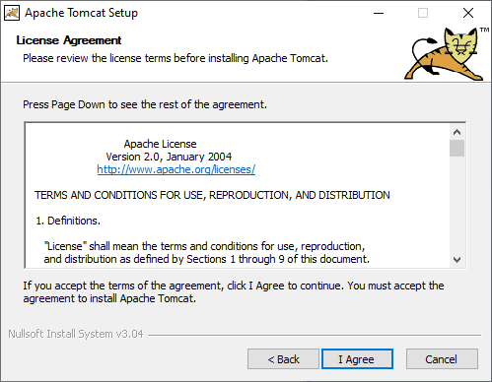
Step 4. Click on the button labeled as "I Agree."

Slide 62
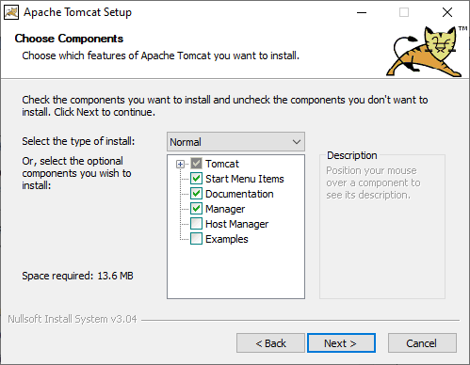
Step 5. Click on the "Next" button.

Slide 63
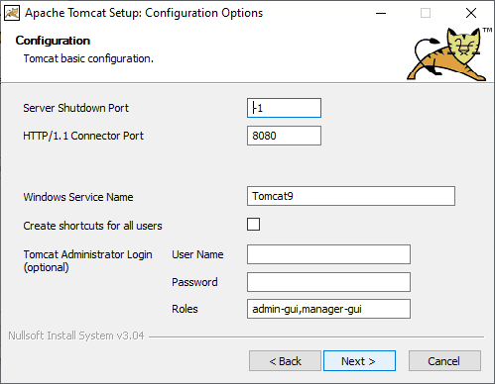
Step 6. Enter the user name and password and click on the " Next" button, as shown below:

Slide 64
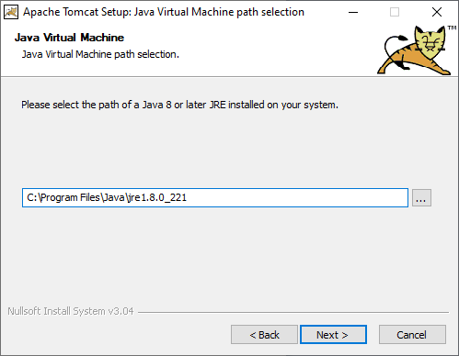
Step 7. Then click on the "Next" button again

Slide 65
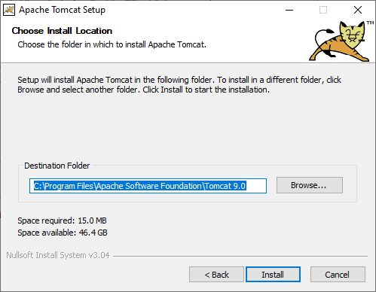
Step 8. Now click on the "Install" button.

Slide 66
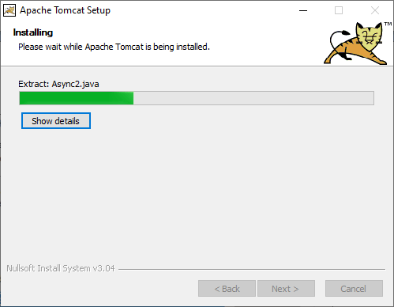
Wait for some time until the Tomcat gets installed.

Slide 67
Step 9.
Now click on the "Finish" button, here the installation of Tomcat is completed.
It may ask you to restart your system, so restart your system. Now you can start the Tomcat by clicking on its icon, and you can start and stop the server.

Slide 68
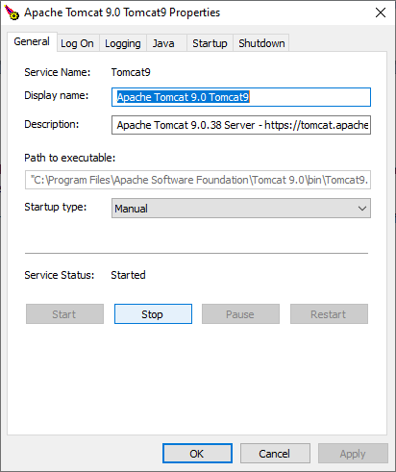

Slide 69
Advantages of Tomcat:
1. It is open-source It means anyone from anywhere can download, install, and use it free of cost, which makes it the first choice among the new developers and new users.
2. Incredibly Lightweight
It is actually a very light application, even with the JavaEE's certification.
However, it provides all necessary and standard functionalities required to operate a server, which means it gives very fast load and redeploys as compared to its various alternatives.

Slide 70
Advantages of Tomcat:
3. Highly flexible
Due to its built-in customization options, extensive and lightweight nature, it offers high flexibility, a user can run it in any fashion he wants, and it will still work as fine without any issues.
4. Stability
It is one of the most stable platforms available today to build on and using it to run our applications.

Slide 71
Advantages of Tomcat:
5. It is one of the most widely used application servers According to an estimation, it holds almost 60 percent of the market share almost all java application server deployments, which makes it one of the most popular application servers used for java web-based applications.
However, we cannot say that it implements all of the features required for a JavaEE application server; instead, it enables us to run Java EE application.
Tomcat acts as a "webserver" or "servlet container." However, there is a plethora of terminology for anything.

Slide 72
Advantages of Tomcat:
6. It is open-source It means anyone from anywhere can download, install, and use it free of cost, which makes it the first choice among the new developers and new users.
7. Incredibly Lightweight It is actually a very light application, even with the JavaEE's certification. However, it provides all necessary and standard functionalities required to operate a server, which means it gives very fast load and redeploys as compared to its various alternatives. Yes, it is right that it does not offer so many features in case you want a number of features, it might be good for you, but if you want to have an easy and fast means in order to run your application, it is the best option for you.

Slide 73
Advantages of Tomcat:
It's mature We take a look back in the past; we will find that it has existed for almost 20 years, which is quite a significant time, in which it gets mature over time passage.

Slide 74
Disadvantages of Tomcat
It is not as fast as the Apache if we are working with the static pages
It has some issues like a memory leak
It's way to handle the logs.
Issues in the SSL installations
Its user interface is inferior and basic.

Slide 75
Thank You

