Slide 1
Agile Process Models

Slide 2
Overview
Agile is a software development approach that emphasizes:
Iterative development
Customer collaboration
Quick delivery
Flexibility to change

Slide 3
Key Agile Models
Extreme Programming (XP)
Scrum
Kanban

Slide 4
Comparison: Agile vs. Traditional
Feature | Agile | Traditional (Waterfall)
Flexibility | High | Low
Planning | Iterative | Upfront
Testing | Continuous | After implementation
Customer Involvement | High | Low
Risk Management | Early detection | Late in process

Slide 5
Extreme Programming (XP) Process Model
An Agile Software Development Methodology

Slide 6
What is Extreme Programming (XP)?
XP is an Agile development model focusing on technical excellence and adaptability.
Frequent releases in short cycles
Improves productivity and introduces checkpoints
Customer involvement is continuous
Automated tests and feedback loops

Slide 7
Core XP Process Phases
Planning – Define user stories, estimate effort
Designing – Simple and evolutionary designs
Coding – Pair programming, frequent integration
Testing – Automated unit testing, customer tests
Listening – Continuous feedback and adaptation

Slide 8
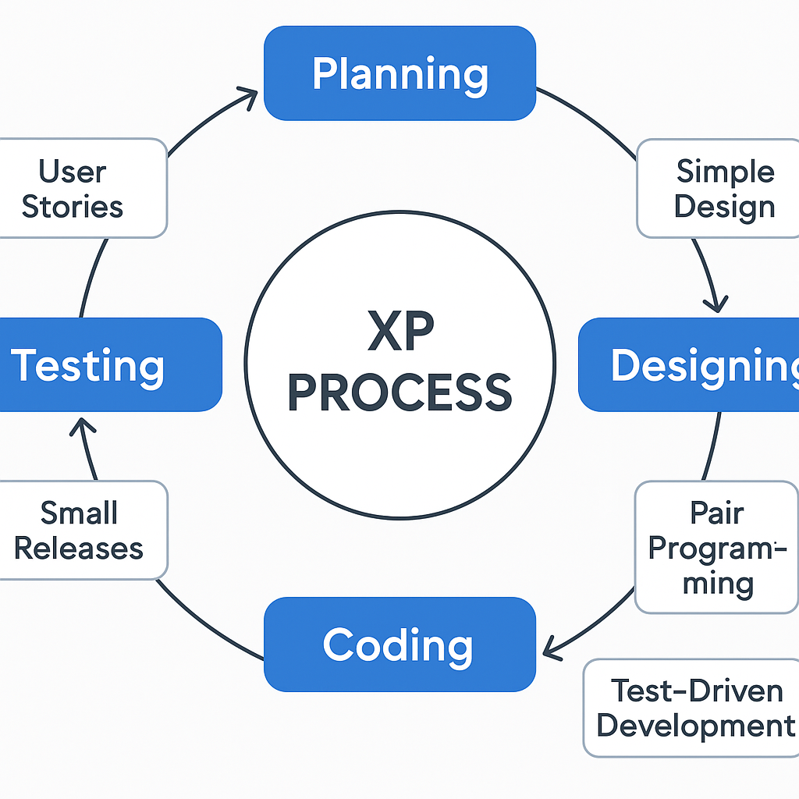
XP Workflow

Slide 9
Scrum Process Model
An Agile Framework for Software Development

Slide 10
What is Scrum?
Scrum is an Agile framework that uses short iterations (Sprints) for product development.
Emphasizes collaboration, accountability, and iterative progress
Each Sprint typically lasts 2-4 weeks
Daily stand-ups for communication
Continuous improvement through retrospectives

Slide 11
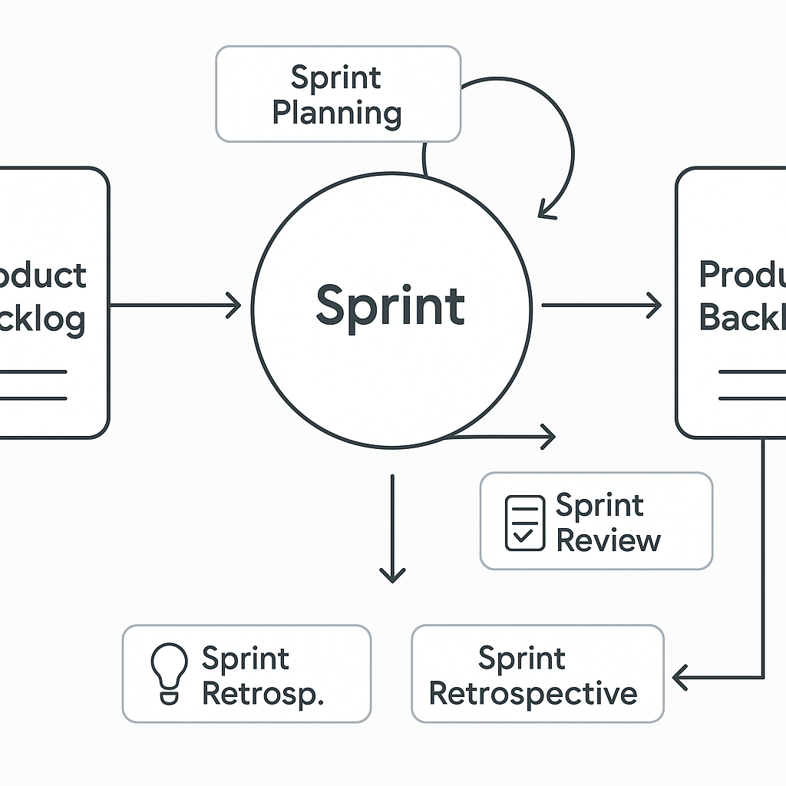
Scrum Workflow

Slide 12
Detailed Scrum Process Flow
Scrum follows a structured workflow divided into time-boxed iterations called Sprints.
1. Product Backlog: Product Owner maintains a prioritized list of features
2. Sprint Planning: Team selects backlog items to complete during the Sprint
3. Sprint: Typically 2–4 weeks, where the team develops and tests features
4. Daily Scrum: 15-minute stand-up meeting to synchronize team efforts
5. Sprint Review: Stakeholders review completed work and provide feedback
6. Sprint Retrospective: Team reflects on the Sprint and plans improvements

Slide 13
Advantages of Scrum
Increased transparency and collaboration
Early and continuous delivery of valuable software
Rapid feedback helps in quick changes
Improves team communication and accountability
Customer involvement ensures better alignment with needs
Focus on continuous improvement

Slide 14
Challenges in Scrum
Requires experienced and self-organized team
Scope creep due to changing requirements
Difficult to scale in large or distributed teams
Needs full commitment from all stakeholders
Scrum roles may be misunderstood or misused

Slide 15
Kanban Software Process
A Visual Agile Method for Managing Work

Slide 16
What is Kanban?
Kanban is an Agile method focused on visualizing work and optimizing flow.
Developed from Lean Manufacturing principles
Uses Kanban boards to manage work items
Emphasizes continuous delivery without overburdening the team
Work in Progress (WIP) limits help identify bottlenecks

Slide 17
Key Principles of Kanban
Visualize the workflow
Limit Work in Progress (WIP)
Manage flow
Make process policies explicit
Implement feedback loops
Improve collaboratively and evolve experimentally

Slide 18
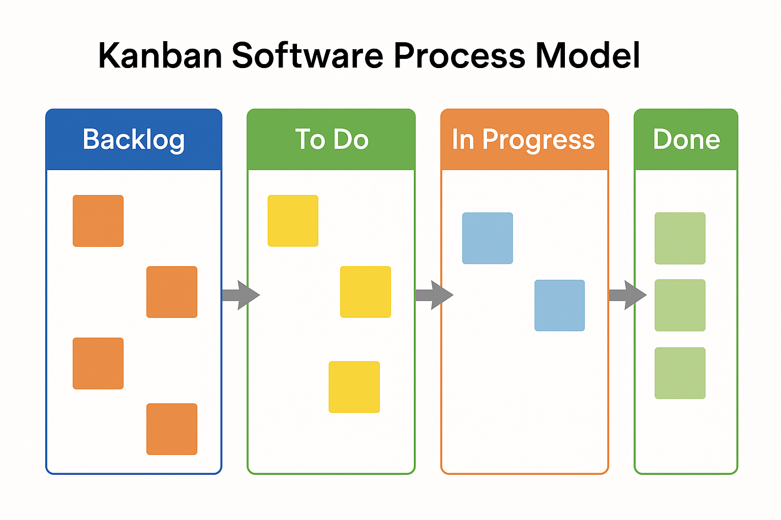

Slide 19
Advantages of Kanban
Increased visibility of work
Improved flow and reduced cycle time
Flexibility to handle changing priorities
Better team communication
Helps identify and remove bottlenecks

Slide 20
Challenges of Kanban
Requires discipline to manage WIP limits
May lack structure for teams needing strict roles
Can become complex without regular monitoring
Less suited for projects with strict deadlines

