Slide 1
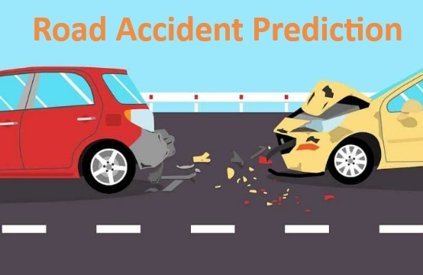
Road Accident Prediction Zone
by
Random Forest Machine Learning Model (Python)

Slide 2
Proposed Model
Dataset
Pre-Processing
Pre-processing
Cleaning
Feature Optimization
Machine Learning
Random Forest Model
Feature Engineering
Training Vector
Testing Vector
Random Forest Learning

