Slide 1

Focus on
innovation.
We take care of the rest.
proto, our AI engineer, plans every step.
baker makes the board. mixer tests it.
protopus-kappa.vercel.app
Notes:
Proto now leads the line: the AI engineer is the company; Baker and Mixer are the machines it works through (Prateek, round 1).

Slide 2
01 · EXECUTIVE SUMMARY
A prototyping lab and a full test bench,
on one desk, run by an AI engineer
MORNING
MIDDAY
AFTERNOON
EVENING
You describe it
Baker builds it
Mixer tests it
You try again
Proto reads the design, checks it and points at what will bite later.
Milled, masked, stencilled and pasted. You drop parts into a printed jig; Baker reflows.
One cable, eight instruments, and a verdict Proto writes in plain words.
The next attempt starts the same evening, not two weeks from now.
WHAT MAKES
IT OURS
Making and testing on one desk, with Proto guiding every step instead of a hundred buttons.
Built for prototypes: the first 1–10 boards of a design. Volume goes to a fab, with files that already worked.
Notes:
Two wording changes from round 1: not 'a small electronics factory' (we are for prototypes), and placement is honest: you drop parts into a printed jig. Baker's own cycle is about two hours, so morning → evening holds.

Slide 3
02 · PROBLEM
A prototype is a loop,
and every lap costs weeks
design
2
weeks waiting for a board to come back from a fabrication house
order
bug found
5
AND AGAIN
instruments to buy before you can even measure it
×3, ×4, ×5
wait 2 weeks
5
test
vendor apps and driver stacks to learn and keep alive
solder by hand
In my department a board ordered in week one gets measured in week four. Nobody is short of ideas. They are short of tries.
WHY NOW · compute is cheap enough for machines to carry the fidelity. People should carry the innovation.

Slide 4
03 · WHY NOW
AI can already build the software.
Hardware is where it gets stuck.
SOFTWARE HAS A CLOSED LOOP
AI ALREADY DRAWS HARDWARE
…AND STOPS AT THE FILE
$100M ARR
Flux
No model can make the board, power it, or see whether it works. The loop breaks at the bench, and a person carries it for two weeks.
$49M raised · 1M+ users
Quilter
Lovable, 8 months after launch, selling to people who can't code. The model writes the code, runs it, reads the error and fixes it.
$40M raised · AI layout
Diode
$11.4M Series A · a16z
Claude ↔ Fusion, Blender
official connectors, 2026
idea
files
board
test
verdict
Smart machines + smart accessories = the AI's access to the real world.
AI works here today
protopus gives the AI hands and eyes here
TechCrunch 23 Jul 2025 · SiliconANGLE 27 Feb 2026 · BusinessWire 7 Oct 2025 · Fenwick · claude.com/connectors · digitalproduction.com 30 Apr 2026
Notes:
The AI part is proven: about $100M has gone into AI that produces hardware files. All of it stops at the file. Protopus builds the machines and accessories that let a model make, measure and learn.

Slide 5
04 · WHO WE UNLOCK
Every rung of hardware knowledge
loses people. Proto removes rungs.
RUNG
YOU USED TO NEED
WHO CARRIES IT NOW
01
idea → spec
What exactly should it do?
Proto asks, then writes it
HOW PEOPLE LEARN
By doing: try, look, adjust (Kolb's cycle). The speed of feedback sets the speed of learning.
02
parts
Datasheets, stock, footprints
Proto picks in-stock parts
03
schematic
Circuit theory, references
Flux + Proto check it
04
layout
An EDA tool, DRC
Proto fixes it (Baker Studio)
2 weeks
05
fabrication
Vendors, customs, 7–20 days
Baker, same day
per try: beginners quit, experts batch changes
06
assembly
SMD soldering, stencil, reflow
Baker + printed jig
same evening
07
bring-up
Scope, logic analyser, firmware
Mixer measures
per try: a student gets many more attempts in one semester
08
debug
Root cause, next revision
Proto explains the fix
Every rung we take away brings in a new crowd: students, designers, domain experts. Lovable showed what happens when the coding rung disappears.

Slide 6
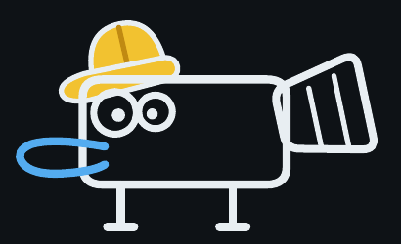
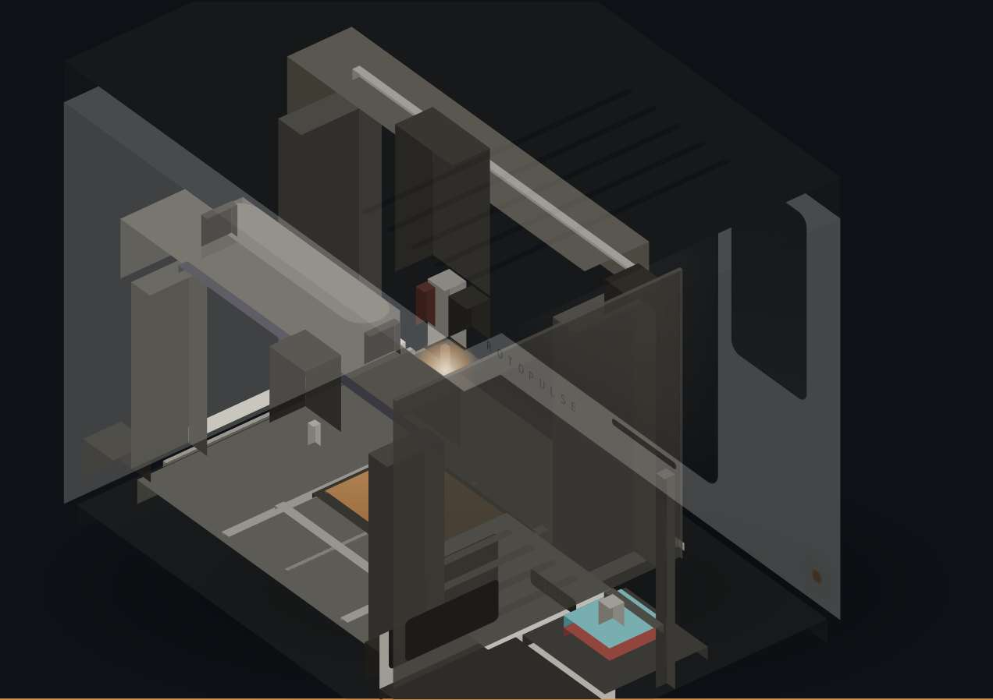
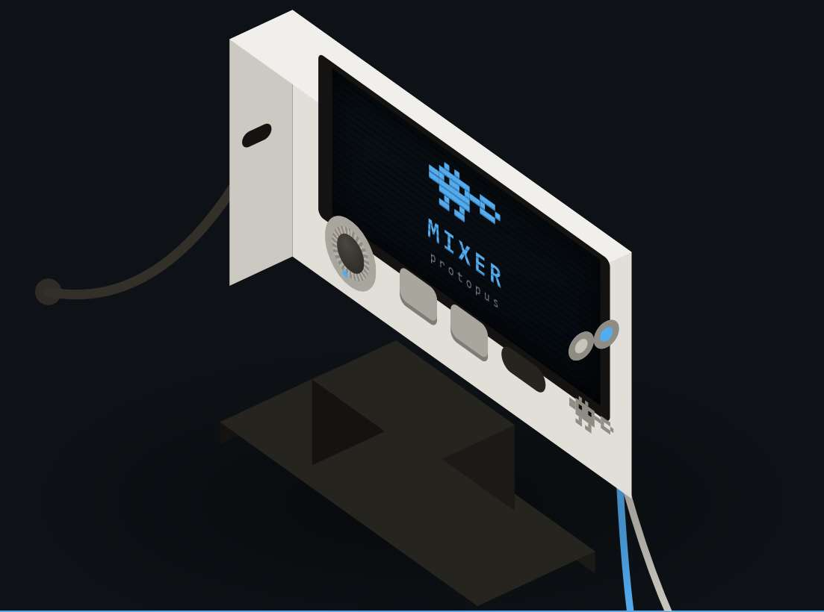
05 · SOLUTION
One AI engineer, and the two smart machines it runs
proto
baker
mixer
A platypus AI engineer inside both machines.
Makes the board, ready for parts.
Tests the board in real life.
Reads the design · plans the job · flags mistakes · explains results
Mill · drill · mask · laser stencil · paste · guided placement · reflow
Eight instruments behind one cable
VISION · a bridge between idea and innovation for anyone who wants to bring theirs to the world.
Website walk-through · protopus-kappa.vercel.app
Video · raw Baker prototype running
DEMO 1
DEMO 2
Notes:
Proto first. Baker now reads 'guided placement', not 'pick and place': the operator drops parts into a printed jig, which is what the prototype does.

Slide 7
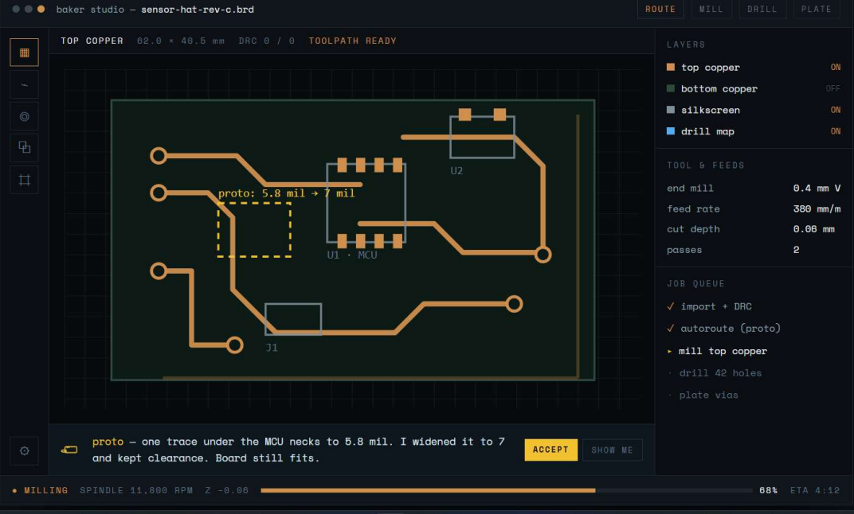
06 · WHAT MAKES IT OURS
Proto: an AI engineer that understands your board
01
READS THE BOARD
Understands schematics and layouts. Pulls designs in through the Flux.ai API.
02
MAKES IT
Generates the Gerbers and the Baker job: mill, drill, mask, stencil, placement.
03
DIAGNOSES IT
Tests through Mixer, understands the waveforms and says in plain words what is wrong.
PROTOPUS Baker Studio
04
HAS A CHARACTER
A platypus engineer with a personality developed through Gemini.
Proto has already found the thin trace, fixed it and planned the mill. You press Accept.
Probe matrix accessory
COMING NEXT
A grid of probes under the board gives Proto full access to every net on the PCB: it can measure anything, not just what you clip.
Simple enough that a high-school student can print a board.

Slide 8
07 · PROTO · HOW THE AI WORKS
Proto is a loop, not a chatbot: understand,
plan, check, make, measure, explain
YOU GIVE IT
UNDERSTAND
PLAN
CHECK
MAKE
an idea in words
Parses netlist, footprints, stack-up into a board model
LLM planner turns the goal into steps; asks when unsure
DRC + Baker rules: trace, clearance, aperture, drill
CAM engine: toolpaths, mask image, stencil, jig → Baker job
a sketch or photo
Flux / KiCad files
next attempt
a Gerber set
YOU GET
EXPLAIN
MEASURE
APPROVE
a tested board and a sentence: what passed, what failed, where to look
Compares measured vs expected; writes the verdict and the fix
Mixer runs the test plan: rails, currents, waveforms, buses
You press Accept. Nothing is cut, lasered or powered before
“why is this hot?”
MEMORY
Every run is logged: design → process settings → measurements → outcome. The next board, and every other Baker, learns from it. No files-only AI tool can collect this data: it is the moat.
Model-agnostic: the character runs on Gemini today; the planner calls any frontier model through an API. Machine control stays local and works offline.
Notes:
How the AI actually works. The language model understands, plans and explains. Precise work (DRC maths, toolpaths, G-code, pass/fail limits) is done by deterministic engines Proto calls as tools. A person approves before anything physical happens. Every run feeds a memory that no files-only AI can build.

Slide 9
08 · PROTO · ONE RUN, STEP BY STEP
What happens between “import” and “PASS”
baker studio — sensor-hat-rev-c.brd · 62.0 × 40.5 mm
WHAT PROTO CALLED
10:02
you
import sensor-hat-rev-c from Flux
Flux.ai API
design in
10:02
proto
DRC 0/0. Baker rules: one trace under the MCU necks to 5.8 mil.
DRC + Baker rules
10:03
proto
widened it to 7 mil and kept clearance. Board still fits. [Accept]
found 5.8 mil
10:03
proto
job: isolation mill, 0.4 mm V, 2 passes · drill 42 holes · mask · stencil · jig
CAM engine
10:04
baker
steps 01–12 running · placement jig printing in parallel
toolpaths, mask, stencil, jig
Klipper / Moonraker
11:40
you
drop parts into the jig pockets · vacuum pen
ran Baker
11:52
baker
reflow, Sn42Bi58 low-temperature profile
Test-plan builder
12:05
mixer
T2 power up: current limit set · idle current in range ✓
from the netlist
12:06
mixer
T3 rails: 3V3 within limit ✓
Mixer driver
supplies, DMM, logic
12:07
mixer
T6 I²C scan: no ACK from the sensor ✗
Language model
12:08
proto
“SDA has no pull-up. R4 is lifted on one pad. Reheat R4 and retest.”
the plain-words verdict
12:15
mixer
retest: sensor ACKs, reading plausible ✓ PASS
Illustrative run on the board shown in Baker Studio. Times are the engineering targets (≈2 h Baker cycle, ≈15–20 min hands-on); the proof of concept measures them.
Notes:
A concrete run, from import to PASS. Proto calls tools; it doesn't improvise G-code. The diagnosis is where the language model shines: it links a missing I²C ACK to a lifted pull-up resistor and says what to do.

Slide 10
09 · PROTO · GUARDRAILS AND ROADMAP
Where the AI is, and where it isn't
THE MODEL DOES
THE ENGINES DO
YOU DO
— understands what you want
— DRC maths and Baker process rules
— describe the idea
— reads the design and datasheets
— toolpaths, G-code, mask and stencil images
— press Accept before anything physical
— plans the job and asks questions
— jig geometry and placement map
— drop parts into the jig
— drafts the test plan
— test limits and pass/fail
— decide on the fix
— explains results and proposes the fix
— current limits on every supply
— own the design and the IP
— has a character (Gemini)
— interlocks: door, E-stop, laser cut-off
The model never drives a motor directly. It proposes; tested engines compute; you approve; the machine executes.
V0 · TODAY
V1 · PROOF OF CONCEPT
V2 · AFTER SEED
V3 · FLEET
Baker Studio: DRC fix + mill planning, with Proto inside
Full Baker job + Mixer test plan + plain-words verdict
Idea → design via Flux/KiCad; enclosures via Fusion/Blender; 3D printer
Learns from every Baker's run data; probe matrix sees every net
Notes:
This slide answers 'is the AI safe near a spindle and a Class 4 laser?' and 'what is real today?'. V0 is running in Baker Studio; V1 is what the ₹16 lakh proves.

Slide 11
10 · BAKER · AT A GLANCE
Fifteen steps on one shuttle, in one box
BAKER ENCLOSURE · T-slot frame · acrylic · 450 nm laser-safe window · door interlocks · E-stop
PLACE + REFLOW
MIXER
Kapton stencil film roll · 4 electromagnet clamp · solenoid cut-off
steps 13–14
printed jig on
the same pins
vacuum pen
300 W hotplate
Sn42Bi58, 138 °C
step 15
one cable
8 instruments
Proto reads
the results
FR4
mag
azine
ZONE A · cross axis + Z
ZONE B · cross axis + Z
Spindle 500 W ER11
touch probe · V-bit · drills
Laser 10 W 445 nm
fixed offset · air assist
vacuum dust extraction
Mask: syringe LPSM
UV: 10.1" 12K LCD, 405 nm
Wipe: Na₂CO₃ + air knife
paste squeegee rides here too
resin printer, in parallel: prints the TR300 jig during steps 01–12
⟷ SHUTTLE = long X axis · ball screw + NEMA23 · FR4 on 2 registration pins · runs under both zones
steps 01–12 happen in one coordinate frame
15
1
100×160
8
steps, blank FR4 → tested board
shuttle, one coordinate frame
mm board in the workflow
instruments on Mixer
Notes:
The whole machine on one slide, from the workflow story. The shuttle never lifts or re-registers the board between cutting, masking and stencilling: that is the process IP.

Slide 12
11 · BAKER · THE STORY OF ONE BOARD
From a plain sheet to a board ready for Mixer
STEPS 01 · 05
STEPS 02–04
STEPS 06–09
It starts as a plain sheet
Zone A reads the board, then cuts it
Zone B finishes the copper
FR4 drops from the magazine onto two registration pins. One coordinate frame from here to placement.
A touch probe maps height on a grid, so the 0.1 mm V-bit cuts the same few microns everywhere. Same spindle drills; vacuum pulls the dust.
Liquid mask, a 10.1" LCD cures all but the pads, a dilute Na₂CO₃ wipe lifts the pads clean, air knife, flood cure. No tank, no bath.
cast · FR4 blanks · dowel pins · ball-screw shuttle + NEMA23
cast · pogo probe · 500 W ER11 · 20° V-bits · 0.3–1.2 mm drills
cast · syringe LPSM · 12K mono LCD · 405 nm UV · peristaltic pump
STEPS 10–12
STEPS 13
STEPS 14 → 15
The stencil fits this exact board
The jig does the aiming
Reflow at low temperature
The laser cuts pad openings in film above the board, from the same Gerber in the same frame. Magnets clamp, squeegee pastes, film is cut away.
While 01–12 ran, the resin printer made a jig with one pocket per part. You drop each part in with the foot-pedal vacuum pen.
The jig lifts off; the hotplate runs a Sn42Bi58 profile (138 °C), below the resin's limit, with less warp. Then Mixer tests it.
cast · 10 W 445 nm laser · Kapton roll · 4 × 8 kg magnets · 25 N solenoid
cast · TR300 resin (160 °C) · vacuum pump + NC valve · foot pedal
cast · 300 W silicone pad · SSR-25DA · MAX31855 + K-type
Source: PROTOPUS Baker + Mixer workflow, “The story of a PCB” (29 Sep 2026).

Slide 13
12 · BAKER · TECH STACK, PROTOTYPE → PRODUCTION
Same story, cheaper parts: ₹3,73,418 → ₹1,44,842
FUNCTION | PROTOTYPE (INDIA, 1 UNIT) | PRODUCTION (CHINA PARTS, 100) | WHY
Axes | Finished ball-screw linear stages | SFU1605 ball screws + HGR15 rails built in | ≈₹5,500 per axis vs ₹16,500
Z axes | 100 mm SFU1605 stage + NEMA17 ×2 | T8 screw + linear guide | Spindle/laser Z and dispense Z
Control | Raspberry Pi 5 + BTT Octopus Pro + DM556 | BTT Manta M8P V2 + CB1 (8 × TMC2209) | One board, 8 drivers, ≈₹10,800
Power | 24 V + 48 V + 12 V supplies | One LRS-350-24 rail (spindle keeps its own) | Fewer supplies, simpler wiring
Spindle + laser | 500 W ER11 kit · 10 W 445 nm diode (retail) | Volume-sourced; quotes at 100 units | Where the turnkey case is won or lost
Mask + UV | Syringe LPSM · 10.1" 12K LCD · ChiTu L K1 · 405 nm | Same engine | The LCD also prints jigs in production
Placement jig | Separate Saturn 3 Ultra + wash/cure | Small resin vat + lift under Baker's own UV screen | Removes the printer (to test)
Frame | T-slot extrusion + acrylic | Sheet-metal frame + acrylic panels | Repeatable fabrication
Firmware | Klipper + Moonraker + Proto job runner | Locked factory image; activation stays with us | IP by architecture
Unit cost | ₹3,73,418 (incl. 35% duty/courier, 15% contingency) | ₹1,44,842 (incl. duty, freight, Delhi assembly) | Deck target ₹1,50,000
Sources: PROTOPUS Cost Report (29 Sep 2026, 81 of 96 lines from live listings, USD at ₹88) · workflow story, chapter 6.

Slide 14
13 · MIXER · AT A GLANCE
Eight instruments, one cable, one brain
2 × scope in · BNC
analog front end
AD8066 FET buffers · relay ranges
ADC ×2
AD9226 12-bit 65 MS/s
FPGA
Tang Primer 20K
capture + trigger
waveform synthesis
pattern gen
logic sampling
INSTRUMENT | PROTOTYPE SPEC
Oscilloscope | 2 ch · 12-bit · 65 MS/s
Waveform generator | 2 ch · 14-bit
Logic analyser | 16 ch
Pattern generator | digital stimulus
Protocol decoder | I²C · SPI · serial
Supply 1 + 2 | set-point + current readback
Multimeter | 24-bit
wavegen out · 2-ch
DAC 2-ch
AN9767 14-bit 125 MS/s
16 logic lines
level shifters
74LVC245 ×2
DMM leads
24-bit multimeter
ADS1256 + REF5025
HOST
Raspberry Pi 5
runs Proto
2 × supply out
2 programmable supplies
MCP4728 → XL6009 ×2 · INA226
→ Proto compares every reading with what the design expects and writes the verdict in plain words
Status: architecture and BOM defined (₹74,847 prototype); first build in the proof of concept.
Analog Discovery 3 class. The prototype keeps 12/14-bit converters so the front end can be tuned first.
Source: workflow story, chapter 4 (signal path drawn from the Mixer BOM).

Slide 15
14 · MIXER · HOW A TEST RUNS
T1 to T8, in the order a careful engineer would work
T1
Connect
T2
Power up safely
T3
Check the rails
T4
Drive the inputs
One cable; probes on the test points the design calls for
Supplies set; INA226 watches current, so a bridge is a spike, not a burnt part
24-bit meter reads each rail and reference
Generator + pattern generator push known signals
T5
Watch the outputs
T6
Read the buses
T7
Verdict
T8
Loop
Scope for analog, 16-ch logic for digital
Decoder turns captures into I²C/SPI/serial traffic
Proto writes what passed, what failed, where to look
The fix goes into the design; next board the same evening
FUNCTION | PROTOTYPE | PRODUCTION | WHY
Capture | AD9226 12-bit 65 MS/s ×2 | AD9288 dual 8-bit 80 MS/s | cost
Generation | AN9767 dual 14-bit | DAC908 8-bit 165 MS/s ×2 | cost
FPGA | Tang Primer 20K Dock | Tang Nano 9K (GW1NR-9 + 64 Mb PSRAM) | smaller, cheaper
Host | Pi 5 + 7" screen | FT232HL USB 2.0 HS, no screen | one USB cable
Unit cost | ₹74,847 | ₹13,740 | target ₹15,000
ALSO OUR PRODUCTION TESTER
A golden Mixer + our test app tests every Mixer, and every Baker module, on the China line. The factory runs it; we own the limits, software and data.

Slide 16
15 · TIME PER LOOP, TOLD HONESTLY
About two hours on Baker; 15–20 minutes of it yours
81–141 min
15–20 min
per board, end to end
hands-on: load, place, hook up
 | USUAL LOOP | BAKER + MIXER
Fabrication | outside fab, shipped | steps 01–12, on the bench
Stencil | ordered, aligned by hand | cut in place, same frame
Placement | tweezers or a service | printed jig + vacuum pen
Test | scope, supply, DMM, LA | Mixer: one cable
Diagnosis | engineer reads raw traces | Proto, in plain words
Next attempt | about two weeks later | the same evening
Engineering targets for a 100 × 160 mm board with ~40 parts; the jig prints in parallel. 3–5 boards per 8-hour shift. The proof of concept measures the real numbers.
Notes:
Replaces 'send the design at night, pick it up in the morning' (Prateek: too aggressive). You load boards and place parts; we say so and give the minutes.

Slide 17
16 · A NEW CATEGORY
Between the DIY bench and
industrial manufacturing
DIY bench
protopus
industrial
breadboards, hand etching, borrowed scopes
proto + baker + mixer
fab house, assembly house, bench
TIME PER LOOP
1–3 days
Same day (≈2 h on Baker)
1–3 weeks + customs
EXPERTISE
A seasoned engineer
Proto guides you
Expert to design and test
ASSEMBLED
By hand, if you can
Baker pastes + reflows; you drop parts into a jig
Yes, at extra cost
TESTED
Only if you own a bench
Yes, by Mixer
Separate ₹ lakhs of instruments
BEST FOR
one-off hacks
the first 1–10 boards of a design
100+ identical boards
The DIY bench needs an expert. The factory needs time and money. Most ideas have neither.

Slide 18
17 · COMPETITION
Others solve one step.
Nobody closes the whole loop.
PRODUCT
PRICE · ₹
MAKE
ASSEMBLE
TEST
GUIDE
Voltera V-One
~3.1 lakh
LPKF ProtoMat
8.6–24.5 lakh
Makera Carvera
~5.1 lakh
Bantam Tools mill · discontinued
~3.1 lakh
Neoden YY1 pick-and-place
<2.6 lakh
Digilent Analog Discovery 3
~33,000
JLCPCB, PCBWay
per order, weeks
Flux (AI design)
1.3–4.3k / month
protopus proto + baker + mixer
3.34 lakh
List prices at ₹88 per US$, before import duty. ASSEMBLE = paste + reflow or placement. Bantam Tools has stopped selling its PCB mill. Flux guides design and stops at the file.
voltera.io · Design World · Makera · ToolGuyd · EEVblog · Digilent · flux.ai
Notes:
Column PLACE became ASSEMBLE: we also place parts by hand, into a jig, so the old knock on Voltera no longer holds. Added Carvera, Neoden, Flux and Bantam's exit.

Slide 19
18 · BUILT FOR PROTOTYPES
Not a desktop mill, not a factory.
Where a fab wins, we say so.
BOARDS A YEAR → RIGHT TOOL
DESKTOP PCB MACHINES: A ROUGH HISTORY
10
baker
same-day loops beat fab minimums
Othermill → Bantam
PCB mill dropped; now sells art machines
100
baker
Voltera V-One
out of stock; moved up to NOVA ($45,974)
one machine covers a busy lab
BotFactory
Squink $3,199–4,499; SV2 now on request
1,000
2 bakers + a fab
any batch of 10+ identical boards → fab
Nano Dimension
sold its electronics unit, Apr 2026, $2M cash
10,000
fab / EMS
production; Proto exports checked files
WHY, AND OUR ANSWER
one step automated → the whole loop, mill to verdict
fought $2 boards on price → we sell hours per loop
a tool for experts → an outcome for non-experts
no software → Proto + run data are the moat
1,00,000
fab / EMS
not what Baker is for
One Baker: 3–5 boards per shift, 750–1,250 a year. We scale by the number of labs, not boards per machine.
Notes:
Prateek: don't pitch a desktop PCB mill, and 'will it scale to 1,000 / 10,000 / 1 lakh boards?'. Answer: it's a prototyping cell for iterations 1–10; volume goes to a fab.

Slide 20
19 · BUSINESS MODEL · PROJECTED
What we aim for: sell the machines, and
one Proto plan runs all of them
PROJECTED PER UNIT · ₹
BAKER
MIXER
PLANNED · ONE PROTO PLAN · EVERY MACHINE
Hardware (target)
1,50,000
15,000
₹9,999 / year
Assembly and QC
12,000
2,000
Packing and shipping
8,000
1,000
One subscription per workspace: Baker Studio, Mixer Station, Proto and every update.
Warranty reserve
7,500
750
Software share
10,000
2,000
Sales and support
12,500
1,750
Consumables
Projected total cost
2,00,000
22,500
Board blanks, mask, paste, film, jig resin and end mills: ≈₹334 of material per board, reordered as labs keep building.
Target selling price
2,99,000
34,999
Projected margin
~33%
~36%
Industrial variants, later
Costed model: Baker ₹1,44,842, Mixer ₹13,740 incl. assembly.
Bigger beds, multilayer and production test come after the base machines.
ROADMAP TO THESE NUMBERS
NOW
MONTHS 0–9 · THIS ASK
AFTER POC · SEED
100-UNIT BATCHES
Prototypes costed: Baker ₹3.73L, Mixer ₹74,847
₹16L proof of concept: Baker Rev B, 5 Mixers in studios
~₹1.5 Cr: China pilots, first 100 Mixers + 20 Bakers
The projected unit economics above

Slide 21
20 · DOES IT PAY FOR ITSELF?
After about 53 boards, before counting
the two weeks each loop saves
₹334
₹6,721
53
Baker consumables per board
the same assembled board from JLCPCB, landed in India
boards to recover ₹3,33,999 (Baker + Mixer)
COMPARED WITH | SAVING / BOARD | BREAK-EVEN | STARTUP · 2 / WEEK | LAB · 1 / WEEK
JLCPCB → India, 7–20 days | ₹6,387 | 53 boards | 6.6 months | 13.3 months
Indian 24-hour fab, bare boards | ₹5,166 | 65 boards | 8.1 months | 16.3 months
HOW ₹6,721 IS BUILT
WHAT IT LEAVES OUT
5 PCBs $5 · PCBA setup $8 · stencil $1.50 · 200 joints $0.34 · 3 extended parts $9 · DHL $35 → ₹5,178 at ₹88, + 10% BCD and 18% IGST (₹1,543).
Components (you buy them either way), engineer hours and the waiting. The Proto plan, ₹9,999 a year, is worth about two boards.
jlcpcb.com PCB/PCBA pricing · zbotic.in (DHL $25–45, 10% BCD + 18% IGST, 7–20 days door to door; Indian 24-h fab ₹3,000–8,000 for 5) · consumables from the BOM listings.
Notes:
Prateek's 'say X lakh, does it cancel my cost?'. At ₹3.34 lakh the pair pays back after ~53 boards against JLCPCB: about 6.6 months for a startup iterating twice a week.

Slide 22
21 · MARKET PLAN / GROWTH STRATEGY
Start in the maker studios, then
follow the people who watch them
₹6.4L cr
₹3.1L cr
₹55K cr
₹8.3K cr
global PCB market
global test and measurement
India PCB, ~15% a year
India test and measurement
33M+
2.3M+
10,000
~2,500
active Arduino users worldwide
Hackster hardware community
Atal Tinkering Labs, 50,000 more planned
Fab Labs in 125 countries
NOW
NEXT
ALONGSIDE
Maker studios
Hobbyists and startups
Prototyping labs
Free Baker and Mixer units, with a contract for featured videos. The Bambu Lab playbook.
The people who watch those videos and lose weeks on every board.
Tinkering labs, Fab Labs and college labs that already buy tools.
IMARC · Grand View · Arduino · Hackster · Atal Innovation Mission · Forbes · at ₹88 per US$. Bottom-up, India only: 5,868 AICTE colleges × ₹3.34 lakh ≈ ₹196 Cr of hardware.

Slide 23
22 · CURRENT PROGRESS / ACHIEVEMENTS & TIMELINE
Where we are, told honestly
Baker
Software
Mixer
Raw prototype running on the bench. The video.
Baker Studio with Proto inside. Website live.
Idea phase. Architecture and BOM defined, not built.
Met Samuel Beek, Founder & CEO of Schematik. Interested in funding us once the proof of concept is ready.
SIGNAL
MONTH 0–2
MONTH 2–4
MONTH 4–6
AFTER POC
Baker runs all 15 steps on a real board
First Mixer built and measuring
Proof of concept, first maker-studio units
Next round, first sales

Slide 24
23 · WHAT THE MONEY PROVES
Our goal: a working proof of concept,
one milestone you can watch at a time
MONTH 2
MONTH 3
MONTH 4
MONTH 5
MONTH 6
MONTHS 7–9
Baker runs all 15 steps
Process proven
Mixer measures
Rev B + Mixer boards
Proof of concept
Next round
Blank FR4 to a reflowed board, on video.
PR-001…004: mask, film, jig and laser pass written tests.
All 8 instruments checked against reference gear.
Baker Rev B built; 5 production Mixers pass test.
20 boards file-to-tested; Mixers in maker studios.
Seed raised on the proof; China quotes out.
₹16 lakh
9 months
1 + 1
Every month
the whole ask
6 to proof + 3 to raise
founder + a software engineer who writes firmware
a demo video + Mixer test logs
Built in the university lab, tested with students and makers.

Slide 25
24 · WHAT COULD STILL BREAK
Four open points, each written as a pass/fail test
ID | OPEN POINT | TEST ON THE PROTOTYPE | PASS | FALLBACK
PR-001 | Wipe-develop cleanliness, 0.5 mm-pitch pads | 0.5 mm footprint; inspect every pad after step 09 | no mask left on any pad | skim pads with the spindle
PR-002 | Film registration after magnetic clamping | measure film-to-copper offset at fiducials | ±50 µm at every fiducial | clamp sequence / frame stiffness
PR-003 | Jig-to-pin accuracy after resin shrink | post-cure jig; pockets vs pin datum | parts land on pads | scale compensation in the jig
PR-004 | Laser offset drift with temperature | fiducial check, cold start and after a long job | inside the stencil budget | re-check every job (planned)
WHY THE ORDER IS THE DESIGN
mill before mask
jig prints in parallel
the mask covers clean, finished copper
placement adds no waiting
cure before stencil
Sn42Bi58 at 138 °C; jig lifts off
the laser never touches uncured mask
stays under TR300's 160 °C; less warp
stencil from the same Gerber, same frame
Also to close before China: one board size, 100 × 160 (workflow) or 100 × 150 mm (BOM blanks). Plus lab safety: Class 4 laser inside an interlocked enclosure.
removes stencil-alignment error

Slide 26
25 · GRANT / FUNDING REQUIRED
₹16,00,000
sixteen lakh: nine months to a proof of concept, and time to raise.
₹4.48L
₹2.20L
₹4.50L
₹1.35L
₹1.50L
₹1.97L
Baker + Mixer builds, costed line by line
Baker Rev B, 5 production Mixers, consumables
One software + firmware engineer, 9 months
Proto software and compute
Testing, tooling, lab safety
IP, outreach, 6.6% reserve
₹4,48,265
₹2,20,000
₹4,50,000
₹1,35,000
₹1,50,000
₹1,96,735
Enough to survive one failed iteration and raise from strength.
This builds the proof. The next round, at proof of concept, builds the business.

Slide 27
26 · COST BREAKUP
Where the ₹16 lakh goes, line by line
Baker
₹3,73,418
Mixer
₹74,847
Use of funds
₹16,00,000
Frame & enclosure
22,795
Capture + generation
18,198
Baker prototype build
3,73,418
Motion
80,382
Front end + instruments
15,752
Mixer prototype build
74,847
Zone A: mill, drill, laser
38,270
Host, screen, I/O
26,752
Baker Rev B iteration
1,00,000
Zone B: mask, UV, wipe
33,058
Enclosure
1,510
Mixer production board ×5
60,000
Stencil film
5,805
Parts
62,212
PoC consumables
60,000
Placement + reflow
4,891
Import duty + courier
2,872
Engineer (software + firmware)
4,50,000
Board handling
300
Contingency (15%)
9,763
Proto software + compute
1,35,000
Electronics & control
42,985
Prototype total
₹74,847
Testing + tooling
1,00,000
Resin printer (jigs)
77,698
PRODUCTION UNIT (PROJECTED)
Lab set-up + safety
50,000
First-run consumables
6,280
IP + legal
75,000
Parts
3,12,465
Baker
₹1,44,842
Demos + studio outreach
50,000
Import duty + courier
12,247
target ₹1,50,000 · under by ₹5,158
Reserve (6.6%)
71,735
Contingency (15%)
48,707
Mixer
₹13,740
Total
16,00,000
Prototype total
₹3,73,418
target ₹15,000 · under by ₹1,260
Hardware ₹4.48L
Iteration ₹2.20L
People ₹4.50L
People 28% · Hardware 28% · Iteration 14% · IP + reserve 12% · Lab + tooling 9% · Software 8%
Basis: PROTOPUS cost report, 29 Sep 2026: 96 BOM lines, 81 from live listings; USD at ₹88; imports carry 35% duty + courier; 15% contingency.

Slide 28
27 · WHAT'S NEXT
After proof of concept: raise, build in China,
run lean from Delhi
THE ROUND
THE CHINA PLAN
OPERATIONS
~₹1.5 crore seed,
at proof of concept
Design in Delhi,
build in Shenzhen
Delhi finalises,
it doesn't build
China pilots + first batches
₹70L
Mixer: full turnkey from batch one.
Every unit: scan, test, activate Proto, ship.
China set-up, IP
₹25L
Team of 5, 12 months
₹25L
Baker: China modules, final build in Delhi; turnkey once ≤ $1,305 ex-works.
Mixer is our production tester: our rig, limits, data.
Delhi centre + capital
₹20L
Buffer
₹10L
12 factories quoted → 2 pilots → 1 primary + backup.
Hire: a mechanical + a manufacturing/quality engineer.
Seed round
₹1.5 Cr
Pilots: 20/50/100 Mixers, 3/5/20 Bakers.
IEC, customs broker, China trademarks first.
Pilot batches are sellable (≈₹95L at list). Schematik interested at PoC.
MONTH 0–2
MONTH 3–5
MONTH 6–9
MONTH 10–12
Design freeze, 12 RFQs out
Pilots in China: EVT and DVT
PVT: first 100 Mixers, 20 Bakers
Mass production, first container
Months counted from the round. Round sizing is indicative; pilots costed from the BOM.

Slide 29
28 · CHINA ASSEMBLY LINE · STATION BY STATION
Two kinds of factory, one test system we own
MIXER LINE · FULL TURNKEY EMS, FROM BATCH ONE
M1
M2
M3
M4
M5
M6
M7
M8
M9
M10
M11
M12
IQC
SMT + AOI
THT
program
PCBA FCT
box build
calibrate
8-instr test
serialise
pack
OQC
ship FOB
BAKER LINE · STAGE 1: TESTED MODULES (SKD) IN CHINA, INTEGRATION IN DELHI
B1
B2
B3
B4
B5
B6
B7
B8
B9
D1
D2
D3
IQC
frame
motion
zone A head
zone B head
stencil module
control box
module test (Mixer rig)
kit + crate
Delhi: integrate
Delhi: calibrate
Delhi: make-a-PCB
INDIA FINALISATION CENTRE · NOT A SECOND FACTORY
I1
I2
I3
I4
I5
I6
receive + scan
quarantine
power-on FCT
calibration check
activate Proto licence
accept → stock
WE OWN THE TEST SYSTEM
IP BY ARCHITECTURE
Golden Mixer + our test app: scan serial → run sequence → PASS/FAIL per step → upload. Operators can't edit limits. One record per serial (PTP-MXR-2027-000173): lots, firmware hash, calibration, every value.
The factory flashes a locked image; Proto activation and calibration logic stay with us. NNN in Chinese under PRC law, tooling is ours, no overruns, no substitution without a signed ECN.
Source: PROTOPUS China assembly line master plan (29 Sep 2026), §7, §10, §14, §17.

Slide 30
29 · CHINA · WHEN TURNKEY WINS
Price the landed cost, not the factory quote
Baker
Mixer
LINE | TODAY (REPORT) | CHINA TURNKEY
Parts | ₹1,14,547 ($1,302) | inside the ex-works price
Duty | ₹14,775 (16.5%) | 16.5% × EXW (HS to confirm)
Freight | ₹3,520 LCL share | ≈₹8,000 crated machine
India labour | ₹12,000 | ≈₹3,000 acceptance
Landed | ₹1,44,842 | EXW × 1.165 + 11,000
LINE | TODAY (REPORT) | CHINA TURNKEY
Parts | ₹9,926 ($112.8) | inside the ex-works price
Duty | ₹1,638 | 16.5% × EXW
Freight | ₹176 | ≈₹176 small carton
India labour | ₹2,000 | ≈₹500 acceptance
Landed | ₹13,740 | EXW × 1.165 + 676
Break-even EXW ≤ $1,305 (≤ $1,356 at the ₹1.5L target) vs $1,302 of parts → start SKD; turnkey when quotes prove it.
Break-even EXW ≤ $127 (≤ $140 at target): $15–27 over parts. Tight at 100, comfortable at 1,000 → turnkey from day one.
NPI GATES · QUANTITIES SIZED TO EACH PRODUCT'S VALUE
GATE | MIXER | BAKER | QUESTION | EXIT (ALL MUST PASS)
EVT | 10 × 2 suppliers | 2–3 module sets each | Can they reproduce it? | meets test spec; Rev B drawings
DVT | 50 | 5 machines | Right for production? | reliability, transport, EMC pre-scan; PR-001…004 on factory units
PVT | 100, sellable | 10–20, sellable | Is the process right? | line operators; yield ≥ target (e.g. 95%); signed authorisation
Source: China assembly line master plan §9 and §12. Freight and India acceptance are the plan's assumptions; duty rate from the cost report. About 12 months to the first container.

Slide 31
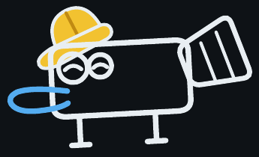
MANAGEMENT TEAM & CORE SKILLS
Who is building this
Soham
Founder
Third year ECE, Faculty of Technology, University of Delhi
Industrial design
Mechanical architecture
Thank you.
Embedded electronics
Machine software
Come and try the loop.
protopus-kappa.vercel.app
HIRING NEXT · a software engineer who also writes firmware.
soham9763015@ece.du.ac.in

Slide 32
APPENDIX · WHERE THE NUMBERS COME FROM
OUR DOCUMENTS
PROTOPUS Cost Report · BOM workbook · Baker + Mixer workflow (“The story of a PCB”) · China assembly line master plan · all 29 Sep 2026
FAB PRICING
jlcpcb.com PCB and PCBA pages · zbotic.in India shipping, duty and rush-fab guides
MACHINES
voltera.io, eleshop.eu, elektor.com · Design World (LPKF) · Makera (PR Newswire, Jun 2026) · ToolGuyd, Make, Hackaday (Bantam) · TechCrunch (BotFactory) · Evertiq, 8 Apr 2026 (Nano Dimension) · EEVblog (Neoden)
INSTRUMENTS
Digilent AD3 (Jameco, DigiKey) · ADALM2000 (Mouser) · Moku:Go (TEquipment) · Red Pitaya · Saleae
AI
Flux (flux.ai; SiliconANGLE 27 Feb 2026) · Quilter (BusinessWire 7 Oct 2025) · Diode (Fenwick) · claude.com/connectors/autodesk-fusion · digitalproduction.com 30 Apr 2026 (Blender) · Lovable (TechCrunch 23 Jul 2025; founded.com)
MARKET
IMARC · Grand View · Arduino · Hackster · Atal Innovation Mission · Forbes · Fab Foundation · AICTE
CONVENTIONS
USD at ₹88 throughout, to match the cost report. Cycle times are engineering targets until the proof of concept measures them.

